Slide 1


Slide 2
Unit
4
Asean and Viet Nam
Unit
FAMILY LIFE
LESSON 4
SPEAKING
DISCUSSING NECESSARY QUALIFICATIONS FOR JOINING A PROGRAMME

Slide 3
LESSON 4
SPEAKING
WARM-UP
ASEAN quiz
Task 1: Match the types of skills and experience with the possible reasons.
Task 2: Complete the conversation.
Task 3: Talk about the most important skill or experience for SSEAYP participants.
CONTROLLED PRACTICE
LESS CONTROLLED PRACTICE
Task 4: Discussion.
CONSOLIDATION
Wrap-up
Homework

Slide 4
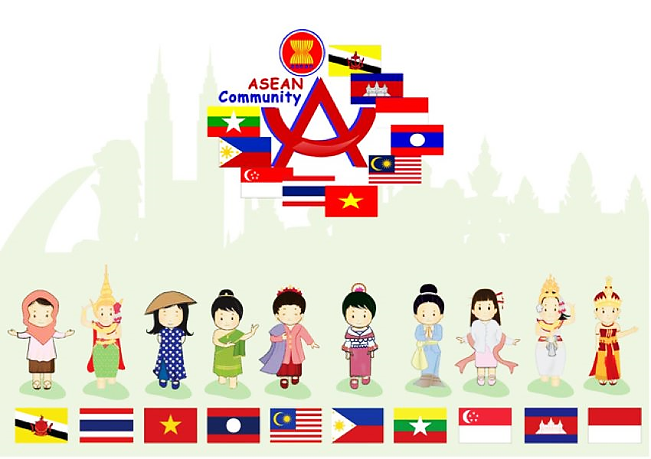
WARM-UP
CHOOSE
THE
CORRECT
INFORMATION
ABOUT
ASEAN

Slide 5


How many colours are there on the ASEAN flag?
1
2
4
3
5

Slide 6
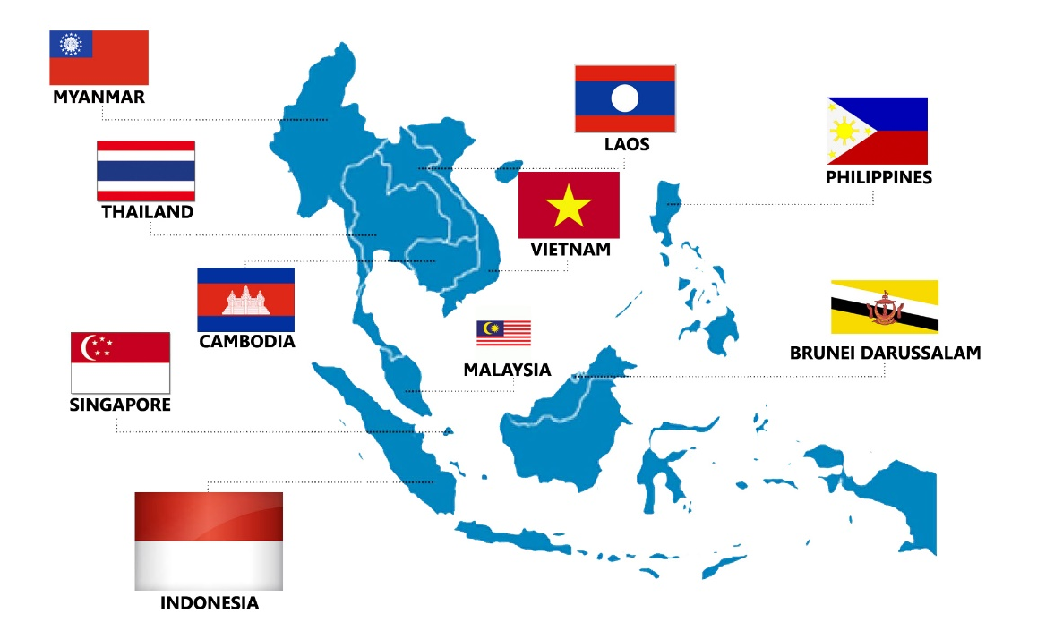
How many ASEAN members are there today?
2
8
12
10
11

Slide 7
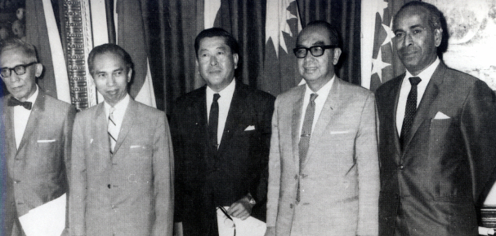
When was ASEAN founded?
3
1999
1988
1979
1967

Slide 8

What does ASEAN stand for?
4
Association of Southeast Asean Nations
Association of Southeast Asean Nation
Association of South East Asian Nations
Association of Southeast Asian Nation

Slide 9

When is ASEAN Day?
5
The eighth of August
The eighth of September
The eighth of November
The eighth of October

Slide 10

Which is NOT correct about Viet Nam?
6
The currency of Viet Nam is called the Dollar.
The National Day is September 2.
The official name of Viet Nam is the Socialist Republic of Viet Nam.
Vietnam shares a land border with China to the north, Cambodia and Laos to the west.

Slide 11
The state capital of Cambodia is _________________.
7
Vientiane
Phnom Penh
Chiang Mai
Yangon

Slide 12

The capital city of Malaysia is _______
8
Bangkok
Phnom Penh
Manila
Kuala Lumpur

Slide 13



Slide 14


VOCABULARY
current (adj)
/ˈkʌrənt/
of the present time

Slide 15

VOCABULARY
issue (n)
/ˈɪʃuː/
a subject or problem

Slide 16

VOCABULARY
solution (n)
/səˈluːʃən/
the answer to a problem

Slide 17

VOCABULARY
skill (n)
/skɪl/
an ability to do an activity or job well

Slide 18
VOCABULARY
Form | Pronunciation | Meaning
1. current (adj) | /ˈkʌrənt/ | of the present time
2. issue (n) | /ˈɪʃuː/ | a subject or problem
3. solution (n) | /səˈluːʃən/ | the answer to a problem
4. skill (n) | /skɪl/ | an ability to do an activity or job well

Slide 19
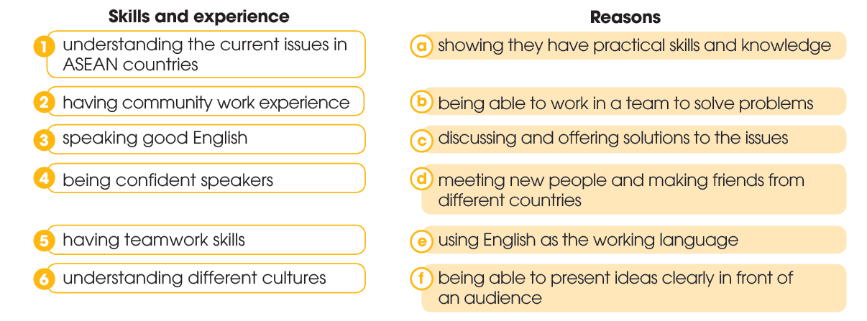
CONTROLLED PRACTICE
1
Read the types of skills and experience participants in the SSEAYP should have. Match them with the possible reasons.

Slide 20
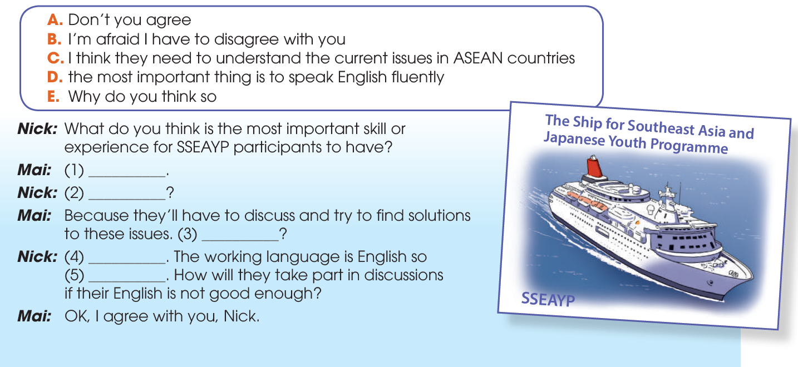
CONTROLLED PRACTICE
2
Use the sentences in the box to complete the conversation.
C
E
A
B
D

Slide 21
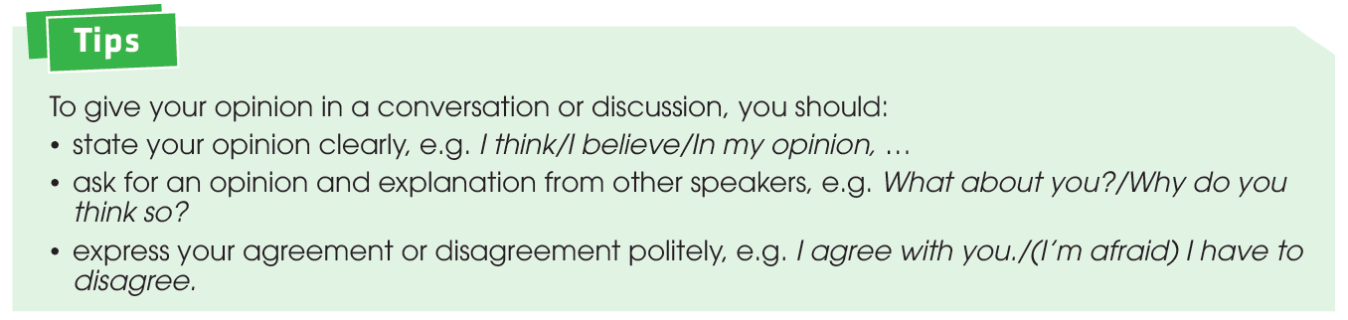

CONTROLLED PRACTICE
3
Work in pairs. Talk about the most important skill or experience for SSEAYP participants. Use the ideas in 1, and the model and tips in 2 to help you.

Slide 22

LESS CONTROLLED PRACTICE
4
Work in groups. Discuss the skills and experience SSEAYP participants should have. Rank them in order of importance (1 - most important to 6 - least important). Report to the whole class.

Slide 23
CONSOLIDATION
1
Wrap-up
What have you learnt today?
Discuss the skills and experience needed for the ASEAN Youth Programme, and ask for and give opinions.
New Vocabulary

Slide 24

CONSOLIDATION
2
Homework
Learn new words by heart
Do exercises in the workbook.
Prepare for Lesson 5 - Unit 4.

Slide 25

Website: hoclieu.vn
Fanpage: facebook.com/www.tienganhglobalsuccess.vn

