Slide 1
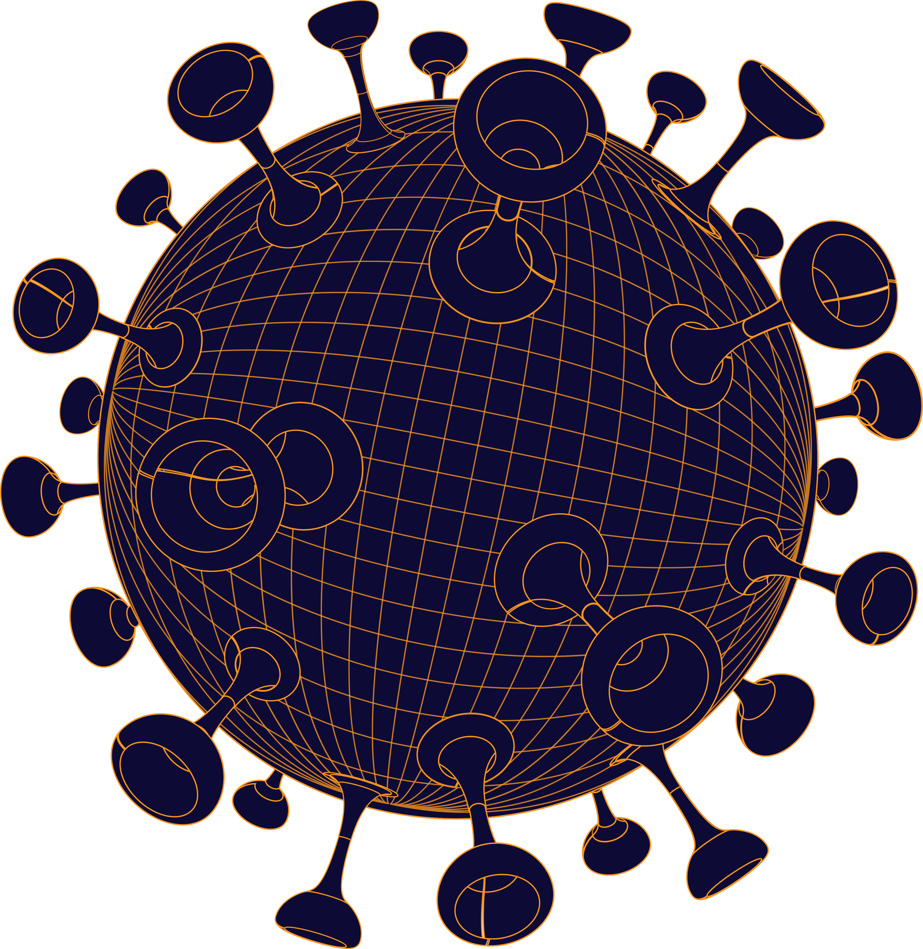
CORONA
VIRUSES
Global Pandemic Disease

Slide 2
What is Corona?
Coronavirus disease (COVID-19) is an infectious disease caused by a new virus.
The disease causes respiratory illness (like the flu) with symptoms such as a cough, fever, and in more severe cases, difficulty breathing. You can protect yourself by washing your hands frequently, avoiding touching your face, and avoiding close contact (1 meter or 3 feet) with people who are unwell.

Slide 3
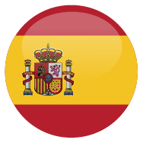
Coronavirus Pandemic
World Wide Count
Spain
Total Cases
722,788
Latest Updates
30 March 2020
12.00 UTC+7
Total Deaths
34,028
+3899
+802
+1565
722,788
34,028
159,226
Total Recovered
Total Cases
Total Deaths
Total Recovered
159,226
Source:
Lastname, Firstname of Creator. Title of Work. Additional contributors. Publishing organization. Publication date. Indication of format/medium, running time. URL

Slide 4
Coronavirus Pandemic
World Count
Latest Updates
30 March 2020
12.00 UTC+7
+3899
+802
+1565
722,788
34,028
159,226
Total Cases
Total Deaths
Total Recovered
Source:
Lastname, Firstname of Creator. Title of Work. Additional contributors. Publishing organization. Publication date. Indication of format/medium, running time. URL

Slide 5
Coronavirus Pandemic
World Map/Count
Latest
Updates
30 March
Total Cases
Total Deaths
Total Recovered
Teritories
12.00 UTC+7
722,788
34,028
159,226
202
Source:
Lastname, Firstname of Creator. Title of Work. Additional contributors. Publishing organization. Publication date. Indication of format/medium, running time. URL

Slide 6
Coronavirus Spread
Count by Country
30 March 2020
Covid-19 Global Pandemic
12.00 UTC+7
Spain
Total Cases
Total Deaths
Total Recovered
722,788
34,028
159,226
13,603
507
11,256
Today
Last Day
+ 12,063
+ 207
+ 9064
Source:
Lastname, Firstname of Creator. Title of Work. Additional contributors. Publishing organization. Publication date. Indication of format/medium, running time. URL

Slide 7
Coronavirus Pandemic
World Count
722,788
Total Cases
34,028
Total Deaths
159,226
Total Recovered
Latest Updates
30 March
12.00 UTC+7
202
Teritories
Source:
Lastname, Firstname of Creator. Title of Work. Additional contributors.
Publishing organization. Publication date. Indication of format/medium, running time. URL

Slide 8
722,788
Daily Confirmed Case (30 Days)
Total Cases
34,028
Total Deaths
Total Recovered
159,226
202
Teritories
Source:
Lastname, Firstname of Creator. Title of Work. Additional contributors. Publishing organization. Publication date. Indication of format/medium, running time. URL

Slide 9
Daily Confirmed Case (30 Days)
Total Cases
30 March 2020
722,788
Total Deaths
34,028
Total Recovered
159,226
Teritories
202
Source:
Lastname, Firstname of Creator. Title of Work. Additional contributors. Publishing organization. Publication date. Indication of format/medium, running time. URL

Slide 10
Spain
Chart update
30 March 2020
Total Cases
Total Deaths
Total Recovered
722,788
34,028
159,226
Population: 60,000,000
Cases
12,166
Deaths
603
Recovered
1,024
Source:
Lastname, Firstname of Creator. Title of Work. Additional contributors. Publishing organization. Publication date. Indication of format/medium, running time. URL

Slide 11
Spain
Total Cases
Total Deaths
Total Recovered
722,788
34,028
159,226
Chart update
30 March 2020
Total Cases
12,166
Total Cases
603
Total Cases
1,024
Source:
Lastname, Firstname of Creator. Title of Work. Additional contributors. Publishing organization. Publication date. Indication of format/medium, running time. URL

Slide 12
Spain
Total Cases
Total Deaths
Total Recovered
722,788
34,028
159,226
Chart update 30 March 2020
Cases
12,166
Deaths
603
Recovered
1,024
Source:
Lastname, Firstname of Creator. Title of Work. Additional contributors. Publishing organization. Publication date. Indication of format/medium, running time. URL

Slide 13















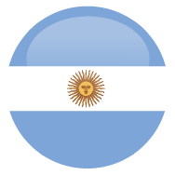








25
Country Map

