Slide 1

Unit 1: My Friends
Lesson 2
Page 16

Slide 2
Lesson Outline
Warm-up
Vocabulary
Structure
Consolidation
Wrap-up

Slide 3
Objectives
By the end of this lesson, students will be able to learn ….
Vocabulary: dancing, singing, drawing, reading, painting
Structure: Do your friends like dancing?
Yes, they do./No, they don't.
Aim: Students will be able to ask what their friends like doing.

Slide 4

WARM UP

Slide 5






Memory Cards!



😐


Japan
India
The UK
1
2
3
4
5
6






Italy
Alpha
The USA
7
8
9
10
11
12
Notes:
Instruction:
There are 6 pictures with 6 names of them.
Students have to choose 2 numbers to open. If the picture and the name match, they get1 point.
If the picture and the name don’t match, close the picture and let them choose again.
Click on the big square to open.
Click on the smaller square with numbers to close.

Slide 6

It’s time to learn …

Slide 7
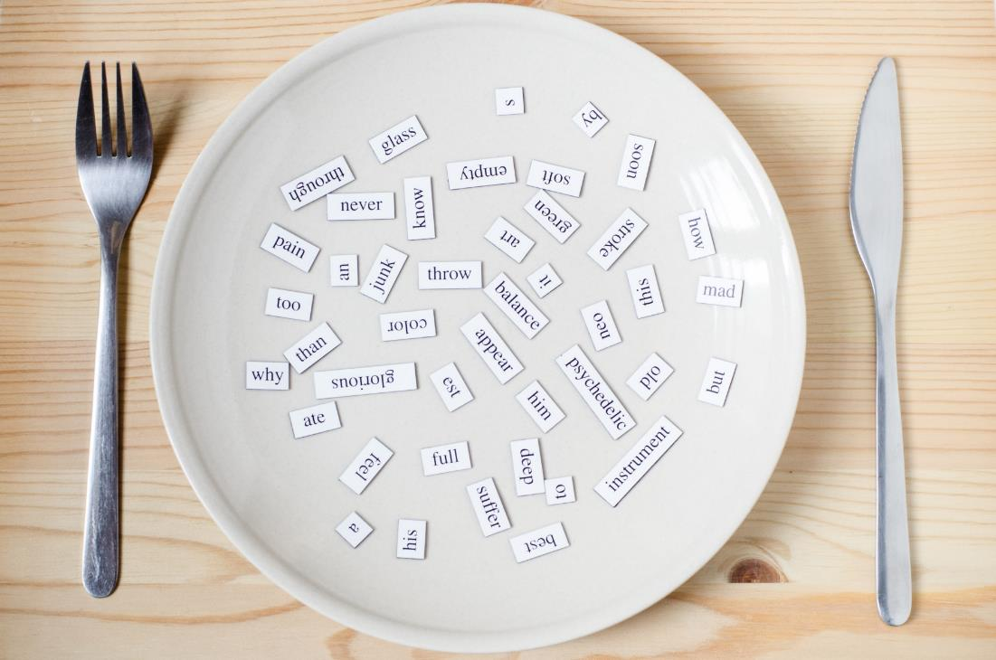
Vocabulary
Dancing
Singing
Drawing
Reading
Painting

Slide 8

Presentation

Slide 9


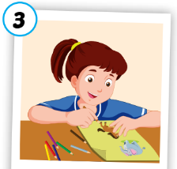
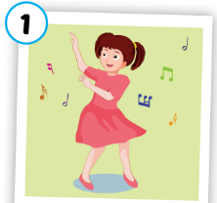
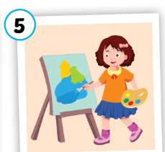
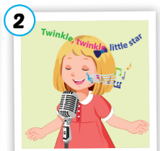

A
1. Listen, point and repeat.
3
5
1
4
2
drawing
dancing
painting
singing
reading
/drɑːɪŋ/
vẽ
/dænsɪŋ/
nhảy, nhảy múa
/peɪntɪŋ/
vẽ bằng cọ
/sɪŋɪŋ/
hát, ca hát
/riːdɪŋ/
đọc
Notes:
Click numbers to show pictures
Click the words to listen
Click to show meanings

Slide 10

Practice

Slide 11

Activity 1
Slow Motion

singing
Notes:
Click to open the picture under the cover slowly.
Click the star to show answer.

Slide 12

Activity 1
Slow Motion

painting
Notes:
Click to open the picture under the cover slowly.

Slide 13

Activity 1
Slow Motion

dancing
Notes:
Click to open the picture under the cover slowly.

Slide 14

Activity 1
Slow Motion

drawing
Notes:
Click to open the picture under the cover slowly.

Slide 15

Activity 1
Slow Motion

reading
Notes:
Click to open the picture under the cover slowly.

Slide 16
Activity 2
Say the right pictures.
dancing
singing
reading
painting
singing
drawing
reading
dancing
singing
STOP
Notes:
Click to show the new words.
Students say the numbers of the pictures.

Slide 17


Activity 3
Listen and Choose the right answer.
singing
dancing
drawing
a
b
c
Notes:
Click the head phones to listen.
Click anywhere to eliminate the wrong answers.

Slide 18

Activity 3
Listen and Choose the right answer.
painting
drawing
singing
a
b
c
Notes:
Click the head phones to listen.
Click anywhere to eliminate the wrong answers.

Slide 19

Activity 3
Listen and Choose the right answer.
drawing
painting
dancing
a
b
c
Notes:
Click the head phones to listen.
Click anywhere to eliminate the wrong answers.

Slide 20

Activity 3
Listen and Choose the right answer.
singing
reading
dancing
a
b
c
Notes:
Click the head phones to listen.
Click anywhere to eliminate the wrong answers.

Slide 21

Activity 3
Listen and Choose the right answer.
painting
reading
drawing
a
b
c
Notes:
Click the head phones to listen.
Click anywhere to eliminate the wrong answers.

Slide 22
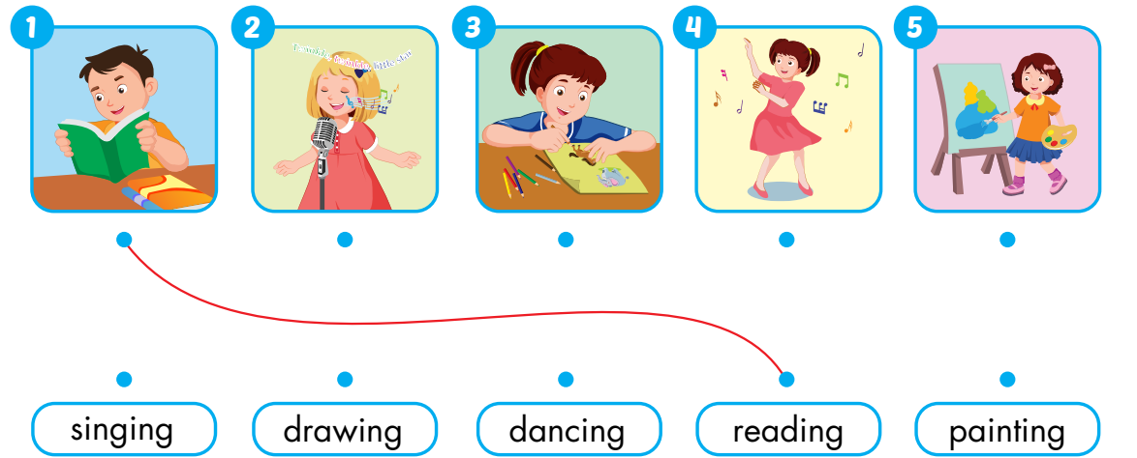
Extra Activity
WB 12
A
Draw lines.

Slide 23
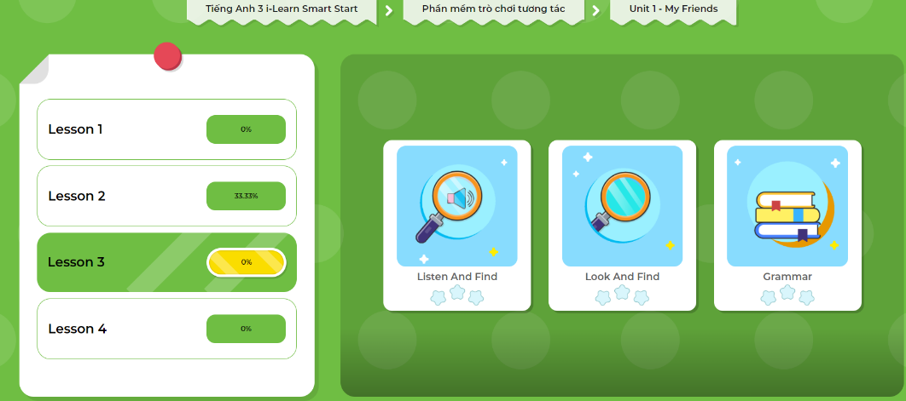
Extra- DHA app.
Click here to play the games

Slide 24
Structure
Do your friends like dancing?
Yes, they do.
No, they don’t.

Slide 25

Presentation

Slide 26

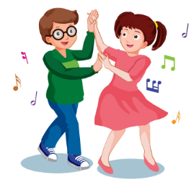

B
1. Listen and practice.
Do your friends like dancing?
A
Yes, they do.✓
B
No, they don’t. ✗
Notes:
Click the picture to listen.
For the boy, click 2 times to listen to both answers.
Click the heart to show the illustration

Slide 27
Practice

Slide 28
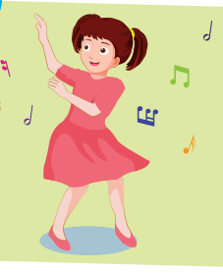
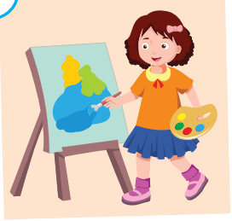
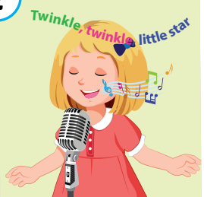
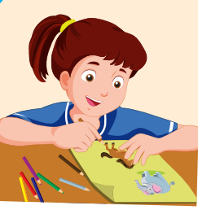

Activity 1
Look and fill in the blank. Then ask and answer.
Yes, they do.✓
B
Do your friends like ………………..?
No, they don’t. ✗
A
1
2
3
4
5
Notes:
Click the hearts to show the pictures.
Click the pictures to let it disappear

Slide 29
















Activity 2
Let’s open the gifts!
☑
☒
☑
☑
1
2
5
7
☒
☒
☒
☑
3
4
6
8
Notes:
Instructions:
Students choose 1 gift and 1 face.
The picture behind the gift is used to make question. “Do you friends like…? The tick and cross is used to answer.” Yes, they do./ No, they don’t.
Click the numbers to open the gifts. Click the face to show the ticks and crosses

Slide 30
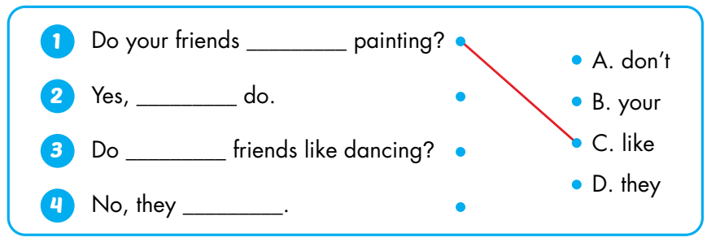
B
2. Look and match.
like
they
your
don’t

Slide 31
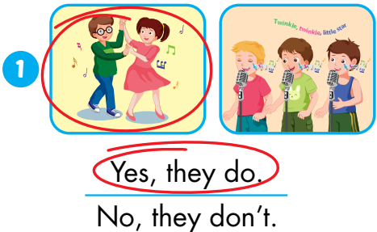
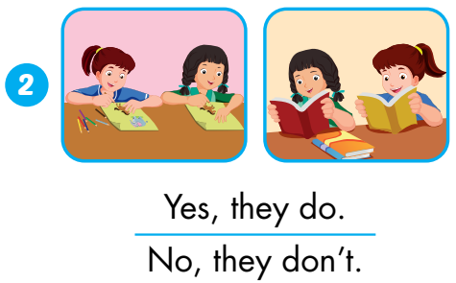
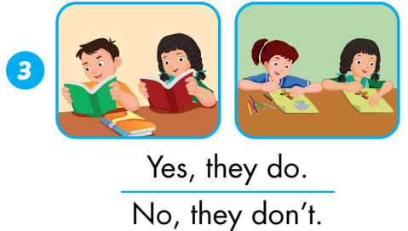
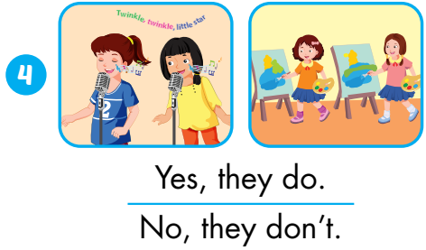
Extra Activity
WB p. 13
C
Listen and circle.
Notes:
Click on the pictures to listen.
Click anywhere to show answers.

Slide 32
Extra- DHA app.
Click here to play the games

Slide 33
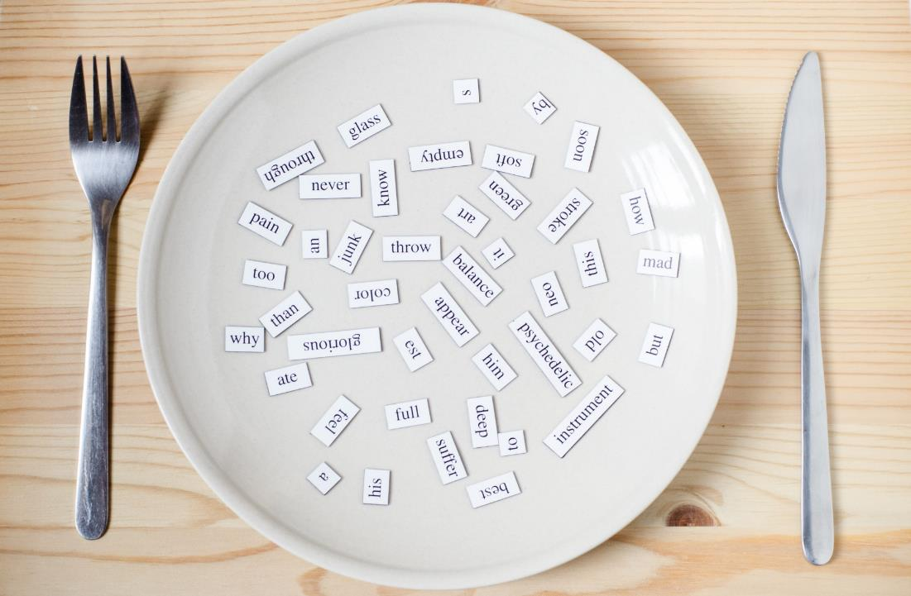
Consolidation

Slide 34
Interview a friend..
Do your friends like singing?
Yes, they do.✓
No, they don’t. ✗
Name | Likes | Yes | No
Anna | singing
 | dancing
 | drawing
 | painting
☑
☒
☑
☒
Notes:
Draw a table as example. Choose a friend to interview and write the data on their notebooks.

Slide 35

WRAP-UP

Slide 36
Lesson 3
Today’s lesson
Vocabulary
Dancing
Singing
Drawing
Reading
Painting
Structures/ Sentence patterns
Do your friends like dancing?
Yes, they do.
No, they don’t.

Slide 37
Lesson 3
Homework
Practice vocabularies and structure. Make sentences using them.
Do the exercises in Tiếng Anh 3 i-Learn Smart Start Workbook (page 13)
Practice the vocabulary in Tiếng Anh 3 i-Learn Smart Start Notebook (page 12)
Play the consolidation games in Tiếng Anh 3 i-Learn Smart Start DHA App on www.eduhome.com.vn
Prepare the next lesson (page 17)

Slide 38
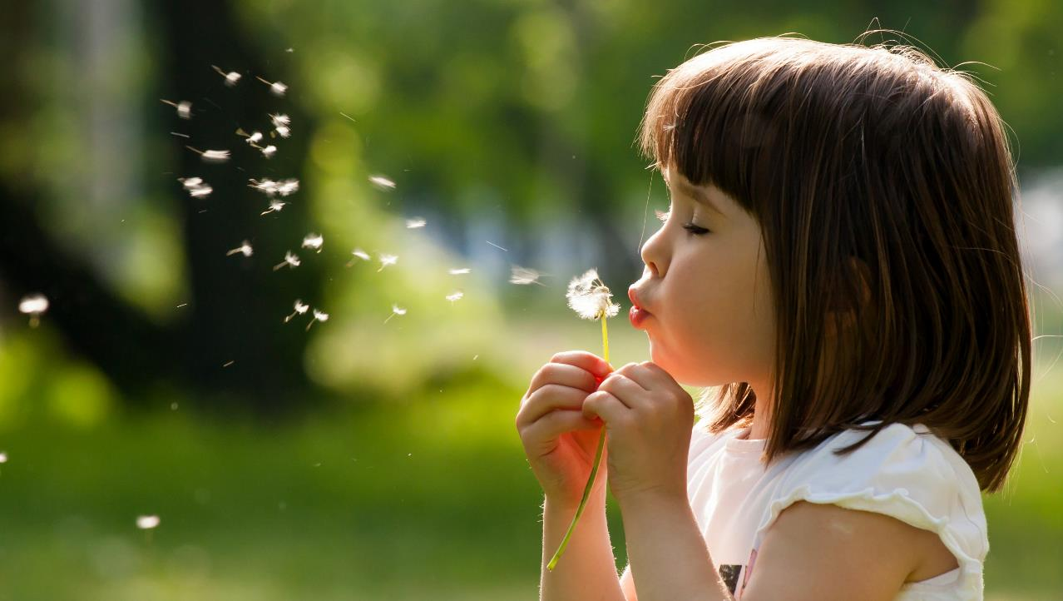
Enjoy your day!

