Slide 1

Unit 4: Holidays!
Overview
Pages 70-71

Slide 2
Lesson Outline
Warm-up
Vocabulary
Speaking
Consolidation
Wrap-up

Slide 3
Objectives
By the end of this lesson, students will be able to…
use some vocabulary related to seasons: winter, and activities: go camping, go sailing, go sightseeing, go skiing, go sledging, go to the beach, have a barbecue, have a picnic, make a snowman, pick pumpkins, take a bike ride, visit museums.
express likes and dislikes and use words to show you agree or disagree with someone.

Slide 4

WARM-UP

Slide 5

Work in pairs.
Choose the word whose underlined part is
pronounced differently from that of the other words.
A. month B. earth C. three D. they
2. A. hand B. day C. age D. place
3. A. season B. weather C. speaker D. teacher
/mʌnθ/
/ɜːθ/
/θriː/
/ðeɪ/
/hænd/
/deɪ/
/eɪdʒ/
/pleɪs/
/ˈsiːzn/
/ˈweðə(r)/
/ˈspiːkə(r)/
/ˈtiːtʃə(r)/

Slide 6
Work in pairs.
Ask and answer the following questions:
- How many months are there in a year?
What’s this month?
How many seasons are there in a year?
What’s this season?

Slide 7

It’s time to learn …

Slide 8


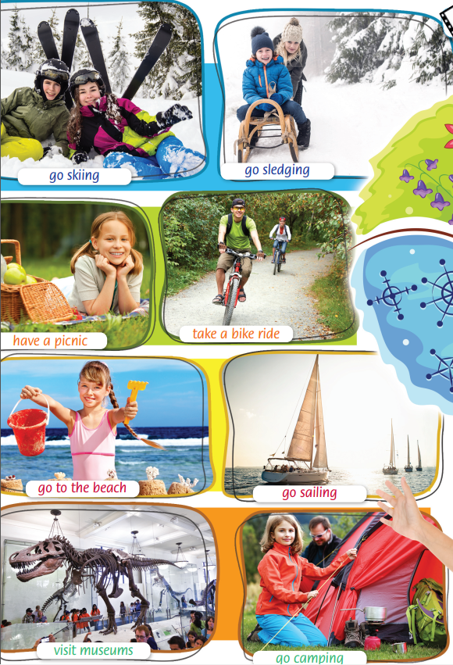

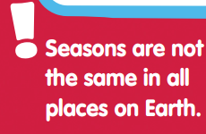

Listen and repeat. What are the seasons in your country?
In Australia?
In the north of Vietnam, we have four seasons like other countries. However, in the south of Vietnam, we have only two seasons - the rainy season, usually from May to October, and the dry season, usually from November to April. In Australia, summer is from December to February, and autumn is from March to May. Winter is June to August, and spring is September to November.

Slide 9
Vocabulary
Listen and repeat.
go camping /ɡəʊ ˈkæmpɪŋ/ (phr): đi cắm trại
go sailing /ɡəʊ ˈseɪlɪŋ/ (phr): đi chèo thuyền
go sightseeing /ɡəʊ ˈsaɪtsiːɪŋ/ (phr): đi ngắm cảnh
go skiing /ɡəʊ ˈskiːɪŋ/ (phr): đi trượt tuyết
go sledging /ɡəʊ ˈsledʒɪŋ/ (phr): đi xe trượt tuyết
go to the beach /ɡəʊ tə ðə biːtʃ/ (phr): đi biển
have a barbecue /həv ə ˈbɑːbɪkjuː/ (phr): làm tiệc nướng

Slide 10
Vocabulary
Listen and repeat.
have a picnic /həv ə ˈpɪknɪk/ (phr): đi dã ngoại
make a snowman /meɪk ə ˈsnəʊmæn/ (phr): chơi đắp người tuyết
pick pumpkins /pɪk ˈpʌmpkɪnz/ (phr): hái bí ngô
take a bike ride /teɪk ə baɪk raɪd/ (phr): đi xe đạp
visit museums /vɪzɪt mjuˈziːəmz/ (phr): tham quan viện bảo tàng
winter /ˈwɪntə(r)/ (n): mùa đông

Slide 11
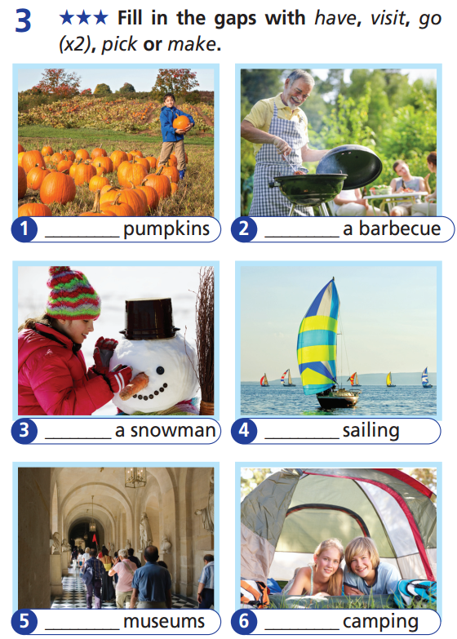
Extra Practice
WB page 38
pick
have
make
go
visit
go

Slide 12
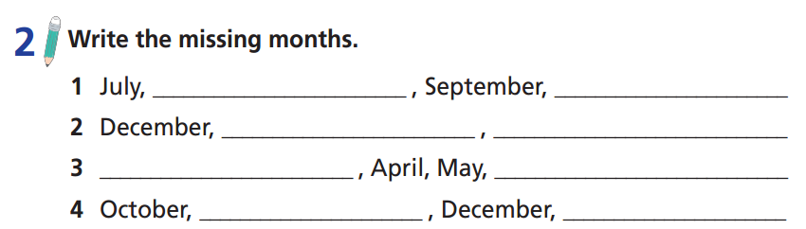
August
October
January
February
March
June
November
January

Slide 13
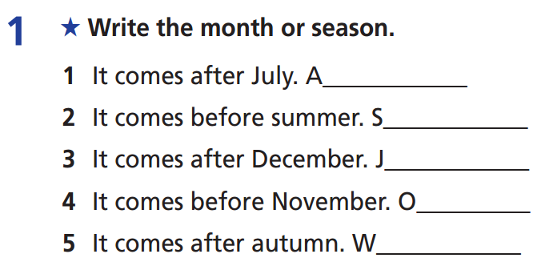
Extra Practice
WB page 38
ugust
pring
anuary
ctober
inter

Slide 14

Speaking

Slide 15
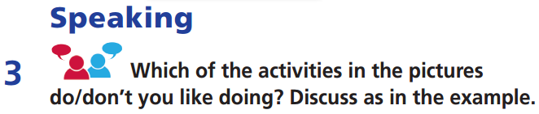
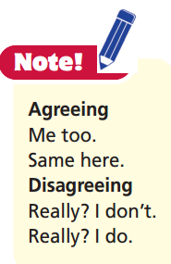

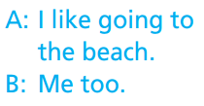
Work in pairs

Slide 16

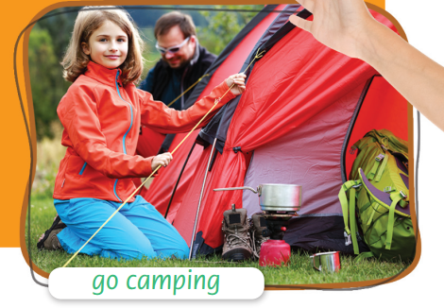
Work in pairs

Slide 17
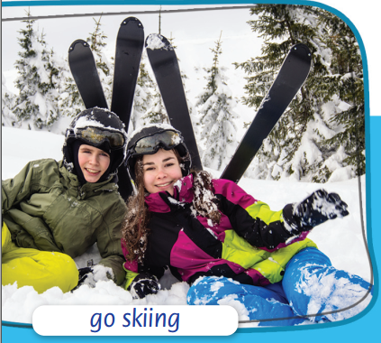
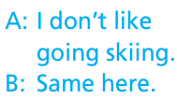
Work in pairs

Slide 18
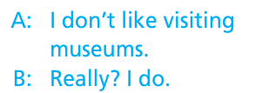
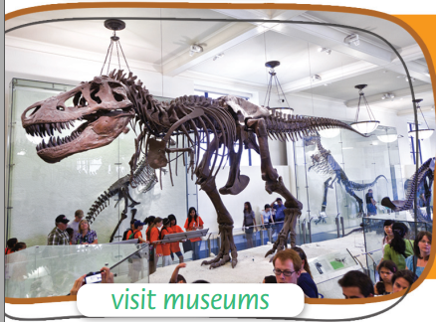
Work in pairs

Slide 19

CONSOLIDATION

Slide 20
Write a paragraph (60-80 words) about the activities you like doing in different seasons of the year and explain why. You can use the activities on pages 70-71 and include the following information:
Where do you live?
How many seasons are there in your area?
What do you like doing in each season? Why?

Slide 21
Write a paragraph (50-70 words) about the activities you like doing in different seasons of the year and explain why.
E.g.
I live in the south of Vietnam. There are two seasons in my area. They are the dry season and the rainy season. In the dry season, I like going sightseeing with my family or going camping with my friends because the weather is good. Because the summer holiday is in the rainy season, I like going to the beach with my family.

Slide 22

WRAP-UP

Slide 23
Today’s lesson
Vocabulary
winter
go camping
go sailing
go sightseeing
go skiing
go sledging
go to the beach
Speaking
expressing likes and dislikes and using words to show you agree or disagree with someone.
have a barbecue
have a picnic
make a snowman
pick pumpkins
take a bike ride
visit museums

Slide 24
Homework
Practise vocabulary and grammar and make sentences using them.
Do the exercises in TA 6 Right on WB (p. 38).
Do the exercises in TA 6 Right on Notebook (pp. 36 & 37).
Prepare for the next lesson (p. 72 SB).

Slide 25
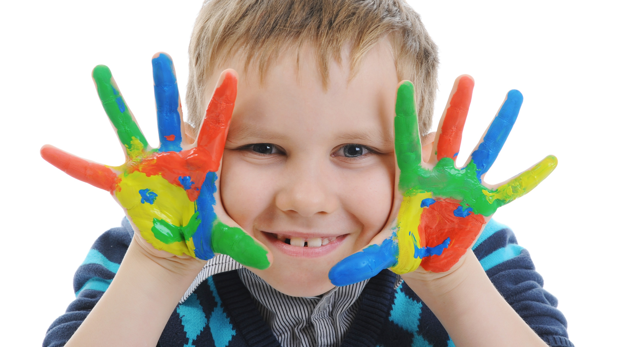
Enjoy your day!

