Slide 1
MATHEMATICS SUBJECT FOR HIGH SCHOOL
GEOMETRY

Slide 2
INTRODUCTION
It’s the closest planet to the Sun and the smallest one in the Solar System—it’s only a bit larger than the Moon. The planet’s name has nothing to do with the liquid metal

Slide 3
—SOMEONE FAMOUS
“This is a quote, words full of wisdom that someone important said and can make the reader get inspired.”

Slide 4
01
OUR TEACHING METHOD

Slide 5
TABLE OF CONTENTS
01
02
03
04
OUR TEACHING METHOD
OUR ACADEMIC AREAS
You can describe the topic of the section here
You can describe the topic of the section here
OUR TEACHERS
ENROLLMENT PROCESS
You can describe the topic of the section here
You can describe the topic of the section here

Slide 6
WHATS SETS US APART
01
02
03
MERCURY
VENUS
SATURN
Mercury is the closest planet to the Sun
Venus is the second planet from the Sun
It’s composed mostly of hydrogen and helium

Slide 7
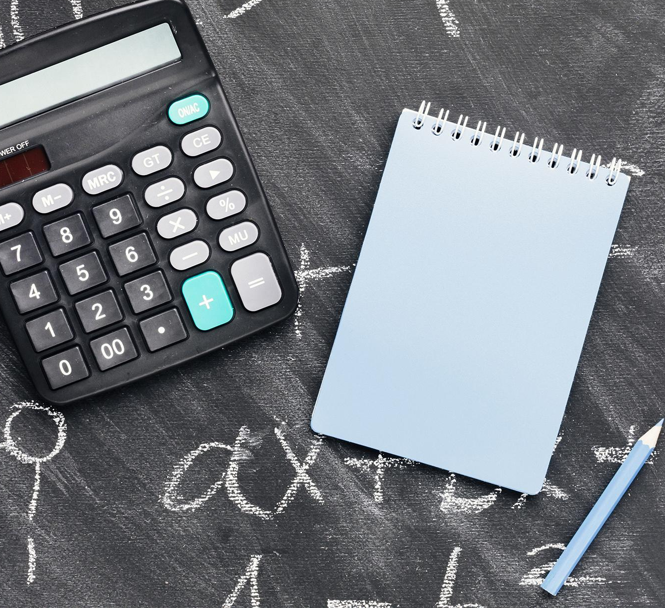
WHOA!
This can be the part of the presentation where you can introduce yourself, write your email…

Slide 8
OUR ACADEMIC AREAS
MERCURY
JUPITER
NEPTUNE
Mercury is the smallest planet
Jupiter is the biggest planet
Neptune is the farthest planet
MARS
VENUS
SATURN
Mars is actually a cold place
Venus is the second planet
Saturn is the ringed one

Slide 9
MISSION AND VISION
MISSION
VISION
Mercury is the closest planet to the Sun and the smallest one
Venus is the second planet from the Sun. It’s terribly hot

Slide 10
ENTRANCE EXAMS
MERCURY
VENUS
SATURN
Mercury is the closest planet to the Sun
Venus is the second planet from the Sun
It’s composed of hydrogen and also helium gases

Slide 11
OUR TEACHING METHOD
Mars
Neptune
Mars is actually a cold place
Neptune is the farthest planet
Venus
Saturn
Venus is the second planet
Saturn is the ringed one

Slide 12
333,000.00
Earths is the Sun’s mass
9h 55m 23s
386,000 km
Is Jupiter’s rotation period
Is the distance between Earth and the Moon

Slide 13
A PICTURE IS WORTH A THOUSAND WORDS

Slide 14
SPECIAL REMINDERS
 | 1st TRIMESTER | 2d TRIMESTER | 3d TRIMESTER
1st GRADE | Mercury is the closest planet to the Sun | Venus is the second planet from the Sun | Neptune is the farthest planet from the Sun
2d GRADE | Jupiter is the biggest planet of them all | Despite being red, Mars is a cold place | Saturn is a gas giant and has big rings

Slide 15
AWESOME WORDS

Slide 16
THIS IS A MAP
NEPTUNE
Neptune is the farthest planet
JUPITER
Jupiter is the biggest planet

Slide 17
4,498,300
Big numbers catch your audience’s attention

Slide 18
OUR VALUES
MARS
SATURN
It’s a cold place. The planet is full of iron oxide dust
Saturn is composed mostly of hydrogen and helium
MERCURY
VENUS
Mercury is the smallest one in the Solar System
Venus is the second planet from the Sun

Slide 19
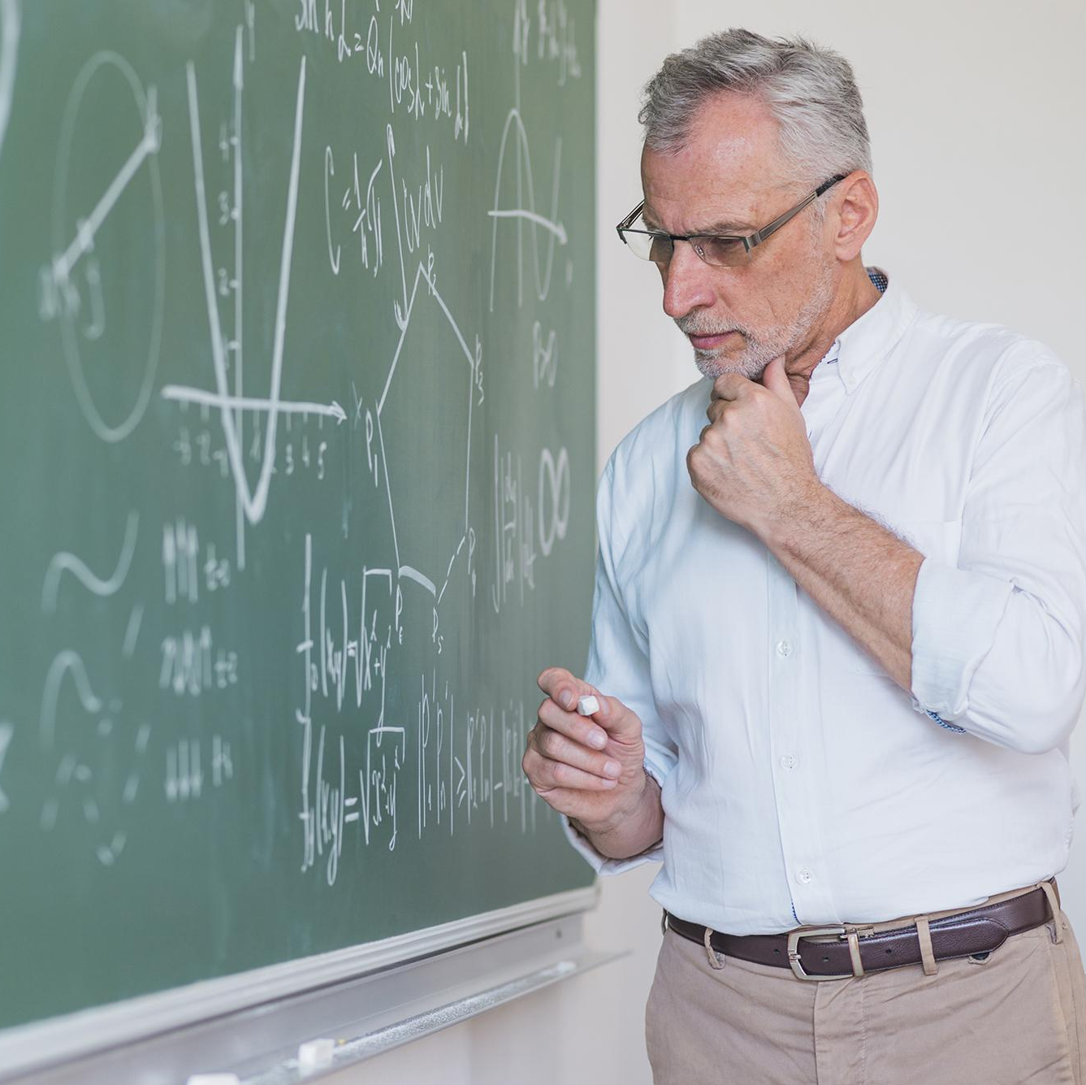
ENROLLMENT PROCESS
Do you know what helps you make your point clear? Lists like this one:
They’re simple
You can organize your ideas clearly
You’ll never forget to buy milk!
And the most important thing: the audience won’t miss the point of your presentation

Slide 20
OUR TEACHERS
JOHN JAMES
JENNA DOE
PETER SMITH
Mercury is the closest planet to the Sun
Venus is the second planet from the Sun
Saturn is a gas giant and has several rings

Slide 21
CURRICULUM
01
02
03
04
05
Mercury is the smallest planet
Jupiter is the biggest planet
Neptune is the farthest planet
It’s actually a cold place
Venus is the second planet

Slide 22
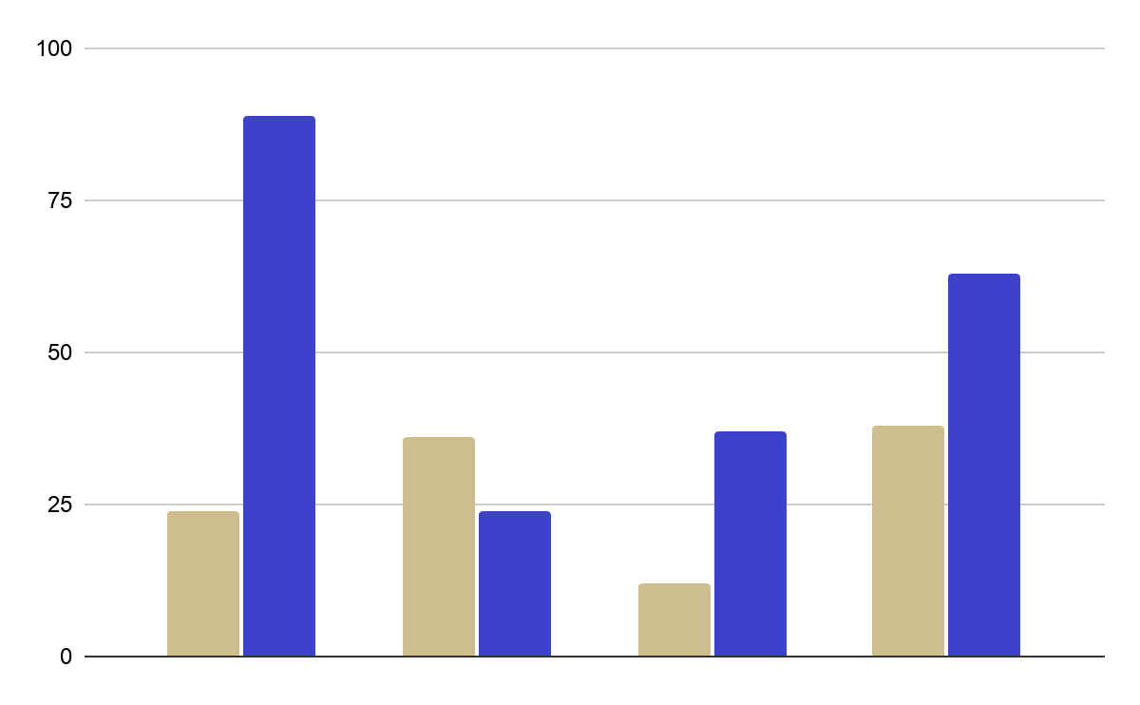
STATISTICS
MERCURY
Mercury is the smallest planet
JUPITER
Jupiter is the biggest planet
Follow the link in the graph to modify its data and then paste the new one here. For more info, click here

Slide 23
OUR GOALS
MARS
NEPTUNE
It’s actually a cold place
Neptune is the farthest planet
VENUS
Venus is the second planet

Slide 24
STUDENT PROGRESS
1 TRIMESTER
3 TRIMESTER
Mars is a very cold place
Venus is the second planet
Neptune is the farthest planet
2 TRIMESTER

Slide 25
STUDENTS’ RESULTS
1st TRIMESTER
2nd TRIMESTER
3rd TRIMESTER
50%
73%
85%
Mercury is the closest planet to the Sun
Venus is the second planet from the Sun
It’s composed mostly of hydrogen and helium

Slide 26
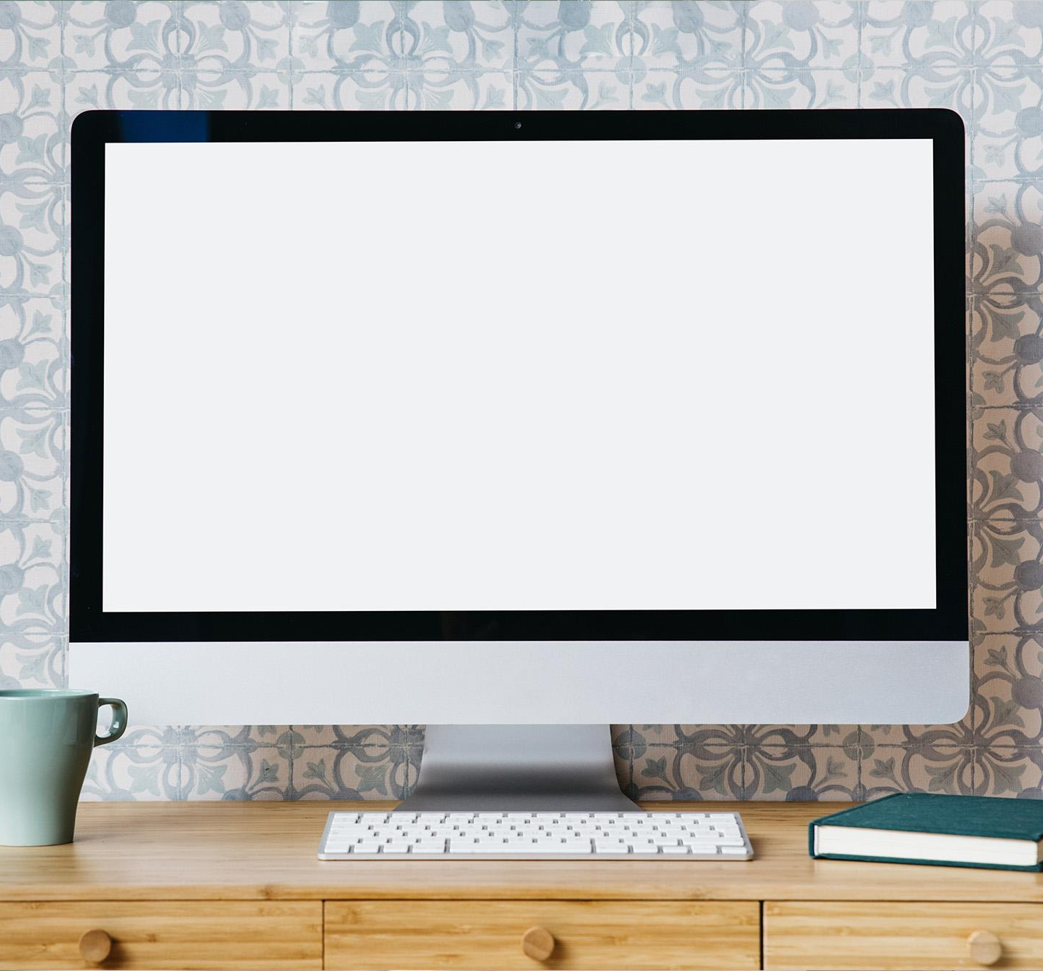
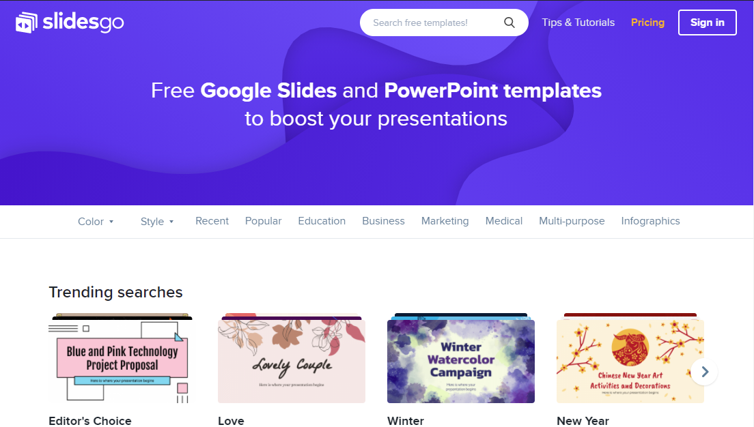
DESKTOP SOFTWARE
You can replace the image on the screen with your own work. Just delete this one, add yours and center it properly

Slide 27
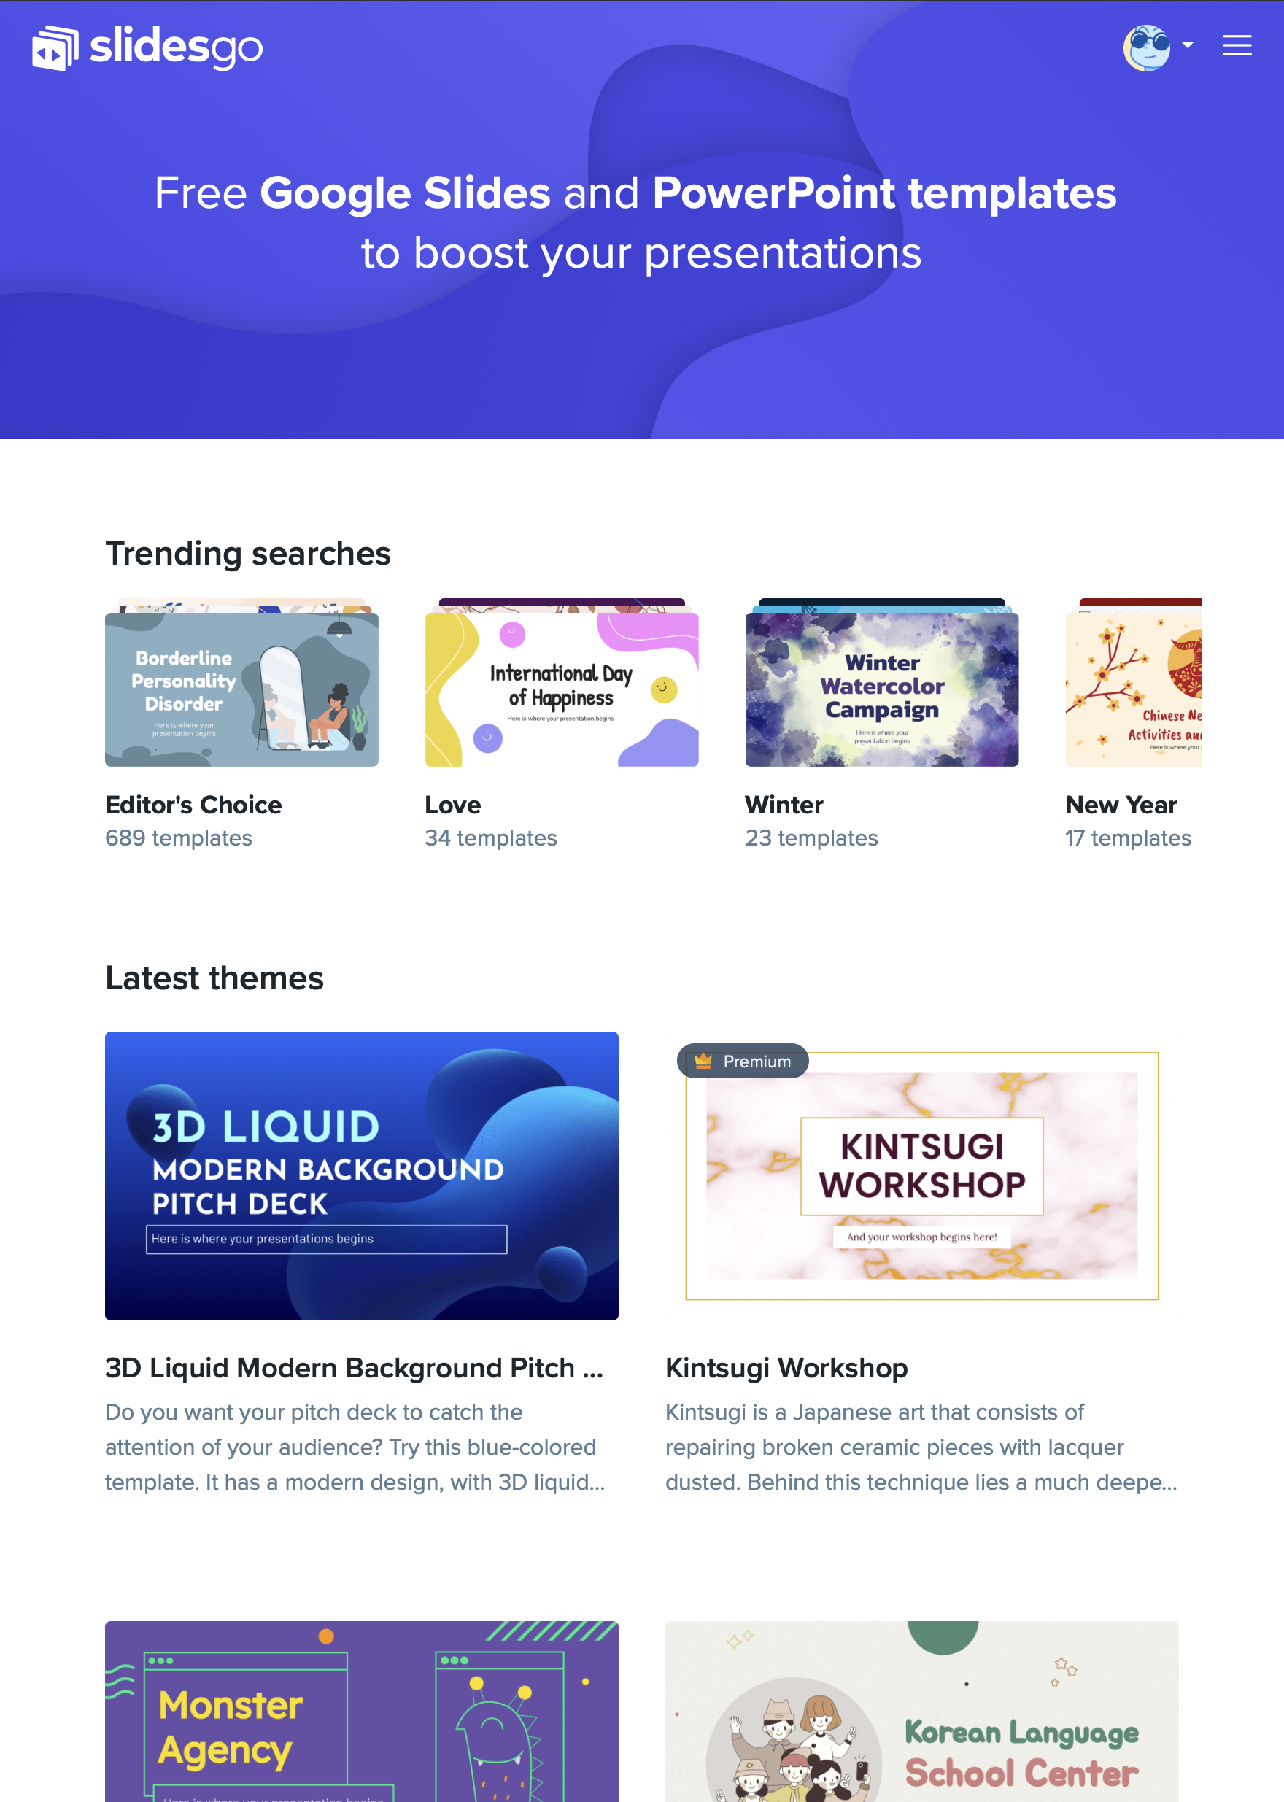
TABLET APP
You can replace the image on the screen with your own work. Just delete this one, add yours and center it properly

Slide 28
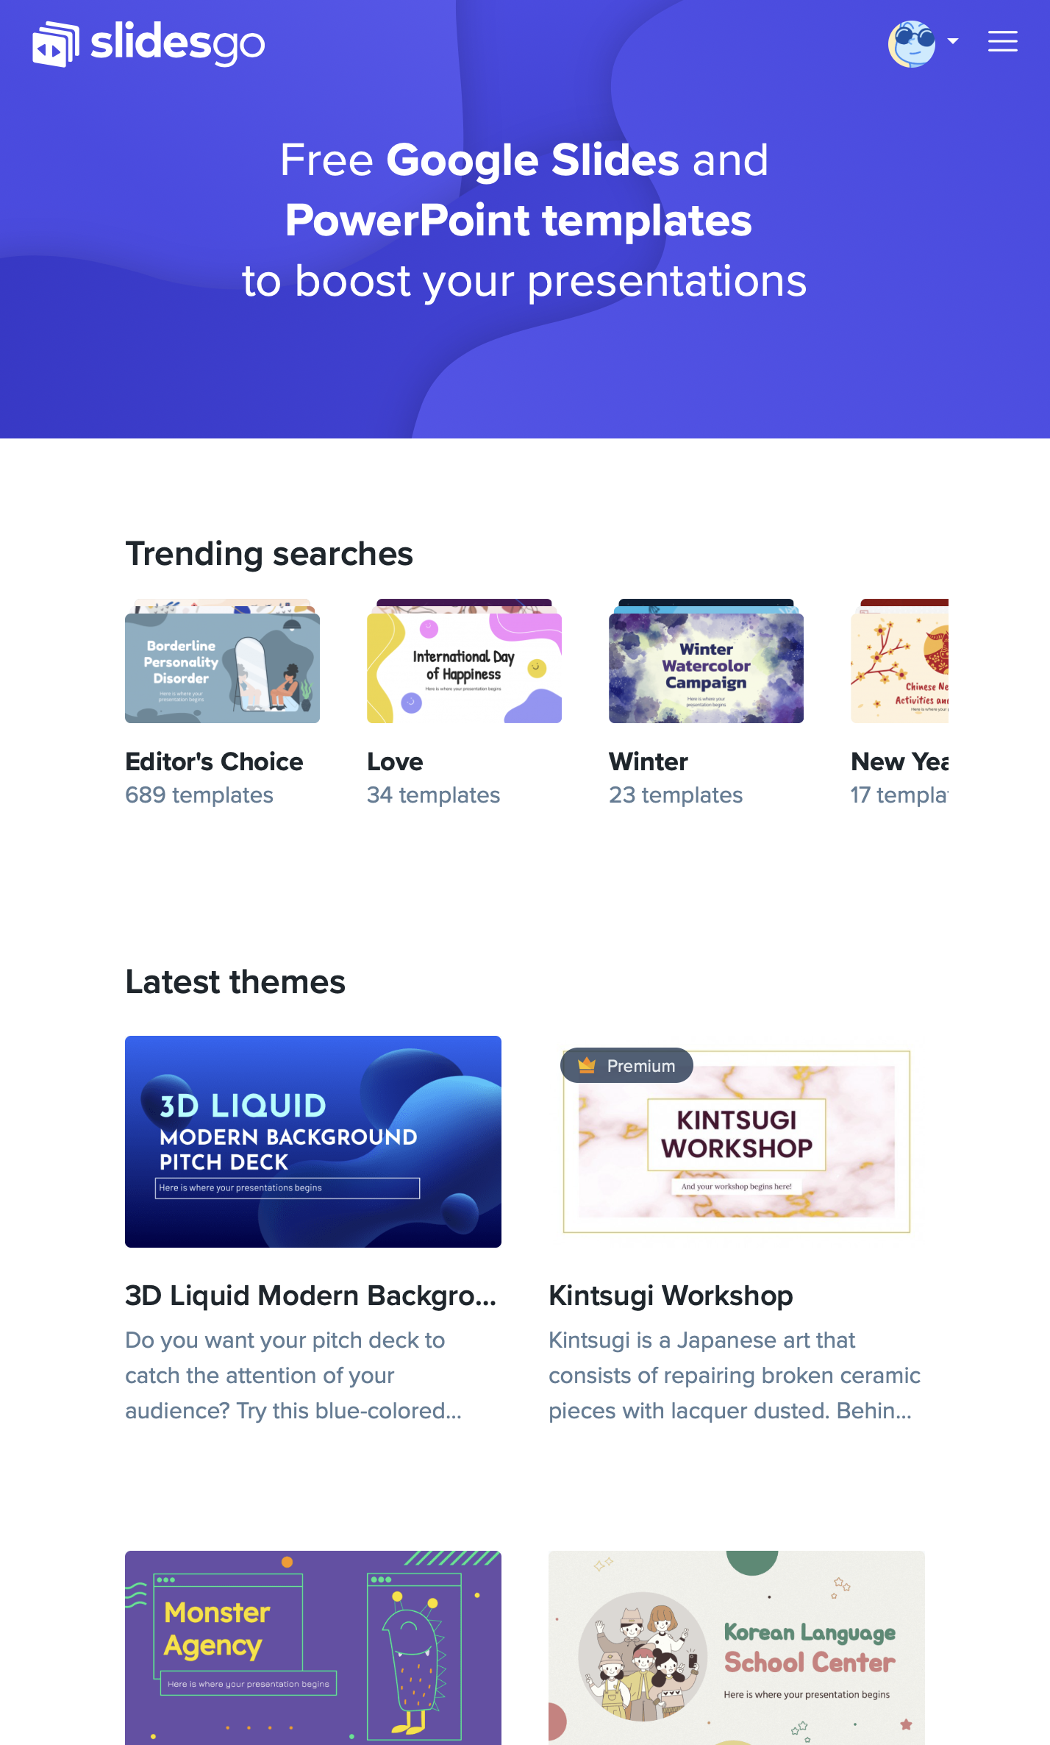
MOBILE WEB
You can replace the image on the screen with your own work. Just delete this one, add yours and center it properly

Slide 29
THANKS!
Do you have any questions?
addyouremail@freepik.com
+91 620 421 838
yourcompany.com
Please keep this slide for attribution

Slide 30
ALTERNATIVE RESOURCES

Slide 31
ALTERNATIVE RESOURCES
VECTORS
Flat design geometric
Flat design geometric
PHOTOS
Smiley teacher
Front view of smiley female
Old teacher using laptop
Close up student
Front view of hardback books
Colleagues studying

Slide 32
RESOURCES
Did you like the resources on this template? Get them for free at our other websites.
VECTORS
Minimal geometric background
Geometric background with lines
PHOTOS
Serious teacher in glasses
Woman explaining to her students
Calculator and notebook
Desktop with wooden geometrical
Arrangement with empty notepad
Cheerful senior professor
Young japanese man
Smiley teacher holding a tablet
Thoughtful male teacher
Desktop pc
Workplace with tablet

