Slide 1
Unit 5: Science and technology
REVIEW 1
Page 98

Slide 2
Lesson Outline
Warm-up
Listening
Reading
Consolidation
Wrap-up

Slide 3
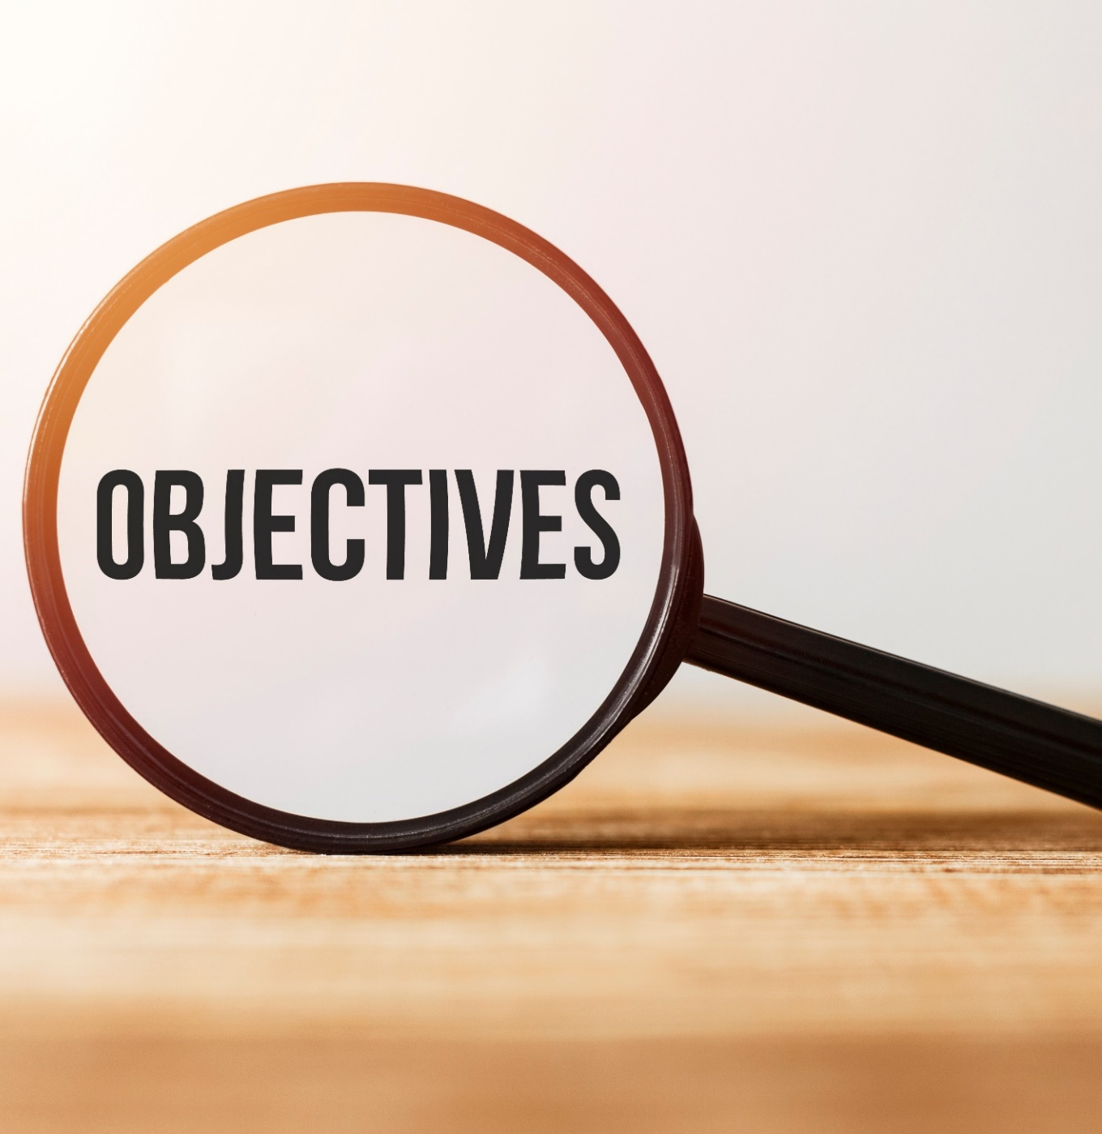
By the end of this lesson, students will be able to…
-review vocabularies and grammar points in Unit 5.
- practice listening, reading, and speaking skills.
- practice test-taking skills.

Slide 4
WARM UP

Slide 5
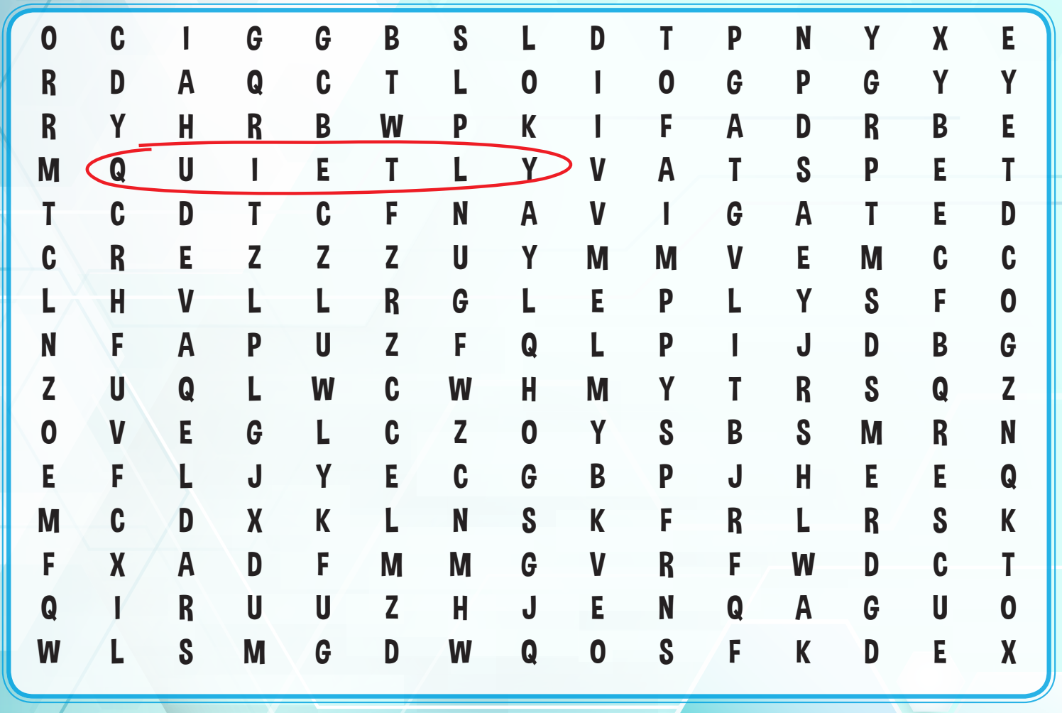
Wordsearch
Can you find five more words?

Slide 6
Listening

Slide 7
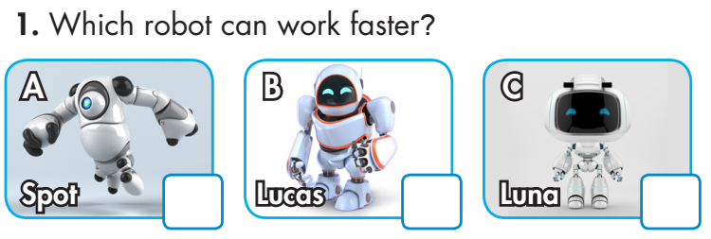
Example:

Slide 10
Audio Scripts
Example:
Salesman: Hello. How can I help?
Lisa: I would like to buy a new tablet.
Salesman: OK. We have three great new tablets for you to choose from.
Lisa: Great. I really want one with a big screen.
Salesman: OK, first, we have the Edge 4. It has a ten-inch screen and an eight-hour battery life.
Lisa: OK.
Salesman: Next, we have the Zoropad. It has an eight-inch screen and a ten-hour battery life. Finally, we have the Stylepad. It has a nine-inch screen and a fifteen-hour battery life.
1.
Narrator: Which robot can work faster?
Tony: Hey, look at these new robots. They’re really cool.
Jane: Wow. What can they do?
Tony: They can lift heavy things and navigate difficult
situations.
Jane: Are they new rescue robots?
Tony: Yep. Lucas is stronger, Luna can work faster, and
Spot can navigate better.
Jane: Cool!

Slide 11
3. Narrator: Which laptop has the longest battery life?
Becky: Hello. Can you help me choose a laptop?
Salesman: Sure. What do you want to use it for?
Becky: For games and studying.
Salesman: OK. The Slim Plus has a battery life of around fourteen hours.
Becky: OK. What about that one? Does it have a long battery life?
Salesman: The BlockHD has a battery life of around twenty hours. It has a great screen, too.
Becky: Hmm. And the FutureLap?
Salesman: It lasts for sixteen hours
Becky: Hmm…OK. How big is…
2. Narrator: What is Laura’s favorite thing about her new phone?
Laura: Hey, Charlie. I got a new phone. Do you want to see?
Charlie: Sure…Wow, that looks awesome.
Laura: It’s so good. It has such a nice big screen. I love it.
Charlie: How much does it weigh?
Laura: That’s the best thing. It doesn’t weigh very much.
Charlie: Great. How’s the battery life?
Laura: It’s pretty good. It’s about fifteen hours.
Charlie: Nice.

Slide 12
5. Narrator: How is the Power Plus Tablet better than the Zero1 Tablet?
John: Hello, Miss? Can you tell me about these tablets?
Saleswoman: Sure. This one is the Power Plus and it costs 199 dollars, and this one is the Zero1 and it costs 299 dollars.
John: OK. What is good about the Zero1?
Saleswoman: It doesn’t weight much and it has a long battery life. It has lots of storage,
too, around 36 gigabytes.
John: I see. How long is the battery life?
Saleswoman: It’s twenty-five hours.
John: OK. And the Power Plus?
Saleswoman: It has the biggest screen of all our tablets, but doesn’t have much storage.
John: I see. How much storage does it have?
Saleswoman: It has around 16 gigabytes of memory.
John: Hmm…OK. I’ll take the Zero1, please
4. Narrator: Which robot cleans more carefully?
John: Can you help me buy a robot cleaner?
Saleswoman: Sure. These are our latest robot
cleaners: Pete, CP-Bot, and Konai. They’re
very easy to use and can work quietly.
John: Konai is more expensive. Why’s that?
Saleswoman: He works more quickly, and his battery
lasts longer.
John: Does he clean carefully?
Saleswoman: No, Pete cleans more carefully, but he
works more slowly.
John: Hmm, I think I’ll buy…

Slide 13
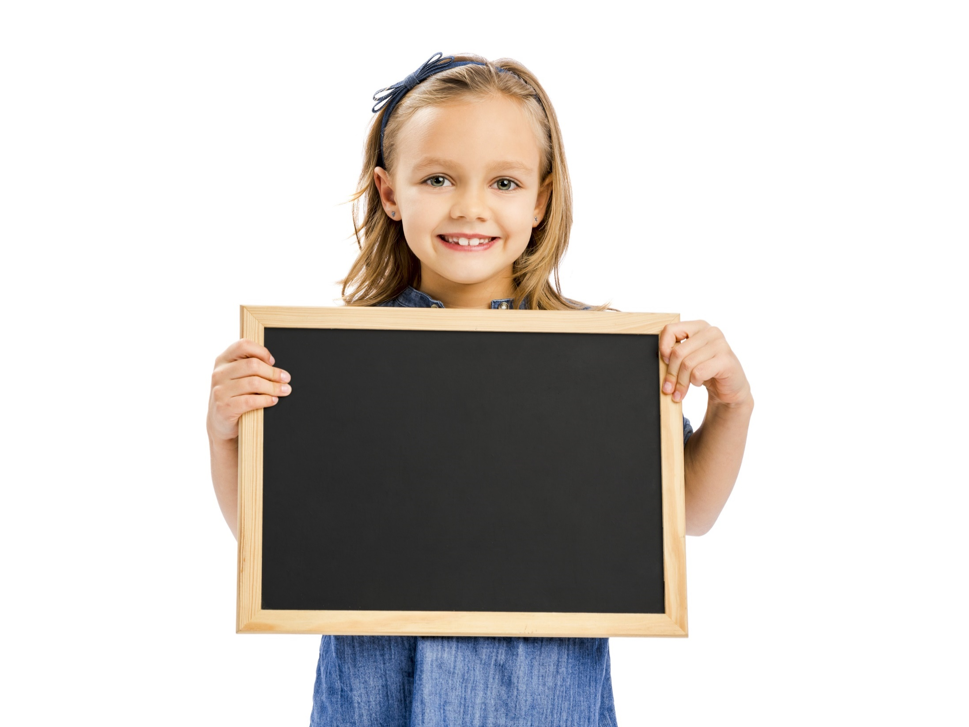
Reading

Slide 14
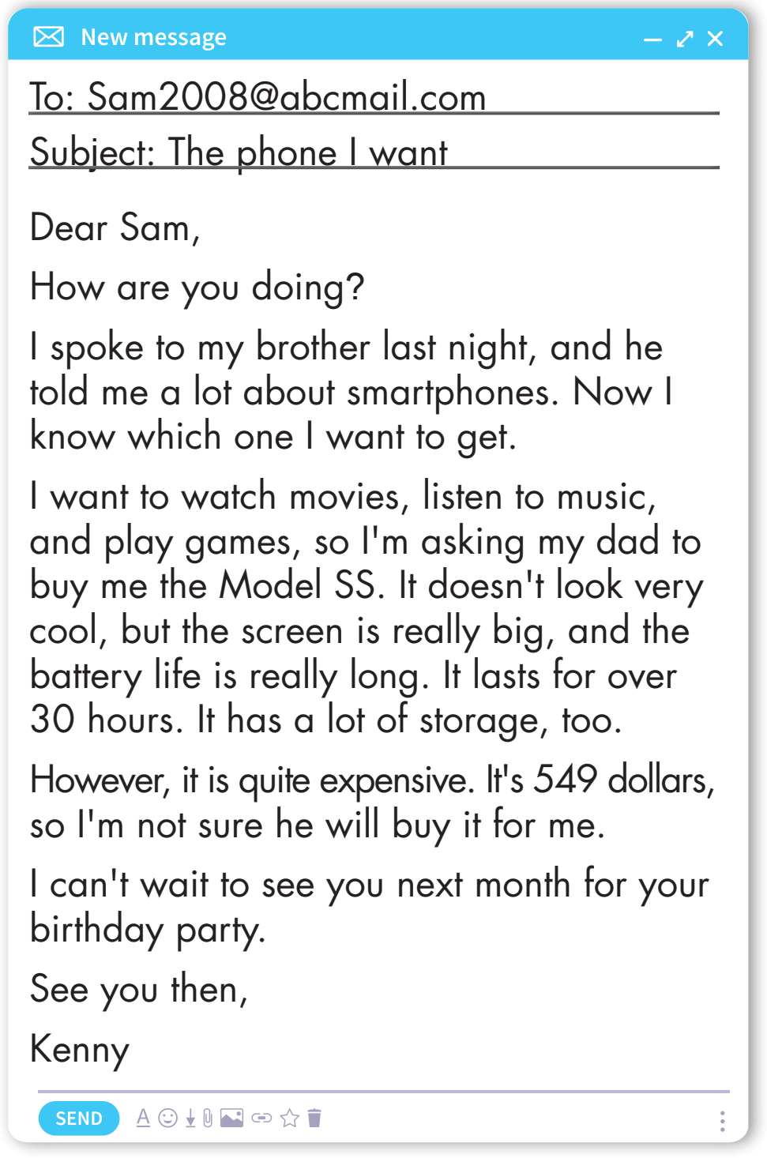

Slide 15
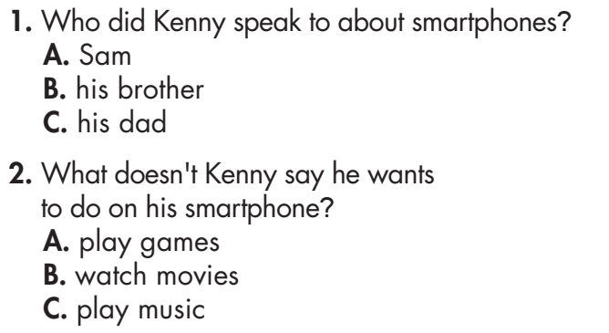

Slide 16
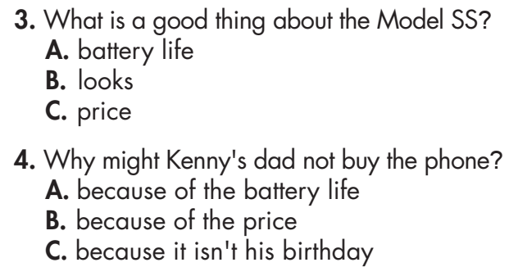

Slide 17
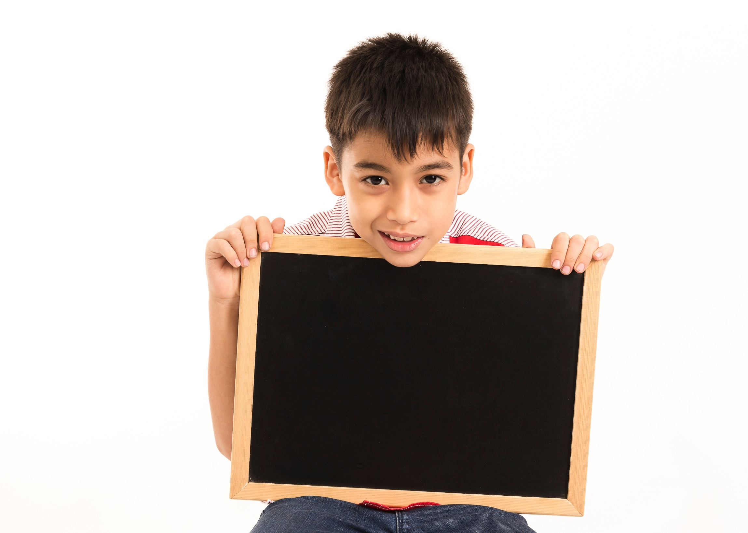
Listening

Slide 18
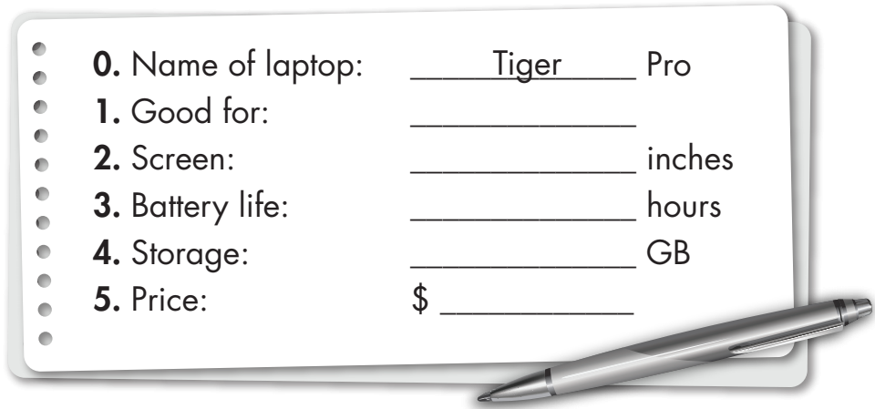
Extra Practice
WB, page 54
You will hear a teenager talking to a store assistant about a laptop.
Listen and fill in the blanks. You will hear the conversation twice.
making presentations
15/ fifteen
3/ three
1,024
520

Slide 19
Audio Scripts
W: Hi, there. Can I help you?
B: Oh, yes, please. I want to buy a new laptop, but I'm not sure which one I want.
W: OK. What do you want to use it for?
B: I want to use it for surfing the internet and making
presentations.
W: I recommend the Tiger Pro. It's good for making
presentations because it has a really nice screen.
B: How big is its screen?
W: It's fifteen inches.
B: Great! Does it have a long battery life?
W: Not really. It only lasts around three hours.
B: Hmm. That's OK. I'll mostly use it at home. How much
storage does it have?
W: It has one thousand and twenty-four gigabytes of storage.
B: Oh, that sounds great! I can't see a price here. How much
does it cost?
W: Let me just check. It costs five hundred twenty dollars.
B: Hmm. I need to talk to my parents first.
W: OK. We're open until 9 p.m.

Slide 20
CONSOLIDATION

Slide 21
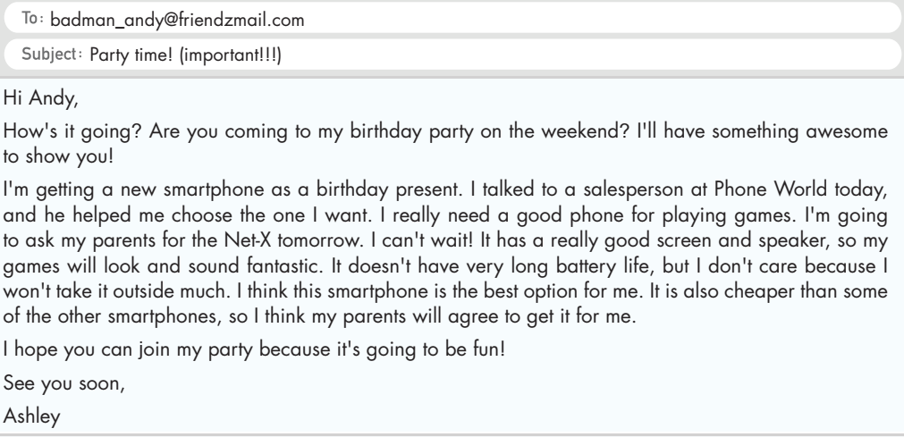
Extra Practice
WB, page 30
Read Ashley's email to tell Andy about a birthday gift.
Circle the correct answers.

Slide 22
Extra Practice
WB, page 30
Read Ashley's email to tell Andy about a birthday gift.
Circle the correct answers.
1. Ashley's birthday party is… A. on the weekend. B. today. C. tomorrow. 2. Ashley wants to use her phone… A. for school. B. to play games. C. outside.

Slide 23
Extra Practice
WB, page 30
Read Ashley's email to tell Andy about a birthday gift.
Circle the correct answers.
3. The Net-X doesn't have a good…
A. speaker. B. screen. C. battery.
4. Ashley says the party is going to be…
A. awesome. B. long. C. fun

Slide 24
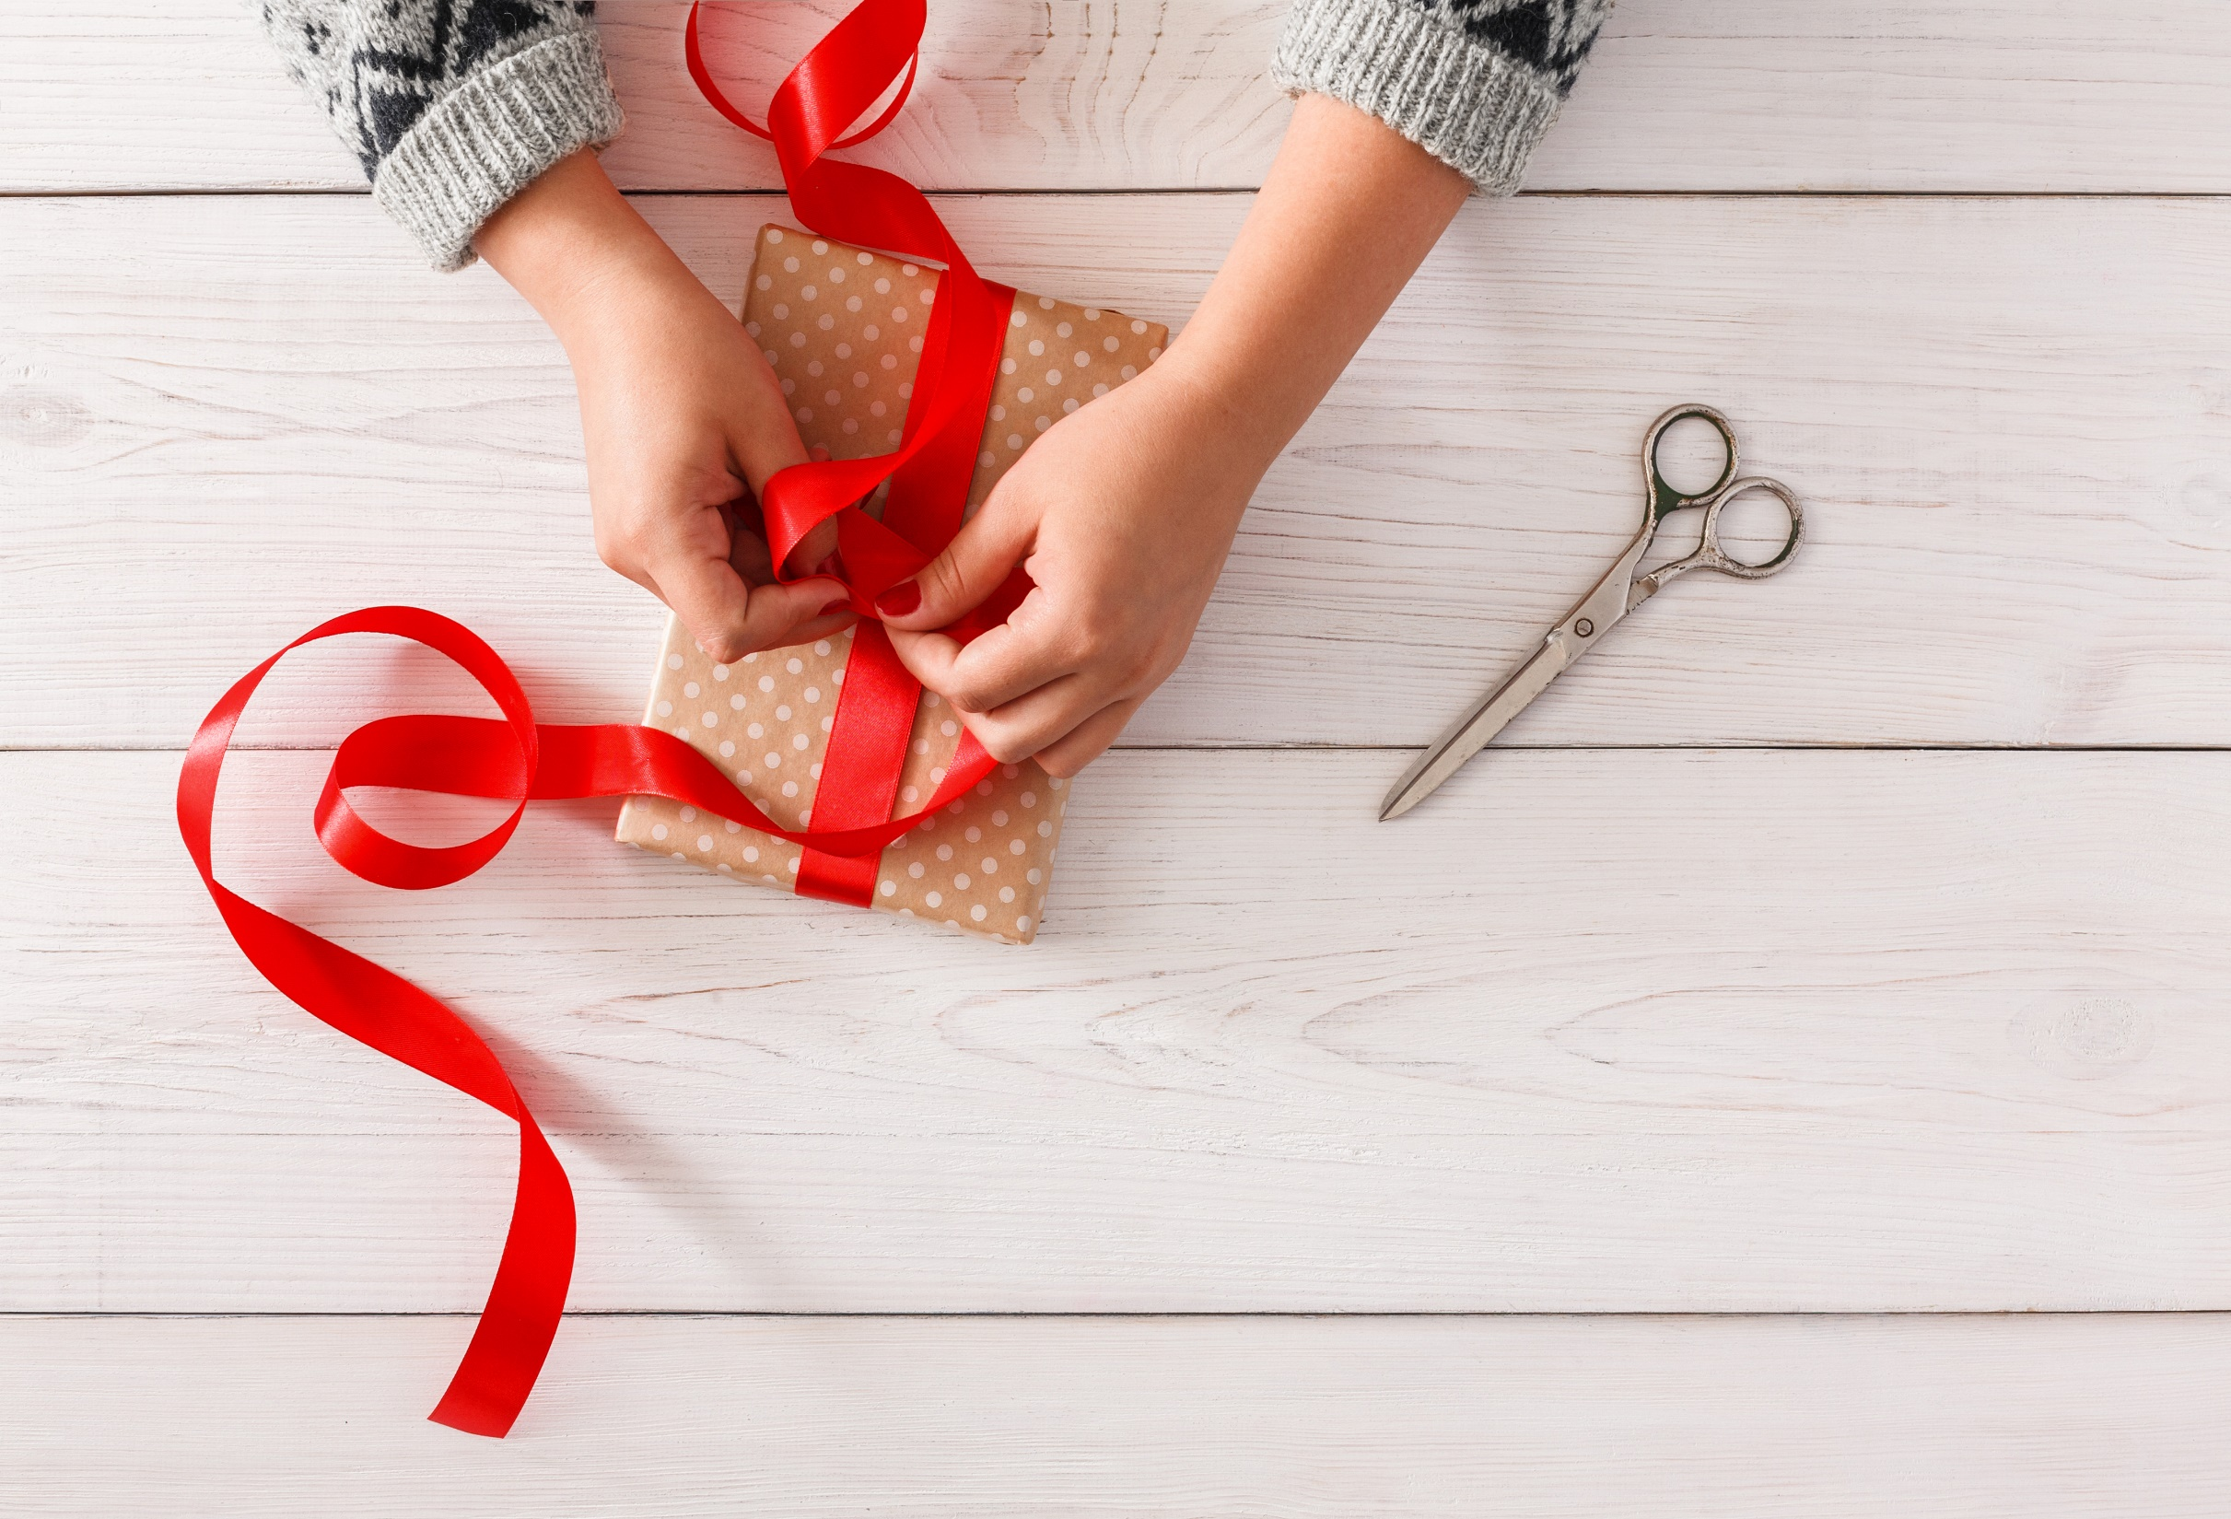
WRAP-UP

Slide 25
Today’s lesson:
Review:
- Grammar of Unit 5: Wh-questions and Yes/No questions and comparative adverbs.
- Vocabulary of Unit 5: Words of the topic “science and technology” (tablet, screen, inch, weight, gigabyte, storage, rescue, lift, complete, navigate, recognize, carefully, quietly, safely).
- Listening and Reading Practice to review the topic “Science and technology”

Slide 26
Homework
- Review vocabulary, grammar and language skills of unit 5.
- Do the exercises in WB: Unit 5 Review - Part 1 (page 54).
- Prepare: Review – SB (page 97)

Slide 27
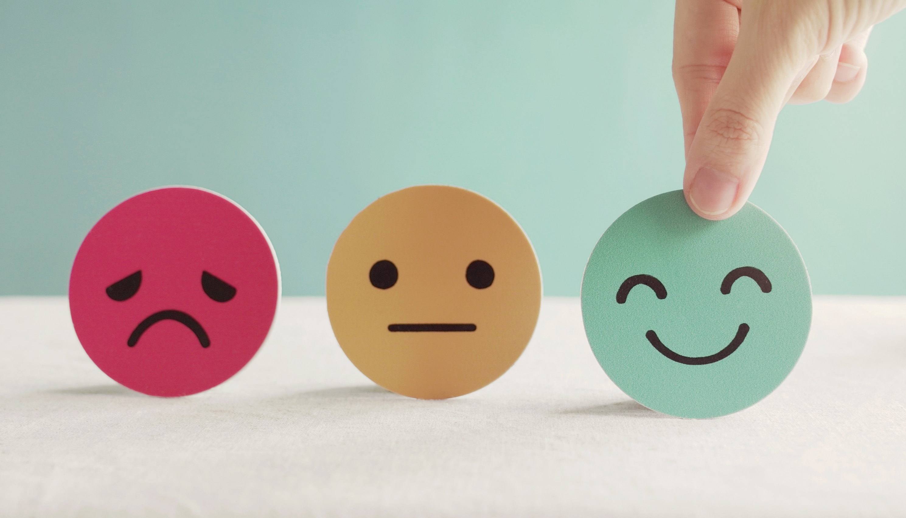
Lesson 3
Stay positive and have a nice day!

