Slide 1




15. 100 000
14. 85 000
13. 60 00
12. 40 000
11. 30 000
10. 20 000
9. 14 000
8. 10 000
7. 6000
6. 3000
5. 2000
4. 1000
HELP
START
QUIT
3. 600
2. 400
1. 200

Slide 2
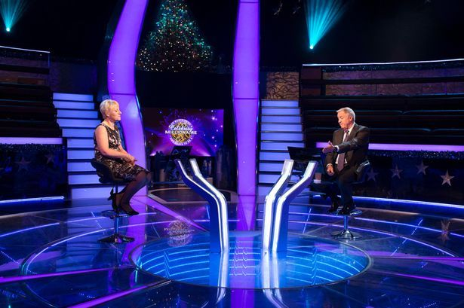

Question 1 : Fill in the blank: different as … and ….
A
Sun- moon
B
Sun- star
C
Day- night
D
Day- night
Sky- sea

Slide 3
Question 2 : when Nguyen Tat Thanh went to find the way to save country, he is … years old.
A
18
B
19
C
D
21
20
21

Slide 4
Question 3 : which country held Sea game 2002?
A
Viet Nam
Viet Nam
B
Laos
C
Singapore
D
Malaysia

Slide 5
Question 4: when was Uncle Ho born?
A
19/5/1981
B
19/5/1980
19/5/1980
C
15/5/1980
D
15/5/1981

Slide 6
Question 5 : who is the author of the famous novel “war and peace”?
A
Mark Twain
B
Shake Spear
C
Lev N. Tolstoy
D
Victor Hugo
Lev N. Tolstoy

Slide 7
Question 6 : the main character of the novel “les misérables” of Victor Hugo
A
Jean Valjean
Jean Valjean
B
Myriel
C
Javert
D
Fantine

Slide 8
Question 7: which country held World Cup 2014?
A
South Africa
B
Brazil
Brazil
C
Germany
D
Hungary

Slide 9
Question 8 : Who is president of the Socialist Republic of Viet Nam?
A
Nguyen Phu Trong
B
Nguyen Tan Dung
C
Tran Dai Quang
D
Tran Dai Quang
Nguyen Sinh Hung

Slide 10
Question 9 : who is the 44th president of the USA?
A
Donal Trump
B
George Washington
C
Barack Obama
D
John F. Kennedy
Barack Obama

Slide 11
Question 10: which country’s football team won in the World Cup in 2010?
A
Uruguay
B
Germany
C
Netherland
D
Spain
Spain

Slide 12
Question 11 :when did 1st world war occur?
A
28/6/1914
28/6/1914
B
28/6/1918
C
26/8/1918
D
26/8/1914

Slide 13
Question 12 :name of two American atomic bombs was dropped in the two cities of Japan
A
Little girl, big man
B
Little boy, big man
C
Little boy, fat man
D
Little girl, fat man
Little boy, fat man

Slide 14
Question 13 :the best technician is?
A
Au
B
Ag
Ag
C
Cu
D
Al

Slide 15
Question 14 :who is father of mobile phone?
A
Martin Cooper
Martin Cooper
B
Thomas Edison
C
Benjamin Franklin
D
John Ellendy

Slide 16
Question 15: how long did the last king of feudal state of Viet Nam – Bao Dai govern?
A
15
B
20
20
C
25
D
30

Slide 17
Congratulate!
Your bonus is ……

Slide 18

SƯU TẦM: ĐOÀN VĂN DOANH, NAM TRỰC, NAM ĐỊNH
LINK NHÓM DÀNH CHO GV BỘ MÔN VẬT LÝ TRAO ĐỔI TÀI LIỆU VÀ CHUYÊN MÔN CT 2018
https://www.facebook.com/groups/299257004355186

