Slide 2


Unit
11
OUR GREENER WORLD
LESSON 7: LOOKING BACK AND PROJECT
1

Slide 3
LESSON 7: LOOKING BACK AND PROJECT
LESSON 1: GETTING STARTED
WARM-UP
Warm-up:
Vocabulary
Task 1: Add more words to the word webs below.
PRESENTATION
Grammar:
Task 2: Write a/an or the
Task 3: Write the correct form of each verb in brackets
Task 4: Combine each pair of sentences below to make a first conditional sentence.
PRACTICE
Project: Creative ideas about reusing old things
Task 1: What can you see in each picture? What did people use to make the things in the pictures?
Task 2: Now work in pairs or in groups to complete the project.
Task 3. Listen to other presentations and decide which is the best
PRODUCTION
CONSOLIDATION
Wrap-up
Homework

Slide 4
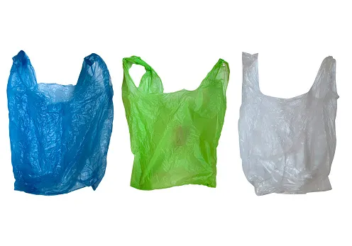

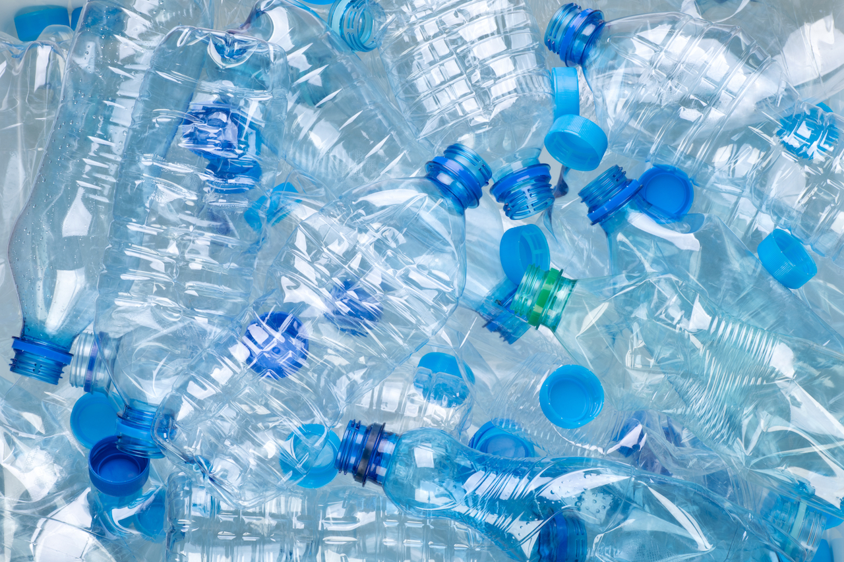
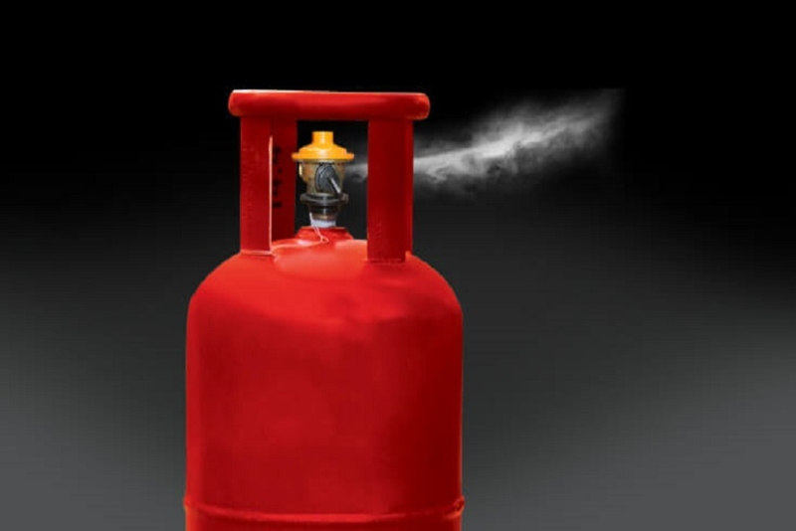
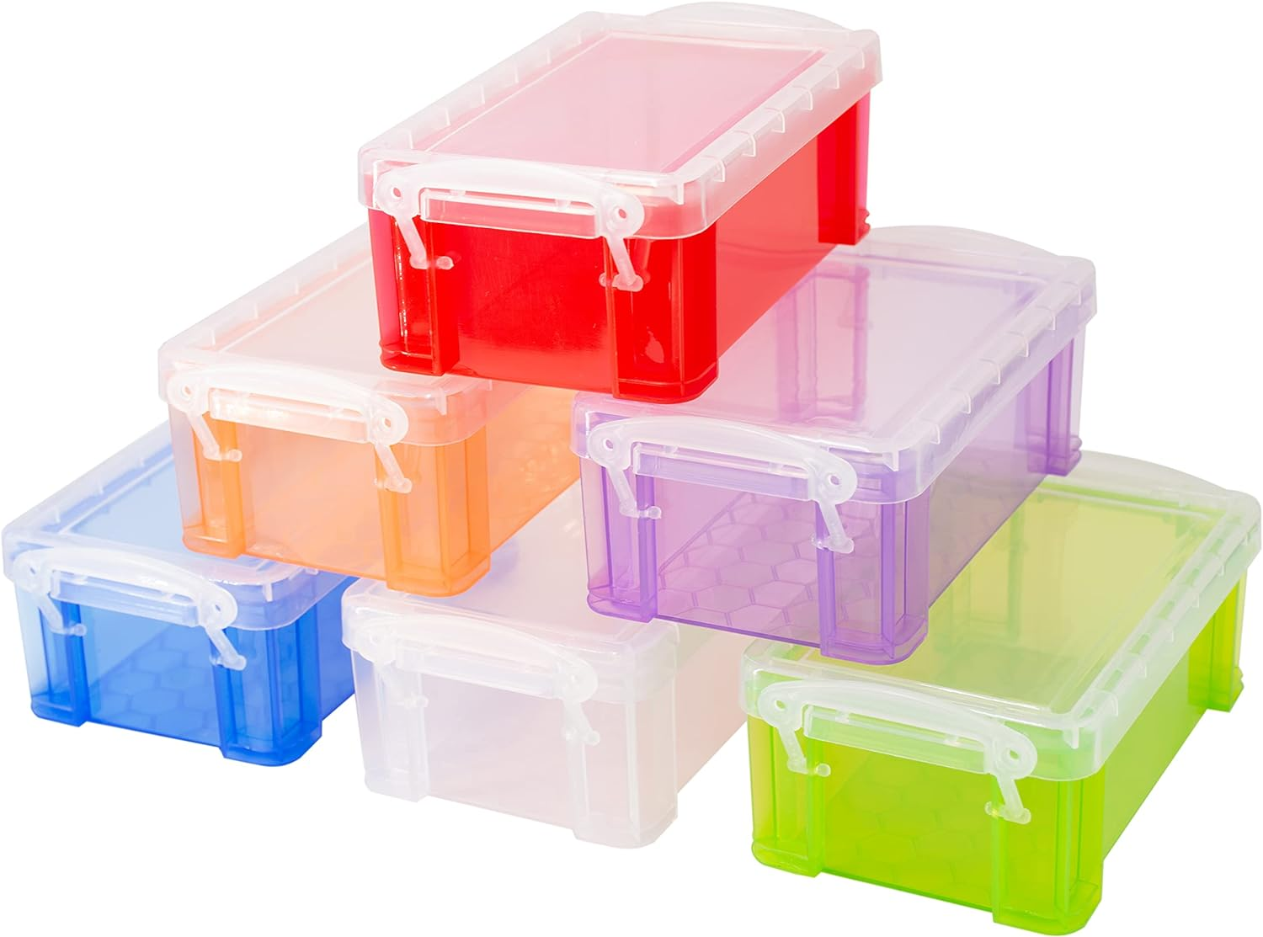
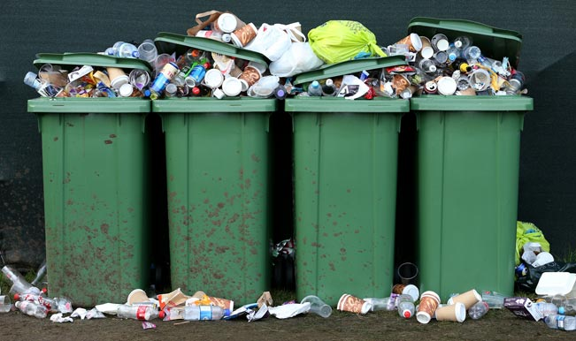
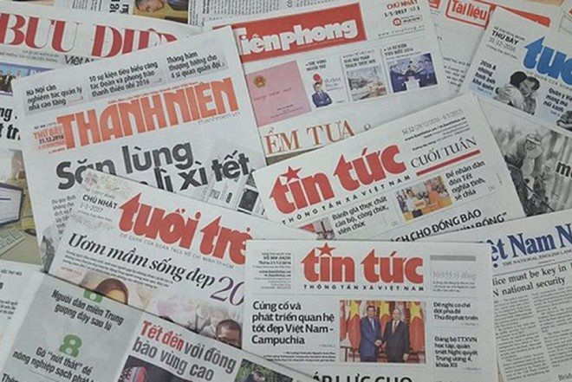
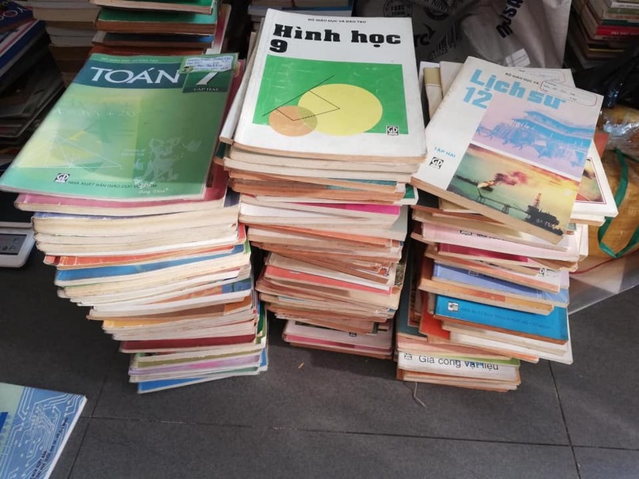
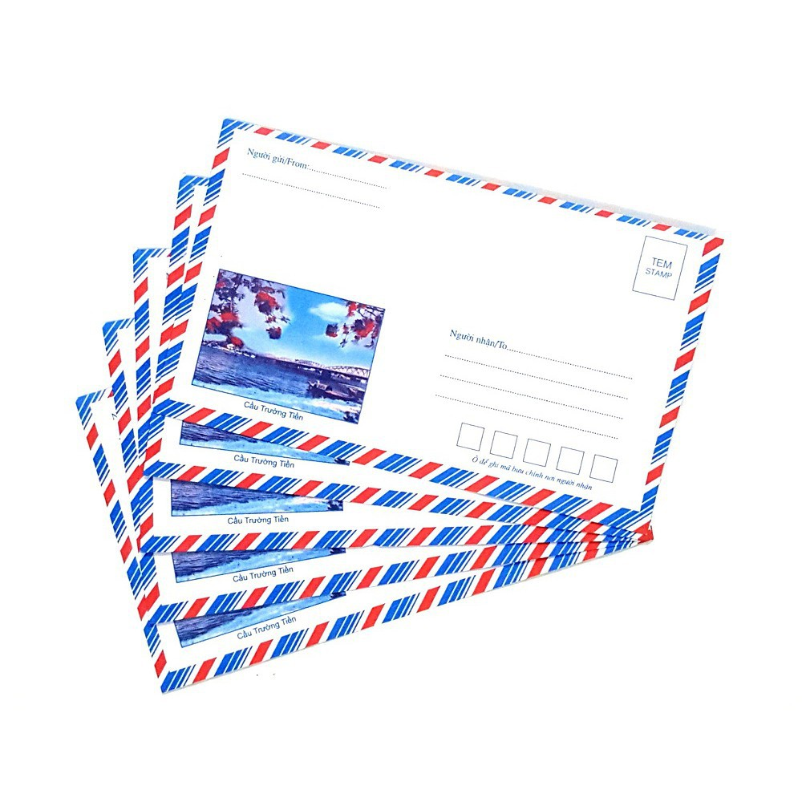
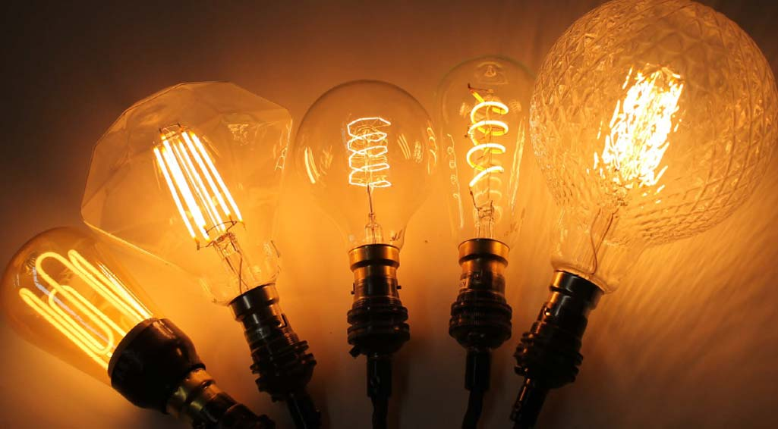
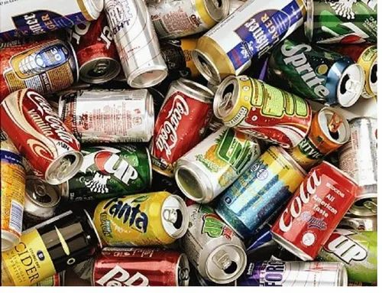
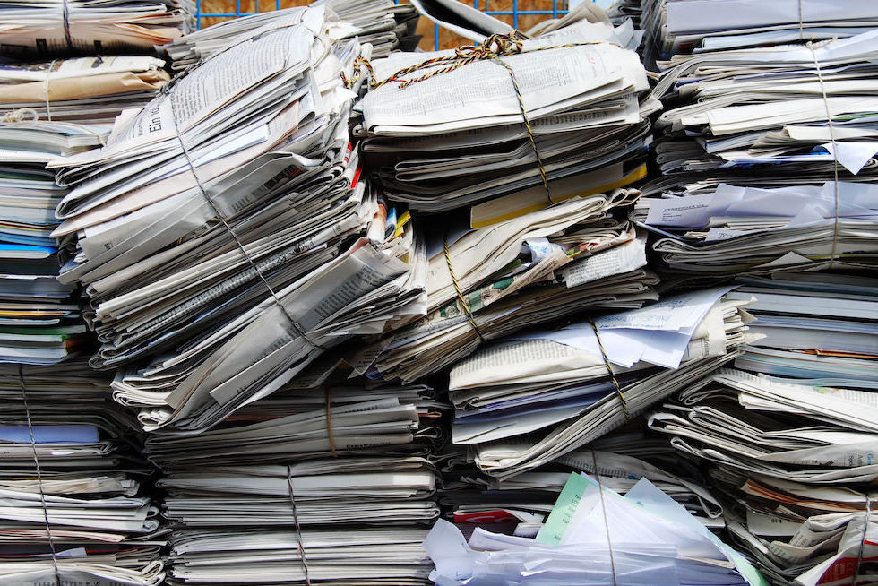
WARM-UP
GAME: KIM’S GAME

Slide 5

Vocabulary

Slide 6

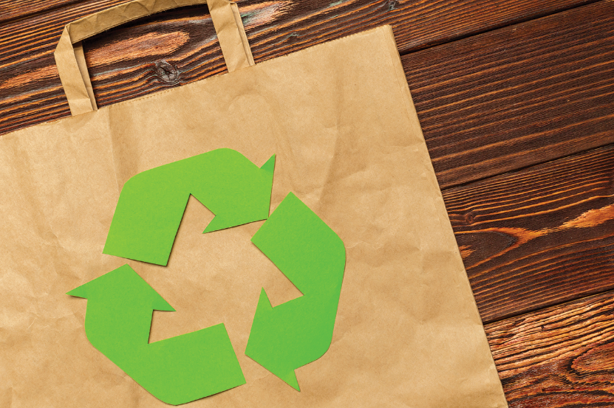
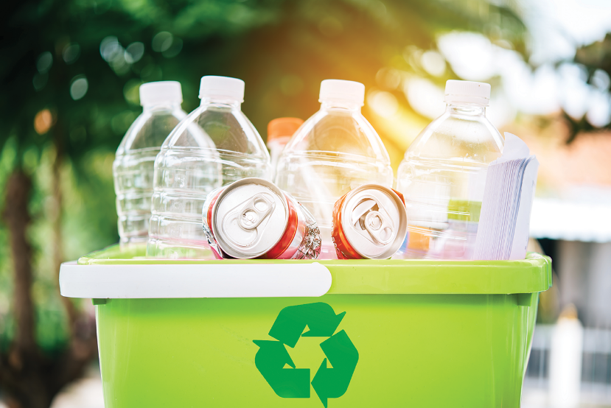
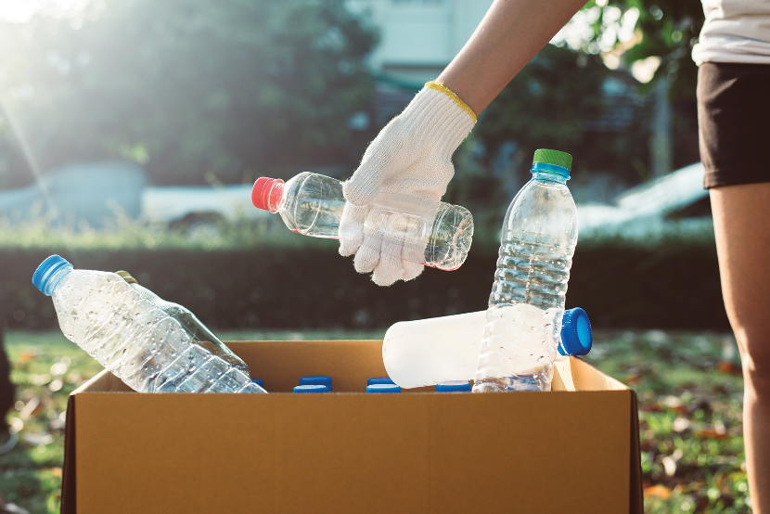
PRACTICE
Add more words to the word webs below.

Slide 7
PRACTICE
Add more words to the word webs below.
electricity
water
gas
Reduce
plastic bags
rubbish
paper

Slide 8
PRACTICE
Add more words to the word webs below.
bottles
envelopes
cans
Reuse
plastic bottles
light bulbs
plastic bags

Slide 9
PRACTICE
Add more words to the word webs below.
plastic
boxes
plastic
bags
books
Recycle
glass
newspapers
cans

Slide 10
Grammar

Slide 11

PRACTICE
Write a / an or the.
1.
If I see
_______ dog, I will run away.
a dog, I will run away.
2.
_______ art gallery?
Does your town have
an art gallery?
_______ Moon is bright tonight.
3.
The Moon is bright tonight.
_______ temple is very old.
4.
The temple is very old.
5.
_______ teacher?
- Is your mother
a teacher?
_______ artist.
- No, she isn’t. She’s
an artist.

Slide 12

PRACTICE
Write the correct form of each verb in brackets.
If they (build) build an airport here, it (be) will be very noisy.
1.
If they (build) _______ an airport here, it (be) _______ very noisy.
People (save) will save the environment if they (reuse) reuse old items.
2.
People (save) _______ the environment if they (reuse) _______ old items.
If we (grow) _______ trees, our school (be) _______ greener.
3.
If we (grow) grow trees, our school (be) will be greener.
4.
If we (not have) don’t have enough food, we (be) will be hungry.
If we (not have) _______ enough food, we (be) _______ hungry.
5.
If we (be) are hungry, we (be) will be tired.
If we (be) _______ hungry, we (be) _______ tired.

Slide 13

PRACTICE
Combine each pair of sentences below to make a first conditional sentence.
1.
We walk or cycle. We are healthy.
2.
We use the car all the time. We make the air dirty.
3.
You reuse paper. You save trees.
4.
You make noise. Your sister doesn’t sleep.
5.
I see a used bottle on the road. I put it in the bin.

Slide 14
PRACTICE
Combine each pair of sentences below to make a first conditional sentence.
1.
We walk or cycle. We are healthy.
If we walk or cycle, we will be healthy.
2.
We use the car all the time. We make the air dirty.
If we use the car all the time, we will make the air dirty.
3.
You reuse paper. You save trees.
If you reuse paper, you will save trees.

Slide 15
PRACTICE
Combine each pair of sentences below to make a first conditional sentence.
4.
You make noise. Your sister doesn’t sleep.
If you make noise, your sister will not / won’t sleep.
5.
I see a used bottle on the road. I put it in the bin.
If I see a used bottle on the road, I will put it in the bin.

Slide 16
PRACTICE
Combine each pair of sentences below to make a first conditional sentence.
1.
We walk or cycle. We are healthy.
If we walk or cycle, we will be healthy.
2.
We use the car all the time. We make the air dirty.
If we use the car all the time, we will make the air dirty.
3.
You reuse paper. You save trees.
If you reuse paper, you will save trees.
4.
You make noise. Your sister doesn’t sleep.
If you make noise, your sister will not / won’t sleep.
5.
I see a used bottle on the road. I put it in the bin.
If I see a used bottle on the road, I will put it in the bin.

Slide 17



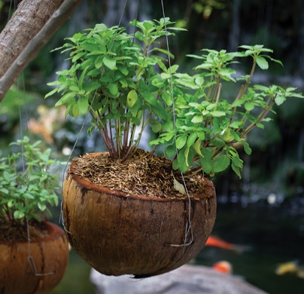

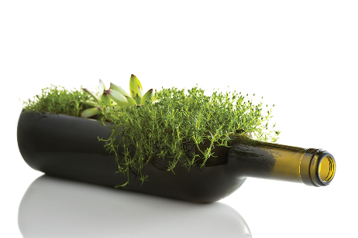
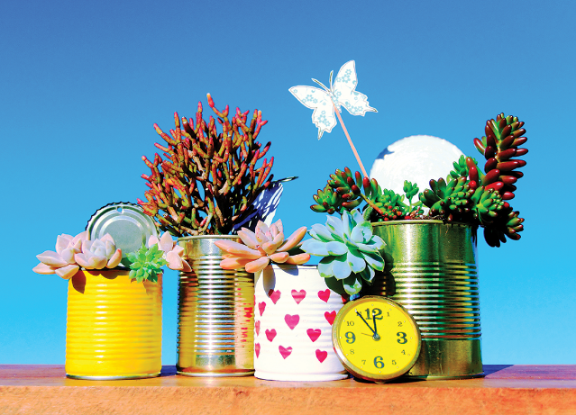
PRODUCTION
What can you see in each picture? What did people use to make the things in the pictures?

Slide 18

PRODUCTION
Now work in pairs or in groups to complete the project.
Choose a used object (a bottle, a sheet of paper, etc.).
Make something new from it and decorate it.
Bring it to class.
Do a “show and tell” about it.

Slide 19

PRODUCTION
Listen to other presentations and decide which is the best.

Slide 20

CONSOLIDATION
1
Wrap-up
What have we learnt in this lesson?
Vocabulary: the words for things that can be reduced, reused and recycled
Grammar: - Articles
- The 1st conditional sentences
Project: Creative ideas about reusing old things

Slide 21

CONSOLIDATION
2
Homework
Do exercises in the handout given by the teacher.

Slide 22
CONSOLIDATION
Now I can … |  |  | 
use the words for things that can be reduced, reused and recycled.
say sentences with correct rhythm.
use the articles correctly.
use the first conditional to talk about possibilities.
give warnings.
read about ways to go green.
talk about tips for going green.
listen about ideas for a green club.
write a paragraph about ideas for a green club.
✓
✓
✓
✓
✓
✓
✓
✓
✓
✓
✓
✓
✓
✓
✓
✓
✓
✓
✓
✓
✓
✓
✓
✓
✓
✓
✓

Slide 23







