Slide 1

Unit 6: Entertainment
Lesson 6c: Vocabulary
Page 108

Slide 2
Lesson Outline
Warm-up
Vocabulary
Speaking
Consolidation
Wrap-up

Slide 3
Objectives
By the end of this lesson, students will be able to…
learn vocabulary about types of TV programmes/ films.
practise expressing opinions.

Slide 4

WARM-UP

Slide 5
What types of TV programmes/ films do you like?

Slide 6

It’s time to learn …

Slide 7
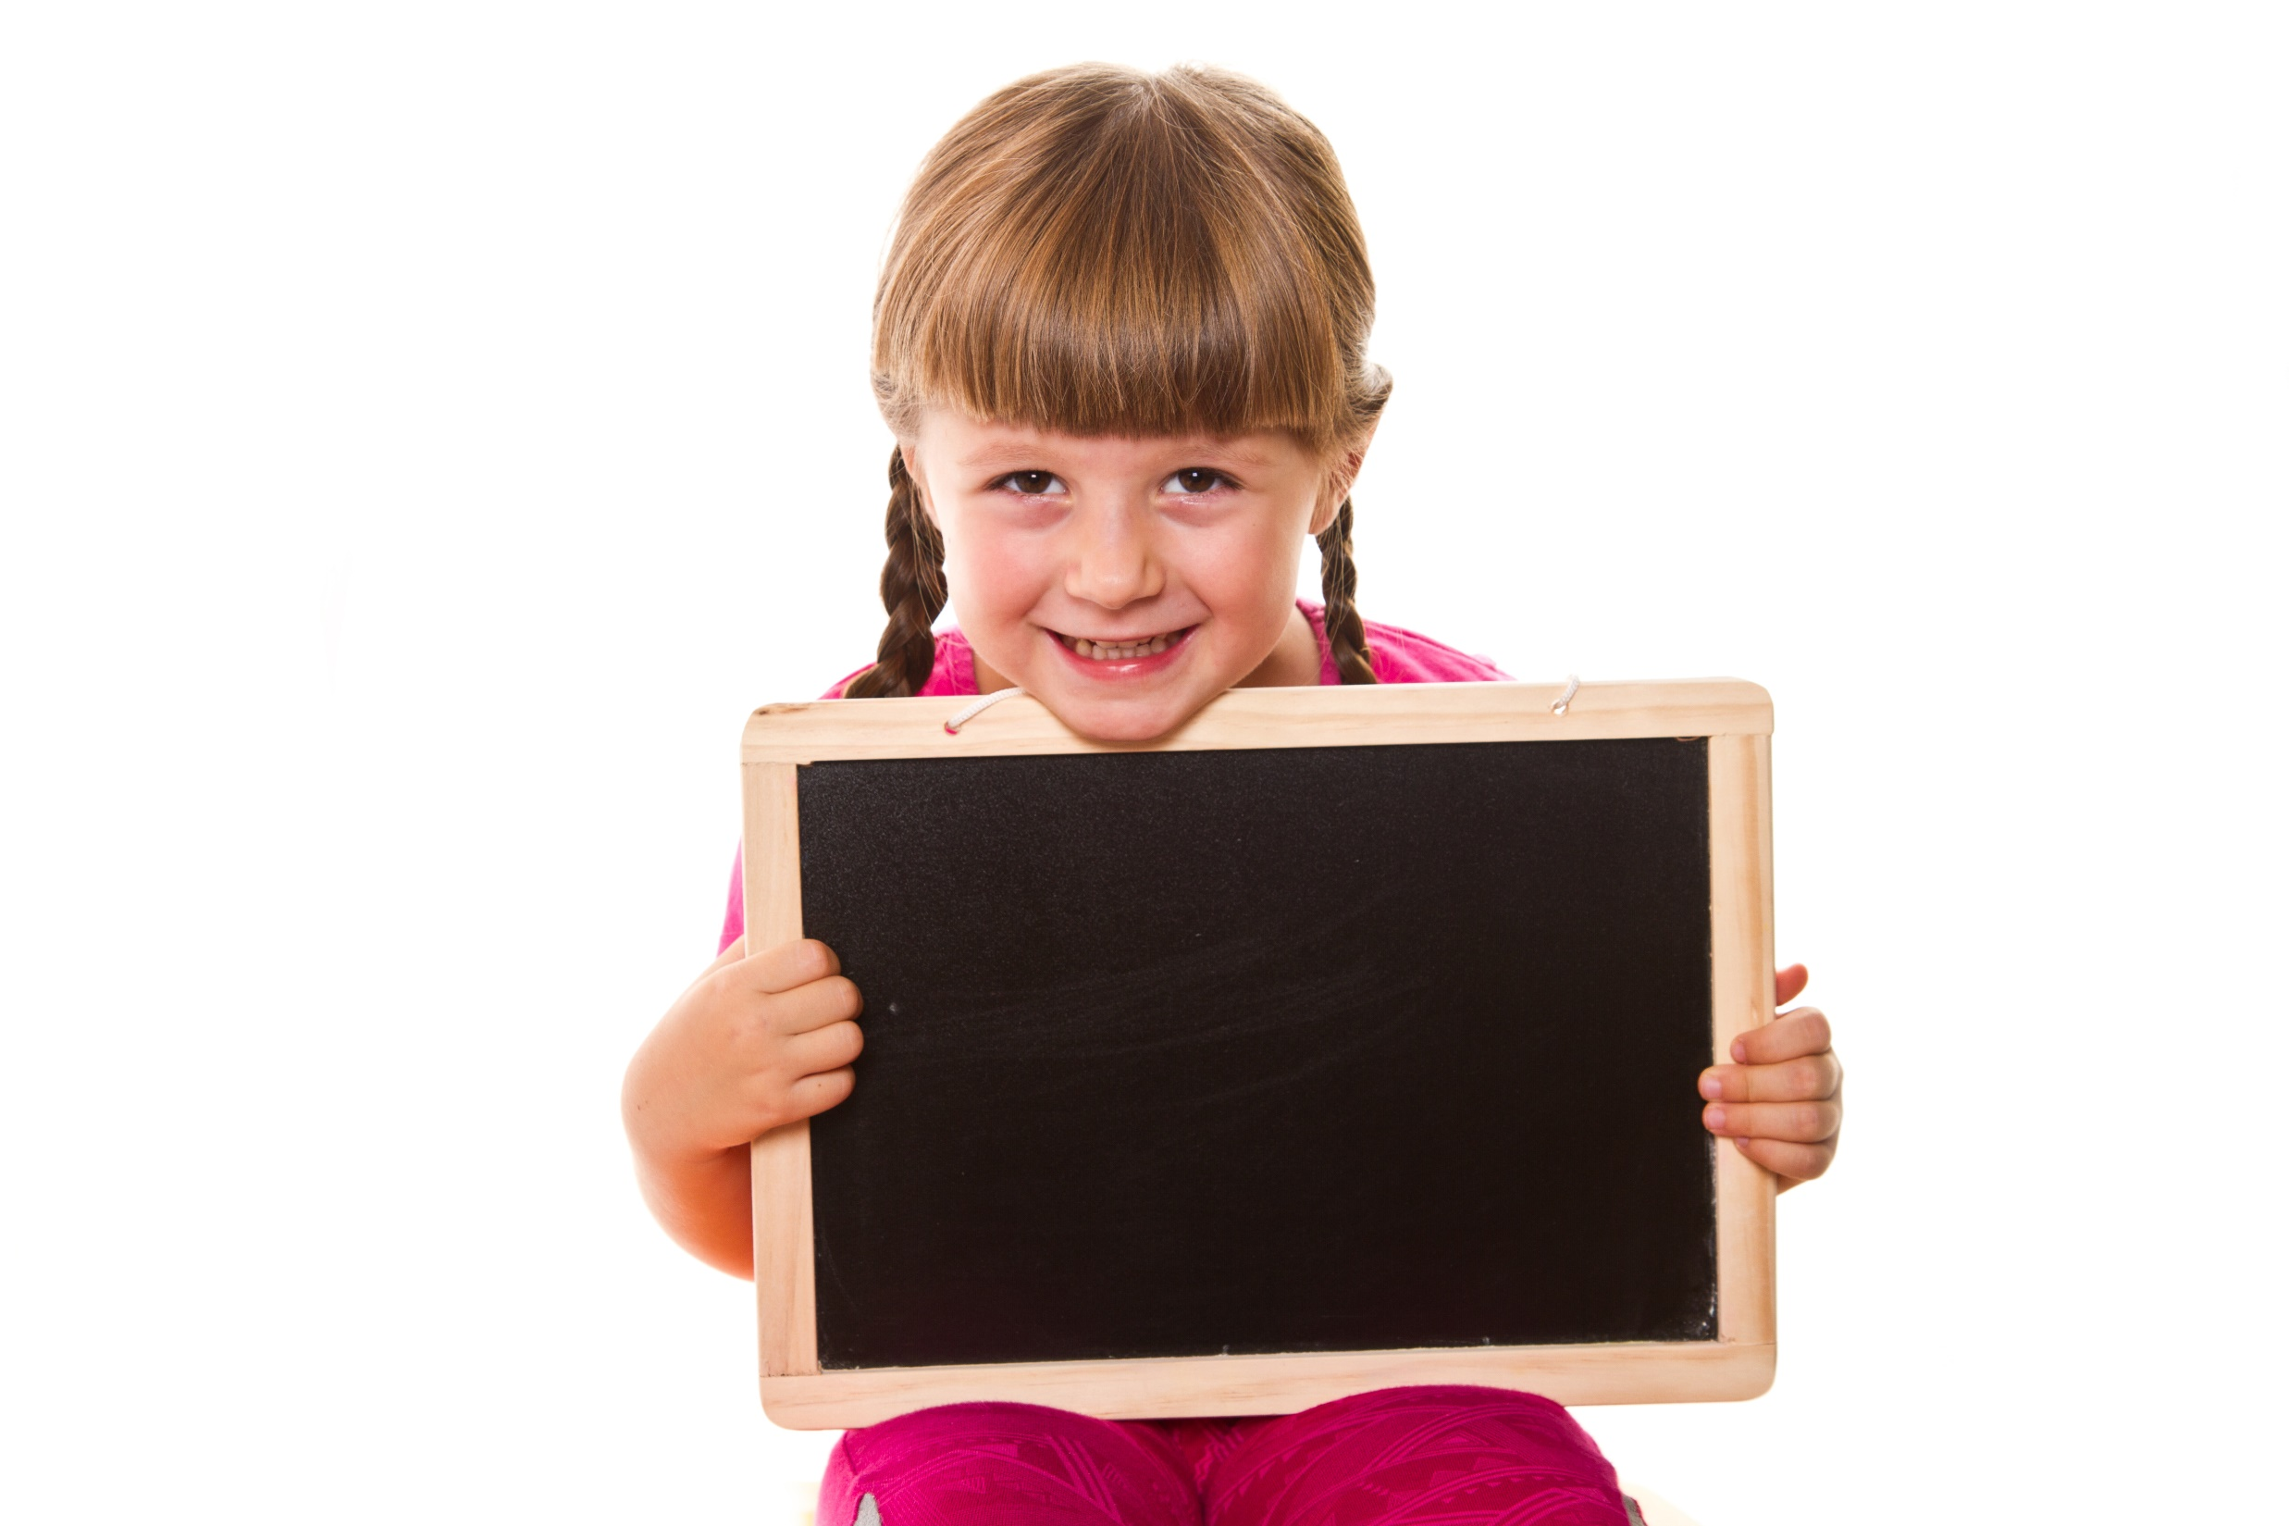
Presentation

Slide 8

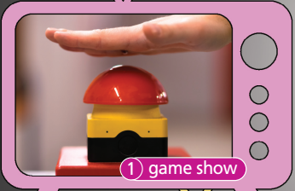
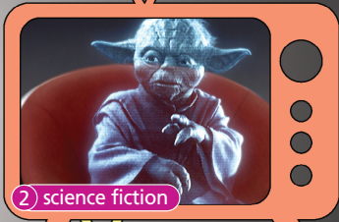
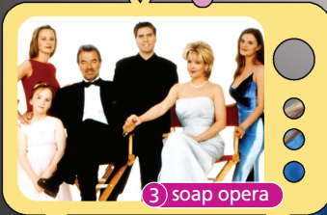
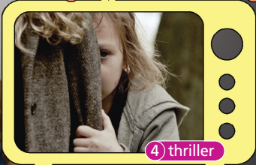
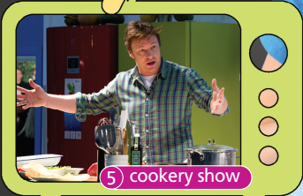


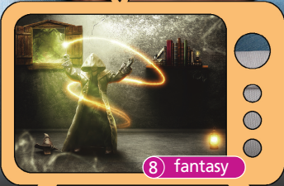
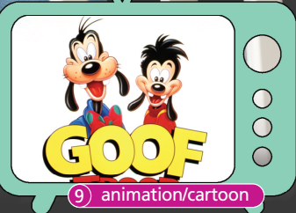
1 Listen and repeat.

Slide 9
Vocabulary
game show /ˈɡeɪm ʃəʊ/ (n): trò chơi truyền hình
science fiction /ˌsaɪəns ˈfɪkʃən/ (n): phim khoa học viễn tưởng
soap opera /ˈsəʊp ˌɒpərə/ (n): kịch/phim dài tập
thriller /ˈθrɪlə/ (n): phim giật gân
cookery show /ˈkʊkəri ʃəʊ/ (n): chương trình nấu ăn
documentary /ˌdɒkjəˈmentəri/ (n): phim tài liệu
action /ˈækʃən/ (n): (phim) hành động
adventure /ədˈventʃə/ (n): (phim) phiêu lưu, mạo hiểm
fantasy /ˈfæntəsi/ (n): phim hư cấu, tưởng tượng
animation /ˌænɪˈmeɪʃən/ (n): phim hoạt hình
cartoon /kɑːˈtuːn/ (n): phim hoạt hình

Slide 10
Vocabulary (stress)
game show /ˈɡeɪm ʃəʊ/ (n): trò chơi truyền hình
•
science fiction /ˌsaɪəns ˈfɪkʃən/ (n): phim khoa học viễn tưởng
•
soap opera /ˈsəʊp ˌɒpərə/ (n): kịch/phim dài tập
•
thriller /ˈθrɪlə/ (n): phim giật gân
•
cookery show /ˈkʊkəri ʃəʊ/ (n): chương trình nấu ăn
•
documentary /ˌdɒkjəˈmentəri/ (n): phim tài liệu
•
action /ˈækʃən/ (n): (phim) hành động
•
adventure /ədˈventʃə/ (n): (phim) phiêu lưu, mạo hiểm
•
fantasy /ˈfæntəsi/ (n): phim hư cấu, tưởng tượng
•
animation /ˌænɪˈmeɪʃən/ (n): phim hoạt hình
•
cartoon /kɑːˈtuːn/ (n): phim hoạt hình

Slide 11
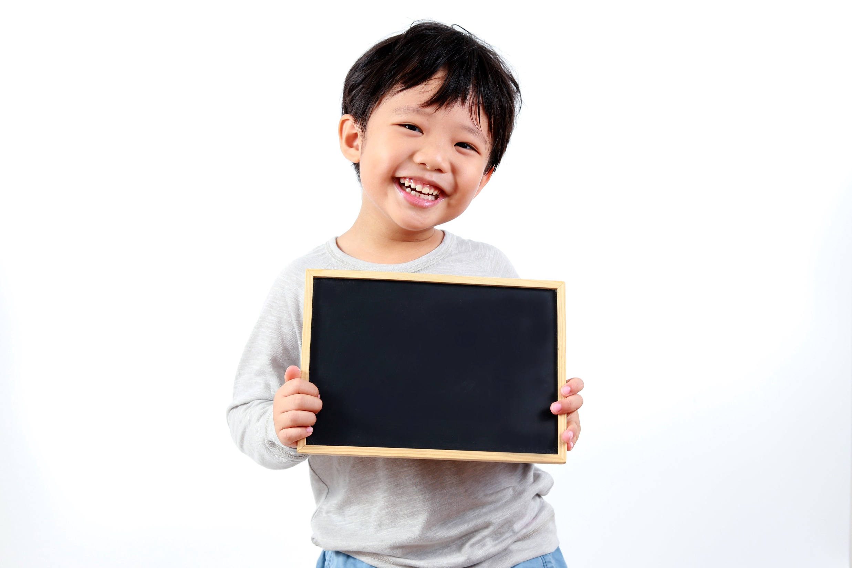
Practice

Slide 12
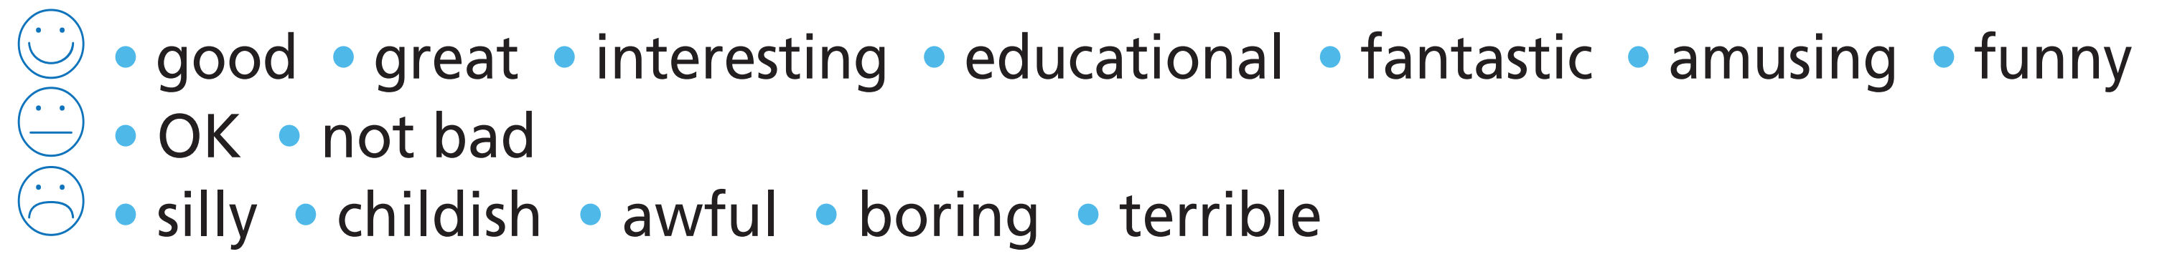
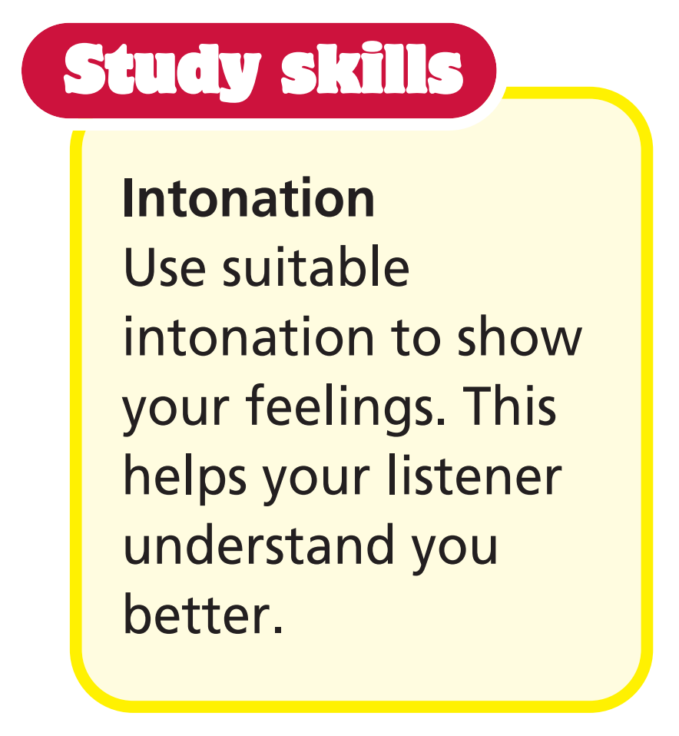
2 Use the adjectives to discuss TV programmes and films as in the example.
Example
A: What do you think of documentaries?
B: I find them boring. I prefer science-fiction films. What do you like watching?
A: I love thrillers. They’re fantastic.

Slide 13
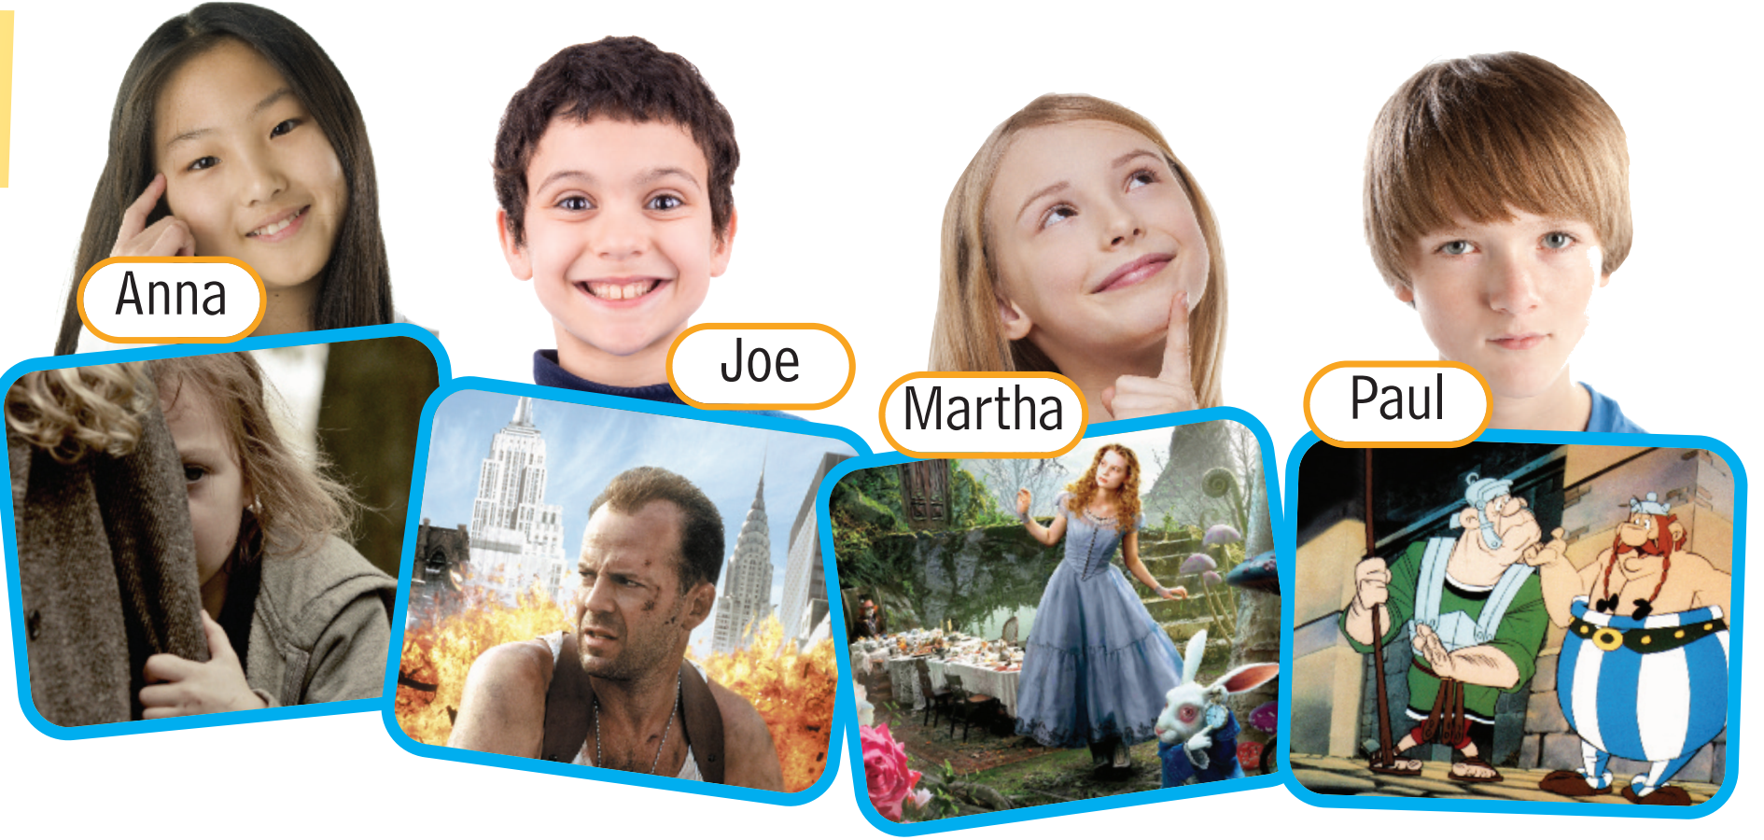
What is each person’s favourite type of film? Complete the sentences with the types of films and adjectives in the list.
Further practice
thrillers
frightening
fantasy
animation/cartoon
amusing
exciting
amazing
action/adventure
1 __________________ are Anna’s favourite type of film. They are __________________ , but she isn’t afraid.
2 _________________ films are Joe’s favourite. He thinks they are _____________________ because lots of things happen.
3 _______________________ films are Martha’s favourite. It’s really _________________ to see all their special effects.
4 _______________________ films are Paul’s favourite. They’re very _________________ and always make him laugh.

Slide 14

Production

Slide 15

3 What do you think the future of entertainment will be? Discuss in pairs.
Sample
People will use VR headsets to watch films. There will be digital music and digital films.

Slide 16

CONSOLIDATION

Slide 17
Write a paragraph (60 words) about your favourite type of TV programme/film.
Your paragraph should include:
What type of TV programme/film it is.
Why you like it.

Slide 18

WRAP-UP

Slide 19
Today’s lesson
Vocabularies
- Types of TV programmes/films.
- Adjectives to describe feelings.

Slide 20
Homework
Practise the vocabularies and make sentences using them.
Do the exercises in TA 6 Right on WB (p. 56).
Do the exercises in TA 6 Right on Notebook (p. 57).
Prepare the next lesson (p. 109 SB).

Slide 21
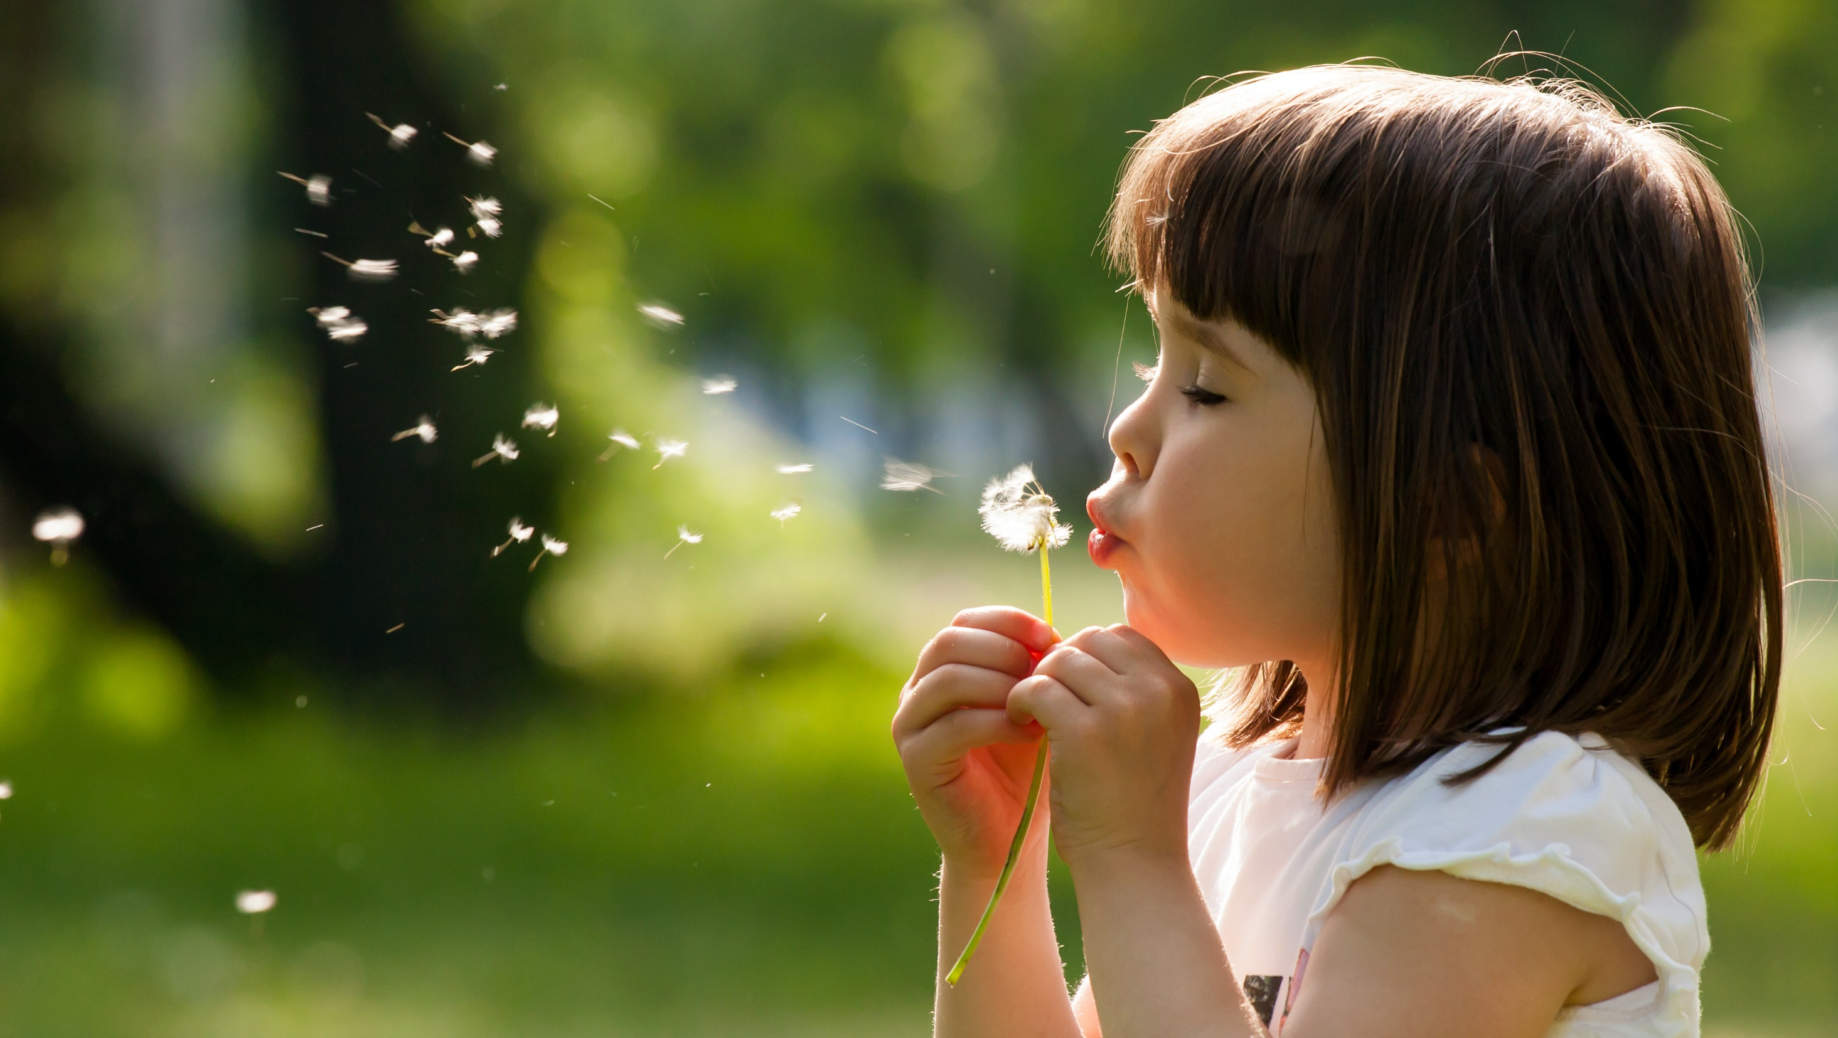
Enjoy your day!

