Slide 1

Unit 2: Every Day
Lesson 2i: Progress Check
Page 51

Slide 2
Lesson Outline
Warm-up
Reading
Listening
Listening
Consolidation
Wrap-up

Slide 3
Objectives
By the end of this lesson, students will be able to…
practise reading a text about a school life in Vietnam.
practise listening to timetable.
practise writing an email.

Slide 4

WARM-UP

Slide 5
Choose the word whose underlined part is pronounced differently from that of the others.
1. A. eat B. read C. break D. leave
/iːt/ /riːd/ /breɪk/ /liːv/
2. A. game B. name C. place D. car
/ɡeɪm/ /neɪm/ /pleɪs/ /kɑː/
3. A. lunchbox B. music C. puzzle D. rubbish
/ˈlʌntʃbɒks/ /ˈmjuːzɪk/ /ˈpʌzəl/ /ˈrʌbɪʃ/

Slide 6
Choose the word whose main stress is placed differently from that of the others.
1. A. enjoy B. visit C. listen D. finish
/ɪnˈdʒɔɪ/ /ˈvɪzɪt/ /ˈlɪsən/ /ˈfɪnɪʃ/
2. A. leaflet B. building C. routine D. transport
/ˈliːflət/ /ˈbɪldɪŋ/ /ruːˈtiːn/ /ˈtrænspɔːt/
3. A. activity B. geography C. environment D. education
/ækˈtɪvəti/ /dʒiˈɒɡrəfi/ /ɪnˈvaɪrənmənt/ /edʒʊˈkeɪʃən/

Slide 7
PAIRWORK
Tell your friend about your school day.
What time does your first lesson start?
How many lessons do you have a day?
Where do you have lunch?
What time do you come back home?
Do you have a lot of homework every day?

Slide 8

It’s time to learn …

Slide 9

Reading

Slide 10
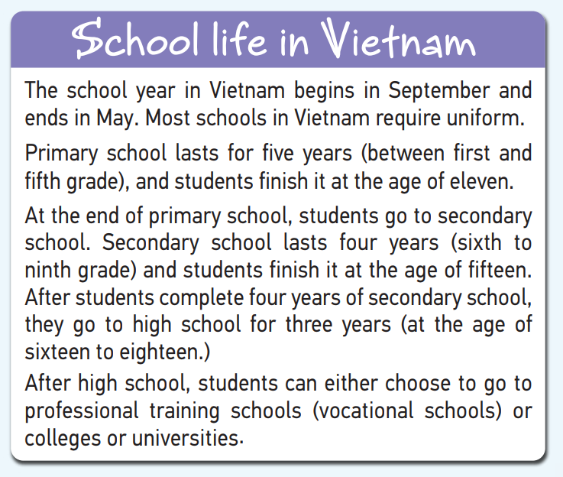
8 Read the text and answer the question: what is the text about?
It’s about school life in Vietnam.

Slide 11
Read the sentences and guess the missing information.
1 The school year in Vietnam starts _____________________ .
2 Primary school lasts ________________________________ .
3 A 7-year-old Vietnamese child goes to ________________ .
4 Secondary school lasts _____________________ .
5 High school is for students aged ______________________ .
6 Students can choose to do professional training after they finish _________________________ .
date
a period of time
place
a period of time
number
noun

Slide 12
Read the text and complete the sentences.
1 The school year in Vietnam starts ________________ .
2 Primary school lasts _________________ .
3 A 7-year-old Vietnamese child goes to ______________ .
The school year in Vietnam begins in September and ends in May.
in September
five years
Primary school lasts for five years (between first and fifth grade), and students finish it at the age of eleven.
primary school

Slide 13
Secondary school lasts four years (sixth to ninth grade) and students finish it at the age of fifteen.
4 Secondary school lasts _______________ .
5 High school is for students aged _________________ .
6 Students can choose to do professional training after they finish _____________ .
four years
After students complete four years of secondary school, they go to high school for three years (at the age of sixteen to eighteen.)
sixteen to eighteen
After high school, students can either choose to go to professional training schools (vocational schools) or colleges or universities.
high school

Slide 14
Listening

Slide 15

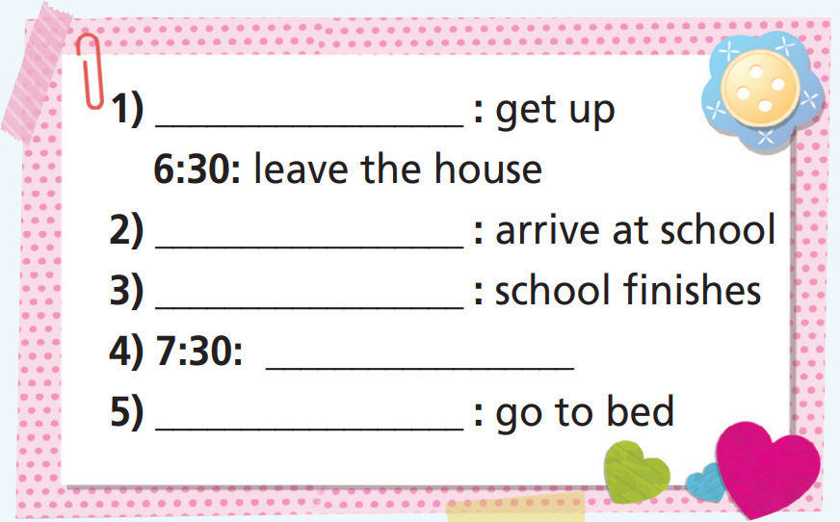
9 Listen and complete Aga’s daily routine.
5:30
8:30
3:30
have dinner
10:00

Slide 16
Pair work
Tell your friend about Aga’s daily routine.
Aga gets up early at 5:50. Then she
leaves the house at 6:30 and it takes her two hours to arrive at school. Her school finishes at 3:30. She has dinner at 7:30 and goes to bed at 10:00 p.m.

Slide 17
Writing

Slide 18
Pair work
Make a list of activities you usually do on Sundays.
get up late
have big breakfast
go to the park
play sports
go shopping
hang out with friends
eat out

Slide 19
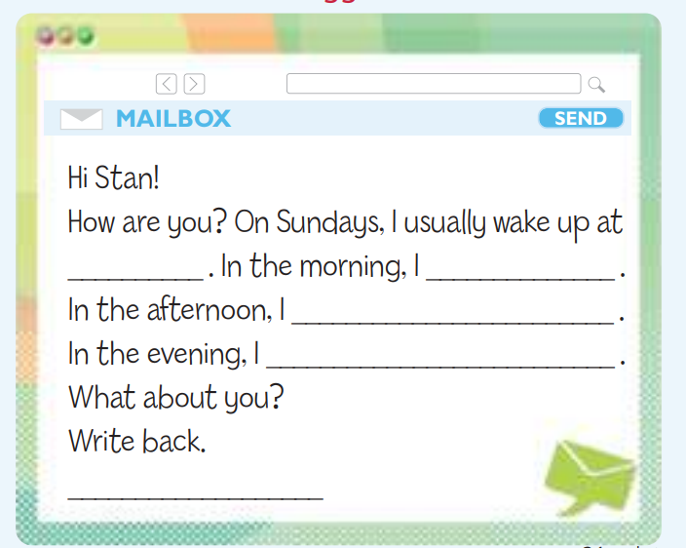
10. Complete an email to your English friend, Stan, about what you do on Sundays (about 50-60 words).

Slide 20
Planning
Think about what you do on Sunday morning, afternoon, and evening.
Morning: take a shower, have breakfast, watch TV
Afternoon: play football at the park, hang out with friends
Evening: eat dinner with my family, chat online

Slide 21
Sample
Hi Stan!
How are you? On Sundays, I usually wake up at 9:00 a.m. In the morning, I take a shower, have my breakfast and watch TV. In the afternoon, I play football at the park and hang out with my friends. In the evening, I eat dinner with my family at 7:00 p.m.
and then I chat online. I go to bed at 9:30 p.m.
What about you?
Write back.
Emily

Slide 22

CONSOLIDATION

Slide 23
Write a short paragraph (about 60 words) about what you usually do on the weekend, use the vocabulary about free time activities and Present Simple tense.

Slide 24

WRAP-UP

Slide 25
Today’s lesson
Reading
Read a text about school life in Vietnam.
Listening
Listen to a daily routine.
Write
Write an email about what you do on Sunday.

Slide 26
Homework
Practise the vocabularies and grammar and make sentences using them.
Prepare the next lesson (p. 52 SB).
Do Unit 2 Test 2 in Bài Tập Bổ Trợ TA 6 Right on (pp. 24-25).

Slide 27
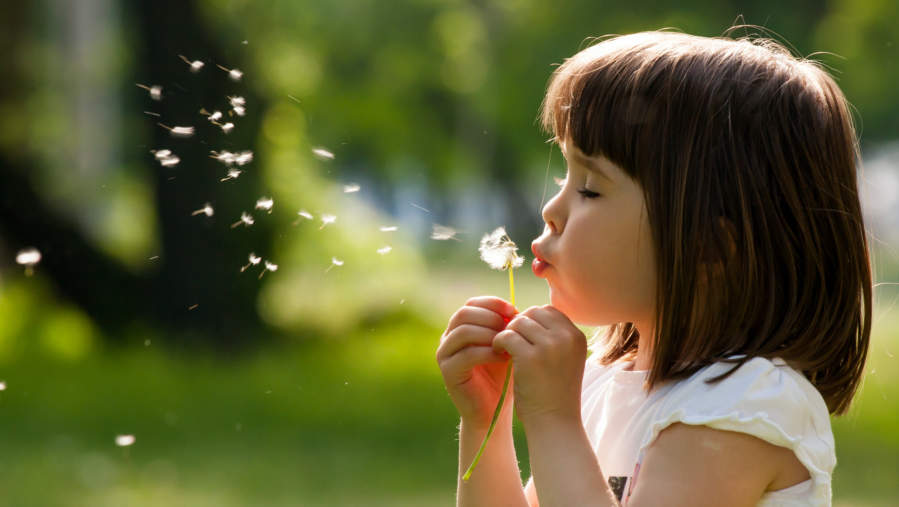
Enjoy your day!

