Slide 1

UNIT 6: COMMUNITY LIFE
Lesson 1.3 – Pronunciation & Speaking
Page 50

Slide 2




Lesson 1.3
LESSON OUTLINE
Consolidation

Slide 3

By the end of this lesson,
students will be able to …
practice /kr/ and /kl/ sounds
talk about changes in the community

Slide 4



Slide 5

Work in pairs.
Choose the word whose main stress is placed
differently from the others.
A. increase B. achieve C. produce D. damage
2. A. advanced B. global C. proper D. grateful
3. A. rebuild B. pollute C. reduce D. fasten
/ɪnˈkri:s/
/əˈtʃi:v/
/prəˈdu:s/
/ˈdæmɪdʒ/
/ədˈvænst/
/ˈɡloʊbəl/
/ˈprɒpə/
/ˈɡreɪtfəl/
/ˌri:ˈbɪld/
/pəˈlu:t/
/rɪˈdu:s/
/ˈfæsən/

Slide 6
Work in pairs.
Choose the word whose underlined part is
pronounced differently from that of the other words.
A.metal B. question C. sentence D. system
2. A. listened B. wanted C. improved D. destroyed
3. A. away B. passive C. alive D. advanced
/ˈmetəl/
/ˈkwestʃən/
/ˈsentəns/
/ˈsɪstəm/
/ˈlɪsənd/
/wɑ:ntɪd/
/ɪmˈpru:vd/
/dɪˈstrɔɪd/
/əˈweɪ/
/ˈpæsɪv/
/əˈlaɪv/
/ədˈvænst/

Slide 7
Game: Slap the board
increase
decrease
develop
change
move away
rebuild

Slide 8



Slide 9

Lead-in
Mini pair /kr/ and /kl/ sounds
b. Listen to the words and focus on the underlined letters
increase, decrease, close, clothes
c. Listen and circle the words you hear.
1. claw law
2. rack crack
3. lap clap
d. Take turns saying the words in c. while your partner points to them.

Slide 10

Practice

Slide 11

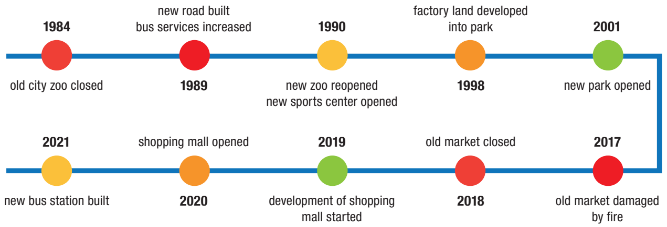
Take turns describing the changes in Gotham City.

Slide 12
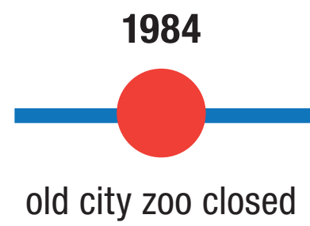
FOR EXAMPLE
In 1984, the old city zoo was closed.

Slide 13
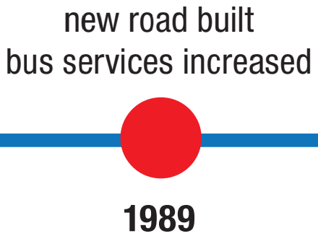
DO THE SAME
In 1989, the new road was built and the bus services increased.

Slide 14
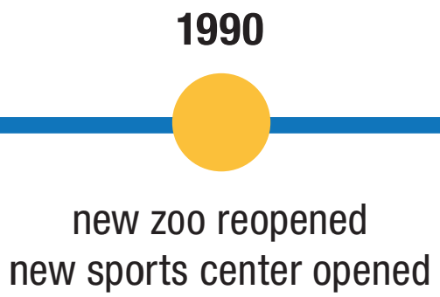
DO THE SAME
In 1990, the new zoo was reopened and the new sports center was opened.

Slide 15
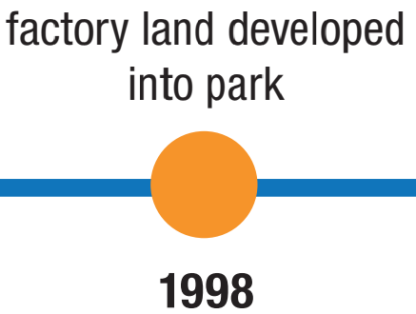
DO THE SAME
In 1998, the factory land was developed into the park.

Slide 16
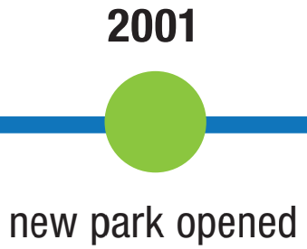
DO THE SAME
In 2001, the new park was opened.

Slide 17
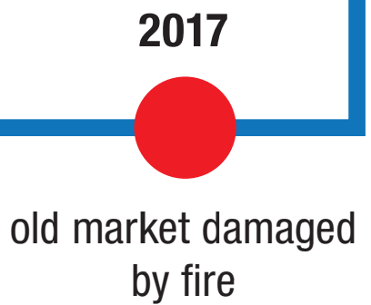
DO THE SAME
In 2017, the old market was damaged by fire.

Slide 18
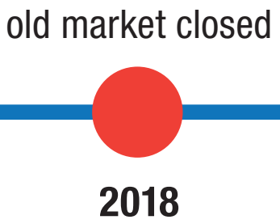
DO THE SAME
In 2018, the old market was closed.

Slide 19
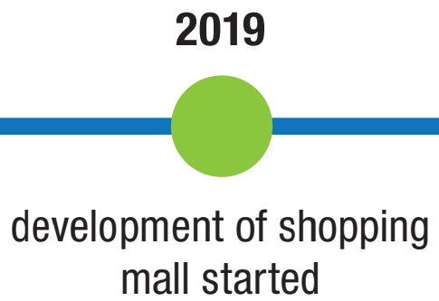
DO THE SAME
In 2019, the development of shopping mall was started.

Slide 20
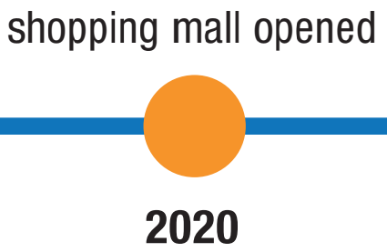
DO THE SAME
In 2020, the shopping mall was opened.

Slide 21
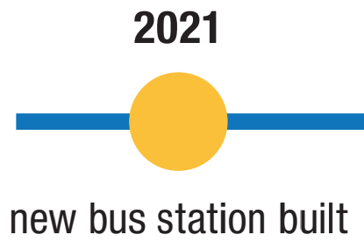
DO THE SAME
In 2021, the new bus station was built.

Slide 22

Production

Slide 23
Work in groups of four.
Discuss the changes of Vietnam in 2021.

Slide 24
You’re working on a school geography project about how towns change. In pairs: Student B, p 94. File 4 . Student A, add your own idea for Palshaw Post Office to the table.
→ Ask Student B about Aston.

Slide 25
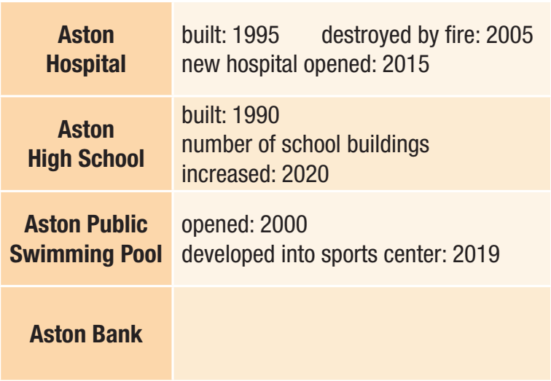

Slide 26
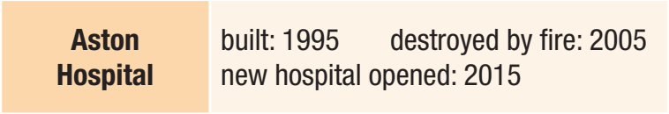
Can you tell me about Aston Hospital?
It was built in 1995, but it was destroyed by fire in 2005. Then the new hospital was opened in 2015.
Thank you for the information.

Slide 27
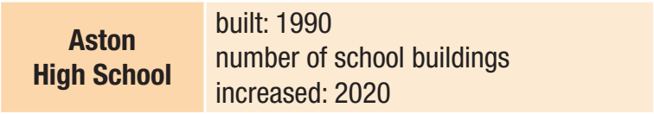
Can you tell me about Aston School?
It was built in 1990, and the number of school buildings increased in 2020.
Thank you for the information.

Slide 28

Can you tell me about Aston Public Swimming Pool?
It was opened in 2000, and it was developed into sports center in 2019.
Thank you for the information.

Slide 29
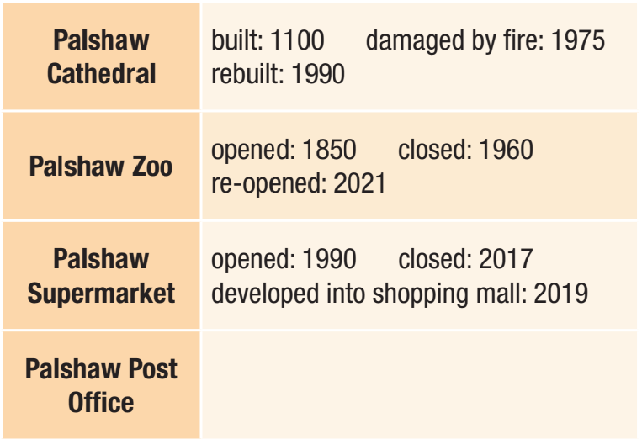
b. Answer Student B’s questions about Palshaw.

Slide 30
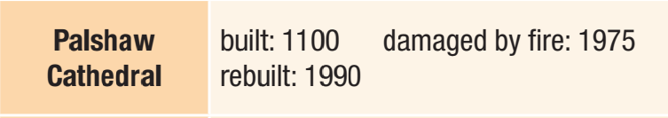
Can you tell me about Palshaw Cathedral?
It was built in 1100, but it was damaged by fire in 1975. It was rebuilt in 1990.
Thank you for the information.

Slide 31
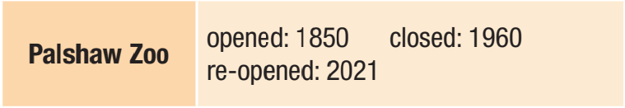
Can you tell me about Palshaw Zoo?
It was opened in 1850, but it was closed in 1960. It was reopened in 2021.
Thank you for the information.

Slide 32
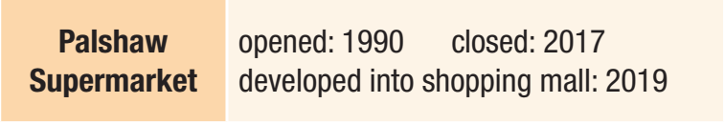
Can you tell me about Palshaw Supermarket?
It was opened in 1990, but it was closed in 2017. It was developed into the shopping mall in 2019.
Thank you for the information.

Slide 33

Consolidation

Slide 34

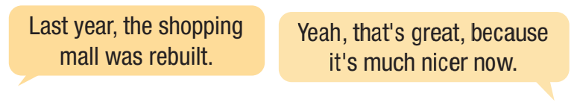
Work in pairs.

Slide 35

WRAP-UP

Slide 36
Today’s lesson
Pronunciation: practice /kr/ and /kl/ sounds
Speaking: talk about changes in the community

Slide 37
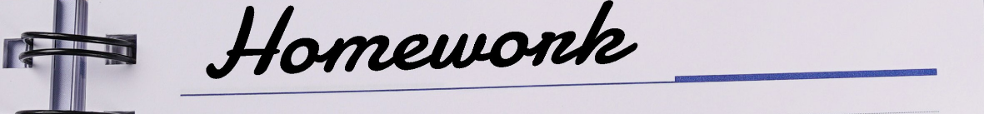
Review all the vocabularies and grammar point in the lesson.
Practice talking about changes in the community with the Simple Past Passive.
Find out more nouns with /kl/ - /kr/ and practice saying them.
Prepare the next lesson – Lesson 2 on page 51 in SB.
Play the consolidation games in Tiếng Anh i-Learn Smart World DHA App on www.eduhome.com.vn

