Slide 1
Graduation album

Slide 2
Input content
THANKS TO MY TEACHER
01
02
03
04
Input content
Input content
Input content
Input content

Slide 3
01
Input content
THANKS TO MY TEACHER

Slide 4
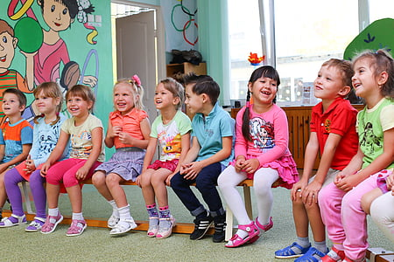
Input content
MY KINDERGARTEN
THANKS TO MY TEACHER
In kindergarten, I learned a lot of knowledge, learned a lot of skills, and made many good friends. I was very, very happy every day.
Input content

Slide 5
Input content
MY KINDERGARTEN
THANKS TO MY TEACHER
In kindergarten, I learned a lot of knowledge, learned a lot of skills, and made many good friends. I was very, very happy every day.
Input content

Slide 6
Input content
Input content
THANKS TO MY TEACHER
In kindergarten, I learned a lot of knowledge, learned a lot of skills, and made many good friends. I was very, very happy every day.
MY KINDERGARTEN

Slide 7
Input content
Input content
THANKS TO MY TEACHER
In kindergarten, I learned a lot of knowledge, learned a lot of skills, and made many good friends. I was very, very happy every day.
MY KINDERGARTEN

Slide 8
Input content
Input content
THANKS TO MY TEACHER
MY KINDERGARTEN

Slide 9
02
Input content
THANKS TO MY TEACHER

Slide 10
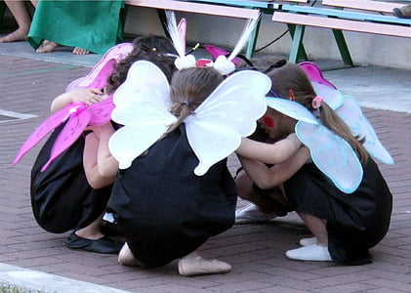
Input content
Input content
THANKS TO MY TEACHER
MY KINDERGARTEN
In kindergarten, I learned a lot of knowledge, learned a lot of skills, and made many good friends. I was very, very happy every day.

Slide 11
Input content
Input content
THANKS TO MY TEACHER
MY KINDERGARTEN
In kindergarten, I learned a lot of knowledge, learned a lot of skills, and made many good friends. I was very, very happy every day.

Slide 12
Input content
Input content
MY KINDERGARTEN
I learned a lot of knowledge, learned a lot of skills, and made many good friends.

Slide 13
Input content
Input content
I learned a lot of knowledge, learned a lot of skills, and made many good friends.
MY KINDERGARTEN

Slide 14
Input content
Input content
MY KINDERGARTEN
Input content
MY KINDERGARTEN
I learned a lot of knowledge, learned a lot of skills, and made many good friends.

Slide 15
03
Input content
THANKS TO MY TEACHER

Slide 16
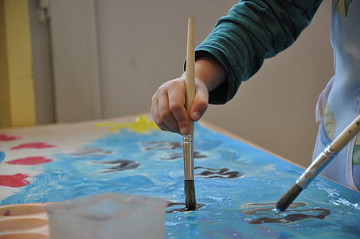
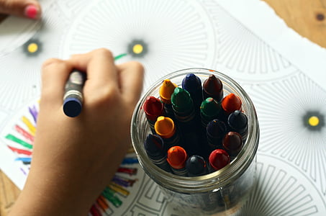
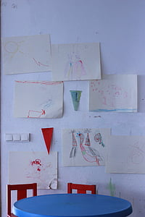
Input content
I learned a lot of knowledge, learned a lot of skills, and made many good friends.
MY KINDERGARTEN
Input content
Input content
MY KINDERGARTEN

Slide 17
Input content
Input content
MY KINDERGARTEN
I learned a lot of knowledge, learned a lot of skills, and made many good friends.
In kindergarten, I learned a lot of knowledge, learned a lot of skills, and made many good friends. I was very, very happy every day.

Slide 18
Input content
Input content
MY KINDERGARTEN
I learned a lot of knowledge, learned a lot of skills, and made many good friends.

Slide 19
Input content
Input content
MY KINDERGARTEN
I learned a lot of knowledge, learned a lot of skills, and made many good friends.

Slide 20
04
Input content
THANKS TO MY TEACHER

Slide 21
Input content
Input content
MY KINDERGARTEN
I learned a lot of knowledge, learned a lot of skills, and made many good friends.

Slide 22
Input content
Input content
MY KINDERGARTEN
I learned a lot of knowledge, learned a lot of skills, and made many good friends.

Slide 23
Input content
Input content
MY KINDERGARTEN

Slide 24
Graduation album
THANKS TO MY TEACHER

Slide 25
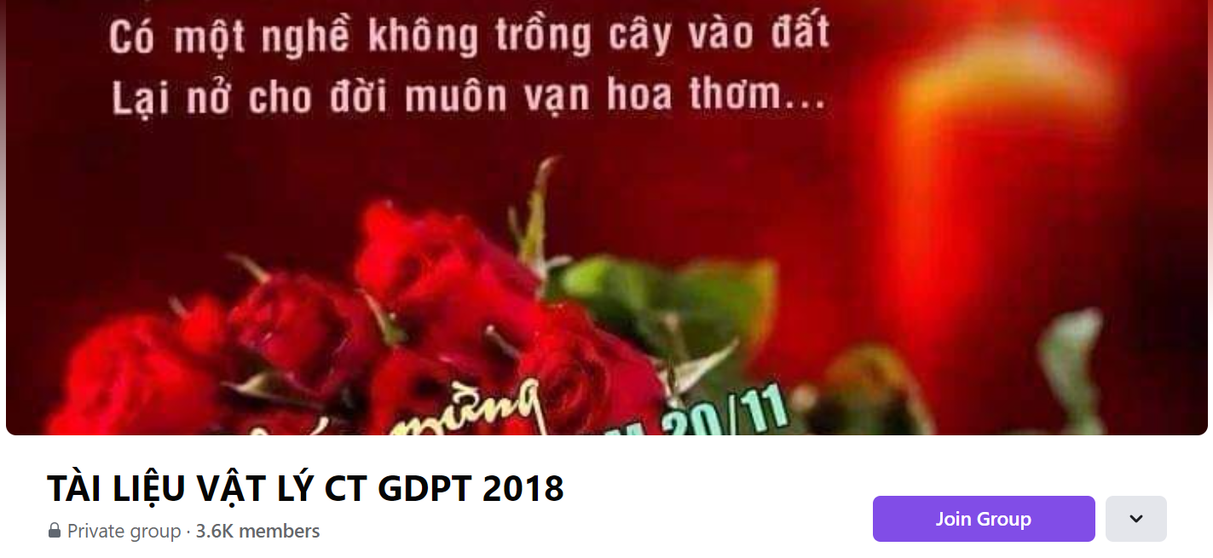
SƯU TẦM: ĐOÀN VĂN DOANH, NAM TRỰC, NAM ĐỊNH
LINK NHÓM DÀNH CHO GV BỘ MÔN VẬT LÝ TRAO ĐỔI TÀI LIỆU VÀ CHUYÊN MÔN CT 2018
https://www.facebook.com/groups/299257004355186

