Slide 1


Slide 2

Unit
7
1
FAMILY LIFE
Unit
VIETNAM AND INTERNATIONAL ORGANISATIONS
LESSON 1
GETTING STARTED
VIETNAM AND INTERNATIONAL ORGANISATIONS

Slide 3

Unit
1
1
FAMILY LIFE
Family Life
Unit
OBJECTIVES
Gain an overview of the topic Viet Nam and international organisations
Identify and use words and phrases related to the topic Viet Nam and international organisations
Identify and use comparative and superlative adjectives.

Slide 4
LESSON 1
GETTING STARTED
Unit
GETTING STARTED
Trivia: Guess the logo
WARM-UP
Vocabulary
PRESENTATION
Task 1: Listen and read.
Task 2:Read the text again and choose the correct answers.
Task 3: Find words in the texts that mean the following.
Task 4: Complete the sentences with the words and phrases from Task 1.
PRACTICE
CONSOLIDATION
Wrap-up
Homework

Slide 5
LESSON 1
GETTING STARTED
Unit
WARM-UP
Trivia: Guess the logo

Slide 6

GUESS THE LOGO!
Hint: “LHQ”
The United Nations

Slide 7

GUESS THE LOGO!
Hint: children
United Nations
Children’s Fund

Slide 8

GUESS THE LOGO!
Hint: development
United Nations
Development
Programme

Slide 9

GUESS THE LOGO!
Hint: buy and sell
World Trade Organization

Slide 10
LESSON 1
GETTING STARTED
Unit
GETTING STARTED
Trivia: Guess the logo
WARM-UP
Vocabulary
PRESENTATION

Slide 11
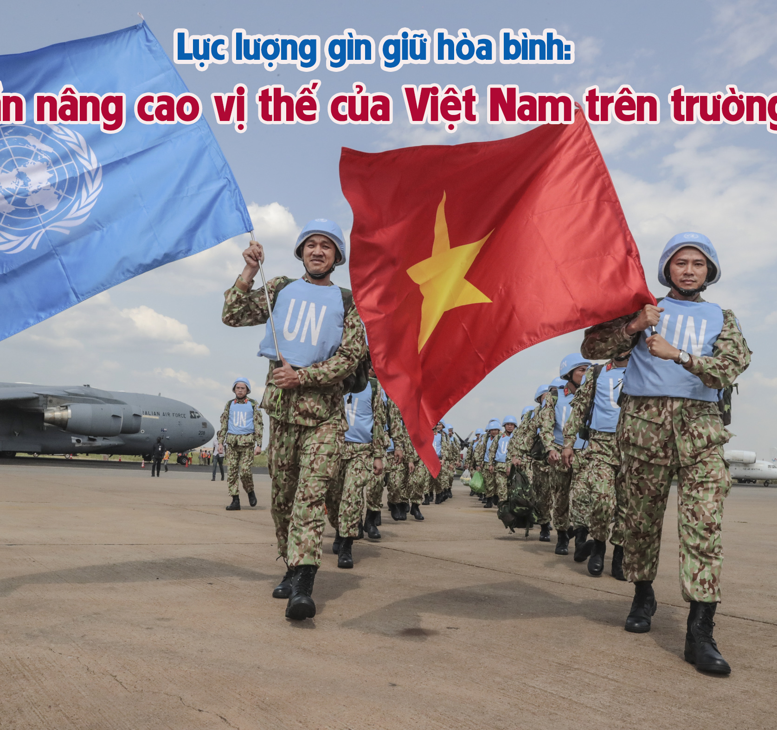

PRESENTATION
peacekeeping (adj)
/ˈpiːskiːpɪŋ/
intended to help stop people fighting and prevent war or violence in a place where this is likely

Slide 12
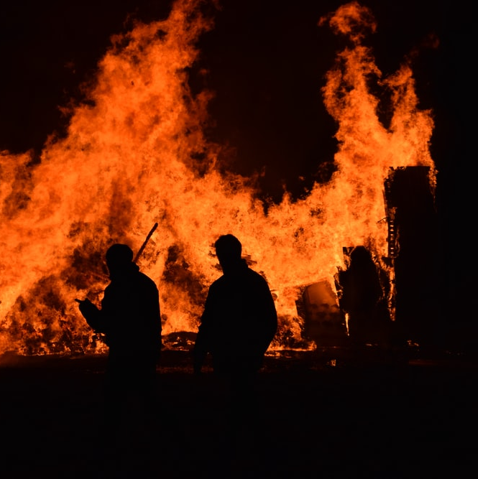
PRESENTATION
harm (n)
/hɑː(r)m/
damage or injury that is caused by a person or an event

Slide 13

PRESENTATION
expert (adj)
/ˈekspɜːrt/
having or involving great knowledge or skill

Slide 14
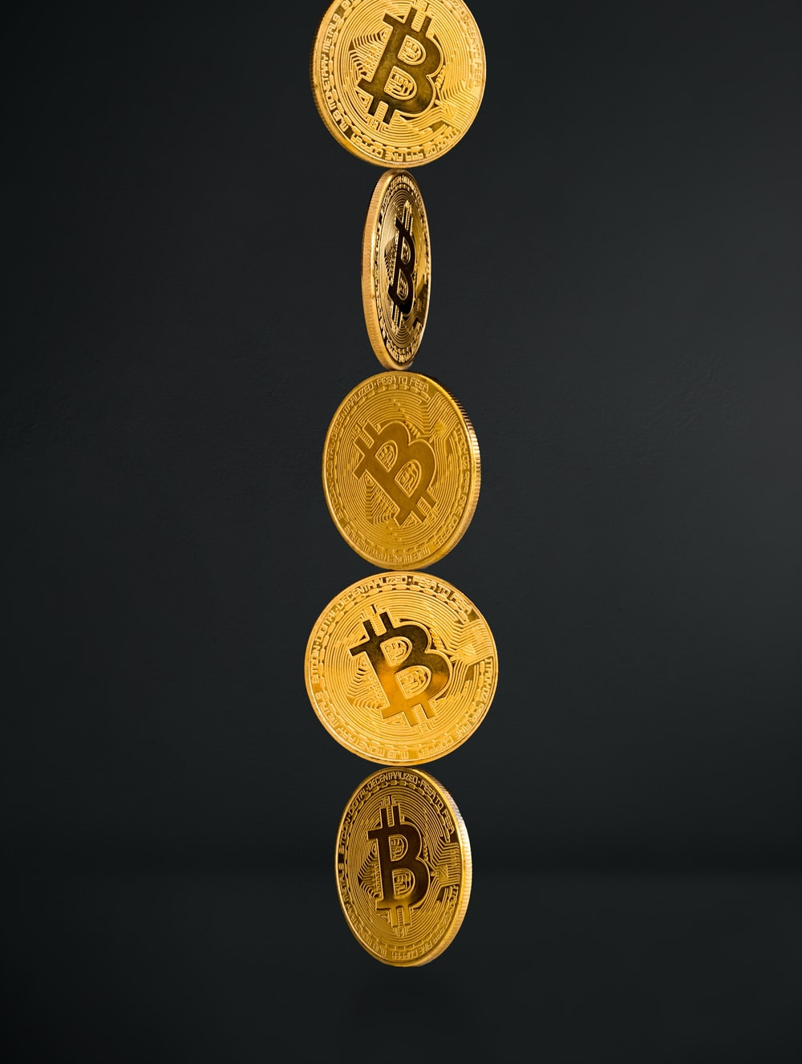
PRESENTATION
investor (n)
/ɪnˈvestə(r)/
a person or an organization that invests money in something

Slide 15
PRESENTATION
Form | Pronunciation | Meaning
1. peacekeeping (adj) | /ˈpiːskiːpɪŋ/ | helping stop people fighting
2. harm (n) | /hɑː(r)m/ | damage or injury
3. expert (adj) | /ˈekspɜːrt/ | having great knowledge
4. investor (n) | /ɪnˈvestə(r)/ | people or organisations that invest money

Slide 16
LESSON 1
GETTING STARTED
Unit
GETTING STARTED
Trivia: Guess the logo
WARM-UP
Vocabulary
PRESENTATION
Task 1: Listen and read.
Task 2:Read the text again and choose the correct answers.
Task 3: Find words in the texts that mean the following.
Task 4: Complete the sentences with the words and phrases from Task 1.
PRACTICE

Slide 17
PRACTICE
1
Listen and read.
Do You Know…?
A. The United Nations (UN) was created in 1945. It is an organisation of most of the world’s countries. Its main goal is world peace. It also works to reduce poverty and improve people’s lives in other ways. Viet Nam joined the organisation in 1977. Since then, our country has become more active and has participated in many UN activities including peacekeeping.
B. UNICEF was formed in 1946. It works in over 190 countries to help improve health and education of children. It particularly aims to support the most disadvantaged children all over the world. UNICEF’s aim in VietNam is to protect children and make sure they are healthy, educated and safe from harm.

Slide 18
PRACTICE
1
Listen and read.
Do You Know…?
C. UNDP was formed in 1965 as part of the UN. It provides technical support, expert advice and training to help people in developing countries have a better life. In Viet Nam, UNDP works closely with the government to reduce poverty and improve people’s lives.
D. The WTO was formed in 1995. It is the world’s largest international economic organisation. VietNam became a WTO member in 2007. Since then, our economy has achieved a high growth level. Viet Nam has also become more attractive to foreign investors.

Slide 19
PRACTICE
PRACTICE
2
Read the text again and choose the correct answers.
1. Which organisation was formed in 1945?
A. The UN B. UNICEF C. The WTO
2. Which organisation aims to help improve children’s health and education?
A. UNDP B. UNICEF C. The WTO
3. Which of the following is the largest international economic organisation?
A. The UN B. UNDP C. The WTO

Slide 20
PRACTICE
PRACTICE
2
Read the text again and choose the correct answers.
1. Which organisation was formed in 1945?
A. The UN B. UNICEF C. The WTO
2. Which organisation aims to help improve children’s health and education?
A. UNDP B. UNICEF C. The WTO
3. Which of the following is the largest international economic organisation?
A. The UN B. UNDP C. The WTO

Slide 21
PRACTICE
3
Find words in the texts (A, B, C, or D) that mean the following.
Words | Meanings
 | helping people stop fighting (A)
 | damage or injury (B)
 | having great knowledge (C)
 | people or organisations that invest money (D)

Slide 22
PRACTICE
3
Find words in the texts (A, B, C, or D) that mean the following.
Words | Meanings
peacekeeping | helping people stop fighting (A)
harm | damage or injury (B)
expert | having great knowledge (C)
investors | people or organisations that invest money (D)

Slide 23
PRACTICE
4
Complete the sentences with the words and phrases from Task 1.
1. Since joining the UN, Viet Nam has become __________ and has participated in many UN activities including peacekeeping.
2. UNICEF particularly aims to support ___________ children all over the world.
3. UNDP helps people in developing countries have a __________ life.
4. The WTO is the world's __________ international economic organisation.
5. Viet Nam has also become _________ to foreign investors.

Slide 24
PRACTICE
4
Complete the sentences with the words and phrases from Task 1.
1. Since joining the UN, Viet Nam has become more active and has participated in many UN activities including peacekeeping.
2. UNICEF particularly aims to support the most disadvantaged children all over the world.
3. UNDP helps people in developing countries have a better life.
4. The WTO is the world's largest international economic organisation.
5. Viet Nam has also become more attractive to foreign investors.

Slide 25
LESSON 1
GETTING STARTED
Unit
GETTING STARTED
Trivia: Guess the logo
WARM-UP
Vocabulary
PRESENTATION
Task 1: Listen and read.
Task 2:Read the text again and choose the correct answers.
Task 3: Find words in the texts that mean the following.
Task 4: Complete the sentences with the words and phrases from Task 1.
PRACTICE
CONSOLIDATION
Wrap-up
Homework

Slide 26
CONSOLIDATION
1
Wrap-up
Some words and phrases related to International Organisations
Reading for specific information
Scanning skills

Slide 27
CONSOLIDATION
2
Homework
Do exercises in the workbook
Project preparation

Slide 28


