Slide 2

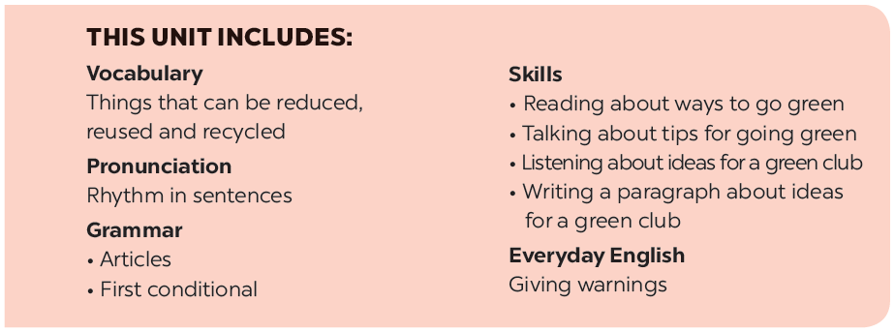

Slide 3






Everyday English
A survey on ways to go green
Giving warnings
Listen and read the dialogue between Mi and Mike. Pay attention to the highlighted sentences.
The 3Rs Club in your school is doing a survey. Answer the following questions by choosing A, B, or C.
Work in pairs. Student A is watering ﬂowers in the garden. Student B is giving some warnings. Act out the dialogue. Remember to use the highlighted language in 1.
Interview a classmate, using the questions in 3. Compare your answers. How many different answers do you have?

Slide 4
Everyday English
Giving warnings

Slide 5



Listen and read the dialogue between Mi and Mike. Pay attention to the highlighted sentences.
Mi: You are giving the goldfish too much food.
Don’t do that.
Mike: Why?
Mi: If you give them too much food, they will die.
Mike: I see. Thank you.

Slide 6

Work in pairs. Student A is watering ﬂowers in the garden. Student B is giving some warnings. Act out the dialogue. Remember to use the highlighted language in 1.

Slide 7
A survey on ways to go green

Slide 8


The 3Rs Club in your school is doing a survey. Answer the following questions by choosing A, B, or C.

Slide 9

1.
John, you are late. The match _______ ten minutes ago.
A.
throw it away
B.
decorate it
C.
use it to keep pencils in
2.
If you have a sheet of paper, how often will you write on both sides?
A.
Sometime.
B.
Never.
C.
Always.
3.
If you bring your lunch to school, you will ______.
A.
wrap the food in paper
B.
put the food in a reusable box
C.
wrap the food in a plastic bag

Slide 10
4.
If you have old clothes, how often will you give them to those in need?
A.
Sometime.
B.
Never.
C.
Always.
5.
If it’s hot in your room, you will _______.
A.
open the fridge and stand in front of it
B.
go outside and enjoy the breeze
C.
turn on both the fan and the air-conditioner.
6.
If your school is one kilometre from your home, you will _____.
A.
walk
B.
ask your parent to drive you
C.
cycle

Slide 11
Check your answers with the key on page 57, count the points and see how green you are.

Slide 12

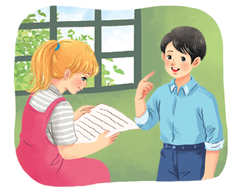
Interview a classmate, using the questions in 3. Compare your answers. How many different answers do you have?
Example:
A: What’s your answer to Question 1?
B: It’s A. What’s your answer?
...
Notes:
City landmarks phải ở trên mục 3

Slide 13






Website: hoclieu.vn
Fanpage: facebook.com/www.tienganhglobalsuccess.vn/

