Slide 1


Slide 2

1
Unit
FAMILY LIFE
REVIEW 4
LESSON 2
SKILLS

Slide 3

Unit
1
1
FAMILY LIFE
Family Life
Unit
OBJECTIVES
Practise listening for general and specific information about a day trip ;
Practise talking about the plan of a day trip.

Slide 4
LESSON 2
SKILLS: LISTENING AND SPEAKING
WARM-UP
Video watching: Travel plans
LISTENING
Task 1: Choose the best title for the talk.
Task 2: Complete the notes
SPEAKING
Discuss and plan your imaginary day trip.
CONSOLIDATION
Wrap-up
Homework

Slide 5
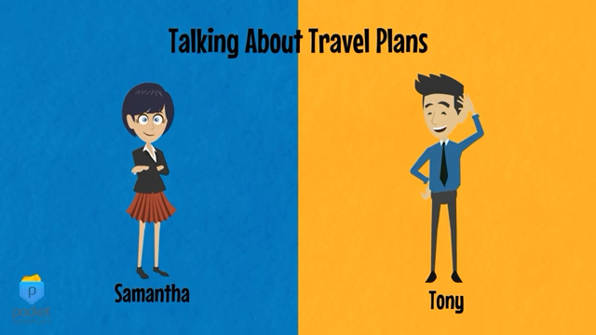
VIDEO WATCHING
Notes:
https://www.youtube.com/watch?v=ePtKgkMVtOc

Slide 6
LESSON 2
SKILLS: LISTENING AND SPEAKING
WARM-UP
Video watching: Travel plans
LISTENING
Task 1: Choose the best title for the talk.
Task 2: Complete the notes

Slide 7

LISTENING
1
Listen and choose the best title for the talk.
A. Information about a day trip
B. What we should do during a trip
C. Reviews of a day trip

Slide 8
LISTENING
2
Listen again and complete the notes with no more than TWO words.
Day trip
Time to leave: 8.30 a.m.
Trip will take: (1) _________ hours
Activities:
- Visiting an ancient (2) _________ built 600 years ago
- Having lunch with a(n) (3) ___________ and enjoying local food
- Seeing the oldest and biggest (4) _________ in the country
Do not:
drop (5) _________ or pick flowers on the roadside
8
house
local family
pagoda
litter

Slide 9
LESSON 2
SKILLS: LISTENING AND SPEAKING
WARM-UP
Video watching: Travel plans
LISTENING
Task 1: Choose the best title for the talk.
Task 2: Complete the notes
SPEAKING
Discuss and plan your imaginary day trip.

Slide 10
SPEAKING
1
Imagine that you are going on a day trip. Work in pairs. Discuss and plan your trip. Use the following points to help you.
- Where you will go
- When you will leave
- Which attractions you will visit
- Things you should avoid doing on the trip to protect the environment

Slide 11
LESSON 2
SKILLS: LISTENING AND SPEAKING
WARM-UP
Video watching: Travel plans
LISTENING
Task 1: Choose the best title for the talk.
Task 2: Complete the notes
SPEAKING
Discuss and plan your imaginary day trip.
CONSOLIDATION
Wrap-up
Homework

Slide 12
CONSOLIDATION
1
Wrap-up
Practise listening for general and specific information about a day trip;
Practise talking about the plan of a day trip.

Slide 13
CONSOLIDATION
2
Homework
Prepare for Review 4 – Skills: Reading and Writing.
Do exercise in the workbook.

Slide 14

Website: hoclieu.vn
Fanpage: facebook.com/www.tienganhglobalsuccess.vn

