Slide 1


Slide 2
Unit
8
BECOMING INDEPENDENT
Unit
FAMILY LIFE
LESSON 2
LANGUAGE

Slide 3
LESSON 2
LANGUAGE
WARM-UP
Watch a video
Task 1: Listen and repeat.
Task 2: Read the sentences out loud. Listen and check.
PRONUNCIATION
Task 1: Match each word with its meaning
Task 2: Complete the sentences using the correct forms of the words
VOCABULARY
Task 1: Rewrite the sentences.
Task 2. Ask and answer questions
GRAMMAR
Wrap-up
Homework
CONSOLIDATION

Slide 4
WARM-UP
WATCH A VIDEO
Work in 4 groups.
Watch the video and list out what to do to become independent.
Stick the paper on the boards.
The group with the most correct answers is the winner.

Slide 5
WARM-UP
WATCH A VIDEO

Slide 6
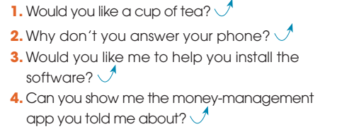
PRONUNCIATION
1
Listen and repeat. Pay attention to the fall-rise intonation in the following sentences.

Slide 7
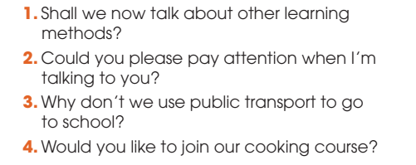
PRONUNCIATION
2
Listen and pay attention to the fall-rise intonation in the following sentences. Then practice saying them in pairs.

Slide 8
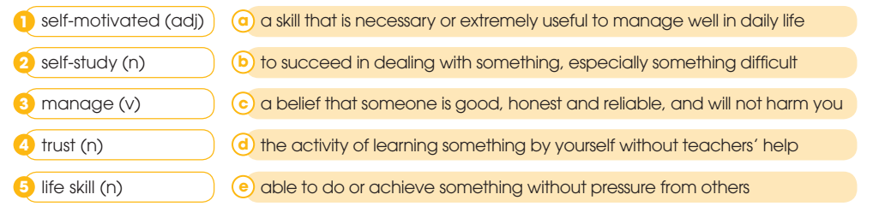
VOCABULARY
1
Match the words with their meanings.
1E 2D 3B 4C 5A

Slide 9
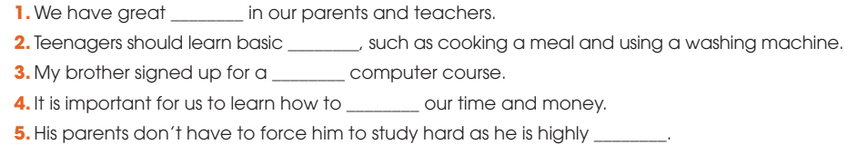
VOCABULARY
2
Complete the sentences using the correct forms of the words in 1.
1 trust 2 life skills 3 self-study 4 manage 5 self-motivated

Slide 10
GRAMMAR
CLEFT SENTENCE
- A cleft sentence is used to focus on a particular part of the sentence and to emphasize what we want to say.
It is/was + S/O/A + that/who ….
Eg:
It was Nam that/who taught Mai how to use the app in the library last weekend. (Focus on Nam - S)
It was the app that Nam taught Mai how to use in the library last weekend. (Focus on the app - O)
It was in the library that Nam taught Mai how to use the app last weekend. (Focus on Nam - A)

Slide 11
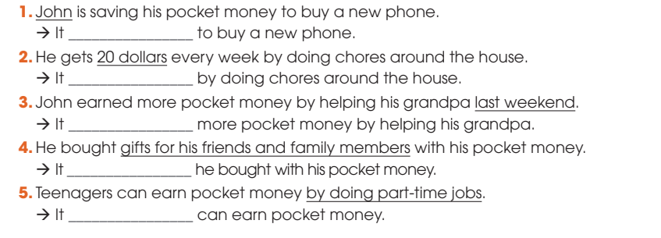
GRAMMAR
1
Rewrite the sentences using cleft sentences focusing on the underlined parts.
1. is John who is saving his pocket money
2. is 20 dollars that he gets every week by
3. was last weekend that John earned
4. was gifts for friends and family members that
5. is by taking part-time jobs that teenagers

Slide 12
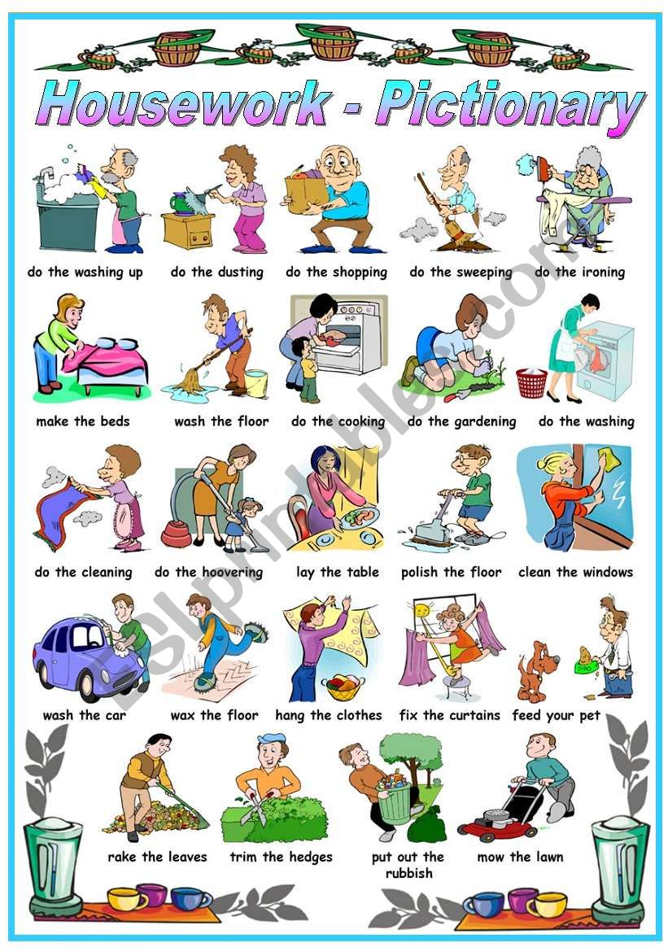
GRAMMAR
2
Ask and answer questions about the chores you and your family members do at home. Use cleft sentences.

Slide 13
CONSOLIDATION
1
Wrap-up
What have you learnt today?
Some lexical items about becoming independent
The fall-rise intonation in a sentence
Cleft sentence

Slide 14
CONSOLIDATION
2
Homework
Do exercises in the workbook.
Prepare for Lesson 3 - Unit 8.

Slide 15

Website: hoclieu.vn
Fanpage: facebook.com/sachmem.vn/

