Slide 1
KET SPEAKING
Time allowed - 8-10 minutes
Normally you will do the speaking test with another candidate. The two of you will meet two examiners. One of the examiners will talk to you, the other does not participate in the conversations.
There are two parts to the speaking test:
Speaking part 1: short questions and answers between you and the examiner.
Speaking part 2: the examiner gives you some information or a card with some ideas for questions. You have to talk with the other candidate and ask or answer questions.
Scoring The Speaking section is worth 25% of the total score for the exam.
How to prepare for KET Speaking:
Speak as much as you can, with your friends
Practise asking and answering questions about daily life
Practise giving information about yourself

Slide 2
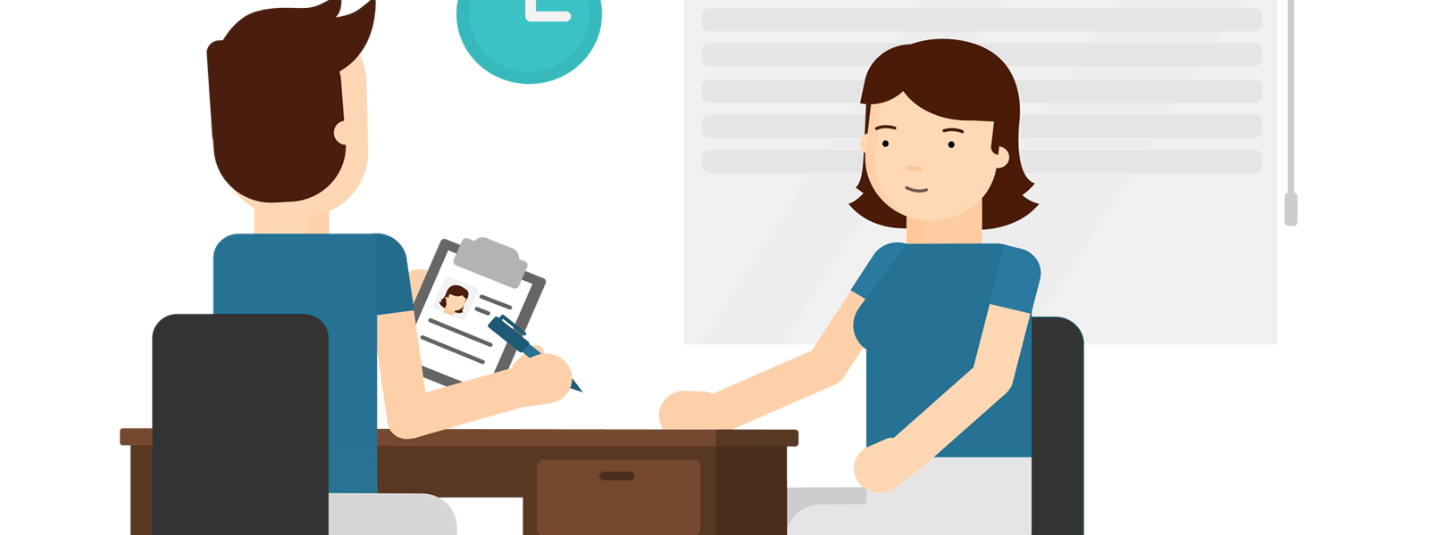
KEY ENGLISH TEST 4
Test 2 - Speaking

Slide 3
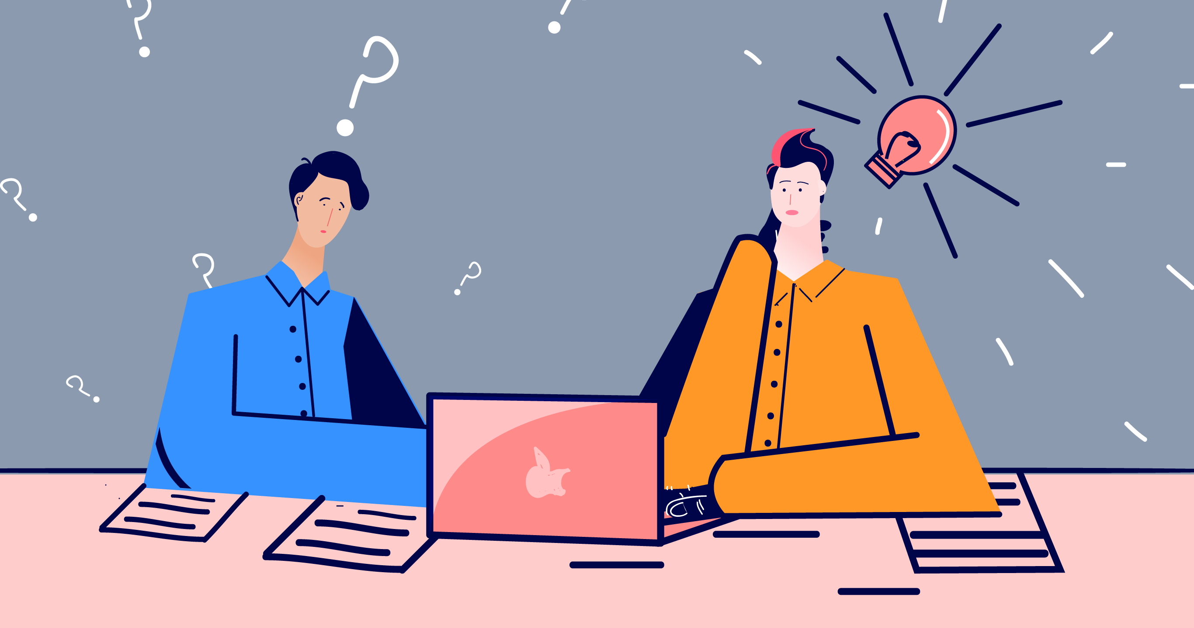
Part 1: Student – examiner interaction
Section 1:
The examiner will ask you:
Your name
Where you come from?
Provide full-sentence answers

Slide 4
Part 1: Student – examiner interaction
Section 2: You will be asked some questions that require longer answers. For example:
Why you like something
Details about a hobby…

Slide 5
Popular topic
family
best friend
hometown
your house
sport
computer
collecting
music

Slide 6
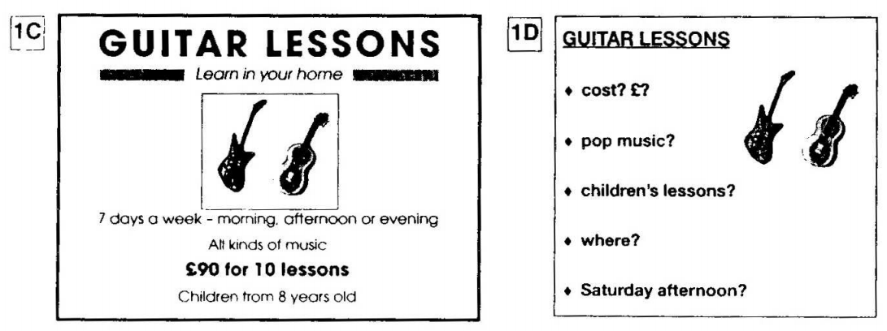
PART 2: Student – student interaction
Ask and answer questions based on the cue cards
For example:
Do not just read from the cards. Answer in full sentences.
Pay attention to the grammar.

Slide 7
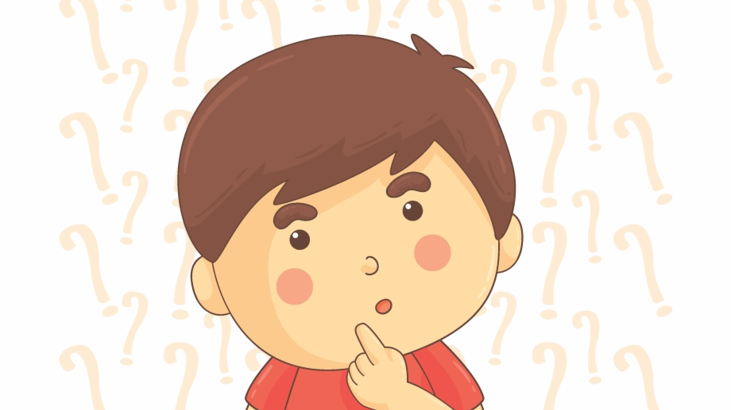
SPEAKING PART 1

Slide 8
Part 1
Do you like shopping?
Where do you usually shop?
What are your favourite shops?
What do you usually buy?
Do you buy designer clothes? Why/Why not?
Where do you go to get the latest fashions?
Are you a fashion victim? Why/Why not?
When did you last go shopping? What did you buy?

Slide 9
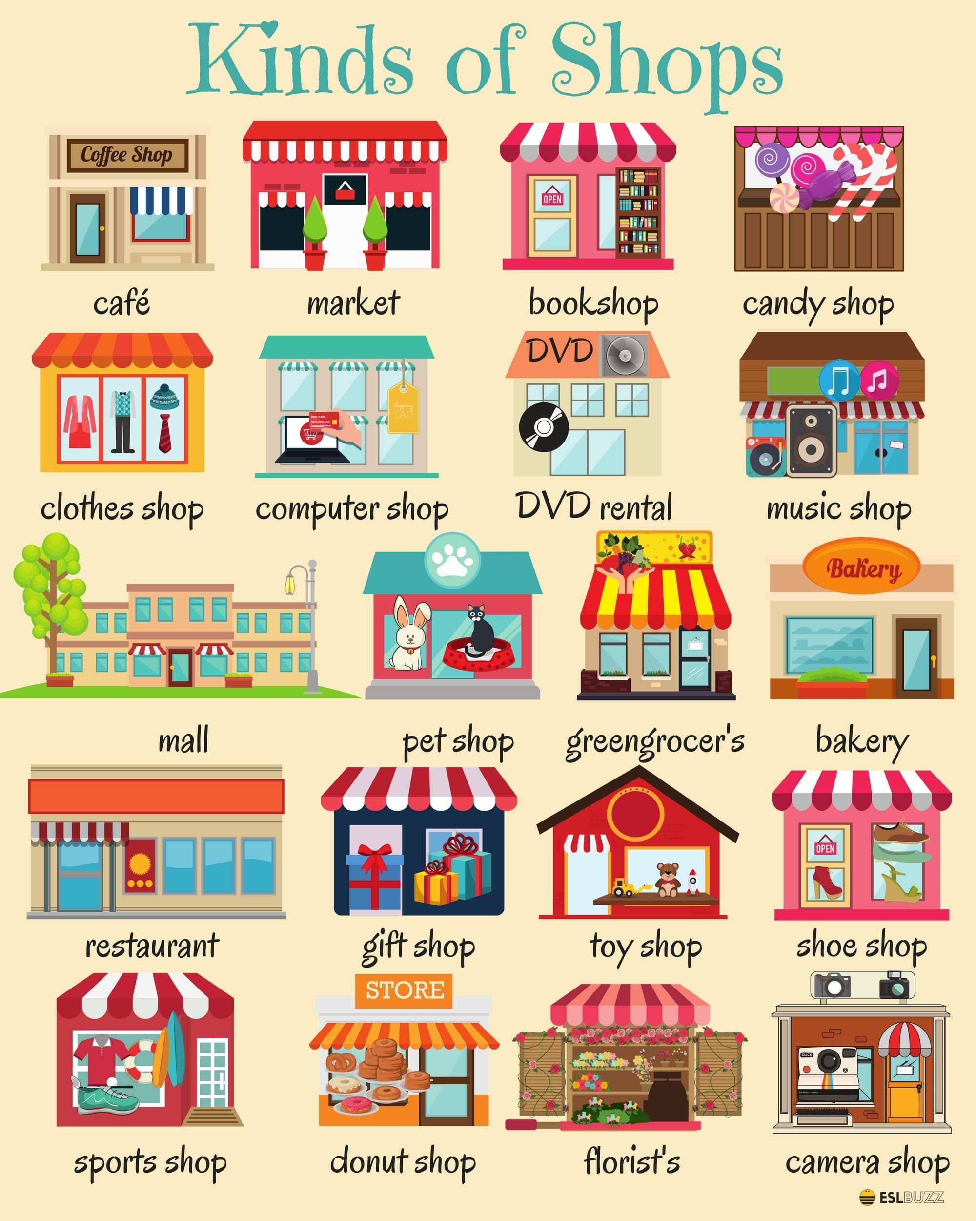

Slide 10
USEFUL VOCABULARY
big brand names: large well-known companies or product names
to be careful with money: to not over-spend
high street names: well-known shops
must-have product: a product that is very popular that a lot of people want to have
to be on a tight budget: to have a limited amount of money to spend
to pick up a bargain: to buy something much cheaper than the normal price
shop assistant: the person who serves customers
to be value for money: to be worth the cost
window shopping: to visit a store to look at items without the intention of buying anything

Slide 11
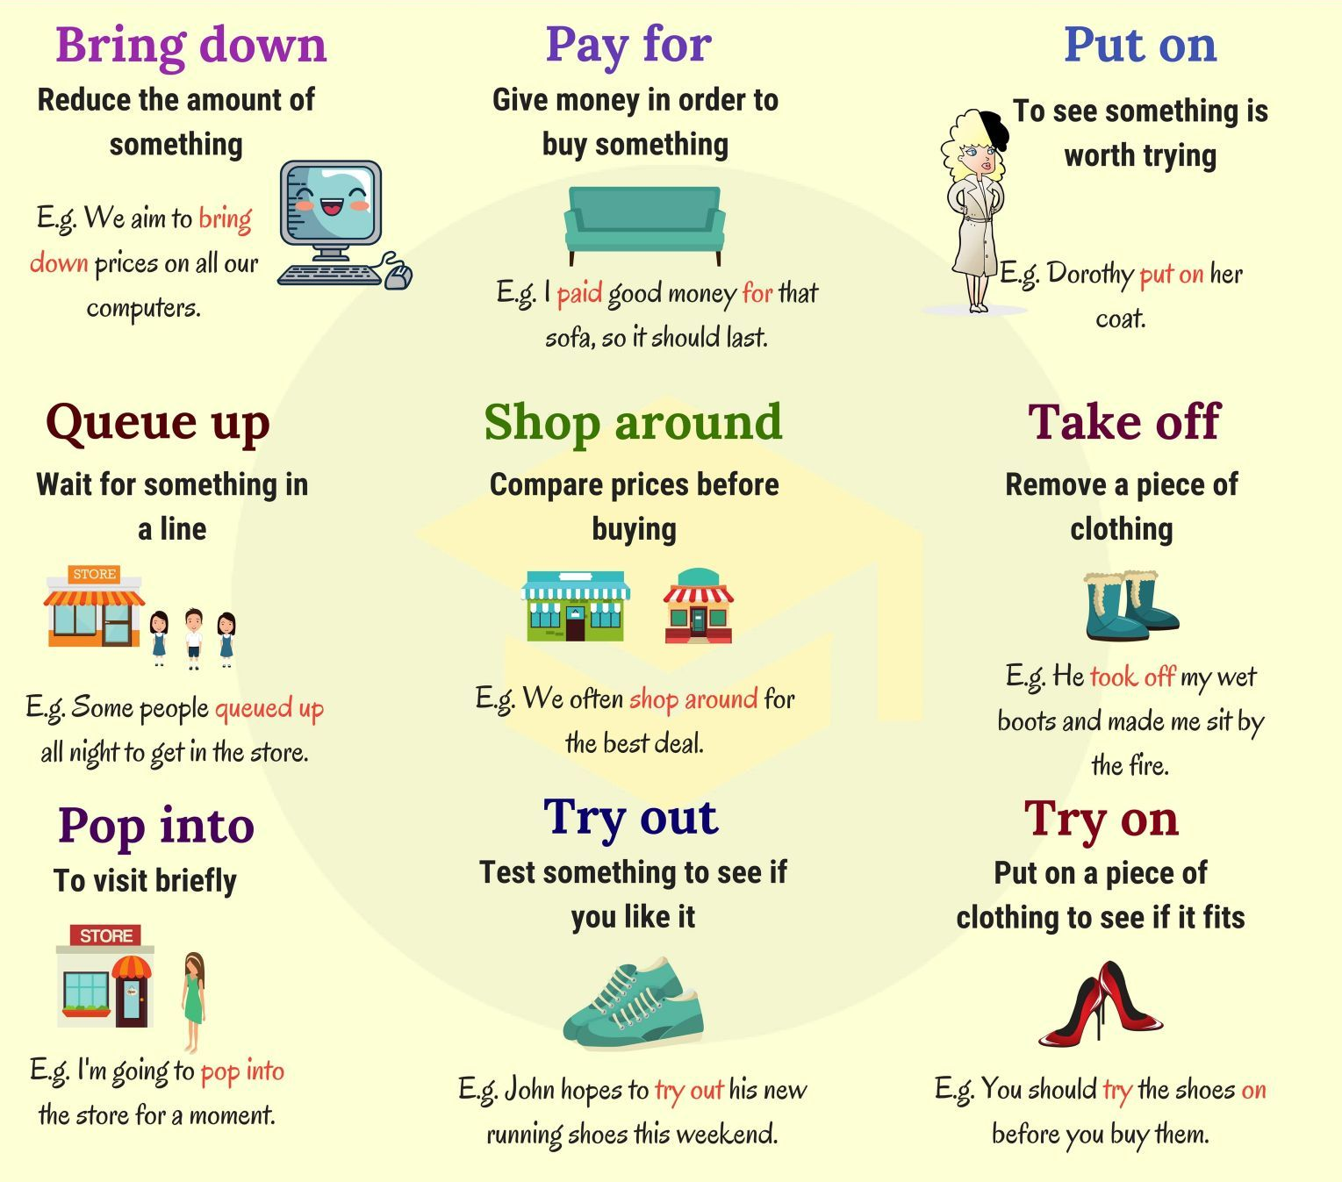
Phrasal verbs for shopping

Slide 12
fashion victim
a person who follows popular trends in dress and behavior slavishly

Slide 13
Talk about an expensive thing you bought recently
What it was
Why you bought it
How do you use it
And explain your feelings after the purchase

Slide 14
SPEAKING PART 2
Asking and answering questions using these prompt cards

Slide 15
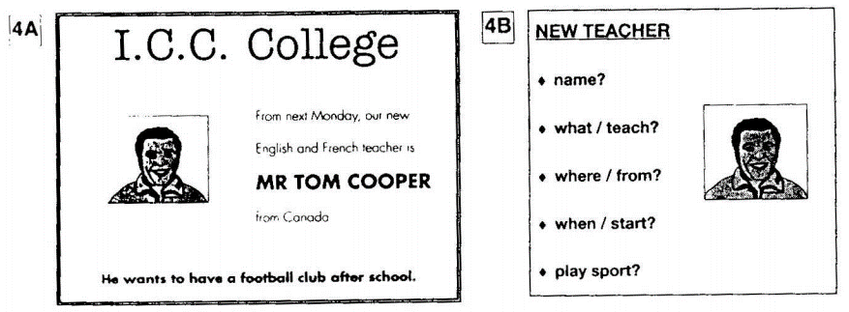
Ask and answer
Ask and answer questions using the words given.

Slide 16
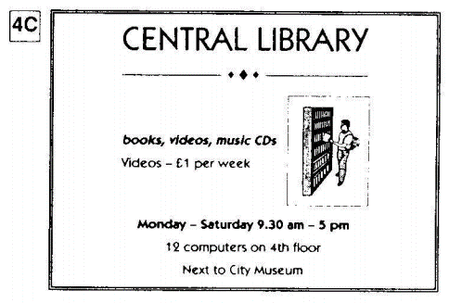
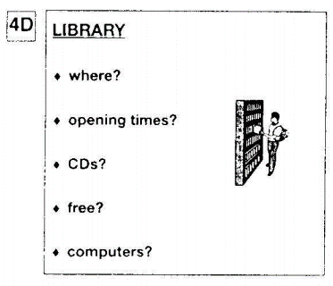
Ask and answer
Ask and answer questions using the words given.
What are other questions and answers you can think of?

Slide 17
Based on the given information, talk about the Central library.

