Slide 1
KET SPEAKING
Time allowed - 8-10 minutes
Normally you will do the speaking test with another candidate. The two of you will meet two examiners. One of the examiners will talk to you, the other does not participate in the conversations.
There are two parts to the speaking test:
Speaking part 1: short questions and answers between you and the examiner.
Speaking part 2: the examiner gives you some information or a card with some ideas for questions. You have to talk with the other candidate and ask or answer questions.
Scoring
The Speaking section is worth 25% of the total score for the exam.
How to prepare for KET Speaking:
Speak as much as you can, with your friends
Practise asking and answering questions about daily life
Practise giving information about yourself

Slide 2
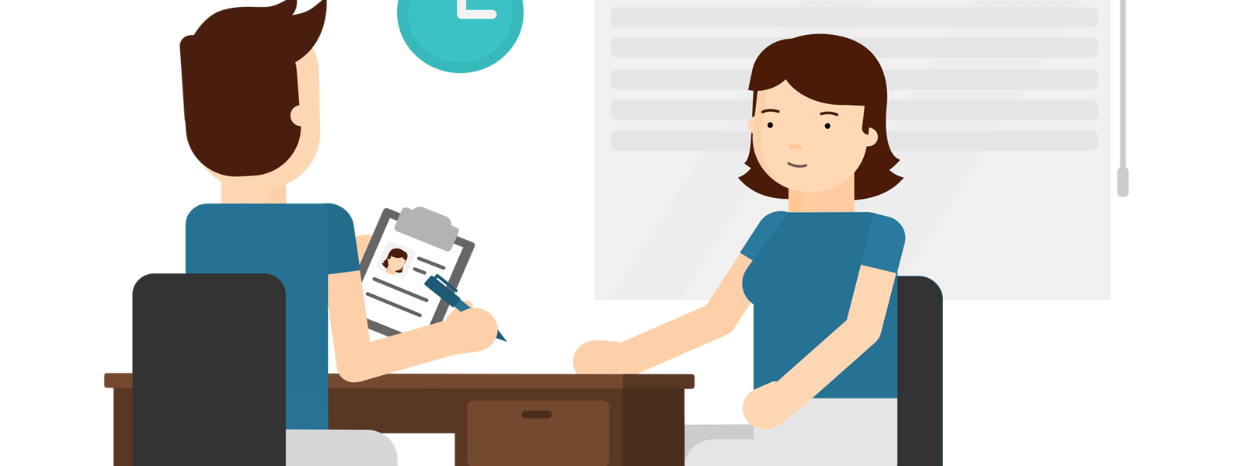
KEY ENGLISH TEST 4
Test 2 - Speaking

Slide 3

Part 1:
Student – examiner interaction
Section 1:
The examiner will ask you:
Your name
Where you come from?
Provide full-sentence answers

Slide 4

Part 1:
Student – examiner interaction
Section 2: You will be asked some questions that require longer answers. For example:
Why you like something
Details about a hobby…

Slide 5
Popular topic
family
best friend
hometown
your house
sport
computer
collecting
music

Slide 6
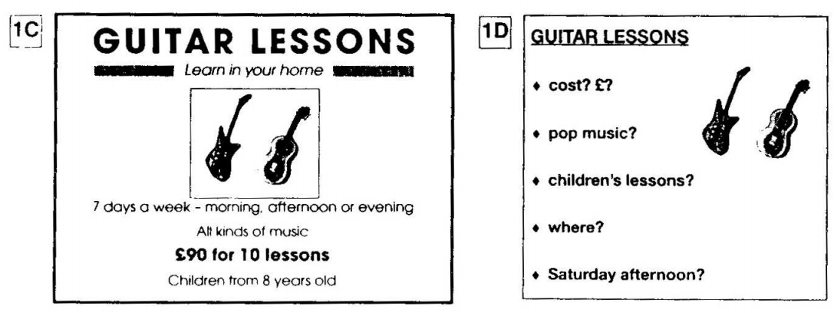
PART 2:
Student – student interaction
Ask and answer questions based on the cue cards
For example:
Do not just read from the cards. Answer in full sentences.
Pay attention to the grammar.

Slide 7

SPEAKING
PART 1

Slide 8
Part 1
How is your health?
01
What health problems do you worry about the most?
02
What do you do to keep fit and healthy?
03
How often do you have a medical checkup?
04
What diseases kill the most people worldwide?
05

Slide 9
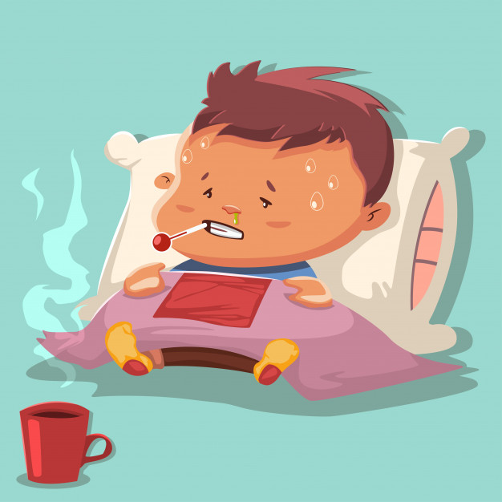
How to say you are ill
I'm ill.
I feel really rough.
I'm shattered (meaning tired out or exhausted)
I'm on my last legs (to be very tired, especially after a lot of physical activity or work).
I feel / look poorly / peaky / rough / bloody awful.
I feel / look like death warmed up.

Slide 10
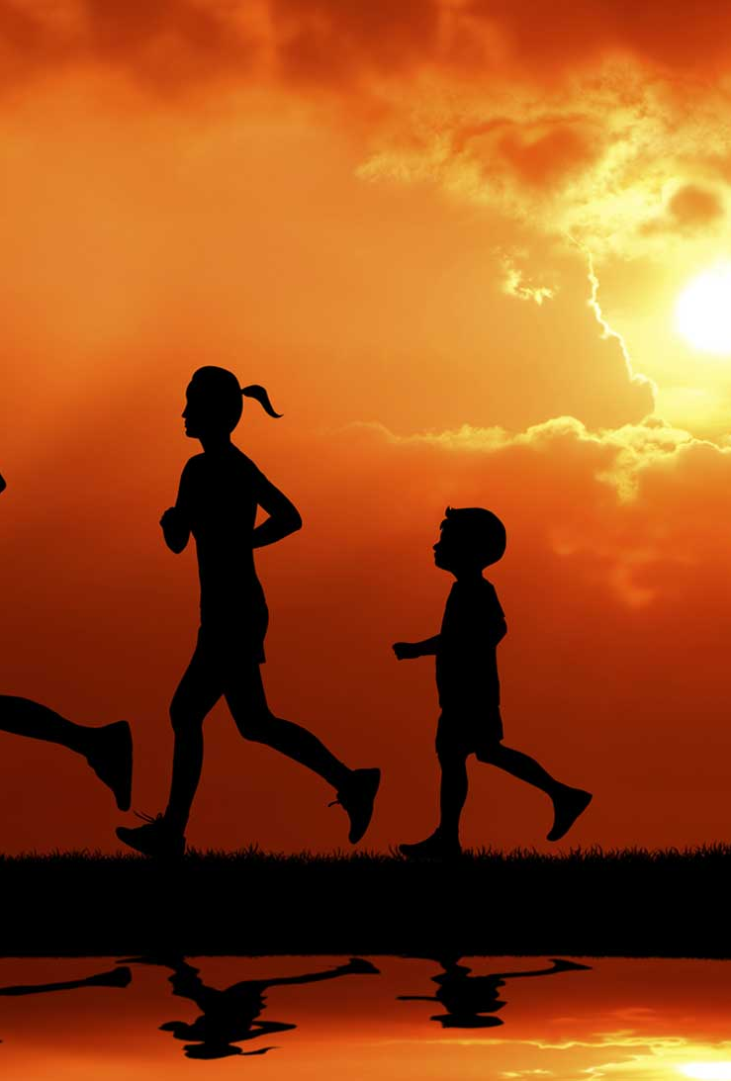
How to say you are feeling OK
I am alive and kicking (to continue to be well, healthy or successful)
I feel good (used to talk about emotional state)
I feel great / well
He is a picture of (good) health (to be in a very healthy condition)
She is hale and hearty (to be in a good health)

Slide 11
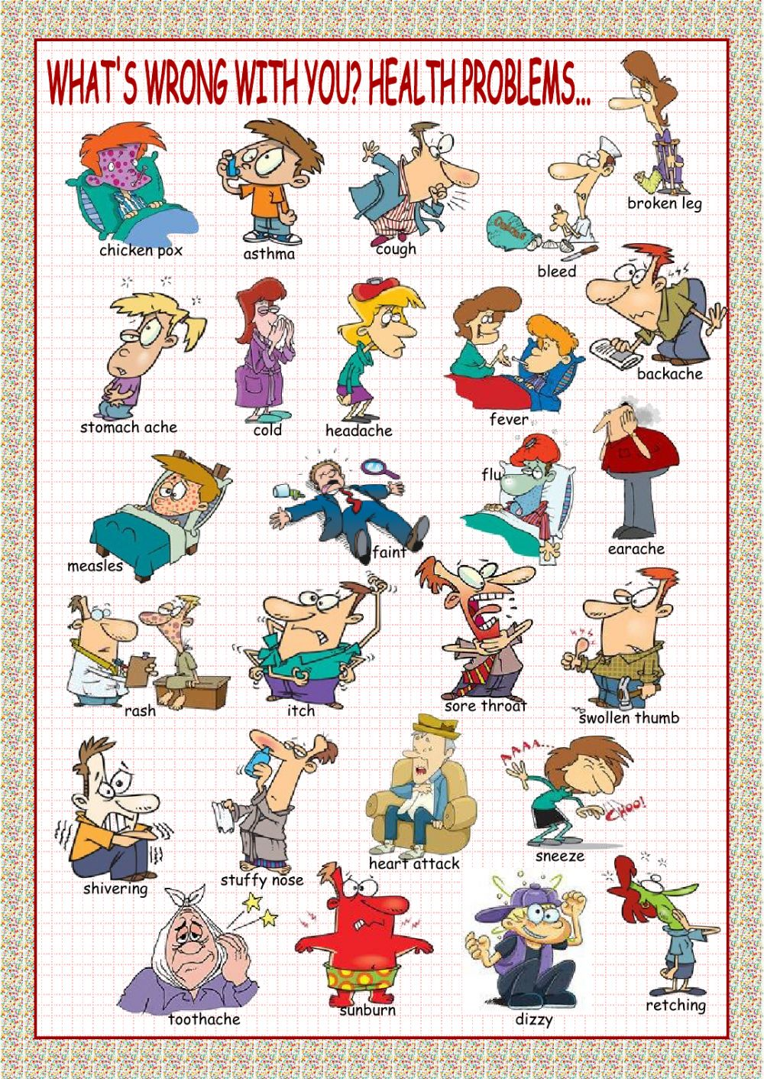

Slide 12
Health problems
I have a headache / toothache / backache / stomachache / earache...
I have a pain in my back / tooth / head...
I have a broken / sprained / twist an ankle / wrist.
I have a flu / cold / runny nose / fever / high temperature / sore throat
I feel sick. I'm feeling nauseous.
I have a bruise / cut / graze / wound.

Slide 13

keep fit
the activity of keeping your body in good condition by doing special exercises

Slide 14
What do you do to stay healthy?
Exercise regularly.
Eat healthy food.
Brush your teeth regularly.
Sleep early (= don't stay up late!)
Have regular medical check up.
Relax.
Go on a diet.

Slide 15

Talk about a good exercise for health
what is it
how it is done
when you first tried it
what kind of people it is suitable for
explain why you think it is a good exercise

Slide 16
SPEAKING PART 2
Asking and answering questions using these prompt cards

Slide 17
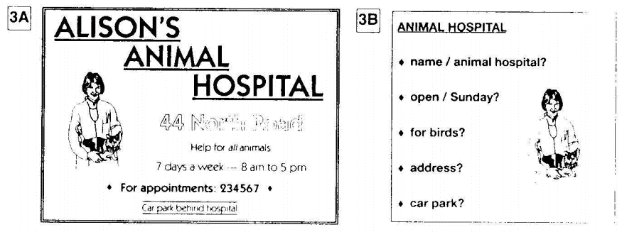
Ask and answer
Ask and answer questions using the words given.

Slide 18

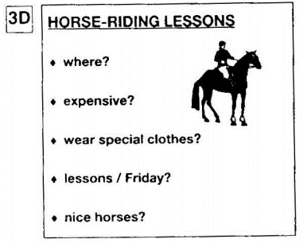
Ask and answer
Ask and answer questions using the words given.
What are other questions and answers you can think of?

Slide 19


Based on the given information, talk about the Horse-riding lessons.

