Slide 1

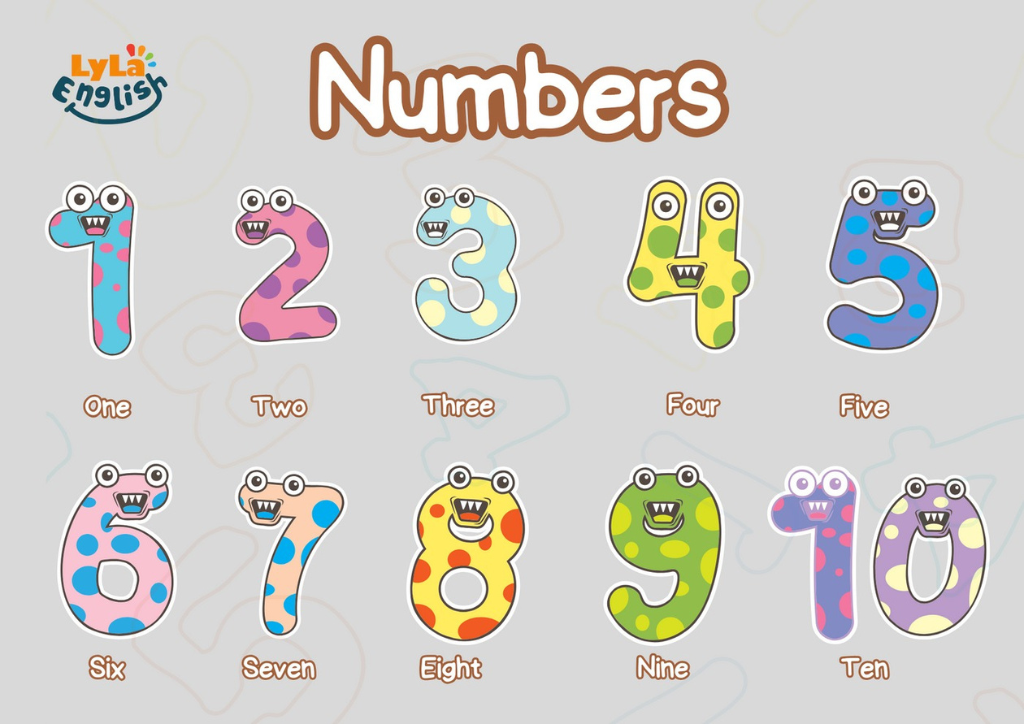


Slide 2
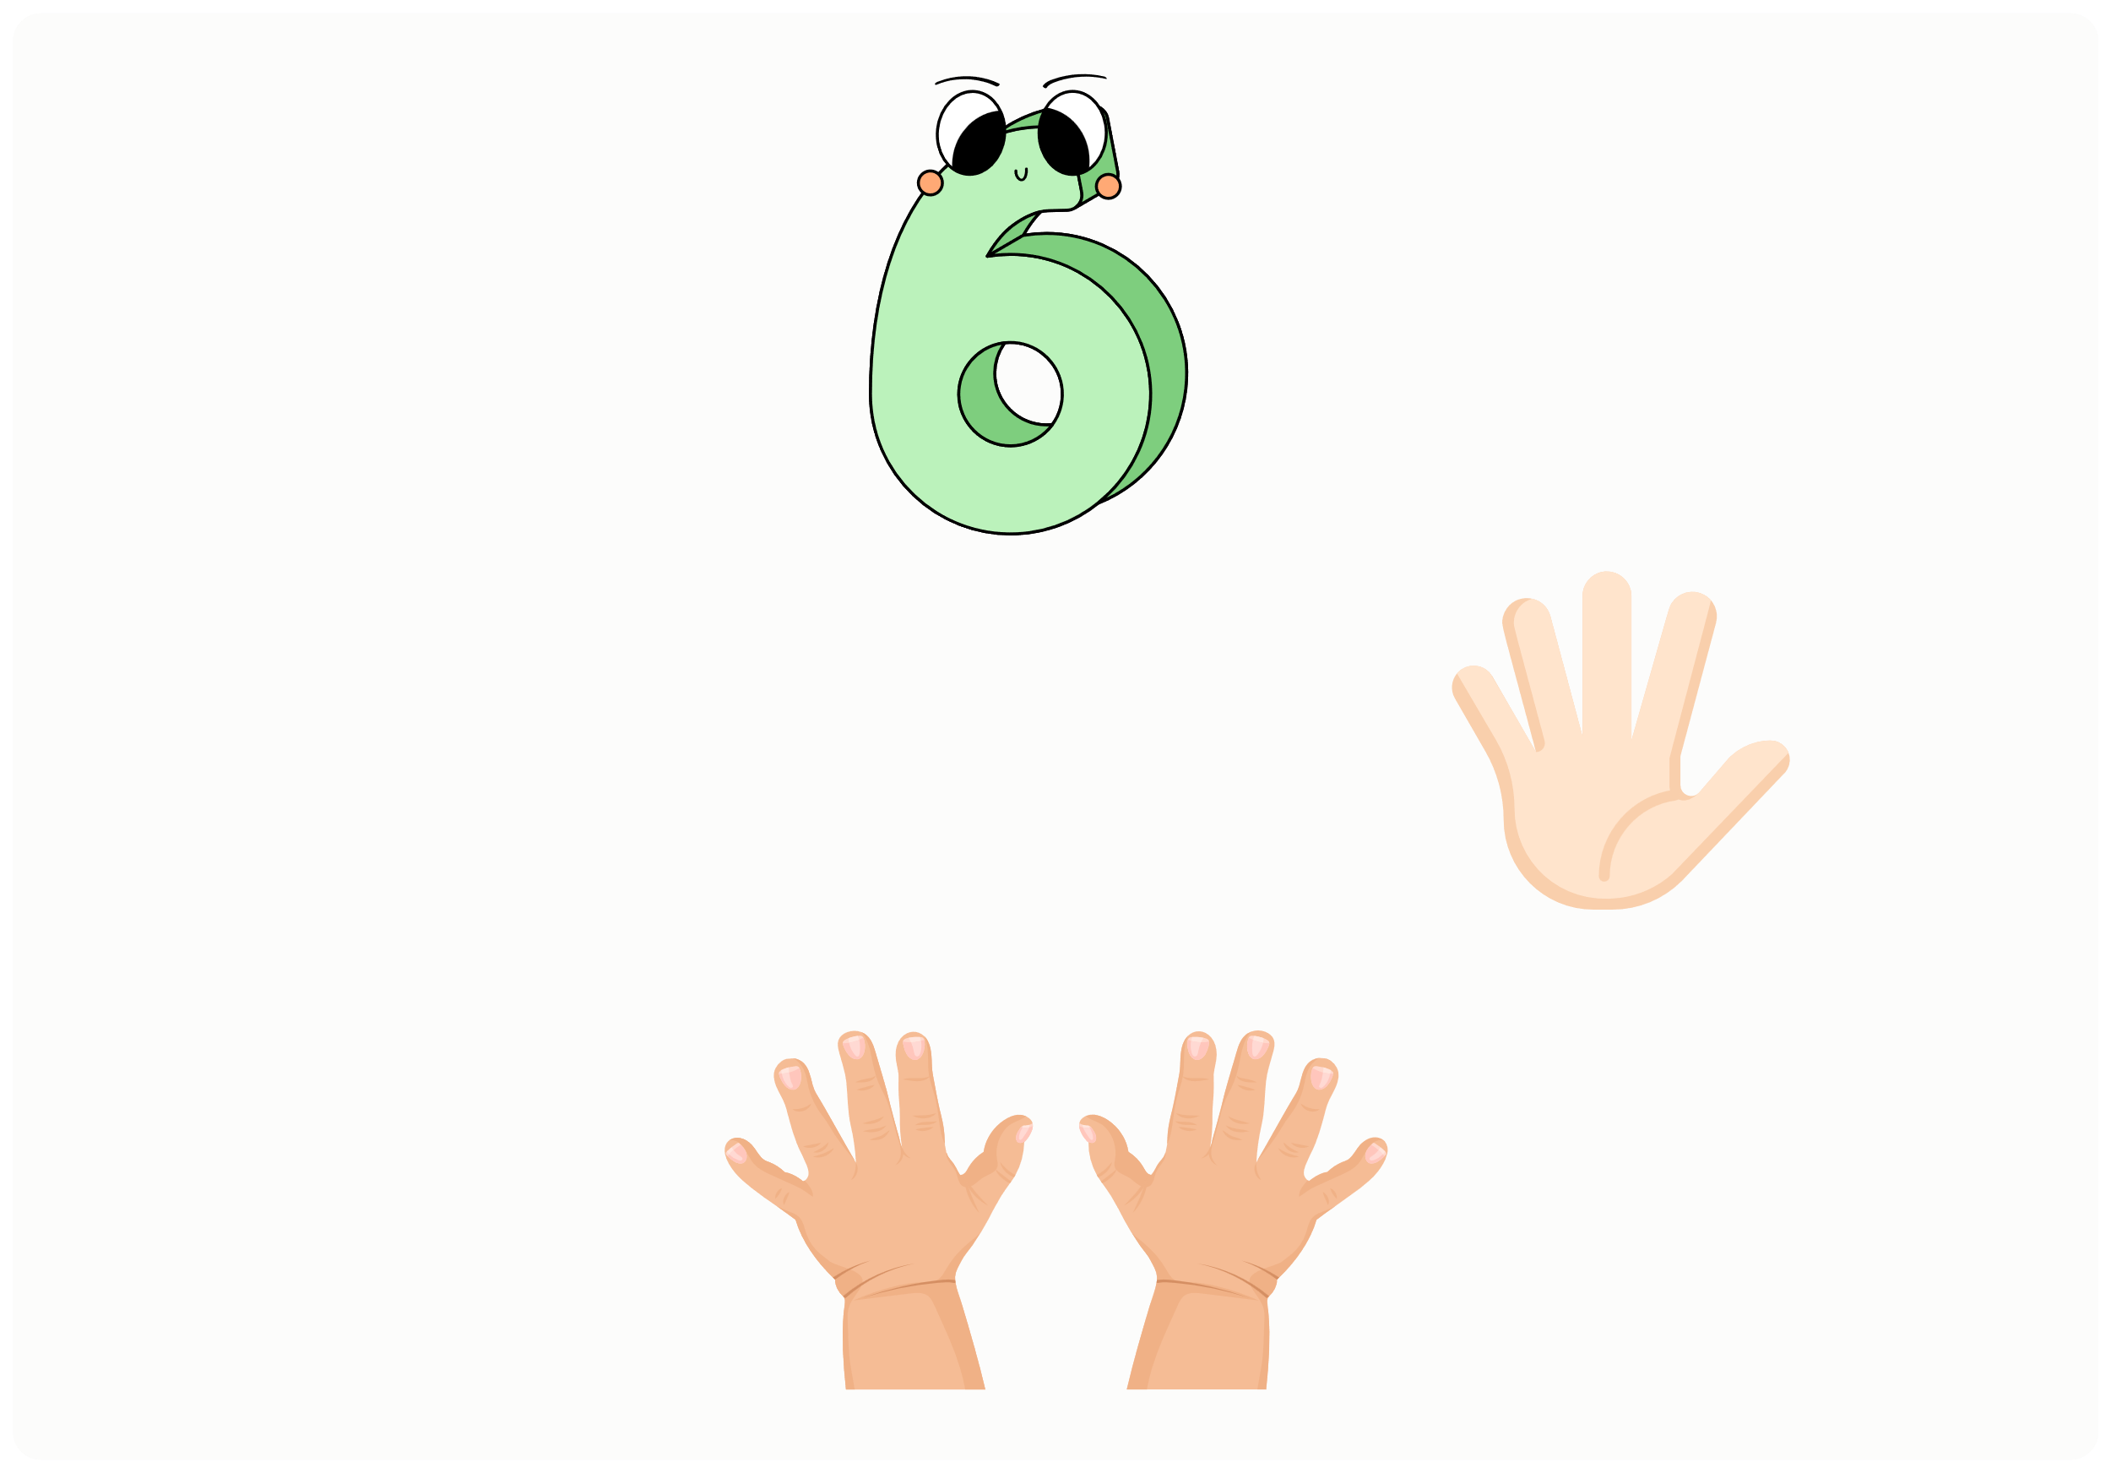
I. QUESTION
1.What number is it?
- It’s number ...
2. 1. How many fingers are there on 1 hand? - There are ...
3. How many fingers are there on 2 hand? - There are ...

Slide 3
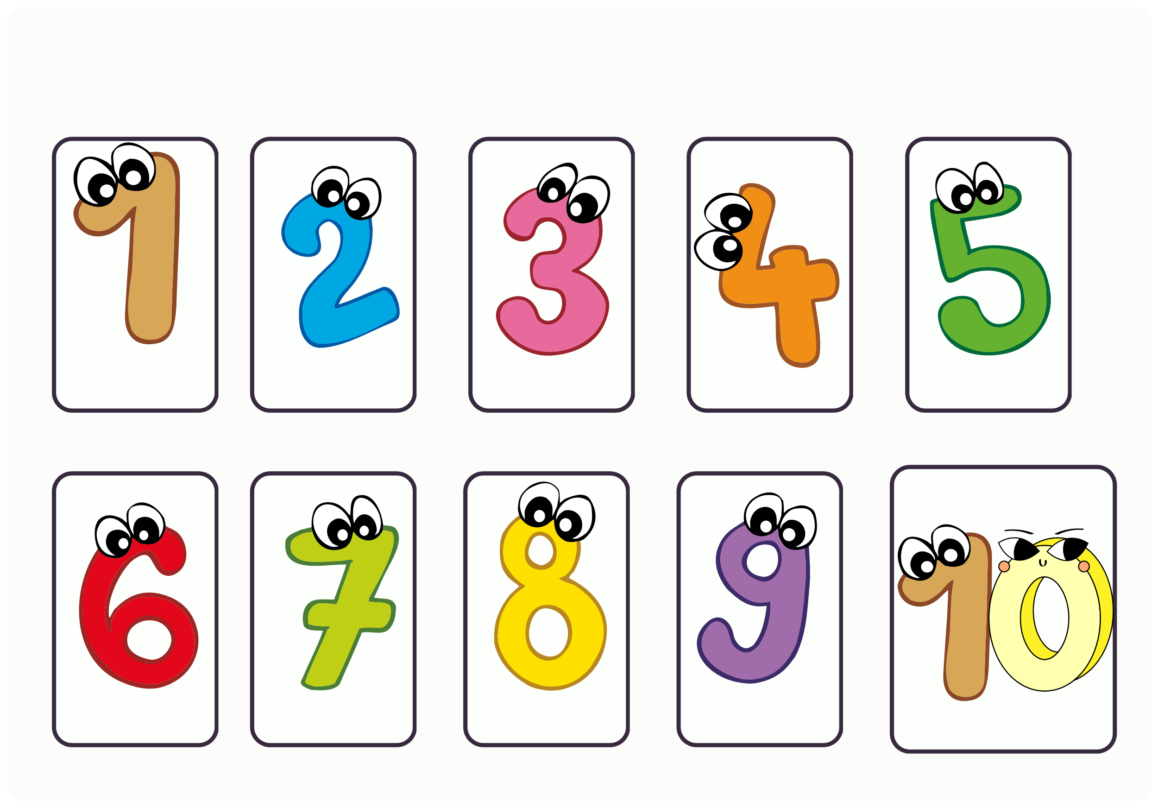
II. VOCABULARY
one
ttwo
thrBeioloegy
four
five
six
seven
eight
nine
ten

Slide 4


III. EXERCISES:
1.Read the words then write the correct numerals in the box:
three
one
seven
five
nine
ten
eight
four
six
two

Slide 5
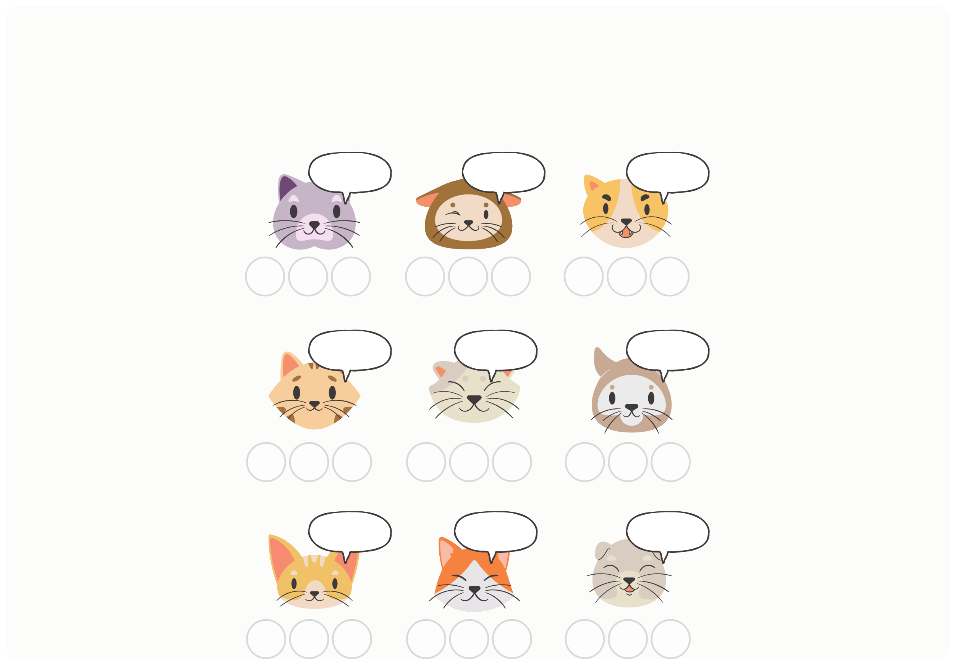
III. EXERCISES:
2. Circle the correct number to match the number:
Nine
Eight
Five
4
9
11
6
8
9
5
6
15
Ten
Eleven
Twenty
10
15
20
8
10
11
19
20
22
Twelve
Sixteen
Seventeen
11
12
14
15
16
19
16
17
18

Slide 6
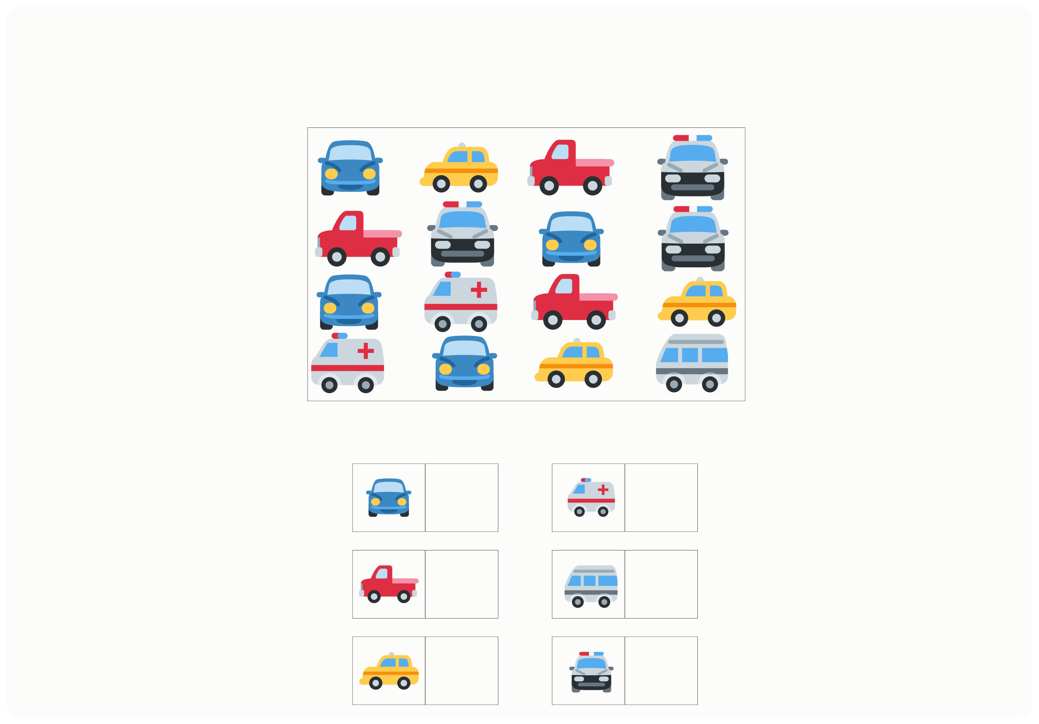
III. EXERCISES:
3. How many of each car can you count?

Slide 7
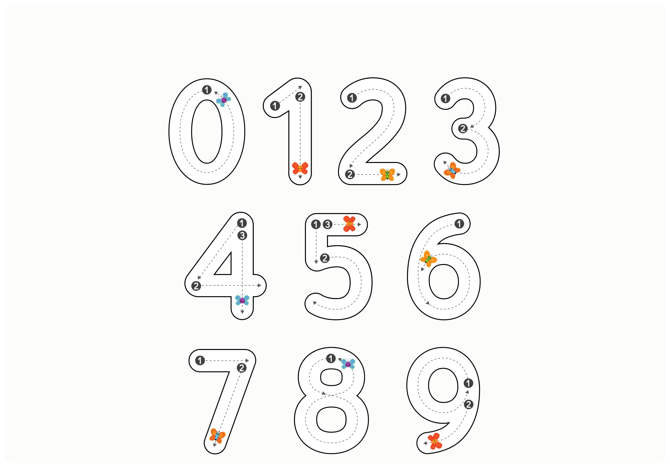
III. EXERCISES:
4. Trace the words:

Slide 8
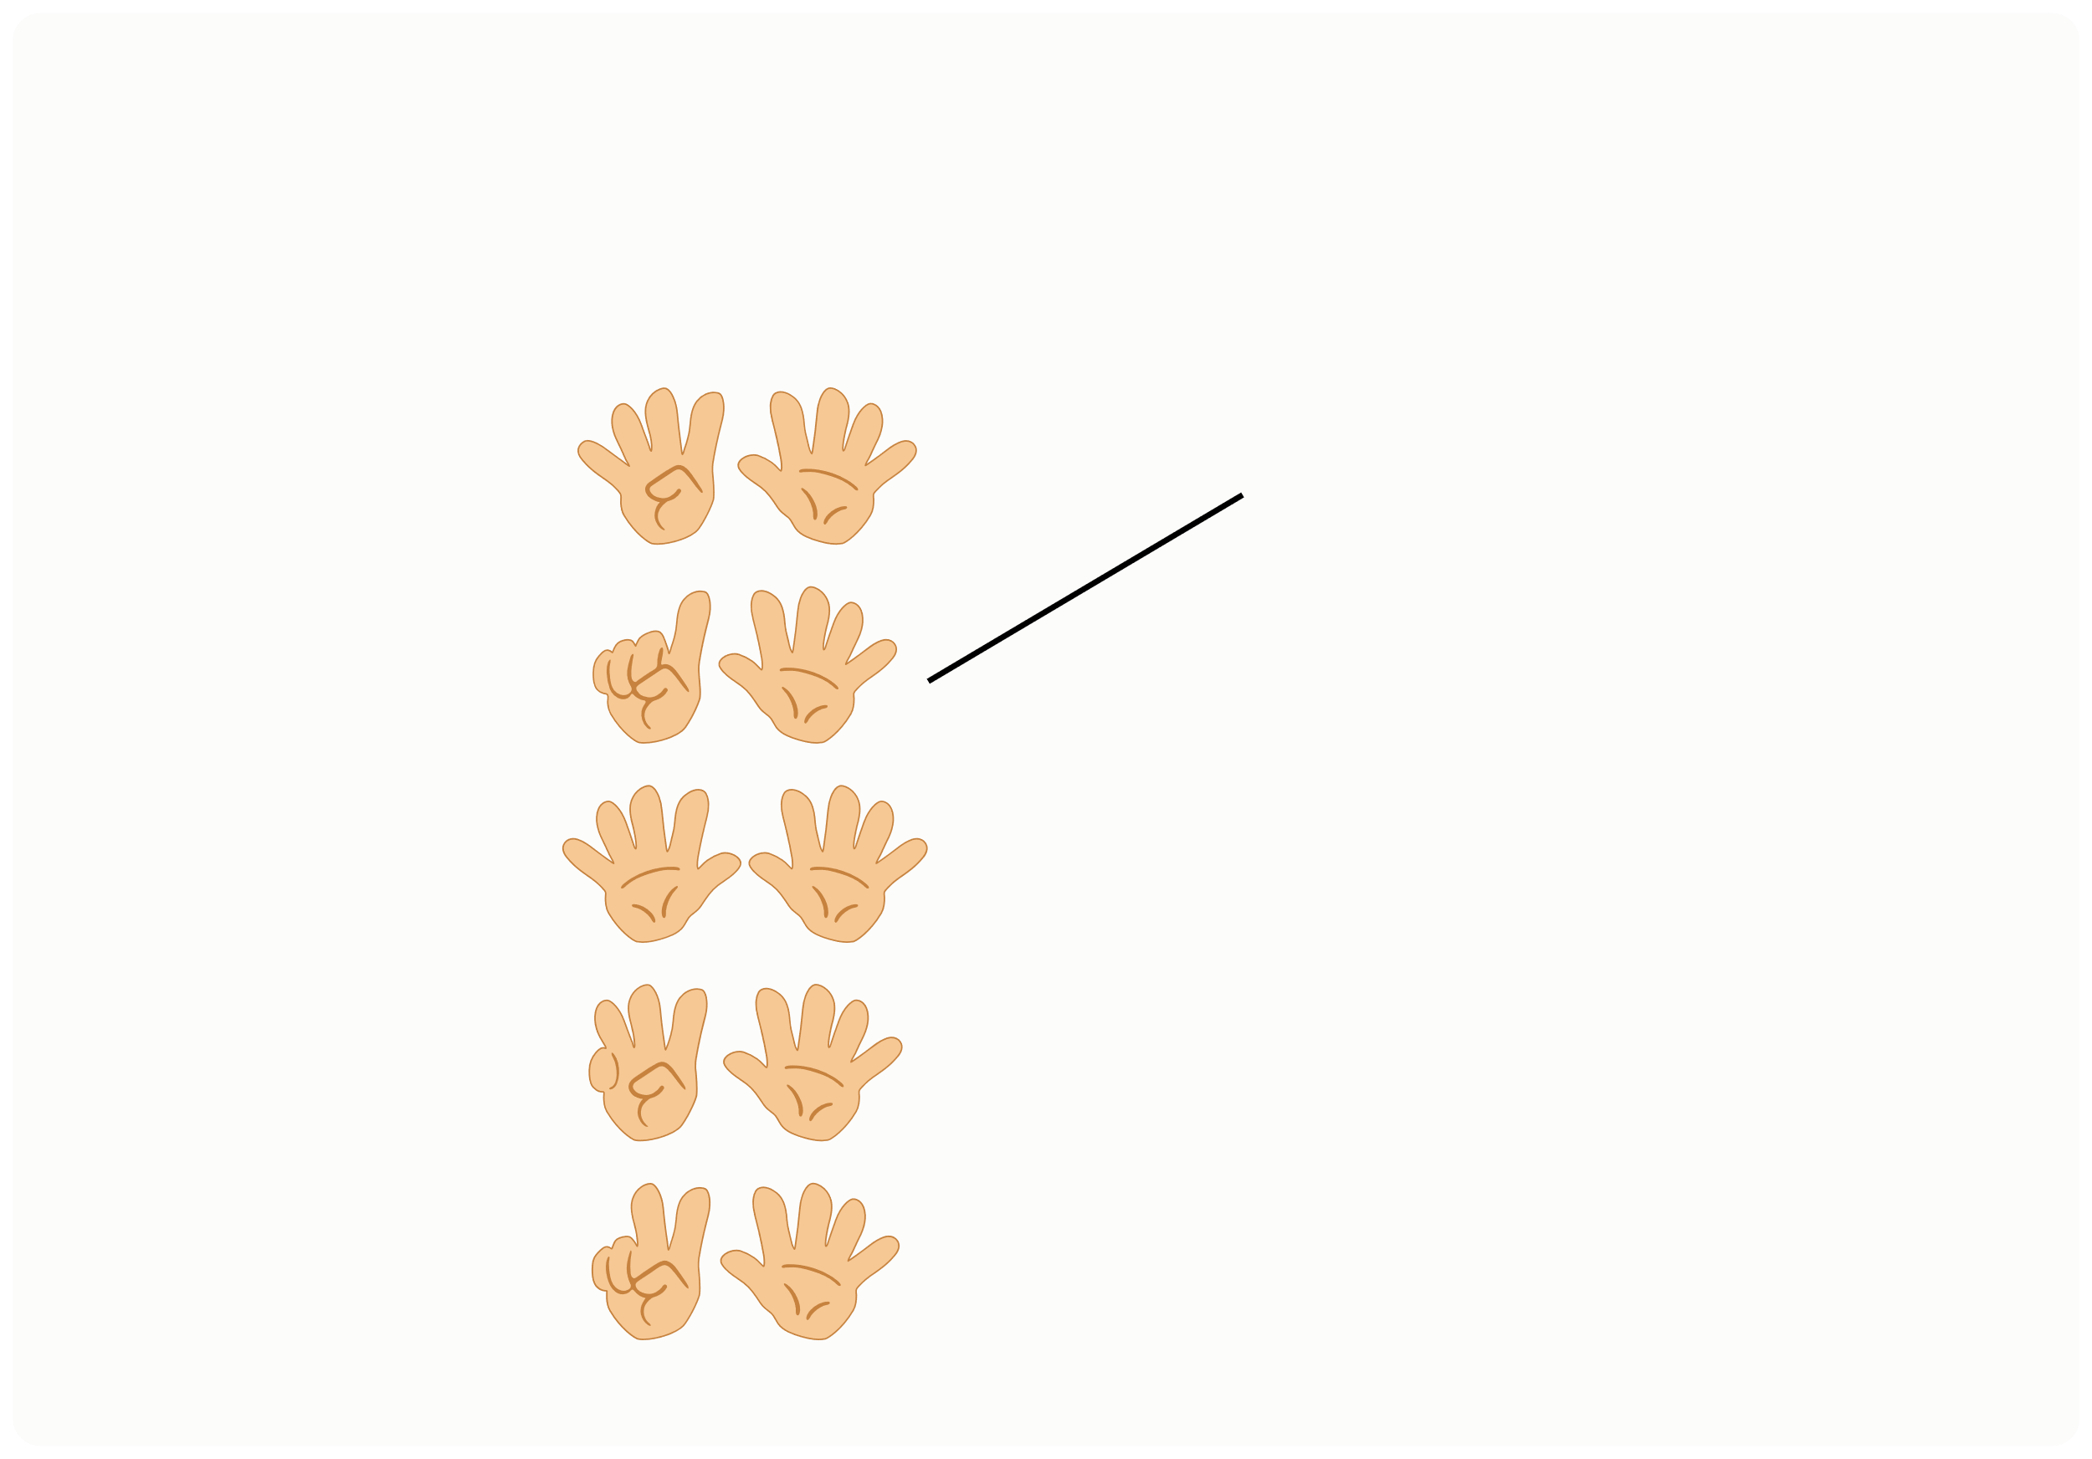
III. EXERCISES:
5. Can you find the matching number to each hand?
6 7 8 9 10
Biology

Slide 9

III. EXERCISES:
6. Find the words below:
one two three four five six seven eight
RSGTWELVEITA BHEEMIOKPVAS DXEVASIXOOLD EOHLETCCENAT LTNCONEITEDH EIICTWEMOTKR VRNSEAFIVESE ECEHNVAAVGFE NUWVECFECRLA BOTWOLKOOTUM BVTEPLCHUEPN EEIGHTIRERFR

Slide 10
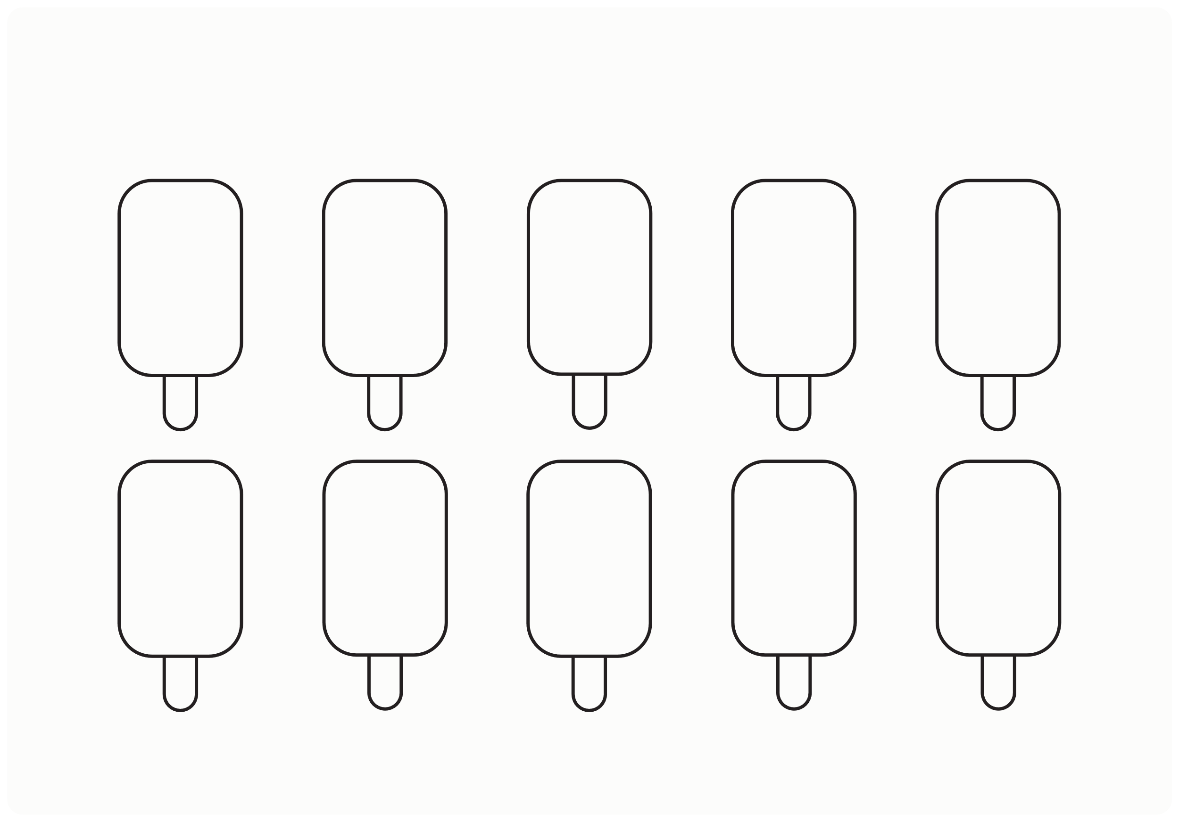
III. EXERCISES:
7. Fill the missing numbers:
1
2
4
5
6
8

Slide 11
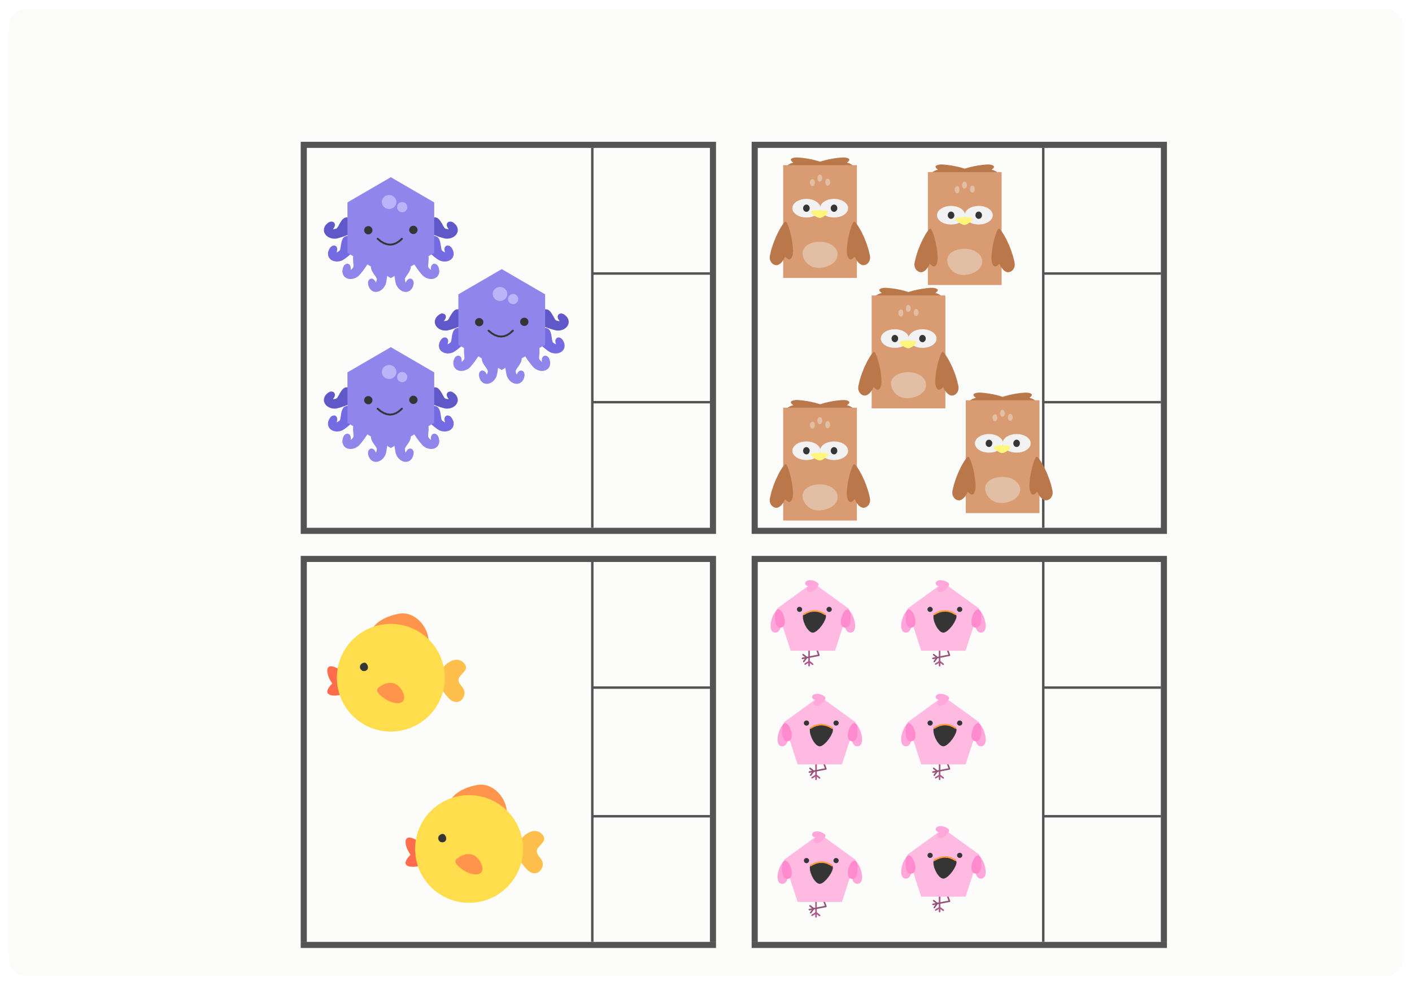
III. EXERCISES:
8. Count:
1 2 3
2
4
6
3 4 5
3
6
9

