Slide 1

Unit 4: All things high-tech
Lesson 4f: Skills
Page 72

Slide 2
Lesson Outline
Warm-up
Reading
Consolidation
Wrap-up

Slide 3
Objectives
By the end of this lesson, students will be able to…
- listen and read for gist, specific information, and details.

Slide 4

WARM-UP

Slide 5

Work in pairs.
What character is it?
1. This character is in a platform game.
2. It has blue color.
3. It can run very fast.

Slide 6

Answer
SONIC

Slide 7

Work in pairs.
Chatting
1 Do you play video/PC/mobile games? Where do you play them:
on a games console?
on a computer/laptop?
on a smartphone/tablet?
Tell your partner.

Slide 8
Work in pairs.
Chatting
Suggested answer
I sometimes play video games and mobile games. I have a games console, so I play video games on that. I also sometimes play mobile games on my smartphone, especially when I’m waiting for a bus.

Slide 9

It’s time to learn …

Slide 10

Reading

Slide 11
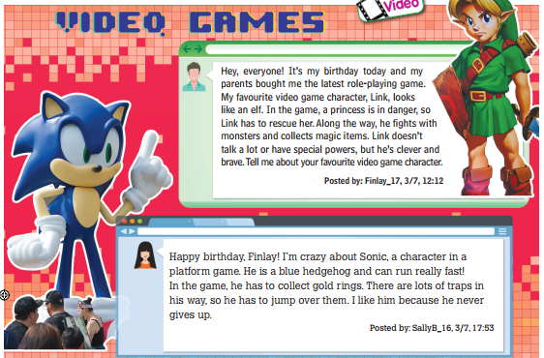
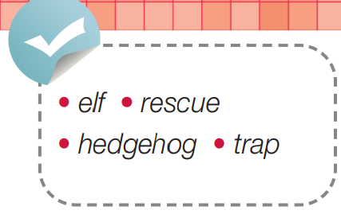
Pre-reading
Find these words in the text, try to guess what their meanings are.

Slide 12

Vocabulary
Listen and repeat. Click each phrase to hear the sound.
elf /elf/ (n) yêu tinh, người lùn
rescue /ˈreskjuː/ (v) giải cứu
hedgehog /ˈhedʒhɒɡ/ (n) con nhím châu Âu
trap /træp/ (n) bẫy, chướng ngại vật

Slide 13
Look at the IPA and the meaning of each word to read out the word.
/elf/ (n) yêu tinh, người lùn
/ˈreskjuː/ (v) giải cứu
/ˈhedʒhɒɡ/ (n) con nhím châu Âu
/træp/ (n) bẫy, chướng ngại vật

Slide 14
Pre-reading
2 Look at the pictures. What special characteristics does each one have? Listen and read to find out.
1. Do you know who these characters are?
Link and Sonic.
2. What are you going to do?
Listen and read to find out what characteristics Link and Sonic have.

Slide 15
While-reading
Listen and skim the text, underline the key words.
Hey, everyone! It’s my birthday today and my parents bought me the latest role-playing game. My favourite video game character, Link, looks like an elf. In the game, a princess is in danger, so Link has to rescue her. Along the way, he fights with monsters and collects magic items. Link doesn’t talk a lot or have special powers, but he’s clever and brave. Tell me about your favourite video game character.
Posted by: Finlay_17, 3/7, 12:12

Slide 16
Listen and skim the text, underline the key words.
Happy birthday, Finlay! I’m crazy about Sonic, a character in a platform game. He is a blue hedgehog and can run really fast! In the game, he has to collect gold rings. There are lots of traps in his way, so he has to jump over them. I like him because he never gives up.
Posted by: SallyB_16, 3/7, 17:53

Slide 17
Answer
These characters are Link and Sonic. Link is clever and brave. Sonic never gives up.

Slide 18
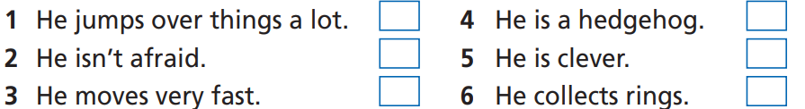
Pre-reading
3 Read the text again and decide whether each sentence (1-6) is about Link or Sonic. Write L (Link) or S (Sonic).
1. How many sentences are there?
There are six.
2. What are you going to do?
Read the text to find out whether each sentence is about Link or Sonic.

Slide 19
3 Read the text again and decide whether each sentence (1-6) is about Link or Sonic. Write L (Link) or S (Sonic).
1. He jumps over things a lot.
2. He isn’t afraid.
3. He moves very fast.
4. He is a hedgehog.
5. He is clever.
6. He collects rings.

Slide 20
Scan the text and underline the key words.
Hey, everyone! It’s my birthday today and my parents bought me the latest role-playing game. My favourite video game character, Link, looks like an elf. In the game, a princess is in danger, so Link has to rescue her. Along the way, he fights with monsters and collects magic items. Link doesn’t talk a lot or have special powers, but he’s clever and brave. Tell me about your favourite video game character.
Posted by: Finlay_17, 3/7, 12:12
(5)
(2)

Slide 21
Scan the text and underline the key words.
Happy birthday, Finlay! I’m crazy about Sonic, a character in a platform game. He is a blue hedgehog and can run really fast! In the game, he has to collect gold rings. There are lots of traps in his way, so he has to jump over them. I like him because he never gives up.
Posted by: SallyB_16, 3/7, 17:53
(4)
(3)
(6)
(1)

Slide 22
3 Read the text again and decide whether each sentence (1-6) is about Link or Sonic. Write L (Link) or S (Sonic).
1. He jumps over things a lot.
2. He isn’t afraid.
3. He moves very fast.
4. He is a hedgehog.
5. He is clever.
6. He collects rings.
S
L
S
S
L
S

Slide 23
Extra Practice
Read the text again and find the words in the text having the closest meanings to the following words or phrases.
the newest
to help someone out of danger
be able to learn and understand things quickly and easily
4. quickly
5. dangerous situations

Slide 24
Extra Practice
Answers
the latest
the newest
to help someone out of danger
be able to learn things quickly and easily
My parents bought me the latest role-playing game.
rescue
In the game, a princess is in danger, so Link has to rescue her.
clever
Link doesn’t talk a lot or have special powers, but he’s clever.

Slide 25
Extra Practice
Answers
fast
4. quickly
5. dangerous situations
He is a blue hedgehog and can run really fast!
traps
There are lots of traps in his way, so he has to jump over them.

Slide 26
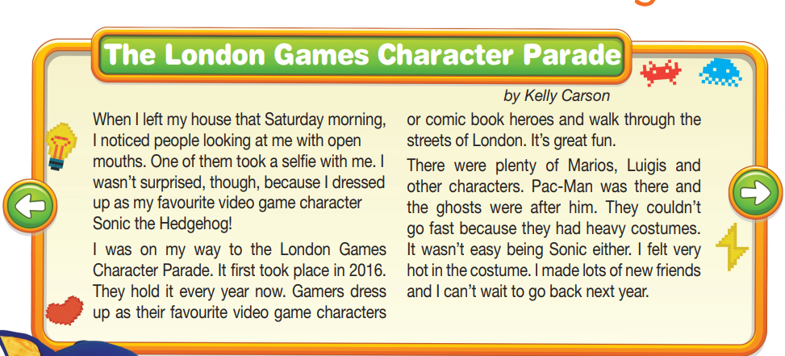
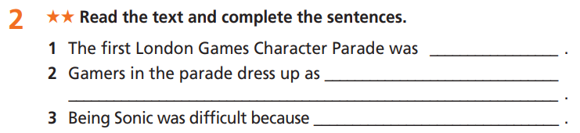
Extra Practice
WB page 37

Slide 27
Extra Practice
WB page 37
Scan the text and underline the key words.
The London Games Character Parade
by Kelly Carson
When I left my house that Saturday morning, I noticed people looking at me with open mouths. One of them took a selfie with me. I wasn’t surprised, though, because I dressed up as my favourite video game character Sonic the Hedgehog! I was on my way to the London Games Character Parade. It first took place in 2016. They hold it every year now.
(1)

Slide 28
Extra Practice
WB page 37
Scan the text and underline the key words.
(2)
Gamers dress up as their favourite video game characters or comic book heroes and walk through the streets of London. It’s great fun. There were plenty of Marios, Luigis and other characters. Pac-Man was there and the ghosts were after him. They couldn’t go fast because they had heavy costumes. It wasn’t easy being Sonic either. I felt very hot in the costume. I made lots of new friends and I can’t wait to go back next year.
(3)

Slide 29
Answer key
1. The first London Games Character Parade was in 2016.
2. Gamers in the parade dress up as video games charaters or comic book heroes.
3. Being Sonic was difficult because she felt very hot in the costume.

Slide 30

Post-Reading
4 Compare the two characters in the text in Exercise 2. Which character seems more fun to you? Why? Tell your partner.
Hi, B. Which character seems more fun to you?
I think that Sonic seems more fun.
Why?
Link seems very serious and he doesn’t say much.
So, you don’t like Link? And what’s more?
Sonic probably has fun jumping over things and spinning around!

Slide 31

CONSOLIDATION

Slide 32
Write a paragraph (about 60-80 words) to answer
the questions: “Are video games good or bad?”
Suggested answer key
I think that video games are good overall. They help teens completely concentrate on something. This helps them relax and feel less stressed about exams and other problems. It is important not to play too much because you need time for your homework or friends and family.

Slide 33

WRAP-UP

Slide 34
Today’s lesson
Vocabularies
elf
rescue
hedgehog
trap
Listening/ Reading: for gist, specific information, and details.

Slide 35
Homework
Practise the vocabularies and make sentences using them.
Do the exercises in TA 7 Right on WB (page 37).
Prepare the next lesson (page 73 SB).
Do the exercise in TA 7 Right on Notebook (page 33).

Slide 36

Enjoy your day!

