Slide 1
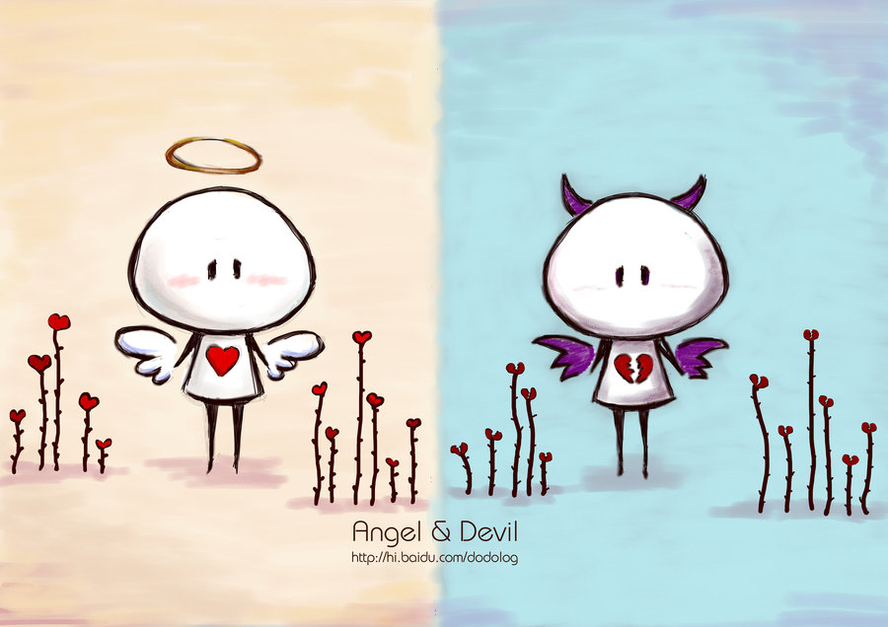


GAME
By Jessica

Slide 2







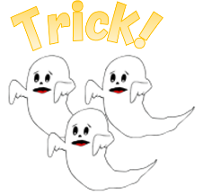







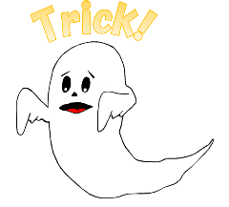














1
2
3
4
5
6
7
8
9
10
11
12
13
14
15
16
17
18
19
20
Jessica
Jessica
Notes:
1 Ghost – 6, 9. 15, 16
3 Ghosts – 2, 13

Slide 3


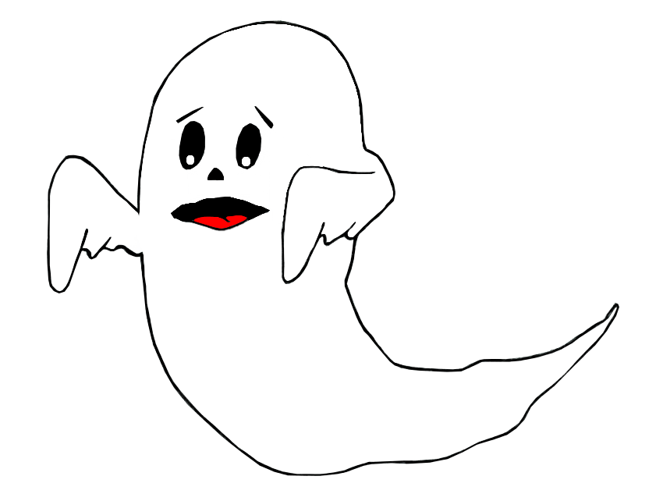

Trick!
Lose half your points!

Slide 4
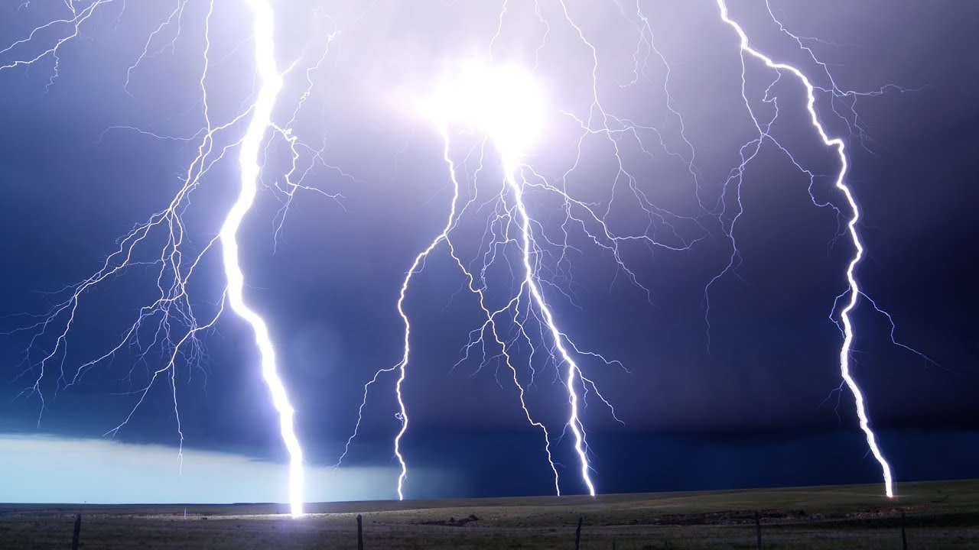

Trick!
Lose all your points!

Slide 5


Do you have any…?
Teddy Bear
Doll
Car
Robot
Jessica
Notes:
A: Correct

Slide 6
Question
Answer
Answer
Answer
Answer
Jessica
Notes:
B: Correct

Slide 7
Question
Answer
Answer
Answer
Answer
Jessica
Notes:
C: Correct

Slide 8
Question
Answer
Answer
Answer
Answer
Jessica
Notes:
D: Correct

Slide 9
Question
Answer
Answer
Answer
Answer
Jessica
Notes:
B: Correct

Slide 10
Question
Answer
Answer
Answer
Answer
Jessica
Notes:
A: Correct

Slide 11
Question
Answer
Answer
Answer
Answer
Jessica
Notes:
D: Correct

Slide 12
Question
Answer
Answer
Answer
Answer
Jessica
Notes:
C: Correct

Slide 13
Question
Answer
Answer
Answer
Answer
Jessica
Notes:
A: Correct

Slide 14
Question
Answer
Answer
Answer
Answer
Jessica
Notes:
B: Correct

Slide 15
Question
Answer
Answer
Answer
Answer
Jessica
Notes:
C: Correct

Slide 16
Question
Answer
Answer
Answer
Answer
Jessica
Notes:
D: Correct

Slide 17
Question
Answer
Answer
Answer
Answer
Jessica
Notes:
B: Correct

Slide 18
Question
Answer
Answer
Answer
Answer
Jessica
Notes:
C: Correct

Slide 19



Jessica

