Slide 2

Unit 4
urbanization
WRITING
Description of a line graph

Slide 3
LESSON 6
WRITING
WARM-UP
Choose the correct information about the Description of a line graph
Task 1: Match the headings.
Task 2. Put the paragraphs in the correct order.
PRE- WRITING
Task 3: Write a description
WHILE- WRITING
Task 4: Peer review
POST- WRITING
CONSOLIDATION
Wrap-up
Homework

Slide 4
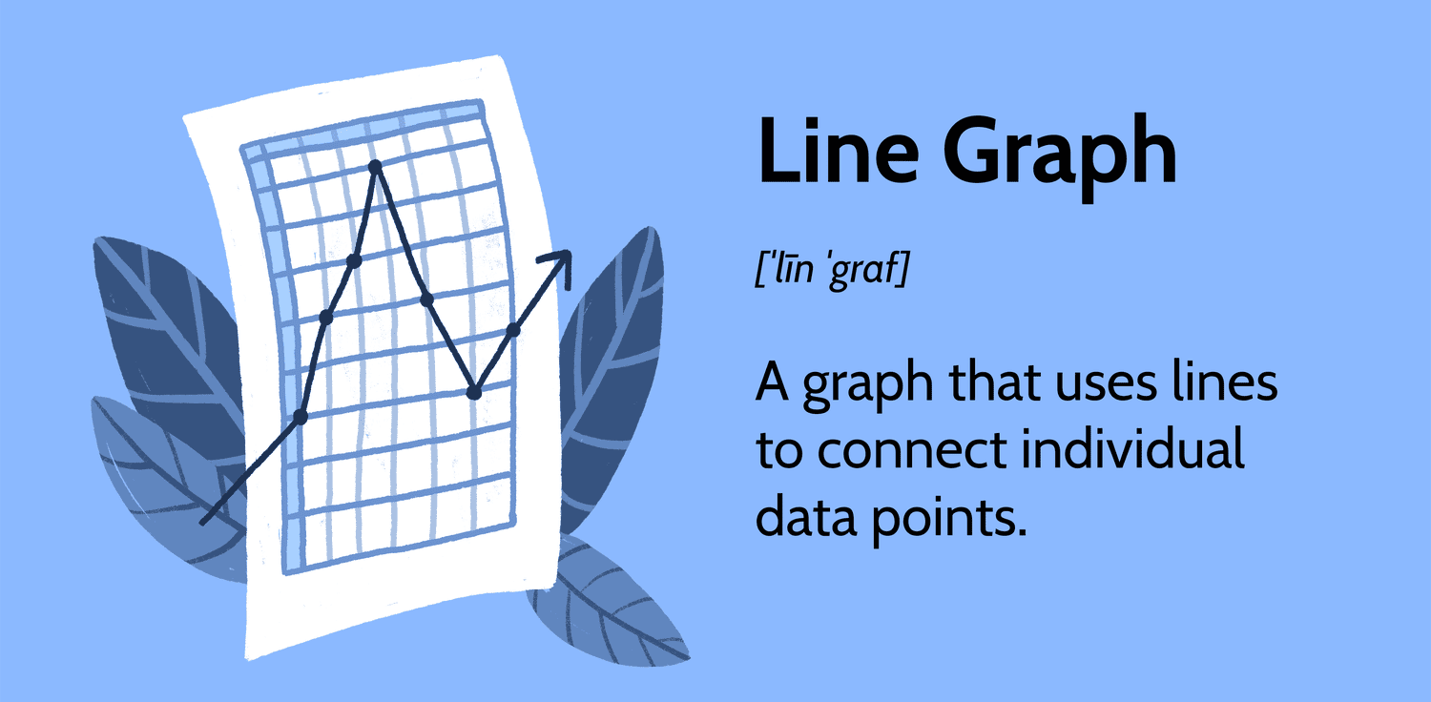
Description of a line graph
Choose the correct information about
Description of a line graph to earn bonuses.

Slide 5
In a line graph, the horizontal axis usually represents:
Values
Time
Categories
None of the above

Slide 6
When describing the trend in a line graph, what term is commonly used for a line that goes upward?
Plateau
Decrease
Fluctuate
Increase

Slide 7
The point where the line on a graph reaches its highest value is called the:
Trough
Vertex
Peak
Apex

Slide 8
Which of the following is essential when providing a description of a line graph?
Clear and concise language
Detailed background information
Random anecdotes
Clear and concise language

Slide 9
If a line on a graph is relatively flat,
it suggests:
Stability
Rapid change
Random fluctuations
None of the above

Slide 10
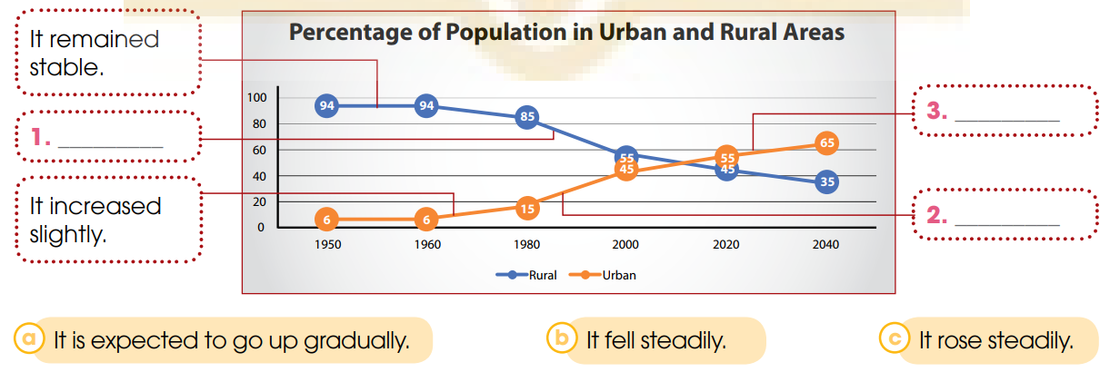
PRE- WRITING
1
Work in pairs. Look at the line graph. match the sentences with the information in the graph.
a
b
c

Slide 11
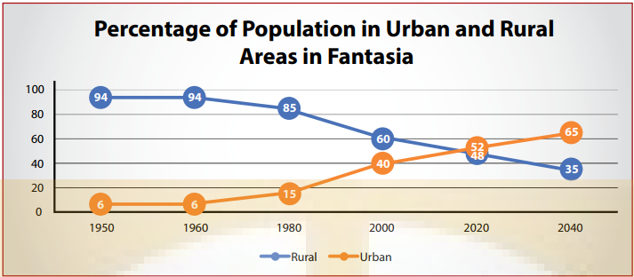
PRE- WRITING
2
Look at the line graph and put the paragraphs in the correct order.

Slide 12
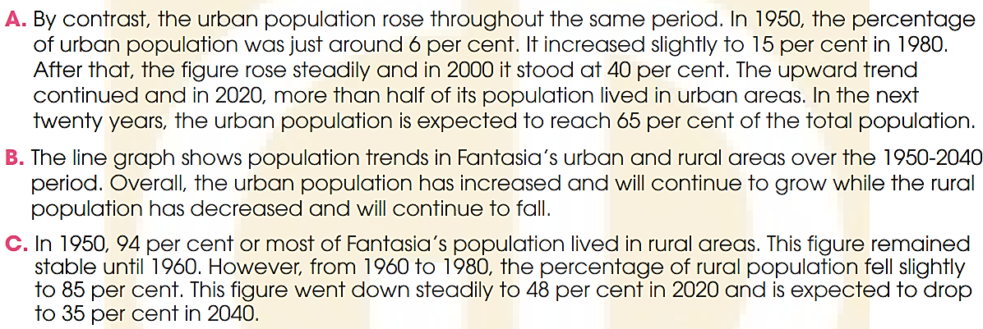
PRE- WRITING
2
Look at the line graph and put the paragraphs in the correct order.
ANSWER
1. B
2. C
3. A

Slide 13
PRE- WRITING
B. The line graph shows population trends in Fantasia’s urban and rural areas over the 1950-2040 period. Overall, the urban population has increased and will continue to grow while the rural population has decreased and will continue to fall.
C. In 1950, 94 per cent or most of Fantasia’s population lived in rural areas. This figure remained stable until 1960. However, from 1960 to 1980, the percentage of rural population fell slightly to 85 per cent. This figure went down steadily to 48 per cent in 2020 and is expected to drop to 35 per cent in 2040
A. By contrast, the urban population rose throughout the same period. In 1950, the percentage of urban population was just around 6 per cent. It increased slightly to 15 per cent in 1980. After that, the figure rose steadily and in 2000 it stood at 40 per cent. The upward trend continued and in 2020, more than half of its population lived in urban areas. In the next twenty years, the urban population is expected to reach 65 per cent of the total population.

Slide 14
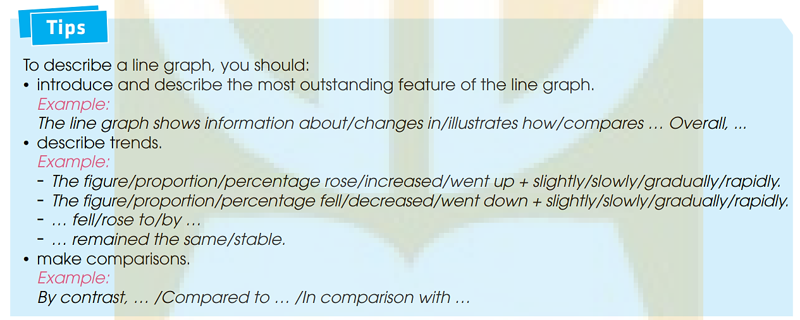
PRE- WRITING
2
Look at the line graph and put the paragraphs in the correct order.

Slide 15

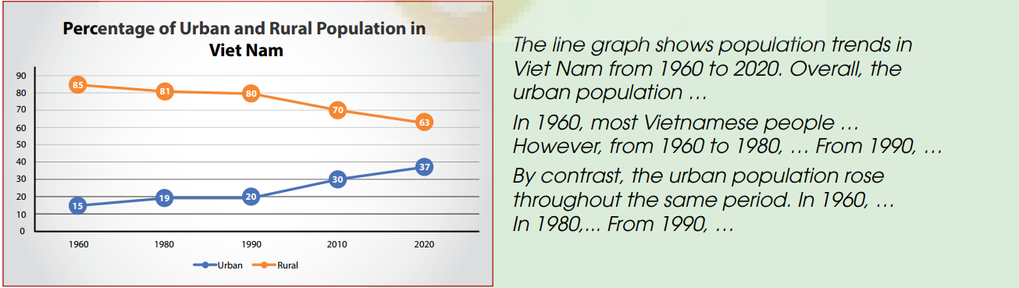
WHILE- WRITING
3
The line graph below illustrates population trends in Vietnam from 1960 to 2020.
Write a description (120–150 words) of the graph. Use the expressions in 1, the model and tips in 2, and the suggestions below to help you.

Slide 16
WHILE- WRITING
**Sample answer:
The line graph shows the urban and rural population in Viet Nam from 1960 to 2020. Overall, the urban population increased while the rural population decreased.
In 1960, most Vietnamese people lived in rural areas. However, from 1960 to 1980, the percentage of the rural population fell slightly to 81 per cent. Then the figure remained stable for the next ten years. From 1990 to 2000, the proportion of the population living in rural areas continued to decrease gradually. In 2020, the rural population was only 63 per cent of the total population of Viet Nam.
By contrast, the urban population rose throughout the same period. In 1960, the percentage of the city population was just around 15 per cent. The figure went up slightly in 1980 and remained stable until 1990 when less than 20 per cent of the population lived in urban areas. Since 1990, the proportion of the urban population has increased gradually and in 2020, it reached 37 per cent of the total population.

Slide 17
POST- WRITING
*Exchange your writing with your friend for peer review.
WRITING RUBRIC
Organization: …/10
Legibility: …/10
Ideas: …/10
Word choice: …/10
Grammar usage and mechanics: …/10
TOTAL: …/50

Slide 18
CONSOLIDATION
1
Wrap-up
What have you learnt today?
Listen for main ideas and specific information in a conversation about a description of a line graph

Slide 19
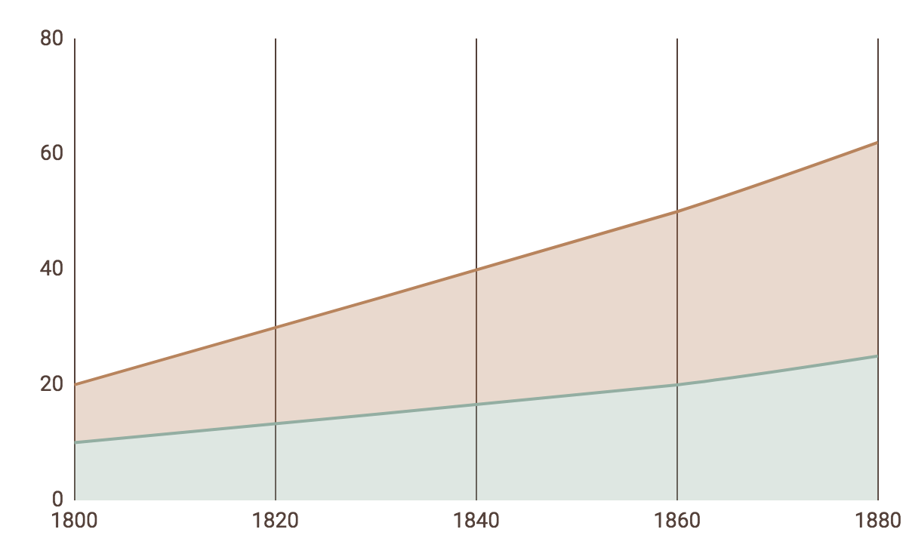
CONSOLIDATION
2
Homework
Learn new words by heart.
Do exercises in the workbook.
Prepare for Lesson 6 - Unit 4.

Slide 20
Website: hoclieu.vn
Fanpage: facebook.com/www.tienganhglobalsuccess.vn

