Slide 1
KET SPEAKING
Time allowed - 8-10 minutes
Normally you will do the speaking test with another candidate. The two of you will meet two examiners. One of the examiners will talk to you, the other does not participate in the conversations.
There are two parts to the speaking test:
Speaking part 1: short questions and answers between you and the examiner.
Speaking part 2: the examiner gives you some information or a card with some ideas for questions. You have to talk with the other candidate and ask or answer questions.
Scoring The Speaking section is worth 25% of the total score for the exam.
How to prepare for KET Speaking:
Speak as much as you can, with your friends
Practise asking and answering questions about daily life
Practise giving information about yourself

Slide 2
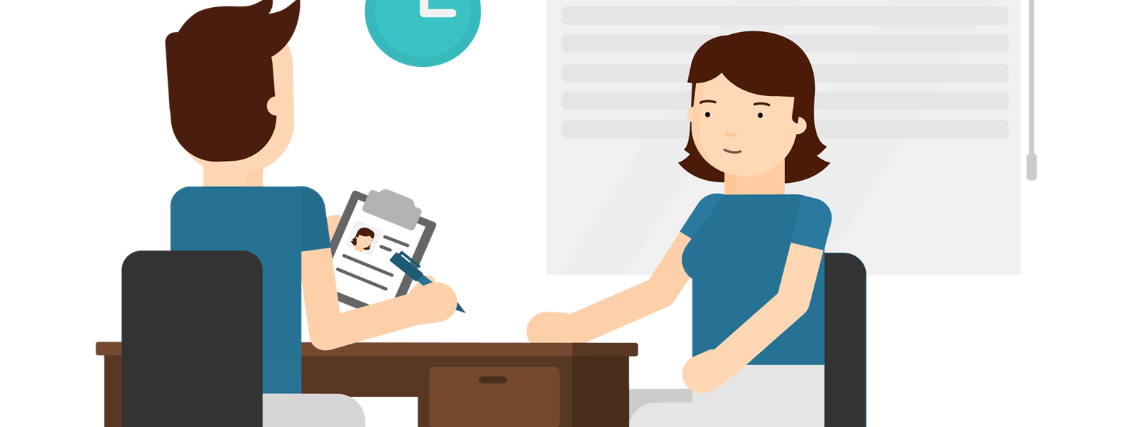
KEY ENGLISH TEST 4
Test 2 - Speaking

Slide 3
Part 1: Student – examiner interaction
Section 1:
The examiner will ask you:
Your name
Where you come from?
Provide full-sentence answers

Slide 4
Part 1: Student – examiner interaction
Section 2: You will be asked some questions that require longer answers. For example:
Why you like something
Details about a hobby…

Slide 5
Popular topic
family
best friend
hometown
your house
sport
computer
collecting
music

Slide 6
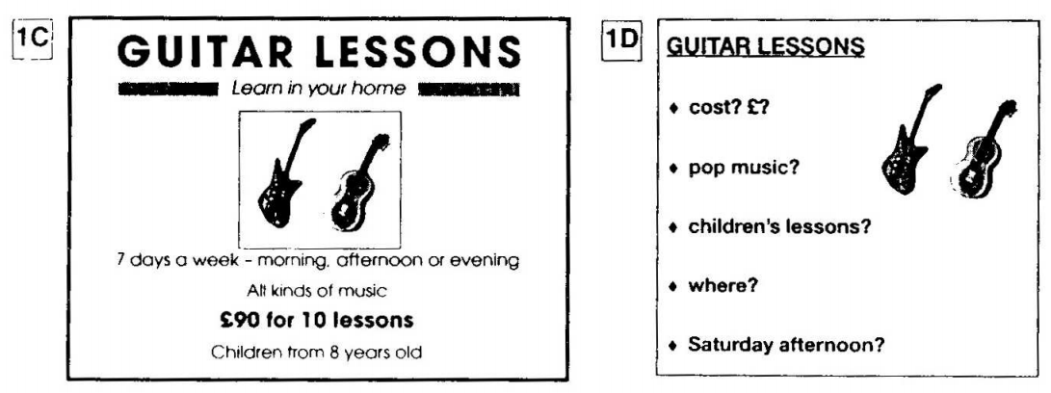
PART 2: Student – student interaction
Ask and answer questions based on the cue cards
For example:
Do not just read from the cards. Answer in full sentences.
Pay attention to the grammar.

Slide 7
SPEAKING PART 1

Slide 8
Part 1
Where do you usually buy your clothes?
What kind of clothes are in fashion now?
How much money do you spend on clothes?
How much time do you spend getting ready to go to school / work?
What's your favourite dress?
Which kind of clothes you don't like to wear?

Slide 9
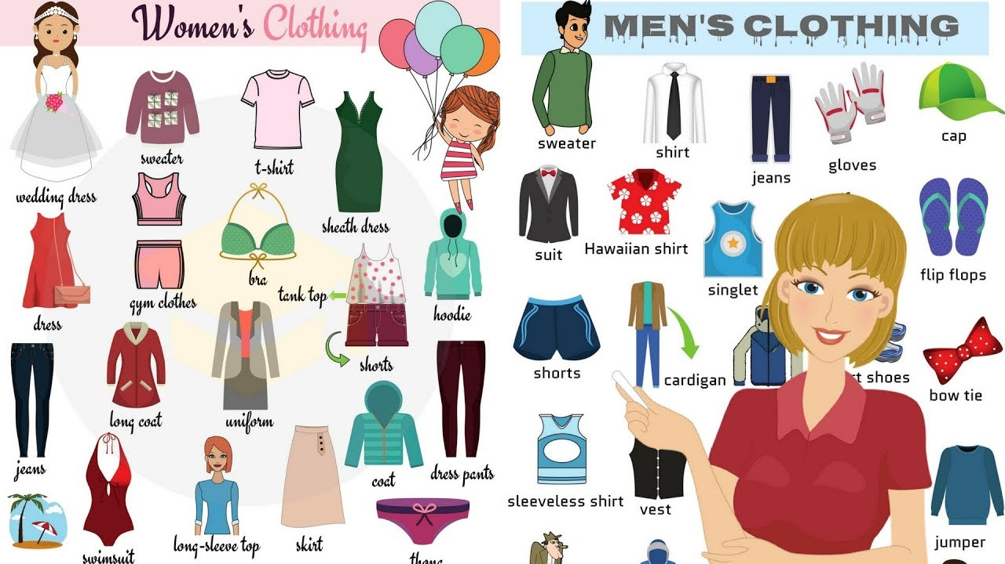

Slide 10
USEFUL VOCABULARY
dress up to dress (oneself or another) in your best clothes
to get dressed to put clothes on (yourself or someone else).
throw on to put on an item of clothing quickly and without thought.
hang out to dry clothes outside after washing
slip on to put on an item of clothing easily
kick off to remove your shoes quickly

Slide 11
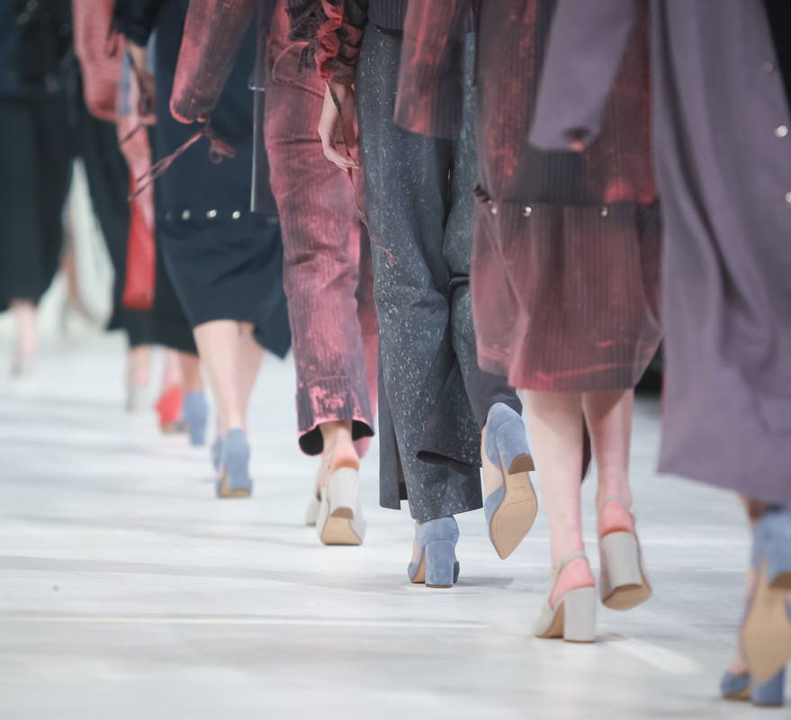
in (or out of) fashion
popular (or unpopular) and considered (or not considered) to be attractive at the time in question

Slide 12
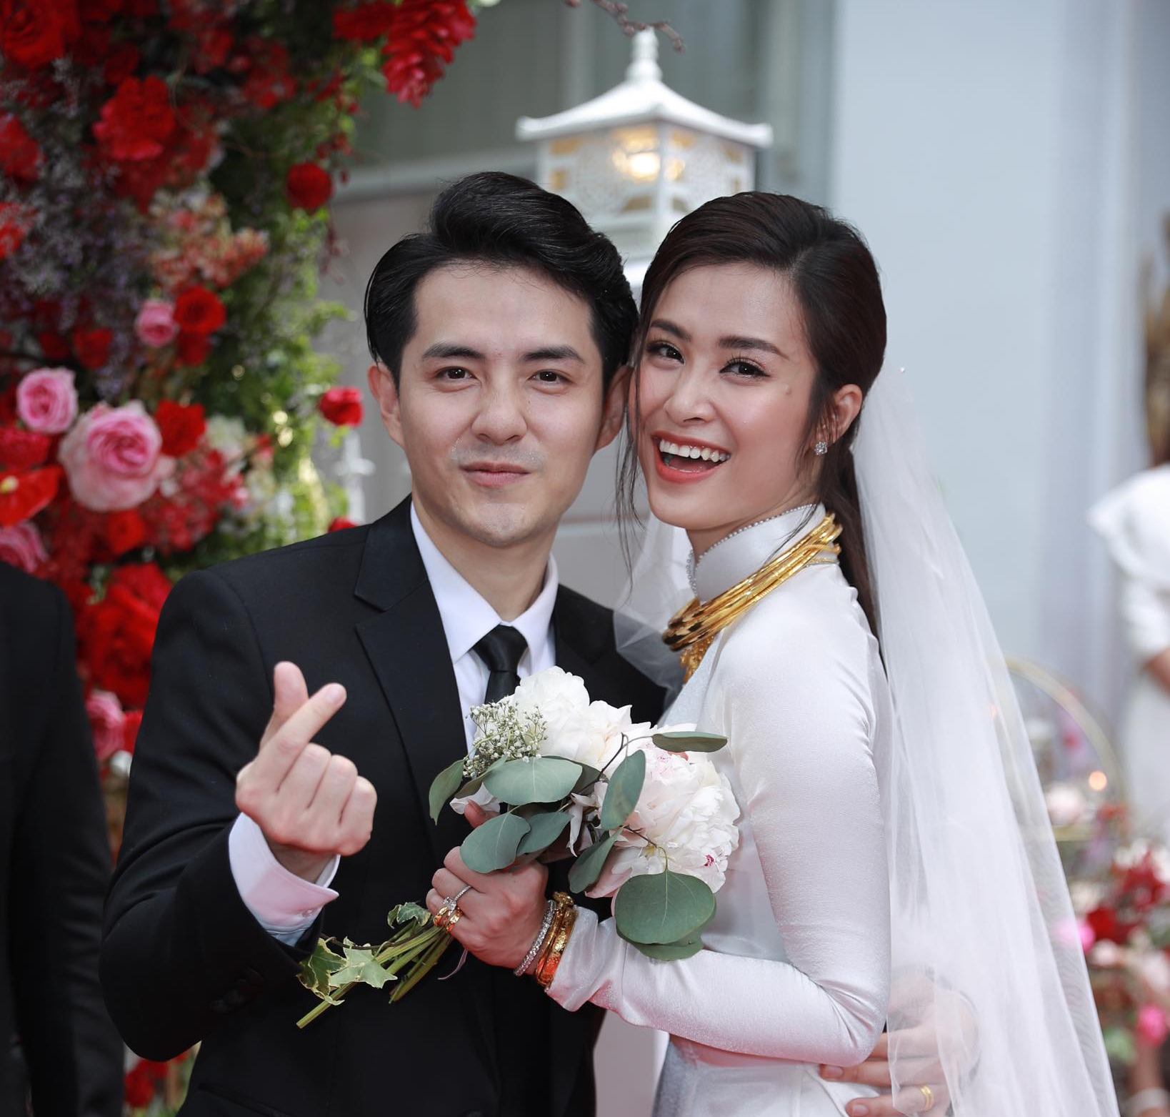
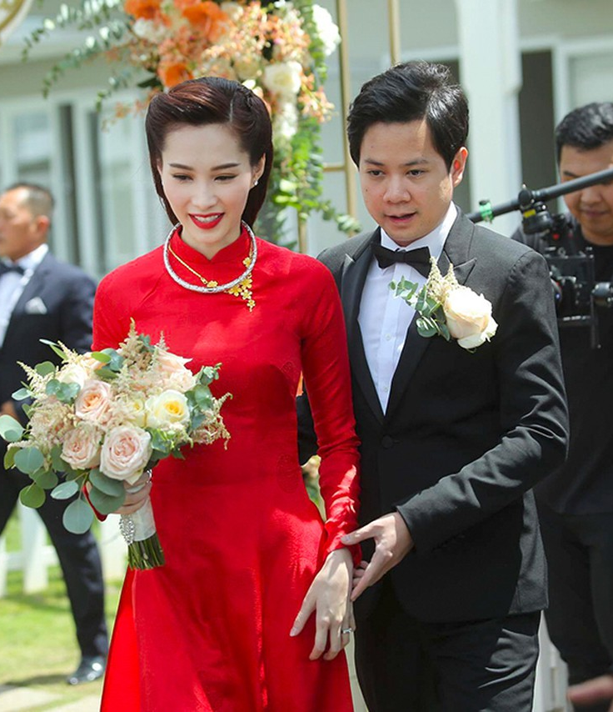
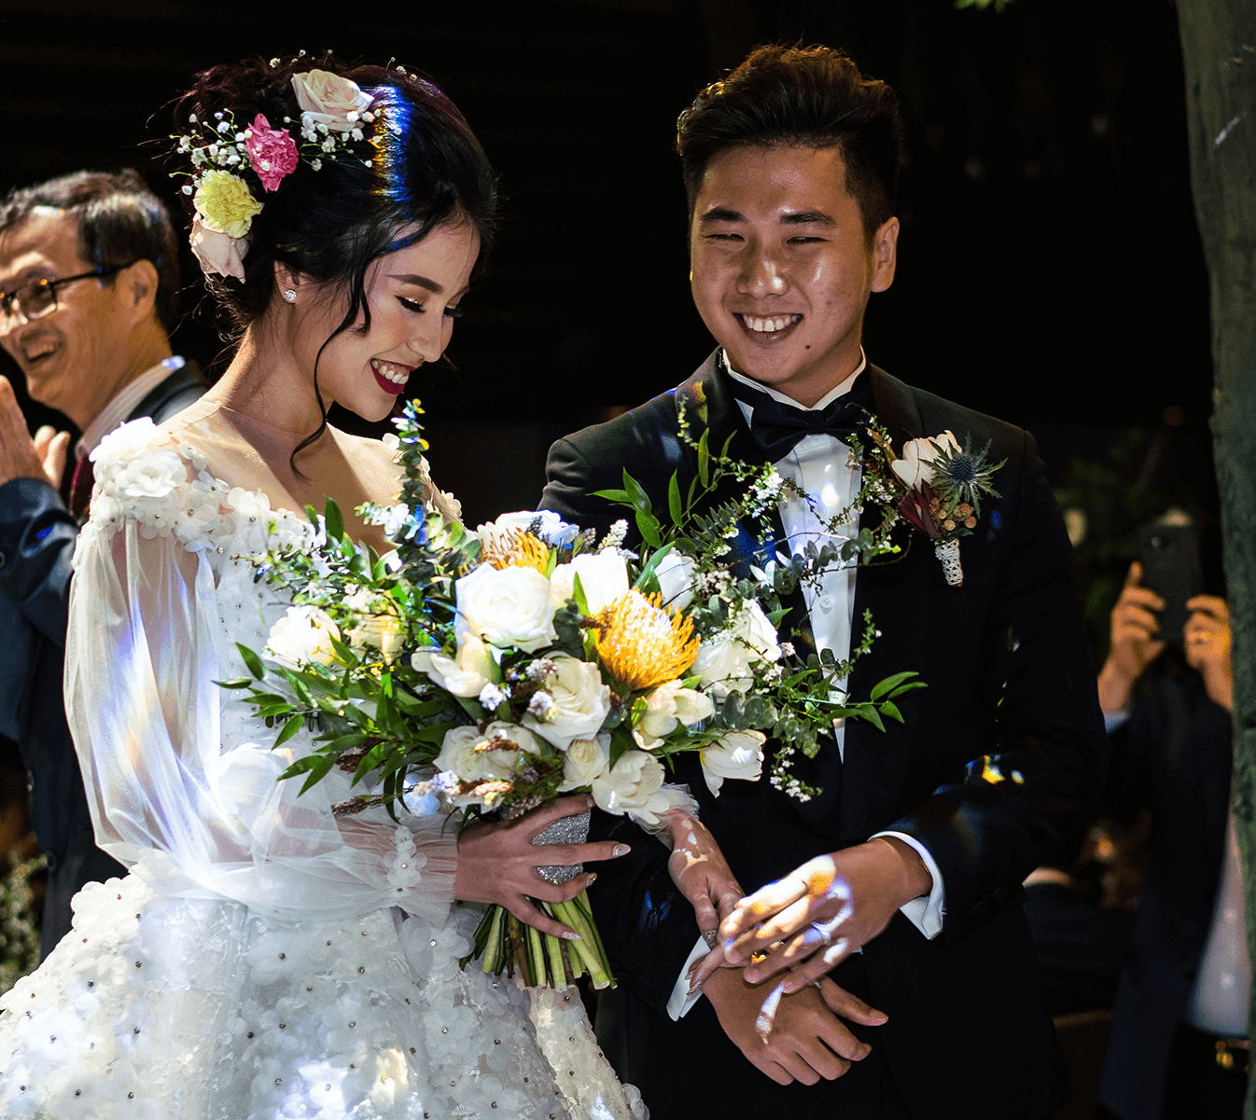
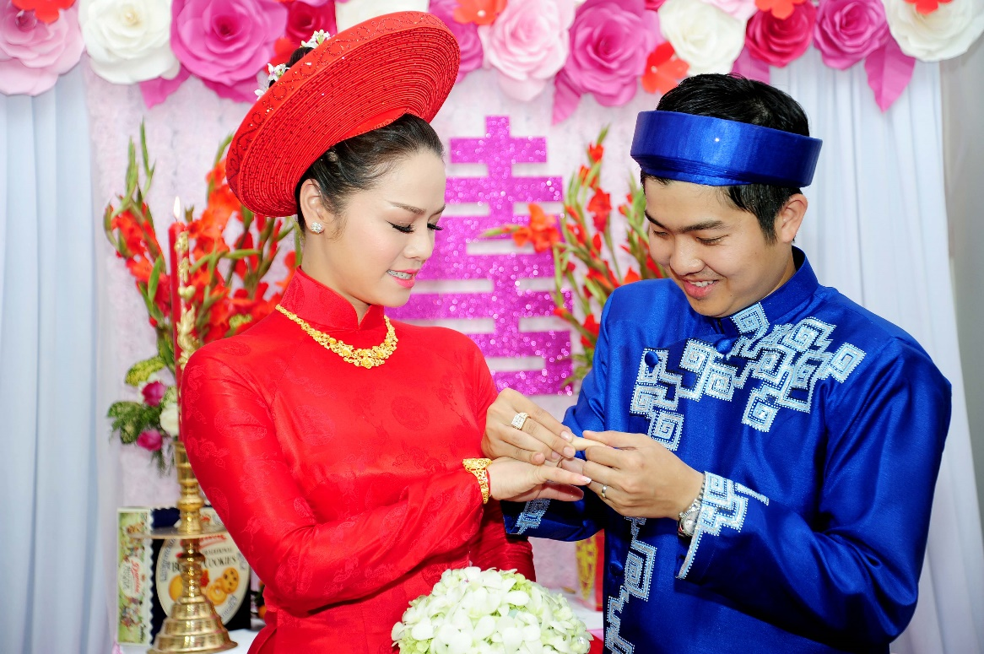
What kind of clothes do the bride and groom wear in your country?

Slide 13
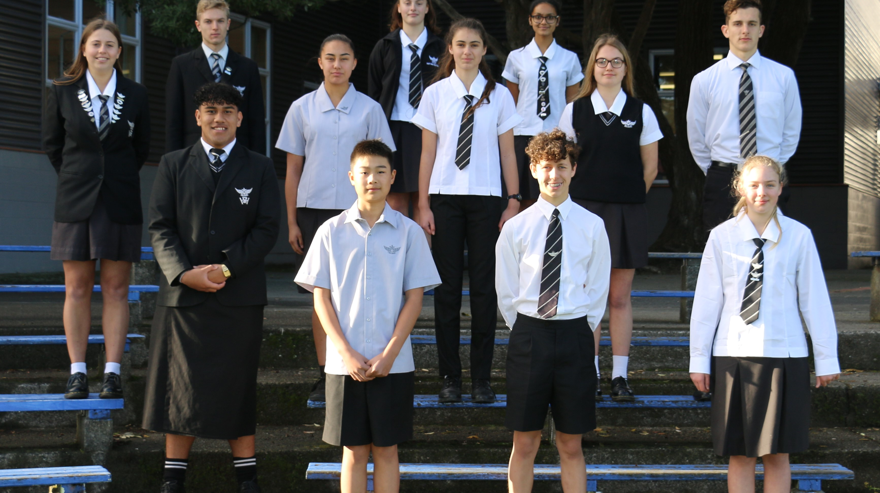
Do you think students need to wear school uniforms? Why?

Slide 14
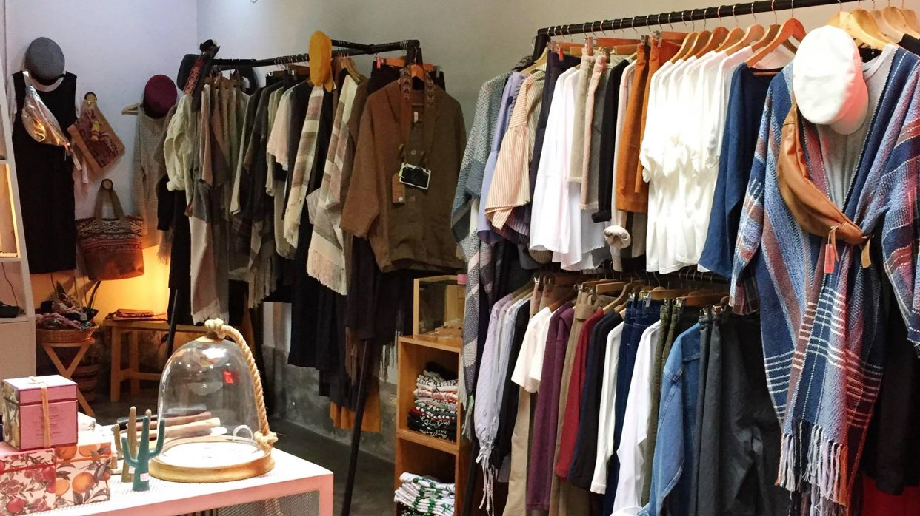
Talk about your favourite dress
For example: I love to wear jeans pants. Those are casual attires for me and I love to wear those during my office hours. I frequently wear jeans pants for some reasons. I can go wherever I want by wearing it. The most important thing about the jeans is that it fits me very well. I also feel comfortable. Movement becomes easier and they are available across Viet Nam.

Slide 15
SPEAKING PART 2
Asking and answering questions using these prompt cards

Slide 16
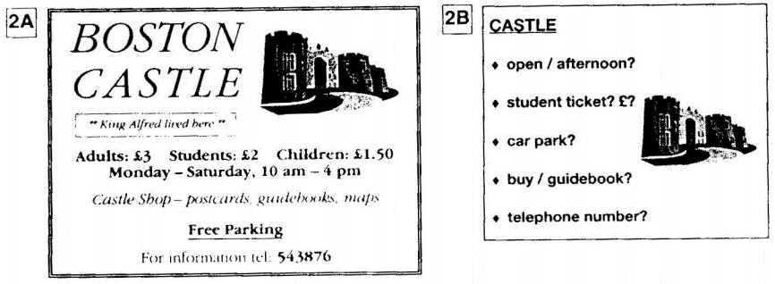
Ask and answer
Ask and answer questions using the words given.

Slide 17
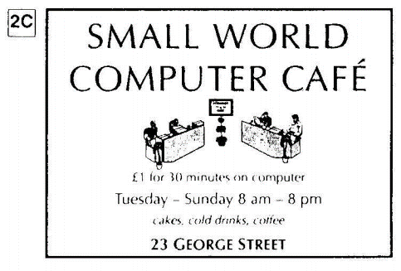
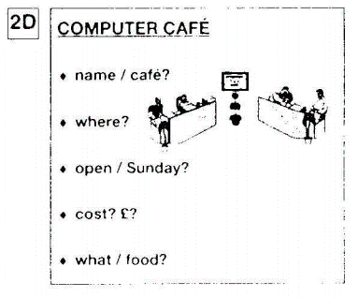
Ask and answer
Ask and answer questions using the words given.
What are other questions and answers you can think of?

Slide 18
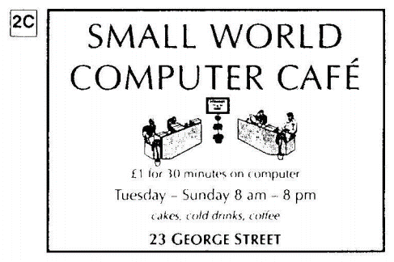
Based on the given information, talk about the Small World computer cafe.

