Slide 1


Slide 2
EXPERIENCING PEER PRESSURE
Unit
9
SOCIAL ISSUES
Unit
FAMILY LIFE
LESSON 4
SPEAKING

Slide 3
LESSON 4
SPEAKING
WARM-UP
Quiz: Peer pressure
Task 1: Order the examples of peer pressure from 1 to 6.
Task 2: Talk about your experiences of peer pressure.
CONTROLLED PRACTICE
LESS CONTROLLED PRACTICE
Task 3: Read the situations and think of some possible responses.
FREE PRACTICE
Task 4: Report your answer.
CONSOLIDATION
Wrap-up
Homework

Slide 4
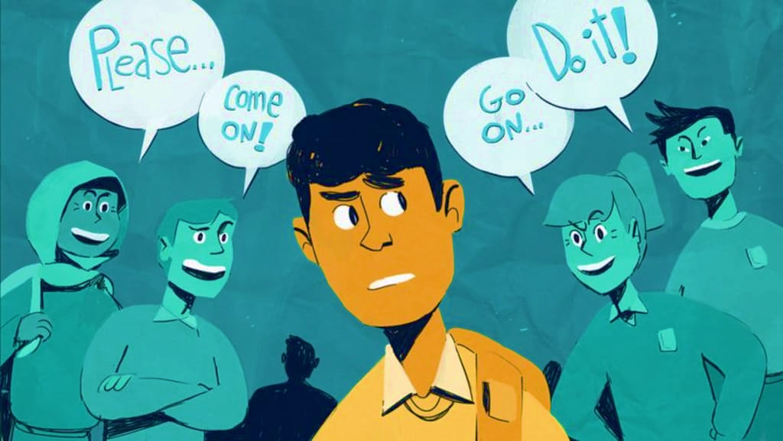
WARM-UP
Let‘s Quiz!
What do you know about Peer Pressure?

Slide 5

1. Your peers are...
your teachers
A
people about your own age
B
your parents
C
your cousins
D

Slide 6
2. When people your age try to influence you to believe or act like them it is called?
Communication
A
Friendship
B
Peer pressure
C
Negotiation
D

Slide 7
3. Peer pressure can be...
positive
A
negative
B
positive OR negative
C
none of them
D

Slide 8
4. Peer pressure can influence which of the following:
Clothing styles
A
Taste in music
B
Hairstyles
C
All of the above
D

Slide 9
5. A friend wants you to smoke with them. This is an example of .....
positive peer pressure
A
negative peer pressure
B

Slide 10


VOCABULARY
positive (adj)
/ˈpɒzətɪv/
full of hope and confidence, or giving cause for hope and confidence

Slide 11

VOCABULARY
permission (n)
/pəˈmɪʃən/
the act of allowing someone to do something, or of allowing something to happen

Slide 12
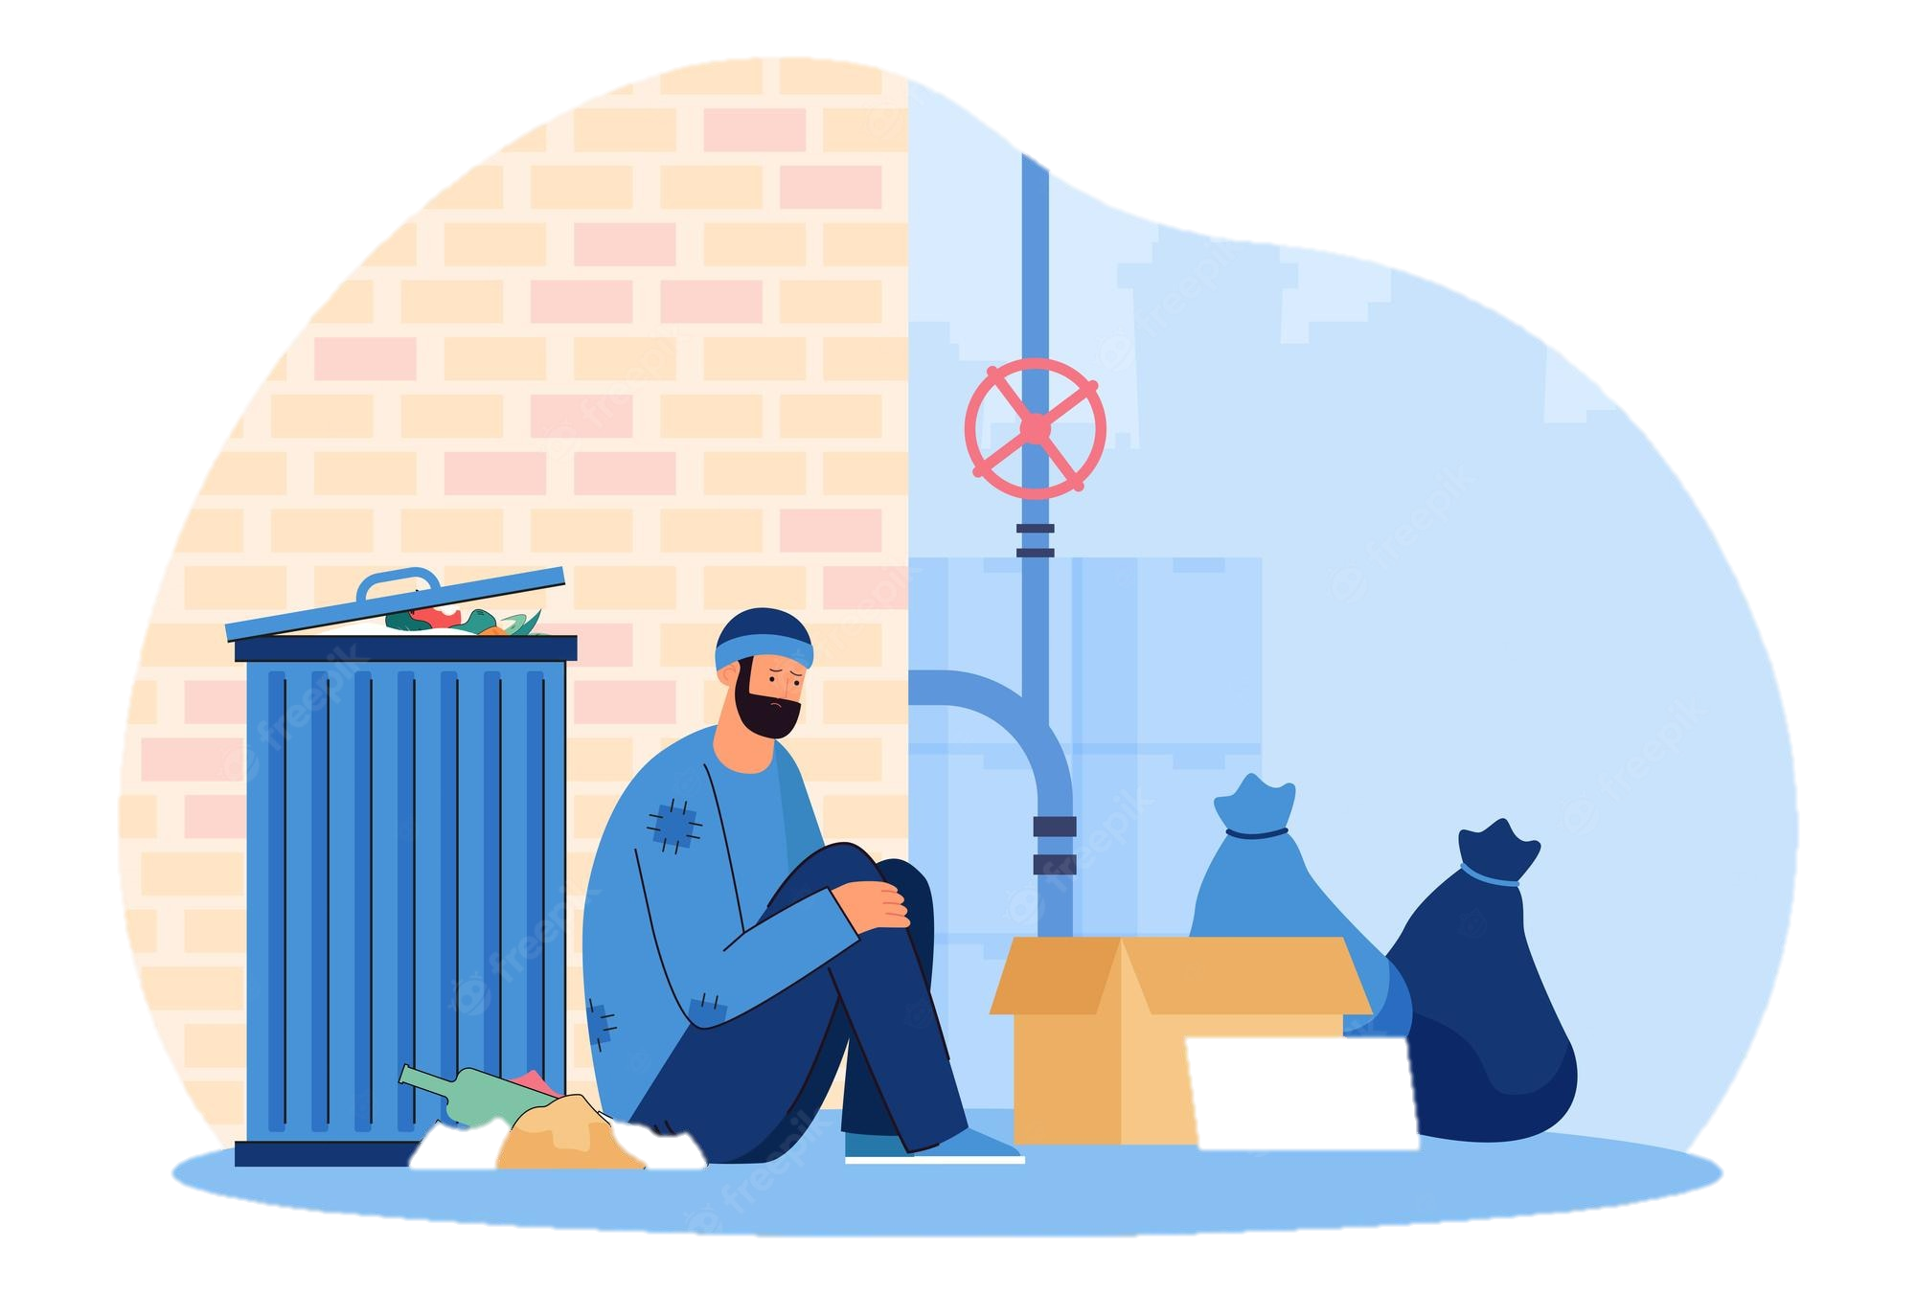
VOCABULARY
poverty (n)
/ˈpɒv.ə.ti/
the condition of being extremely poor

Slide 13
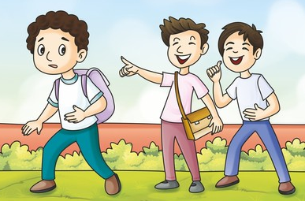
VOCABULARY
make fun of
/ˌmeɪk ˈfʌn əv/
to make a joke about someone or something in a way that is not kind

Slide 14
Form | Pronunciation | Meaning
1. positive (adj) | /ˈpɒzətɪv/ | full of hope and confidence, or giving cause for hope and confidence
2. permission (n) | /pəˈmɪʃən/ | the act of allowing someone to do something, or of allowing something to happen
3. poverty (n) | /ˈpɒvəti/ | the condition of being extremely poor
4. make fun of | /ˌmeɪk ˈfʌn əv/ | to make a joke about someone or something in a way that is not kind

Slide 15
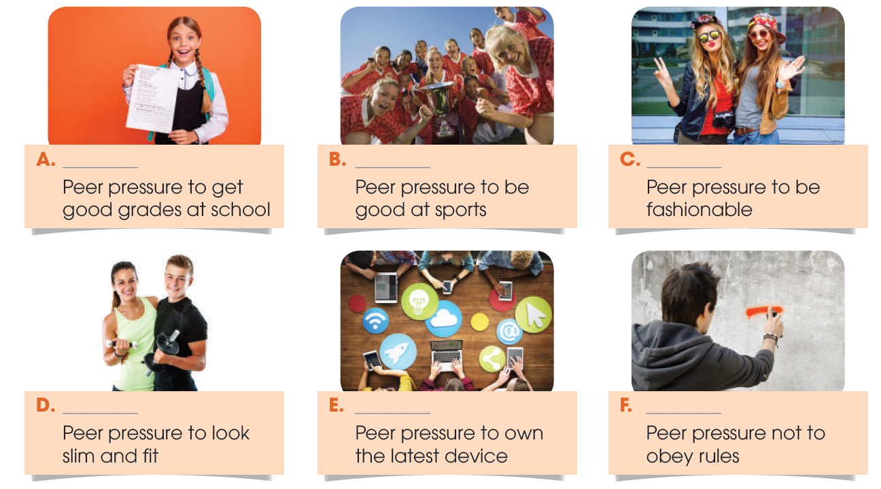
CONTROLLED PRACTICE
1
Order the examples of peer pressure below from 1 (most powerful) to 6 (least powerful).

Slide 16
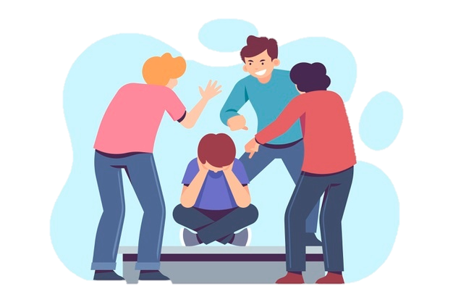
CONTROLLED PRACTICE
2
Work in pairs. Talk about your experiences of peer pressure. Use the following guiding questions.
- Which example of peer pressure (A–F) in 1 affects you most? Why?
- Which one affects you the least? Why?
- Which are examples of positive peer pressure?

Slide 17
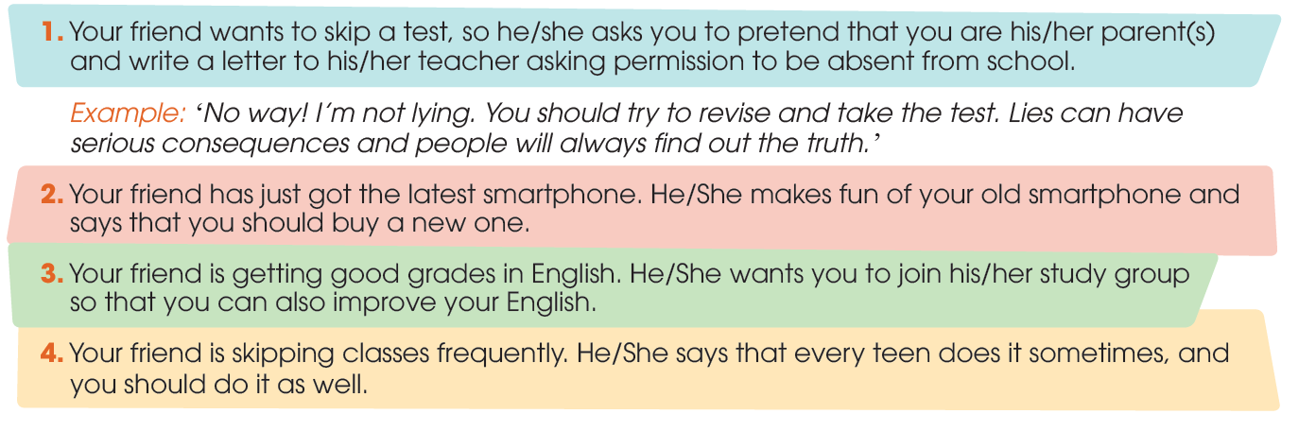
LESS CONTROLLED PRACTICE
3
Work in groups. Read the situations below and think of some possible responses. Provide reasons for each answer.

Slide 18

SUGGESTED ANSWERS
LESS CONTROLLED PRACTICE
2. I’m not ashamed of my old phone. We are students and not making any money yet, so buying the latest smartphone will cost my parents too much money. Besides, my phone is still working properly and I don’t see any reason why I should buy a new one.
3. That’s a great idea! Learning with stronger students like you will motivate me to study harder. Besides, I could learn some useful techniques from you and others to improve my grades.
4. No way! Skipping classes without permission is a sign of disrespect to the teacher. Besides, I don’t want to fall behind with my schoolwork.

Slide 19

FREE PRACTICE
4
Report your answers to the whole class. Vote for the most interesting response.

Slide 20

CONSOLIDATION
What have you learnt today?
Talk about experiences of peer pressure and respond to peer pressure situations.

Slide 21

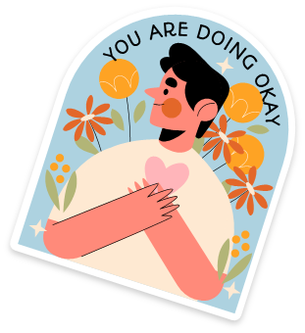
CONSOLIDATION
Do exercises in the workbook.
Prepare for Lesson 5 - Unit 9.

Slide 22

Website: hoclieu.vn
Fanpage: facebook.com/www.tienganhglobalsuccess.vn/

