Slide 1

Unit 3: All about food
Lesson 3i: Progress Check
Page 66

Slide 2
Lesson Outline
Warm-up
Vocabulary
Grammar
Everyday English
Consolidation
Wrap-up

Slide 3
Objectives
By the end of this lesson, students will be able to…
review vocabulary about foods and cooking tools.
review quantifiers, comparatives and superlatives.
read a text and answer questions.

Slide 4

WARM-UP

Slide 5
Choose the word whose underlined part is pronounced differently from that of the others.
1. A. carrot B. powder C. lemon D. carton
/ˈkærət/ /ˈpaʊdər/ /ˈlemən/ /ˈkɑːtən/
2. A. butter B. ketchup C. lettuce D. mustard
/ˈbʌtər/ /ˈketʃʌp/ /ˈletɪs/ /ˈmʌstəd/
3. A. relish B. oven C. vendor D. pepper
/ˈrelɪʃ/ /ˈʌvən/ /ˈvendər/ /ˈpepər/

Slide 6
Choose the word whose main stress is placed differently from that of the others.
1. A. include B. decide C. cover D. prepare
/ɪnˈkluːd/ /dɪˈsaɪd/ /ˈkʌvər/ /prɪˈpeər/
2. A. amount B. number C. water D. flavour
/əˈmaʊnt/ /ˈnʌmbər/ /ˈwɔːtər/ /ˈfleɪvər/
3. A. ingredient B. entertainment C. information D. preparation
/ɪnˈɡriːdiənt/ /entəˈteɪnmənt/ /ɪnfəˈmeɪʃən/ /prepəˈreɪʃən/

Slide 7

It’s time to learn …

Slide 8

Vocabulary

Slide 9
Put the words below into three groups: foods/drinks, food preparation verbs, cooking tools.
orange juice, pizza, chop, knife, beef, ice cream, grate, cake tin, peel, milk, pepper, whisk, saucepan, mix
Foods/drinks | Food preparation verbs | Cooking tools
orange juice
pizza
beef
ice cream
milk
pepper
chop
grate
peel
mix
knife
cake tin
whisk
saucepan

Slide 10
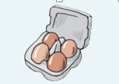




Fill in the letters to complete the food words.
1 e _ _ _
2 b _ _ _ _
3 b _ _ _ _ _
4 c _ _ _ _ _ _
5 c _ _ _ _ _
g
g
s
r
e
a
d
u
t
t
e
r
h
i
c
k
e
n
h
e
e
s
e

Slide 11
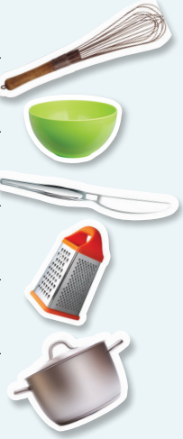
Unscramble the letters and write the correct word.
1 kiwhs ______________
2 lwob ______________
3 ifenk ______________
4 retrag ______________
5 ucesanpa ______________
whisk
bowl
knife
grater
saucepan

Slide 12
1. Choose the correct word.
1 Chop/Add the onions with a whisk/knife.
2 Grate/Beat the eggs with a grater/whisk.
3 To make potato chips, mix/peel the potatoes and slice/mix them thin.

Slide 13
2. Circle the odd word out.
1 Vegetables: onions – rice – lettuce – cucumber
2 Fruit: cherries – strawberries – chicken – oranges
3 Dairy products: tea – milk – butter – cheese
4 Grain: bread – flour – cereal – fish

Slide 14

Grammar

Slide 15
Quantifiers
 | Countable | Uncountable | Affirmative | Negative | Interrogative
A lot of/ lots of
Many
Much
Some
Any
A few
A little
Few
Little
no
v
v
v
v
v
v
v
v
v
v
v
v
v
v
v
offer
v
v
v
v
v
v
v
v
v
v
v
v
v
v
v

Slide 16
3. Choose the correct word.
1 How much/How many apples do we need? Not much/Not many.
2 There isn’t many/much pasta. Can you buy a can/packet, please?
3 Can I please have any/some tea? A cup/bowl is fine.
4 There are a few/a little oranges in the fridge. We can make some/an orange cake.
5 There aren’t some/any oranges. Let’s go and buy a little/some.
6 There isn’t some/any milk. Would you like any/some apple juice?
7 Can you please buy a jar/loaf of bread and two bars/cartons of milk?
8 There’s a few/a little yoghurt. Would you like a few/some?

Slide 17
Comparison
 | Comparative | Superlative
Short adjective | Adj + ER | the + adj + EST
Long adjective | MORE + adj | the + MOST + adj
Exception:
happy – happier – the happiest
good – better – the best
bad – worse – the worst
many/much/a lot – more – the most

Slide 18
4. Put the adjectives in brackets into the comparative or superlative form.
1 This café is ______________________ (expensive) than that one.
2 The restaurant near my house is ___________________ (cheap) than Karen’s.
3 This is ____________________ (trendy) restaurant in town.
4 This is ____________________ (delicious) pie of the café!
5 Here’s _____________________ (good) place to have a juicy burger.
6 I find hot dogs ___________________ (tasty) than fish and chips.
7 Mark’s is ____________________ (popular) fast food restaurant in the area.
8 There are ____________ (many) dishes to choose from at Paul’s than at Mike’s.
more expensive
cheaper
the trendiest
the most delicious
the best
tastier
the most popular
more

Slide 19

Reading

Slide 20
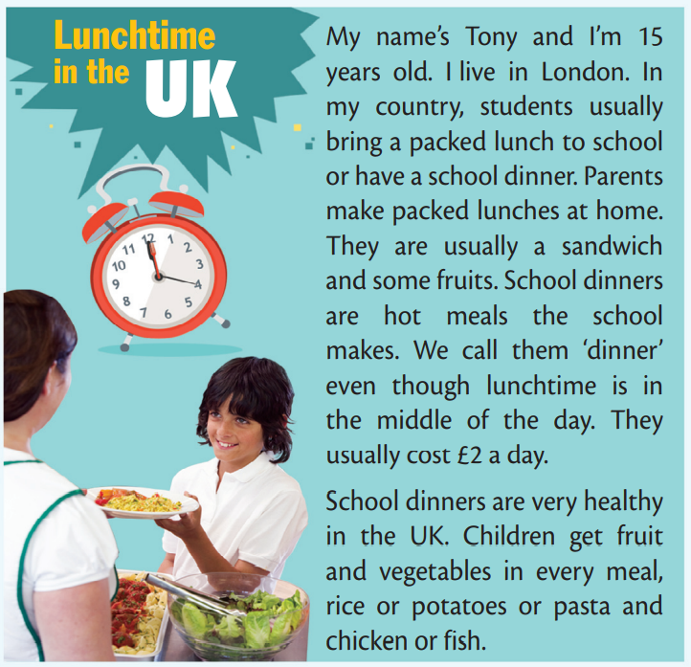
Look at the picture and the title and guess what the text is about.
It’s about lunch time of students in the UK.

Slide 21
Read the questions and underline key words.
1 Where is Tony from?
2 What is a packed lunch?
3 What is a school dinner?
4 How much does a school dinner cost?
5 What food is usually in a school dinner?

Slide 22
Read the text and answer the questions.
1 Where is Tony from?
My name’s Tony and I’m 15 years old. I live in London.
He’s from the UK.
2 What is a packed lunch?
Parents make packed lunches at home. They are usually a sandwich and some fruits.
It usually includes a sandwich and some fruits.
3 What is a school dinner?
School dinners are hot meals the school makes.
They are hot meals the school makes.

Slide 23
4 How much does a school dinner cost?
We call them ‘dinner’ even though lunchtime is in the middle of the day. They usually cost £2 a day.
It costs £2 a day.
5 What food is usually in a school dinner?
School dinners are very healthy in the UK. Children get fruit and vegetables in every meal, rice or potatoes or pasta and chicken or fish.
A school dinner usually has fruit and vegetables, rice or potatoes or pasta, and chicken or fish.

Slide 24

CONSOLIDATION

Slide 25
Write a short paragraph (about 60 words) about lunchtime of a Vietnamese student, using the vocabulary you have learnt.

Slide 26

WRAP-UP

Slide 27
Today’s lesson
Vocabularies
Foods and drinks
Food preparation verbs
Cooking tools
Grammar
Quantifiers
Comparatives
Superlatives
Reading
Read a text about lunchtime in the UK

Slide 28
Homework
Practise the vocabularies and grammar by making sentences using them.
Prepare for the next lesson (p. 67 SB).
Do Unit 3 Test 2 in Bài Tập Bổ Trợ TA 6 Right on (pp. 30-31).
Do the review (Units 1-3) in TA 6 Right on Notebook (pp. 34-35).

Slide 29

Enjoy your day!

