Slide 1

Unit 5: Travel & Transportation
Right on!
Page 91

Slide 2
Lesson Outline
Warm-up
Project
Consolidation
Wrap-up

Slide 3
Objectives
By the end of this lesson, students will be able to…
create a brochure of wonders in your country.
give a presentation on wonders in your country.
talk about the value of being a responsible traveller.

Slide 4

WARM-UP

Slide 5

Work in groups.
Decide two wonders in Vietnam that your group will introduce to students from other countries. Why do you choose those wonders?

Slide 6

It’s time to learn …

Slide 7
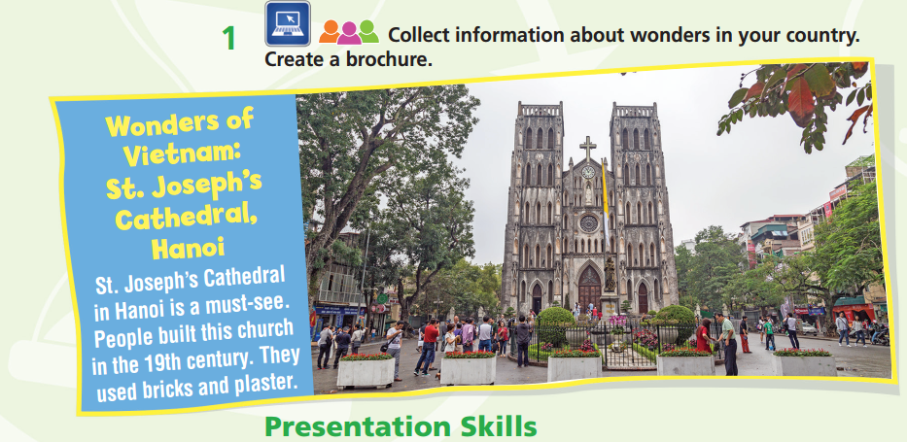

Work in groups.
Where is it in Vietnam?
When was it built?
What are special things about it?

Slide 8
Requirement for a brochure
Use the main heading: WONDERS IN VIETNAM
At least 2 wonders
Content: Where is it in Vietnam? When was it built? What are special things about it? etc.
At least 25 words for each wonder
Clear and brief information
Effective display, especially pictures

Slide 9
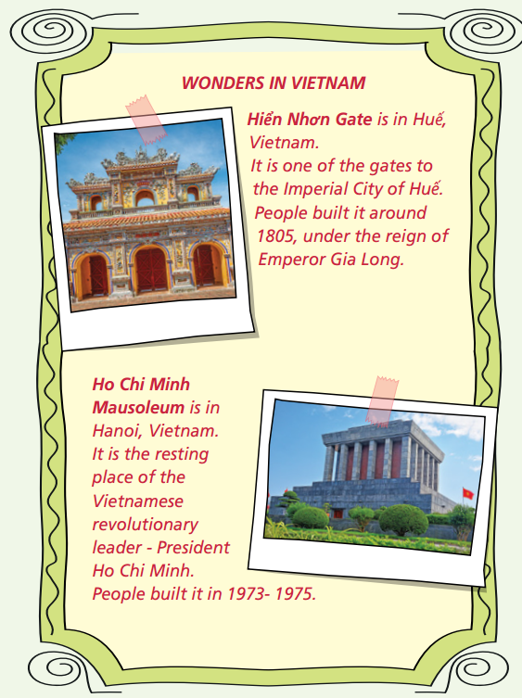
SAMPLE
BROCHURE

Slide 10

Work in groups.
Hello everyone.
Welcome to Vietnam! Today, I’m going to talk to you about some wonders in Vietnam which you might want to visit.
First of all, ………..
Another place you should see is ………….
Those are two famous wonders you should visit while you’re here in Vietnam.
I hope you enjoy your visit! Thank you for listening.

Slide 11
Sample presentation
Hello everyone.
Welcome to Vietnam! Today, I’m going to talk to you about some wonders in Vietnam which you might want to visit.
First of all, there is the Hiển Nhơn Gate in Huế. It is one of the gates to the Imperial City of Huế. They built the gate around 1805, under the reign of Emperor Gia Long. You should go and see it.
Another place you should see is Ho Chi Minh Mausoleum in Hanoi. It is the resting place of the Vietnamese revolutionary leader – President Ho Chi Minh. People built it in 1973-1975.
Those are two famous wonders you should visit while you’re here in Vietnam.
I hope you enjoy your visit! Thank you for listening.

Slide 12
Presentations tips
Keep eye contact with the class.
Look around the class.
Point at the brochure (pictures, text…) when needed.
Use suitable movements.
Don’t turn your back to the class.
Be confident!
Speak loudly and clearly.

Slide 13
Evaluation form
While your friends are making a presentation, please leave your comments on the following form:
Criteria | Yes | No | Comments (if any)
Brochure Effective display Clear and brief information Meaningful content | ✓ | ✓
Presentation skills Confident Loud and clear voice Good eye-contact Suitable movement

Slide 14
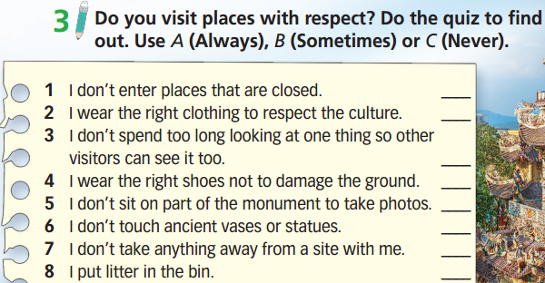


Slide 15
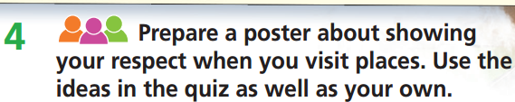
Work in groups.
Requirement for a poster
Display: effective, especially pictures
Content: meaningful messages about respect when visiting places
Clear and brief information

Slide 16
Present the poster to the class.
Hello everyone.
My name is …. I am here today to share with you what we can do to show respect when visiting places.
First, we should/shouldn’t…… Second, ………. Third, …………
In addition, ………. Also, …….. Finally, ……..
There are so many ways for us to show respect when we visit places. Let’s do it together to protect beautiful places around us. Thanks for listening.

Slide 17
Present the poster to the class.
Sample presentation
Hello everyone.
My name is…. I am here today to share with you what we can do to show respect when visiting places.
First, we should wear the right clothing to respect the culture, especially when we go to religious regions. Second, don’t touch ancient vases or statues because the natural oil in our hands may be bad for them. Third, don’t take anything away from a site so that other visitors can see them. In addition, we should put litter in the bin to keep the site clean. Finally, we shouldn’t enter places that are closed because we may be punished.
There are so many ways for us to show respect when we visit places. Let’s do it together to protect beautiful places around us. Thanks for listening.

Slide 18
Evaluation form
While your friends are making a presentation, please leave your comments on the following form:
Criteria | Yes | No | Comments (if any)
Brochure Effective display Clear and brief information Meaningful content | ✓ | ✓
Presentation skills Confident Loud and clear voice Good eye-contact Suitable movement

Slide 19

CONSOLIDATION

Slide 20

GROUPWORK
Your class is going to have a holiday tour. You can use ideas in Task 3 or your own ideas to decide 3 most important things your group will do to show respect for your holiday destination.
e.g.
put litter in the bin
don’t enter places that are closed
wear the right clothing

Slide 21

WRAP-UP

Slide 22
Today’s lesson
Create a brochure of wonders in your country.
Give a presentation on wonders in your country.
Talk about the value of being a responsible traveller.

Slide 23
Homework
Practise giving a presentation on a familiar topic.
Prepare the next lesson (page 92 SB).

Slide 24

Enjoy your day!

