Slide 2



Unit
9
CITIES OF THE WORLD
LESSON 7: LOOKING BACK & PROJECT
1

Slide 3
LESSON 7: LOOKING BACK & PROJECT
LESSON 1: GETTING STARTED
Adjective Brainstorming
WARM-UP
Looking back
Vocabulary
Task 1: Choose the best two options to complete the sentences.
Task 2: Write the words in the box under their pictures.
Grammar
Task 3: Complete the sentences with the correct possessive pronouns in the box.
Task 4: Read the sentences and correct the underlined words.
LOOKING BACK
PROJECT
Project
CONSOLIDATION
Wrap-up
Homework

Slide 4




WARM UP
ADJECTIVE BRAINSTORM
1.
Work in 6-8 groups to list out all the suitable adjectives for the given topics.
2.
1 minute/topic
3.
The team with the most suitable words wins
CITY
WEATHER
PEOPLE
FOOD

Slide 5

Vocabulary

Slide 6
LOOKING BACK
1
Choose the best two options to complete the sentences.
1.
The city is .
B.
amazing
A.
exciting
C.
long
2.
The weather is .
A.
cold
B.
quiet
C.
sunny
3.
The people are .
B.
C.
helpful
A.
friendly
expensive
4.
The buildings are .
A.
B.
beautiful
C.
fast
tall
The food is .
5.
A.
B.
delicious
C.
good
cute

Slide 7
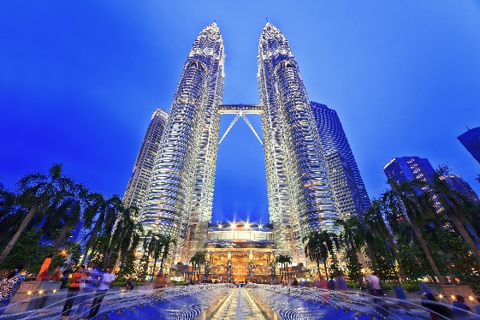
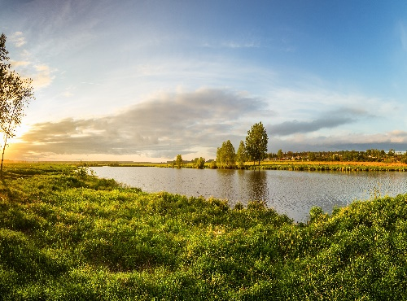
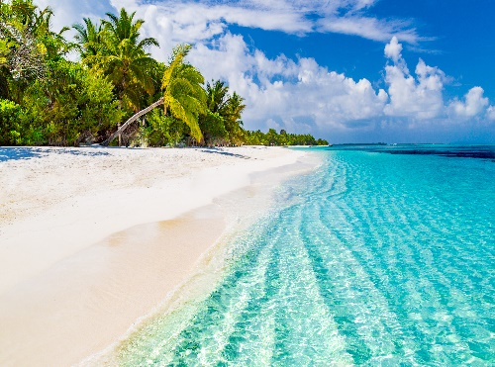
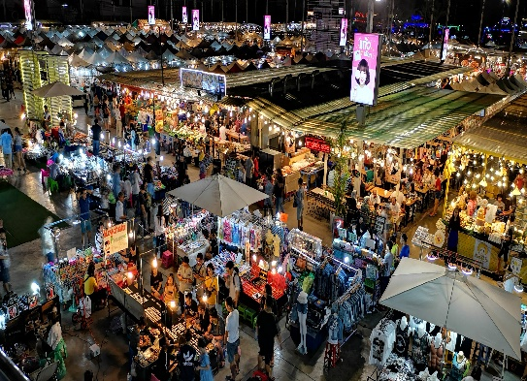
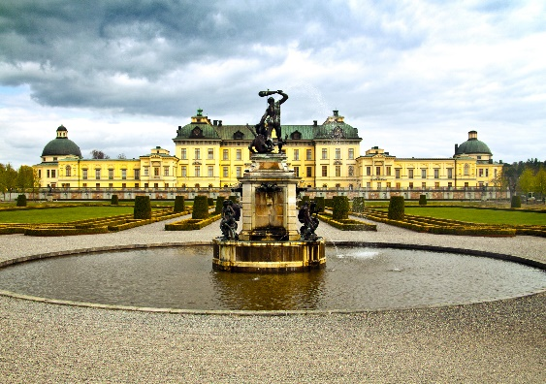

LOOKING BACK
2
Answer questions about your classmates.
towers
postcard
beach
1.
towers
2.
river bank
beach
3.
palace
river bank
night market
4.
5.
palace
postcard
night market
6.

Slide 8
Grammar

Slide 9
LOOKING BACK
3
Complete the sentences with the correct possessive pronouns in the box.
theirs
hers
yours
mine
ours
1.
Hey Phong. You’re wearing my hat. It’s not .
yours
2.
theirs
We’re looking for Mr and Mrs Smith’s house. Is that ?
3.
mine
This is my drawing. It’s .
4.
Ours
This is your room. is next door. So call us if you need anything.
5.
Sue doesn’t need to borrow my pen. She’s got .
hers

Slide 10
LOOKING BACK
4
Read the sentences and correct the underlined words.
1.
Bangkok is an exciting city. I love it’s people
its
2.
We are watching the sunrise at Angkor Wat with ours local friends.
our
3.
Discover Beijing and Shanghai through theirs food tours.
their
4.
Visit Hue and try your food.
its
5.
Venice is your city and Jakarta is our.
ours

Slide 11
PROJECT

Slide 12



Work in groups.
Make a report of your findings and present it to the class.
Choose one city in the world you would like to visit.
Find necessary information for your visit.

Slide 13
Suggestions:
Make a report of your findings and present it to the class.
What city is it?
Where is it?
How can you go there?
What’s the weather like there?
What would you like to see and do there?

Slide 14
CONSOLIDATION
Now I can … |  |  | 
use the words related to cities and landmarks.
pronounce the sounds /əʊ/ and /aʊ/ correctly.
use possessive adjectives and possessive pronouns.
express exclamations with What.
read about a holiday postcard.
talk about a city.
listen to a description of a city.
write a holiday postcard.
✓
✓
✓
✓
✓
✓
✓
✓
✓
✓
✓
✓
✓
✓
✓
✓
✓
✓
✓
✓
✓
✓
✓
✓

Slide 15

CONSOLIDATION
1
Wrap-up
What have we learnt in this lesson?
Review the vocabulary and grammar of Unit 9
Apply what they have learnt (vocabulary and grammar) into practice through a project

Slide 16

CONSOLIDATION
2
Homework
Prepare for the next lesson: Read Unit 10.

Slide 17






Website: hoclieu.vn
Fanpage: facebook.com/www.tienganhglobalsuccess.vn/

