Slide 1

UNIT 4: INTERNATIONAL
ORGANIZATIONS AND CHARITIES
Lesson 3.2 – Writing and Speaking
Page 38

Slide 2




Lesson 3.2
LESSON OUTLINE
Consolidation

Slide 3

By the end of this lesson,
students will be able to …
write an article about how to raise money, using synonyms to avoid repetition.

Slide 4



Slide 5
Game
Work in groups. Match the words with the closest meaning together.
select
awful
happy
important
furious
love
answer
amazing
begin
end
reply
incredible
necessary
start
glad
finish
terrible
choose
angry
admire
select - choose
awful - terrible
happy - glad
important - necessary
furious - angry
love - admire
answer - reply
amazing – incredible
begin - start
end -finish
→

Slide 6



Slide 7
a. Read about using synonyms to avoid repetition, then read Minh Phan's article again and underline the synonyms for trip.
Pre-writing
Answer:
journey, expedition, travels

Slide 8
Writing skill
Using synonyms to avoid repetition
To avoid repetition and make your writing more varied, you can use synonyms. A synonym is a word that has the same or almost the same meaning as another word.
For example:
A schoolgirl has raised two thousand dollars for charity in just four days. The schoolgirl young student wanted to give something back to the community after receiving so much help after her accident last June.
Joanne Evans completed a 3,000 km hike to raise money for charity. She began her hike journey on September 12th with a goal of raising three thousand dollars.

Slide 9
Replace the underlined words with their synonyms from the box.
1. Emma organized an event to support the Battersea Dogs and Cats Home.
2. She hoped that the bike ride from Vietnam to the UK would raise awareness of environmental and social issues.
3. James and his friend participated in a marathon and raised over eight hundred dollars for the organization.
4. Five-year-old Rachel gave all her savings to charity and inspired many others to do the same.
5. An 11-year-old boy climbed Mount Snowdon and organized an event to raise money for two charities.

Slide 10
1. Emma organized an event to support – help the Battersea Dogs and Cats Home.
2. She hoped that the bike ride – cycle trip from Vietnam to the UK would raise awareness of environmental and social issues.
3. James and his friend participated in – took part in a marathon and raised over eight hundred dollars for the organization.
4. Five-year-old Rachel gave - donated all her savings to charity and inspired many others to do the same.
5. An 11-year-old boy climbed Mount Snowdon and organized – set up an event to raise money for two charities.

Slide 11



Slide 12
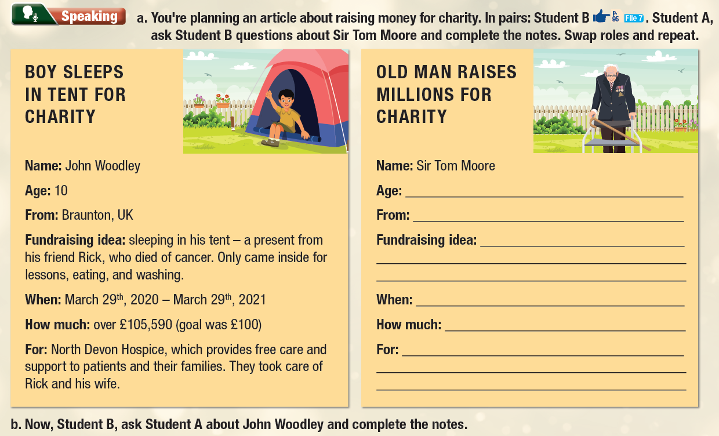

Slide 13
Fundraising idea:
What was his fundraising idea?
What did he do to raise money?
When:
When did he do it?
When was it?
How much:
How much did he get?
How much did he raise?
For:
What did he use the money for?
What did he do with the money?
Pre-speaking
Name:
What is his name?
Who is he?
Age:
How old is he?
What is his age?
From:
Where is he from?
Where does he come from?
Where is his hometown?

Slide 14

While-speaking
Work in pairs.
Student B: Look at Page 95 – File 7.
Student A: Ask Student B questions about Sir Tom Moore and complete the notes.
Swap roles and repeat. Now, Student B, ask Student A about John Woodley and complete the notes.

Slide 15
Post-speaking
Work in pairs.
Talk about someone you know who works to raise money for charity

Slide 16
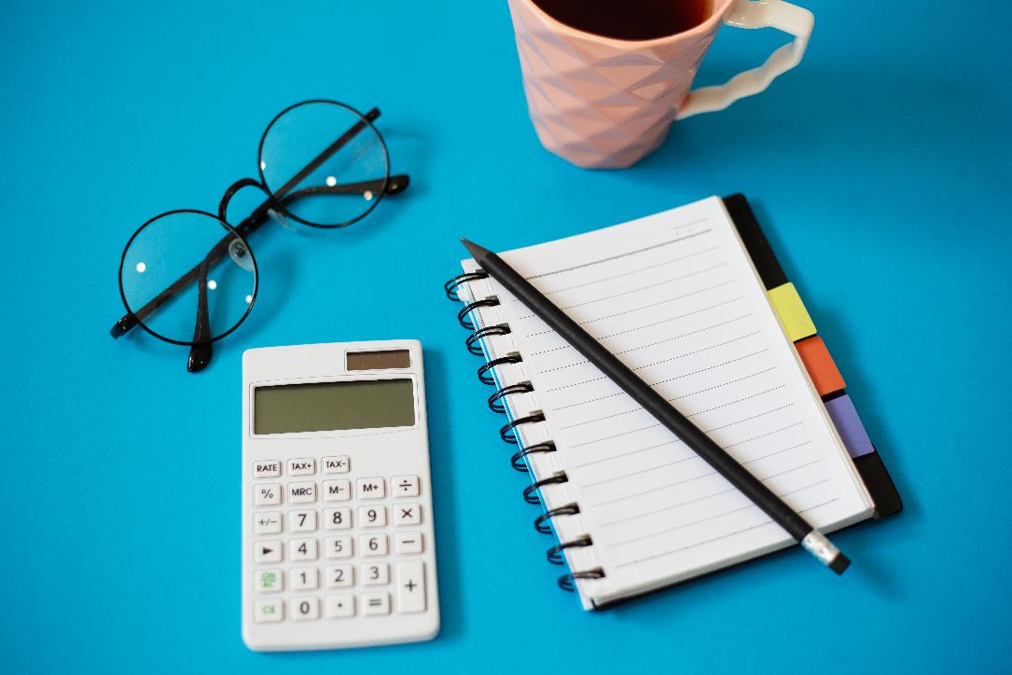


Slide 17
Now, write an article about John Woodley, Sir Tom Moore, or someone raising money for charity that you know. Use the Feedback form to help you. Write 120 to 150 words.
Pre-writing
Read the article about Minh Phan on page 36 again. Pay attention to the sentence or structure you will use in your writing exercise.
Read the notes about John Woodly and Sir Tom Moore. Try to give the answer in complete sentences. Pay attention to the tenses of verbs.

Slide 18
While-writing
Now, write an article about John Woodley, Sir Tom Moore, or someone raising money for charity that you know. Use the Feedback form to help you. Write 120 to 150 words.

Slide 19
SAMPLE:
BOY RAISES MONEY FOR CHARITY BY SLEEPING IN TENT
A ten-year-old boy from Braunton raised money for charity by camping in his yard.
Every night, John Woodley slept in the tent that his friend Rick gave him before Rick died of cancer. The boy started sleeping in Rick's tent on March 29th, 2020 and continued for one year. He stayed in his backyard most of the time, only came inside for school lessons, eating, and washing. John raised over 105,590 pounds for North Devon Hospice, which provides free care and support to patients and their families. The hospice took care of Rick and his wife before they passed away.
John's story has inspired many people to raise money for other charities.

Slide 20
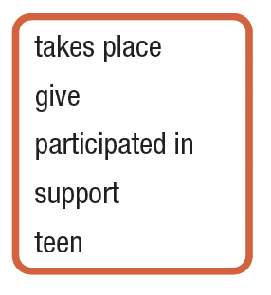
Extra Practice
WB, page 25
1. The high school student raised two thousand dollars in just a week for her local charity.
2. They donate clothes and books to help poor children.
3. The charity aims to help poor local children.
4. Twenty thousand people joined the Color Run and helped raise two hundred thousand dollars.
5. The marathon happens every September.
Answer:
teen
give
support
participate in
takes place

Slide 21
Extra Practice
WB, page 25
1. The high school student raised two thousand dollars in just a week for her local charity.
2. They donate clothes and books to help poor children.
3. The charity aims to help poor local children.
4. Twenty thousand people joined the Color Run and helped raise two hundred thousand dollars.
5. The marathon happens every September.
Answer:
teen
give
support
participate in
takes place

Slide 22
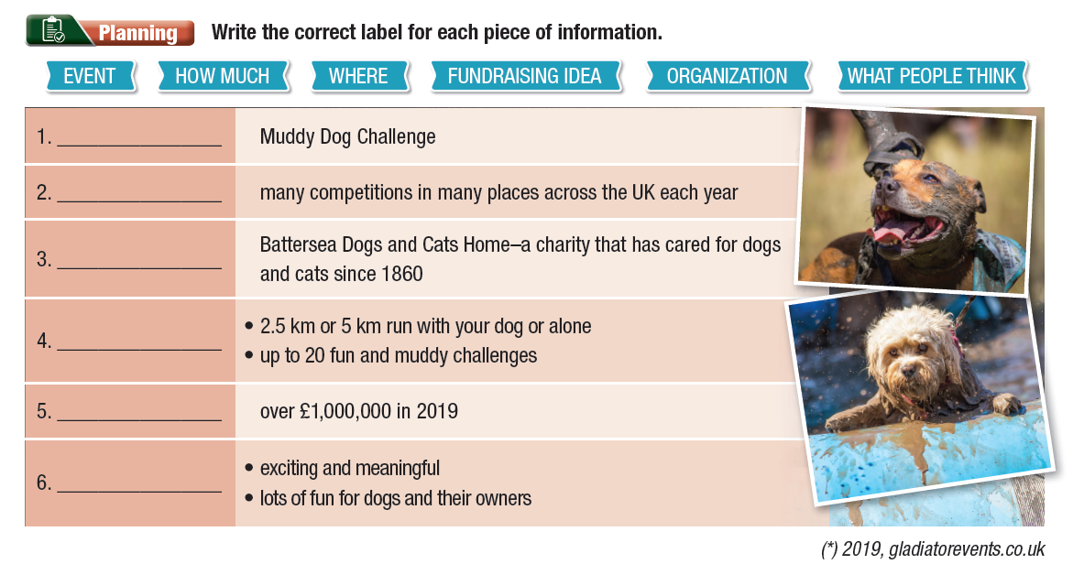

Slide 24
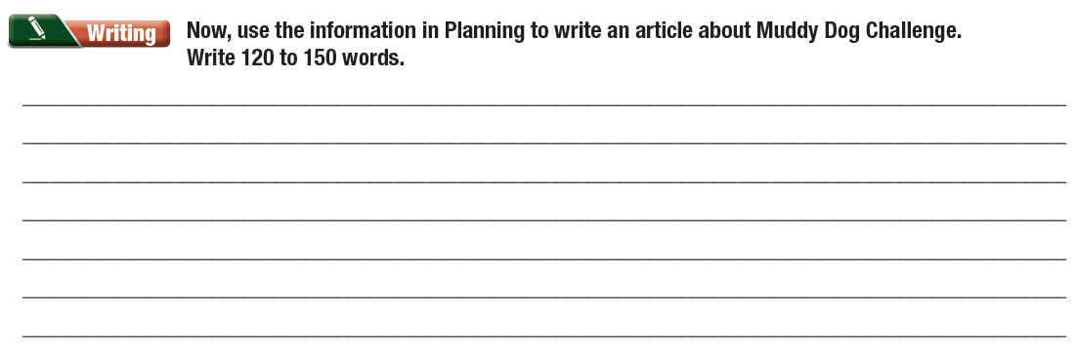

Slide 25

Consolidation

Slide 26

Work in groups.
Think of some interesting ways to raise money to help underprivileged students at your school.
I think we can/ should …
It’s a good idea to …
In my opinion, we can/ should …

Slide 27

WRAP-UP

Slide 28
Today’s lesson
Writing: write an article about ways to raise money for charity, using synonyms to avoid repetitions.
Speaking: talk about interesting ways to raise money for charity.

Slide 29
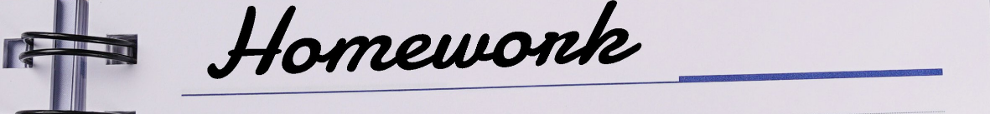

Write an essay in on page 37.
Review the vocabulary and grammar points in the unit in Tiếng Anh 10 i-Learn Smart World Notebook.
Prepare the next lesson – Unit 5 in SB.
Play the consolidation games in Tiếng Anh 10 i-Learn Smart World DHA App on www.eduhome.com.vn

