Slide 2


Unit
5
NATURAL WONDERS OF VIET NAM
LESSON 7: LOOKING BACK AND PROJECT
1

Slide 3
LESSON 7: LOOKING BACK AND PROJECT
LESSON 1: GETTING STARTED
WARM-UP
Brainstorming
Vocabulary
Task 1: Write the name for each picture.
Task 2: Match.
Task 3: Write the words
Grammar
Task 4: Find the mistake and correct it.
Task 5: Complete the dialogue.
LOOKING BACK
Task 1: Make a poster about a natural wonder you like to visit.
Task 2: Introduce the attraction.
PROJECT
CONSOLIDATION
Wrap-up
Homework

Slide 4
WARM-UP
Brainstorming
Things in nature
Travel items
desert, forest, mountain, lake, river, valley, cave, island, beach …
lighter, scissors, sleeping bag, compass, plastic, backpack …

Slide 5

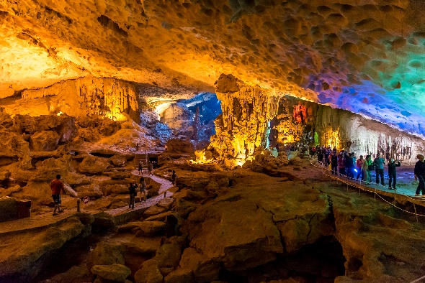
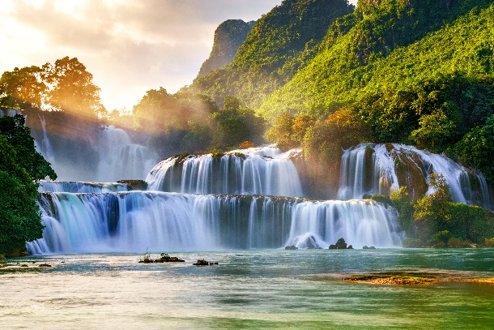
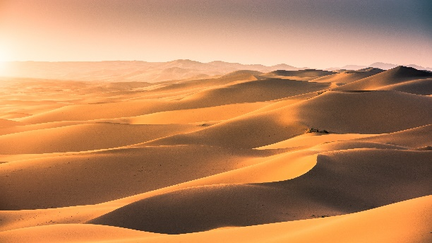
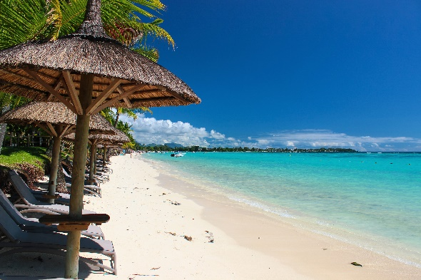
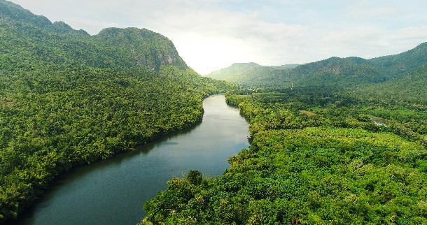
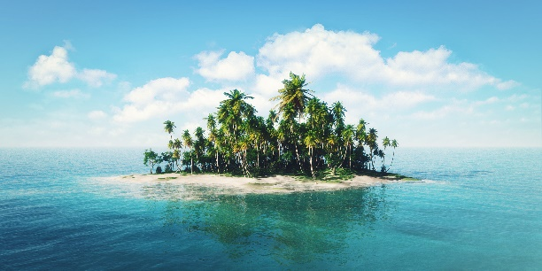
VOCABULARY
Write the name for each picture.

Slide 6

VOCABULARY
1.
waterfall

Slide 7

VOCABULARY
2.
cave

Slide 8

VOCABULARY
3.
desert

Slide 9

VOCABULARY
4.
river

Slide 10
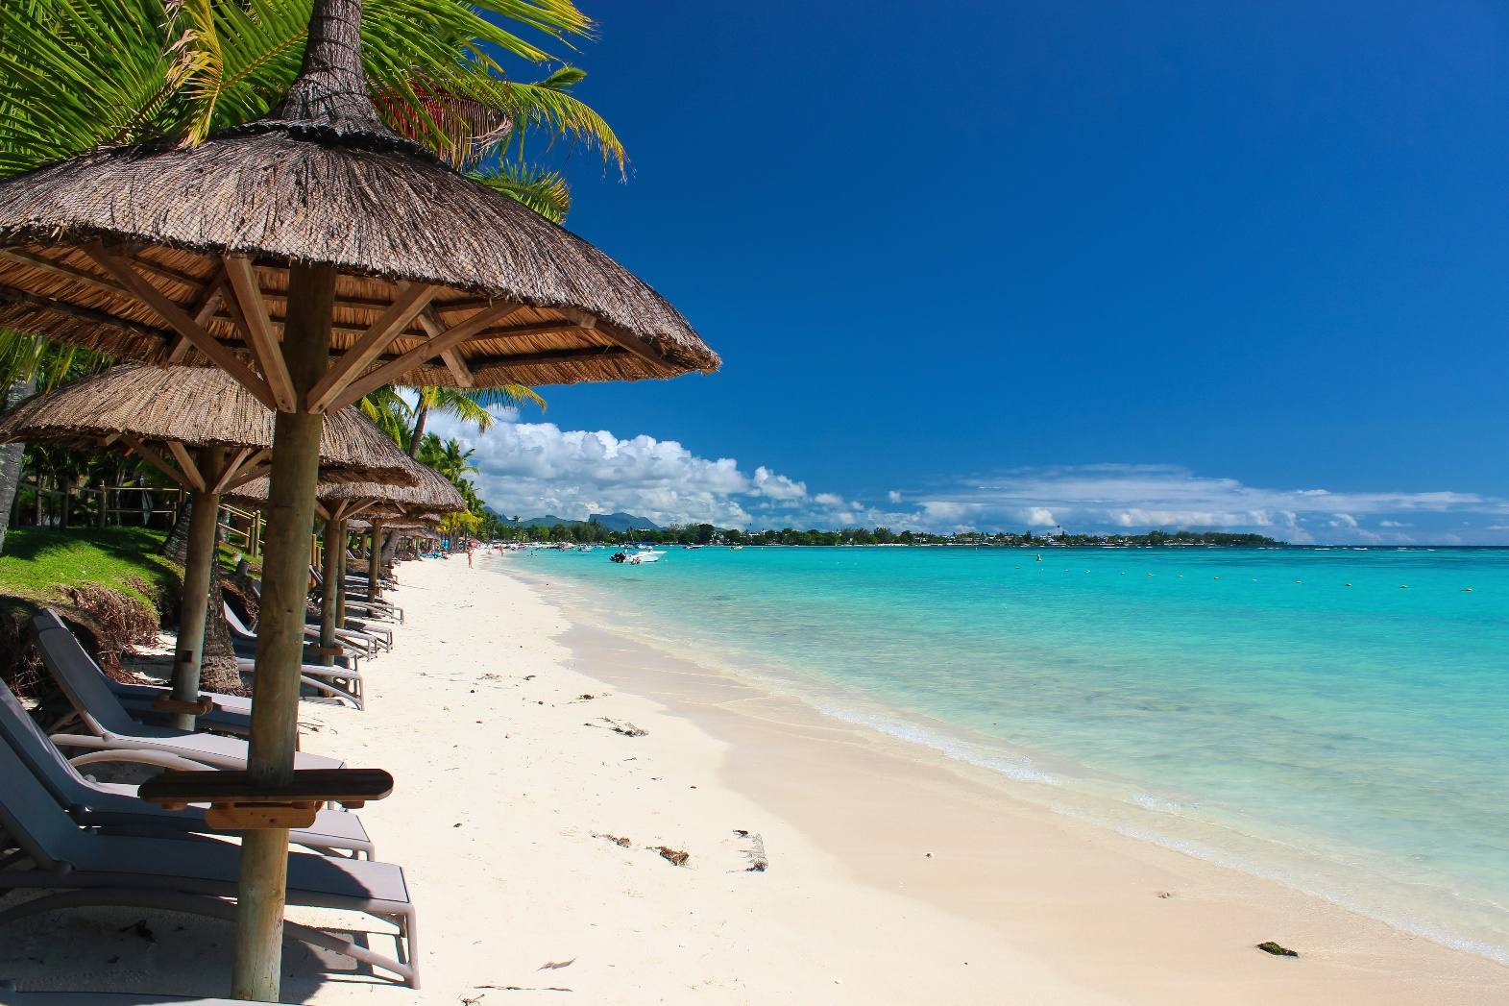
VOCABULARY
5.
beach

Slide 11
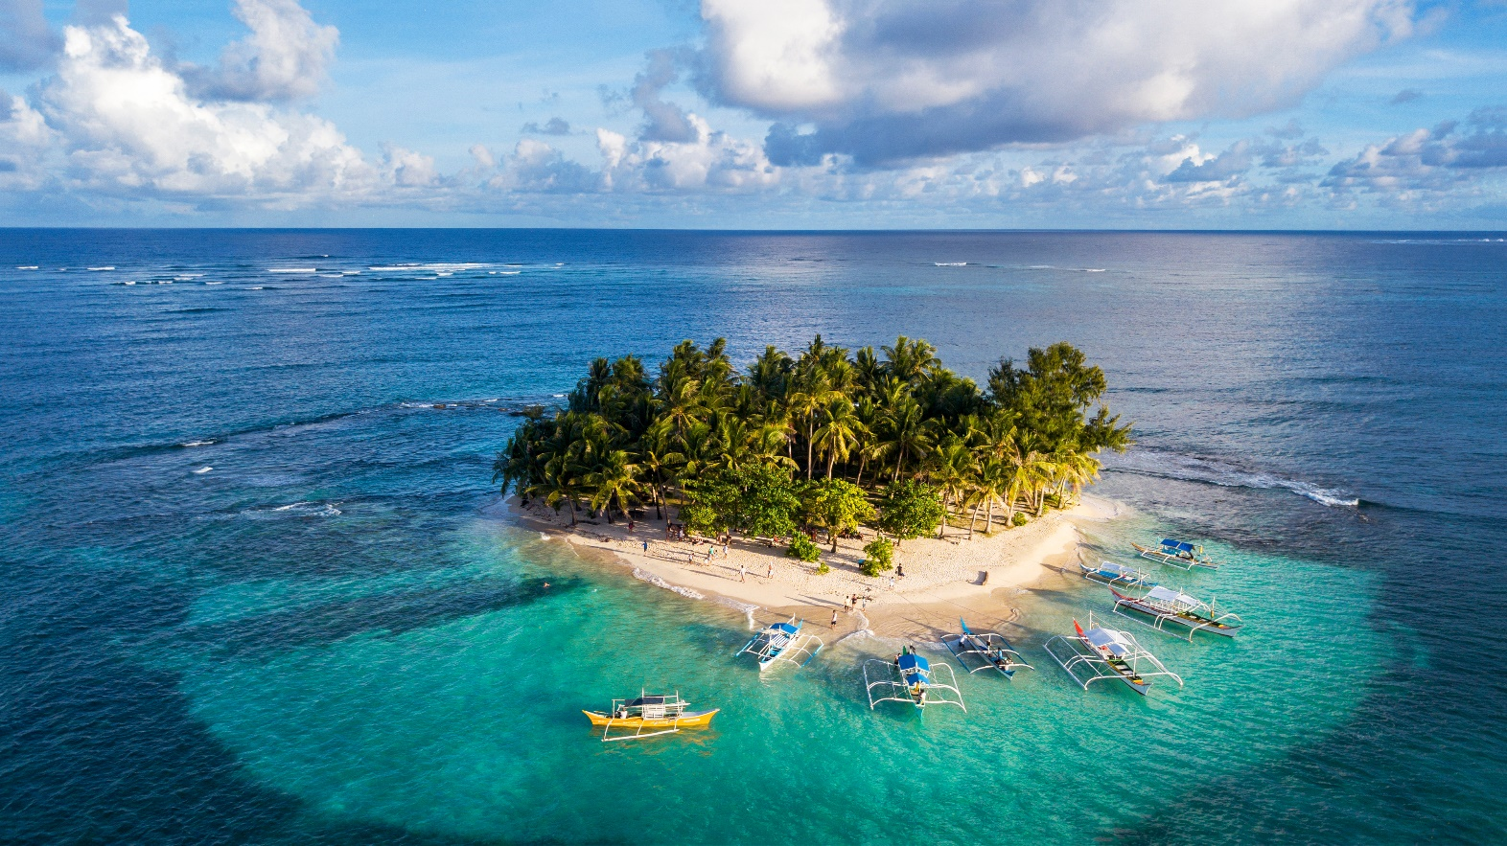
VOCABULARY
6.
island

Slide 12

VOCABULARY
Match the name of a natural wonder in column A with a word indicating it in column B.
A
B
1. Fansipan
a. bay
d. mount
2. Ban Gioc
b. island
c. waterfall
3. Ha Long
c. waterfall
a. Bay
4. Cuc Phuong
d. mount
e. forest
5. The Sahara
e. forest
f. desert
6. Con Dao
f. desert
b. Island

Slide 13


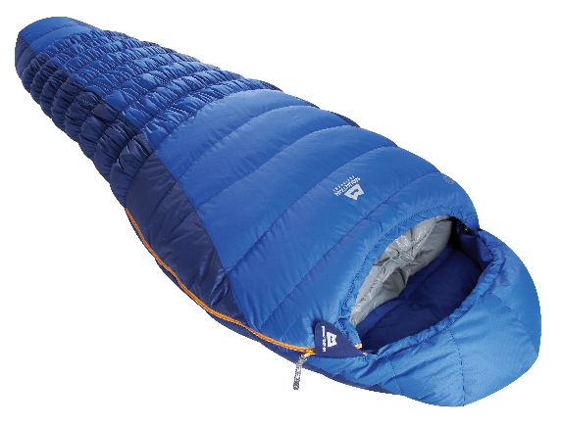
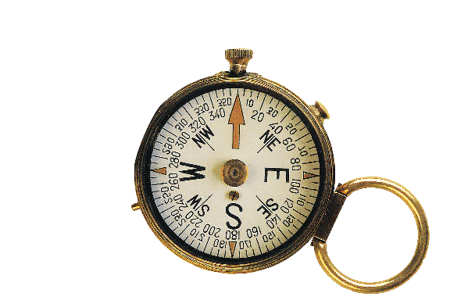
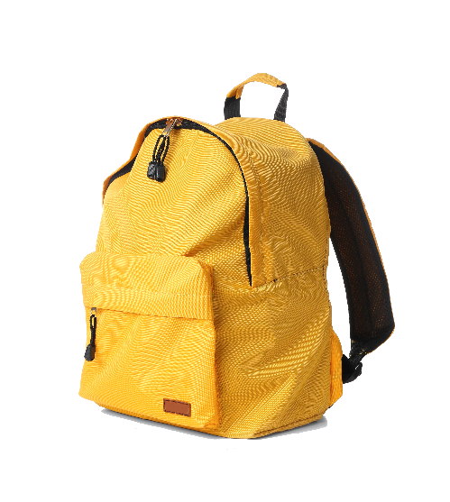
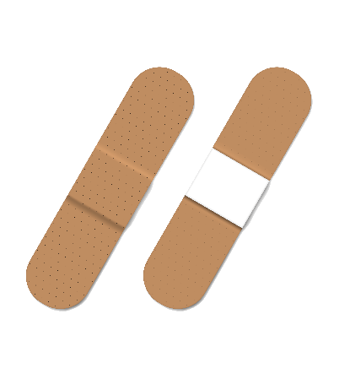
VOCABULARY
Write the words.
2. sleeping bag
3.
1. scissors
2.
3. compass
1.
5. plasters
4.
5.
4. backpack

Slide 14

GRAMMAR
Find the mistake in each sentence and correct it.
1. How many candles is on that birthday cake?
________________________________________
2. There are so much snow on the road.
________________________________________
3. Michael can play different musical instrument.
________________________________________
4. There are not much milk left in the fridge.
________________________________________
5. Don’t take too much luggages on your trip.
________________________________________
→ are
→ is
→ instruments
→ is
→ luggage

Slide 15

PRACTICE
Complete the dialogue, using must or mustn’t.
A: It’s dangerous to go hiking there. You (1) _______ tell someone where you are going.
B: Yes. And I (2) _______ take a warm coat. It’s very cold there.
A: Right. But you (3) _______ bring any heavy or unnecessary things with you.
B: OK, and I (4) _______ take a mobile phone. It’s very important.
A: And you (5) _______ forget to bring a compass.
must
must
mustn’t
must
mustn’t

Slide 16
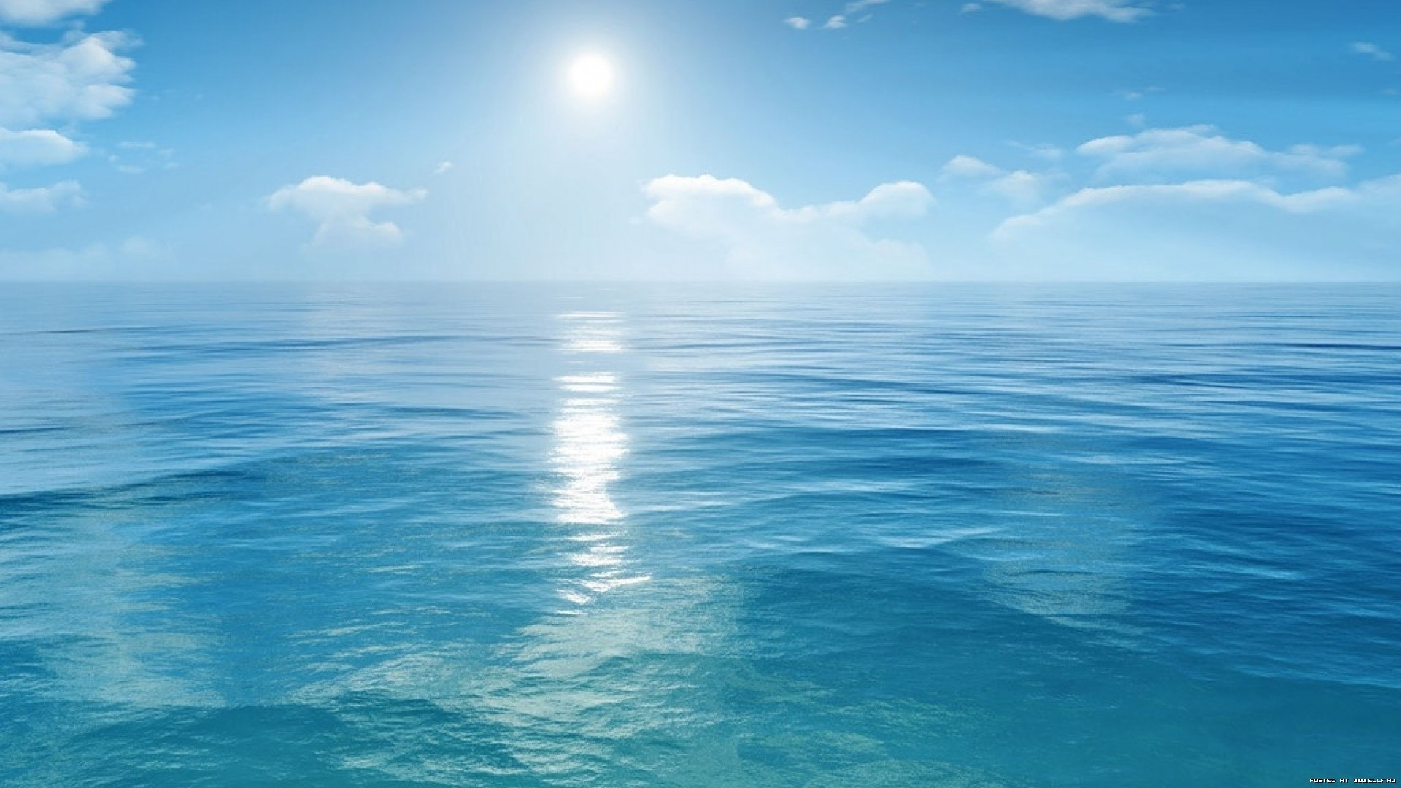

PROJECT
DREAM DESTINATION
what the natural wonder is
where it is
how you can go there
what it is special about
what you can do there
…

Slide 17

CONSOLIDATION
1
Wrap-up
What have we learnt in this lesson?
Vocabulary: Natural wonders and travel items
Grammar: Countable and uncountable Nouns
Must and mustn’t
Project: Dream destination

Slide 18

CONSOLIDATION
2
Homework
Do exercises in the workbook.
Prepare for Unit 6

Slide 19






Website: hoclieu.vn
Fanpage: facebook.com/www.tienganhglobalsuccess.vn/

