Slide 1


Slide 2



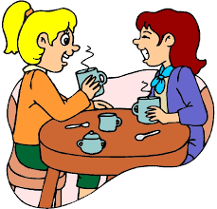
Unit
7
TRAFFIC
LESSON 4: COMMUNICATION
Unit
HOBBIES

Slide 3

OBJECTIVES
By the end of the lesson, students will be able to:
learn how to ask and answer about means of transport and some strange traffic rules
practise using some grammar points and vocabulary related to the topic

Slide 4
LESSON 4: COMMUNICATION
WARM-UP
Game: Brainstorming
Task 1: Listen and read the conversation, paying attention to the highlighted parts.
Task 2: Ask and answer about the means of transport your family members use every day.
EVERYDAY ENGLISH
Task 3: Which countries keep to the left? Tick the correct answers.
Task 4: Listen and check your answers in 3. Then listen again and complete the sentence with no more than THREE words.
Task 5: Read, discuss which one do is the strangest rule?
STRANGE TRAFFIC RULES
CONSOLIDATION
Wrap-up
Homework

Slide 5

LESSON 4: COMMUNICATION
WARM-UP
Game: Brainstorming
Aims of the stage:
To lead in the lesson

Slide 6
WARM-UP
Bicycle
Motobike
Train
HOW DO YOU GO TO SCHOOL?
Bus
Helicopter
Plane
Car

Slide 7
LESSON 4: COMMUNICATION
WARM-UP
Game: Brainstorming
Task 1: Listen and read the conversation, paying attention to the highlighted parts.
Task 2: Ask and answer about the means of transport your family members use every day.
EVERYDAY ENGLISH

Slide 8
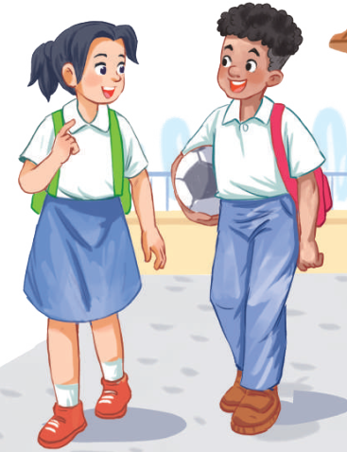
PRACTICE
EVERYDAY ENGLISH
Aims of the stage:
To let students know the structure to ask and answer about means of transport

Slide 9
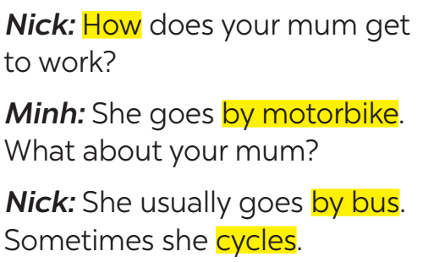

EVERYDAY ENGLISH
1
Listen and read the conversation, paying attention to the highlighted parts.
Which tense do we use to ask and answer?
Which question word do we use?

Slide 10

EVERYDAY ENGLISH
STRUCTURES
HOW + DO/DOES + S + GO TO …?
S + GO/GOES TO … BY …

Slide 11

EVERYDAY ENGLISH
2
Work in pairs. Take turns to ask and answer about the means of transport your family members use every day.
How does your father
go to school?
He usually drives his car but sometimes he goes by bus.
How about your father?
He walks because we live near his office.

Slide 12
LESSON 4: COMMUNICATION
WARM-UP
Game: Brainstorming
Task 1: Listen and read the conversation, paying attention to the highlighted parts.
Task 2: Ask and answer about the means of transport your family members use every day.
EVERYDAY ENGLISH
Task 3: Which countries keep to the left? Tick the correct answers.
Task 4: Listen and check your answers in 3. Then listen again and complete the sentence with no more than THREE words.
Task 5: Read, discuss which one do is the strangest rule?
STRANGE TRAFFIC RULES

Slide 13
STRANGE TRAFFIC RULES!
STRANGE TRAFFIC RULES!
Aims of the stage:
To provide students with more knowledge about strange traffic rules and help them practise listening for details

Slide 14
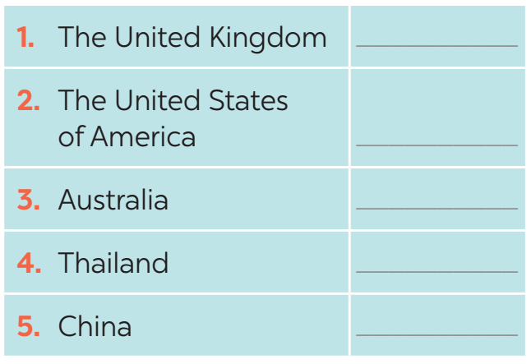
STRANGE TRAFFIC RULES!
3
Which countries below keep to the left? Tick the correct answers.

Slide 15

STRANGE TRAFFIC RULES!
4
Listen and check your answers in 3. Then listen again and complete the sentence with no more than THREE words.
One explanation is that some countries use ______________ as the UK.
same traffic rules

Slide 16
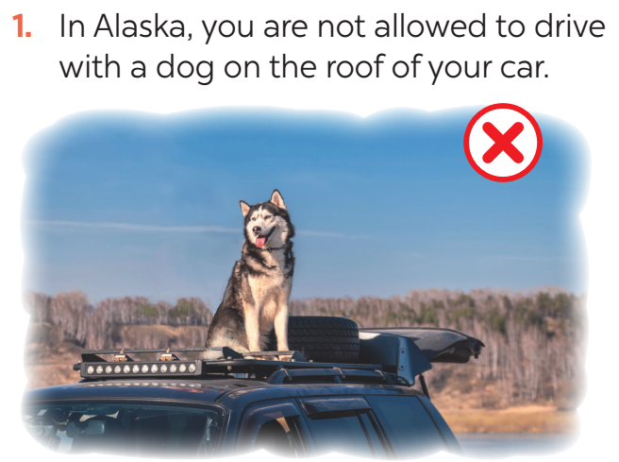

STRANGE TRAFFIC RULES!
5
Read, discuss which one do is the strangest rule?

Slide 17
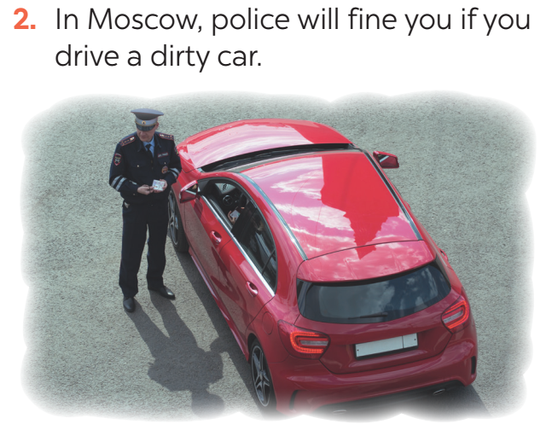
STRANGE TRAFFIC RULES!
5
Read, discuss which one do is the strangest rule?

Slide 18
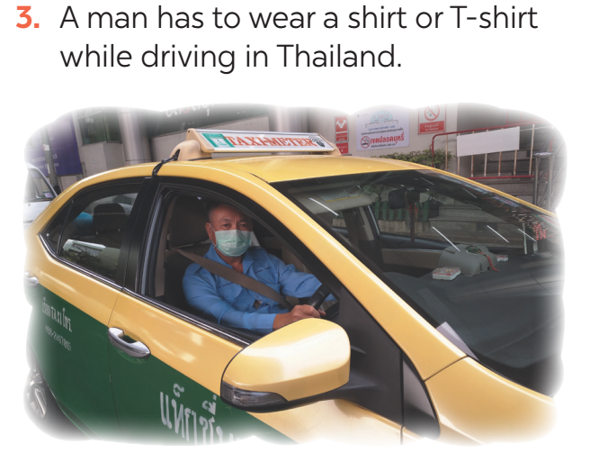
STRANGE TRAFFIC RULES!
5
Read, discuss which one do is the strangest rule?

Slide 19
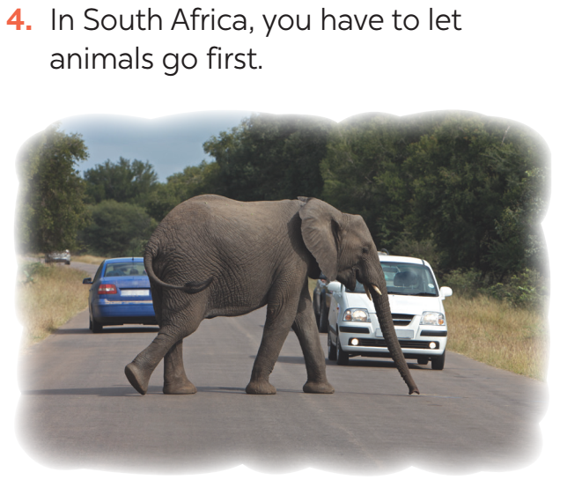
STRANGE TRAFFIC RULES!
5
Read, discuss which one do is the strangest rule?

Slide 20
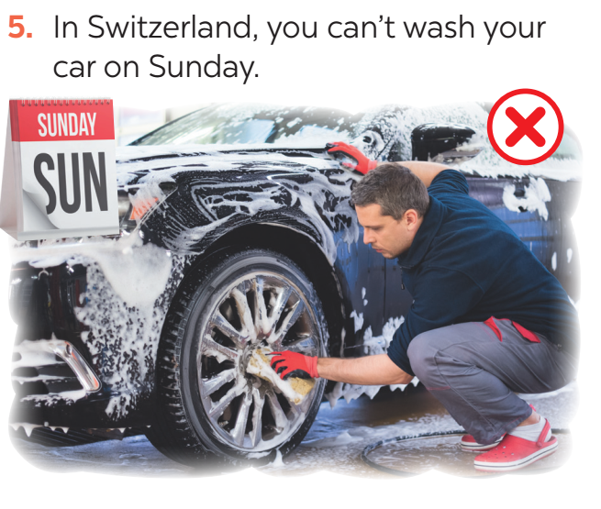
STRANGE TRAFFIC RULES!
5
Read, discuss which one do is the strangest rule?

Slide 21
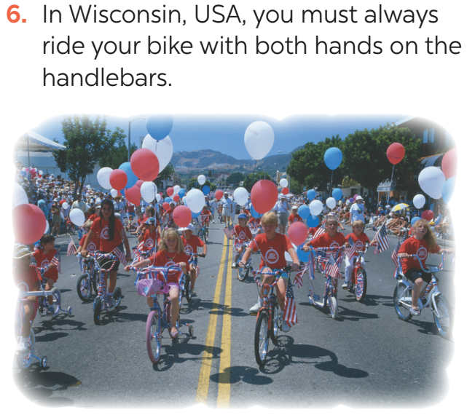
STRANGE TRAFFIC RULES!
5
Read, discuss which one do is the strangest rule?

Slide 22

CONSOLIDATION
1
WRAP-UP
In this lesson, we have learn to:
ask and answer about means of transport and some strange traffic rules
practise using some grammar points and vocabulary related to the topic

Slide 23

CONSOLIDATION
2
HOMEWORK
Do exercises in the workbook.
Prepare for the next lesson: Skills 1

Slide 24

Website: hoclieu.vn
Fanpage: facebook.com/www.tienganhglobalsuccess.vn/

