Slide 1
The Marketing slides templates
Tech Skill
Here is where your presentation begins

Slide 2
Table of contents
About us
Goals & strategy
01
03
Market analysis
Content plan
02
04
You can describe the topic of the section here
You can describe the topic of the section here
You can describe the topic of the section here
You can describe the topic of the section here

Slide 3



Table of contents
About us
Market analysis
Goals & strategy
1
3
5
Content plan
History
Budget
2
4
6
You can describe the topic of the section here
You can describe the topic of the section here
You can describe the topic of the section here
You can describe the topic of the section here
You can describe the topic of the section here
You can describe the topic of the section here

Slide 4
—Someone Famous
“This is a quote, words full of wisdom that someone important said and can make the reader get inspired.”

Slide 5



—Someone Famous
“This is a quote, words full of wisdom that someone important said and can make the reader get inspired.”

Slide 6
Whoa!
This can be the part of the presentation where you introduce yourself, write your email…

Slide 7



Yeah!
This can be the part of the presentation where you introduce yourself, write your email…

Slide 8
01
About us
You can enter a subtitle here if you need it

Slide 9
Introduction
You can give a brief description of the topic you want to talk about here. For example, if you want to talk about Mercury, you can say that it’s the smallest planet in the entire Solar System

Slide 10



About us
You can give a brief description of the topic you want to talk about here. For example, if you want to talk about Mercury, you can say that it’s the smallest planet in the entire Solar System

Slide 11
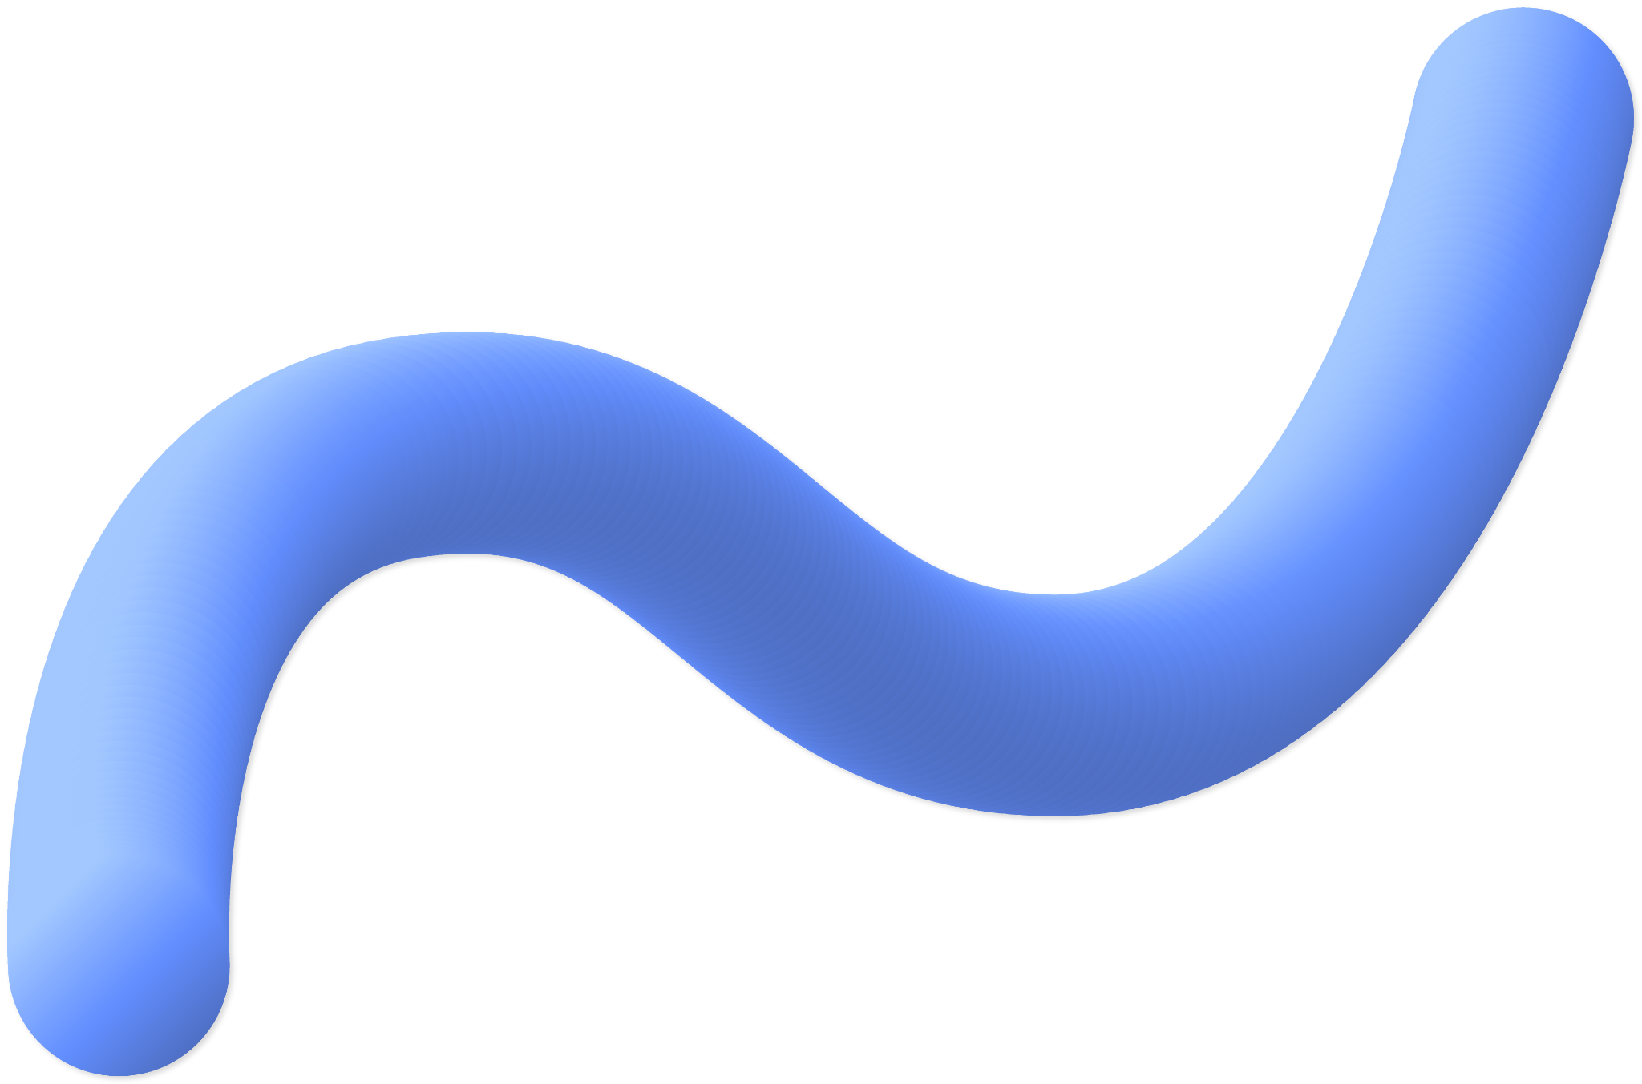
What sets us apart?
Do you know what helps you make your point clear?
Lists like this one:
They’re simple
You can organize your ideas clearly
You’ll never forget to buy milk!
And the most important thing: the audience won’t miss the point of your presentation

Slide 12

The dorm room
Them
Us
Mercury is the closest planet to the Sun and the smallest one in the Solar System—it’s only a bit larger than the Moon
Venus has a beautiful name and is the second planet from the Sun. It’s hot and has a poisonous atmosphere

Slide 13

Roommates
Them
Us
Mercury is the closest planet to the Sun and the smallest one in the Solar System—it’s only a bit larger than the Moon
Venus has a beautiful name and is the second planet from the Sun. It’s hot and has a poisonous atmosphere

Slide 14



The dorms
Them
Us
Mercury is the closest planet to the Sun and the smallest one in the Solar System—it’s only a bit larger than the Moon
Venus has a beautiful name and is the second planet from the Sun. It’s hot and has a poisonous atmosphere

Slide 15
The first website
Mercury
Venus
Mars
It’s the closest planet to the Sun and the smallest one in the Solar System
Venus has a beautiful name and is the second planet from the Sun
Despite being red, Mars is actually a cold place. It’s full of iron oxide dust

Slide 16
Awesome words

Slide 17


Amazing ideas

Slide 18
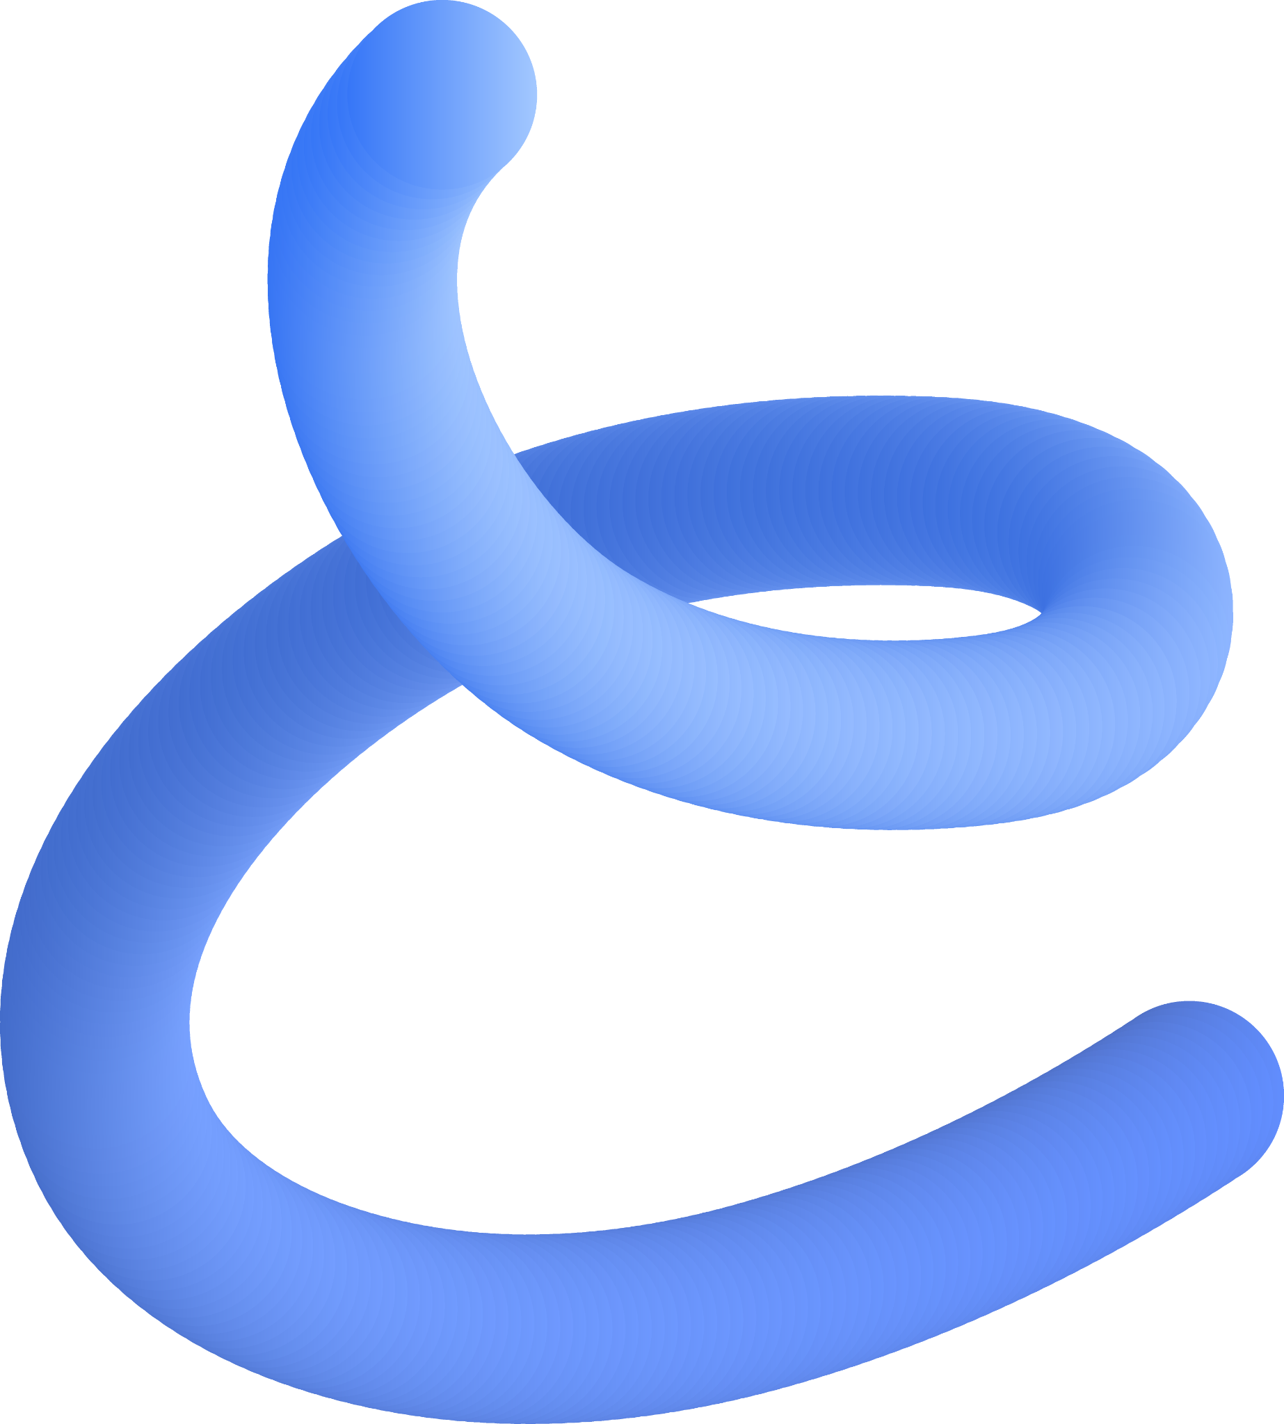
02
Market analysis
You can enter a subtitle here if you need it

Slide 19
Virtual “friends”
Mercury
Venus
Mars
This planet's name has nothing to do with the liquid metal, since Mercury was named after the Roman messenger god
It’s terribly hot, even hotter than Mercury, and its atmosphere is extremely poisonous
Despite being red, Mars is actually a cold place. It's full of iron oxide dust, which gives the planet its reddish cast

Slide 20
Virtual “friends”
Mercury
Venus
Mars
Jupiter
Saturn
Mercury is the closest planet to the Sun
Venus is the second planet from the Sun
Despite being red, Mars is actually a very cold place
Jupiter is the biggest planet of them all
It’s composed mostly of hydrogen and helium

Slide 21
User demographics
Mercury
Mars
Venus
Jupiter
Mercury is the closest planet to the Sun
Mars is actually a very cold place
Venus is the second planet from the Sun
Jupiter is the biggest planet of them all

Slide 22
User demographics
Mercury
Jupiter
Mercury is the closest planet to the Sun
Jupiter is the biggest planet of them all

Slide 23


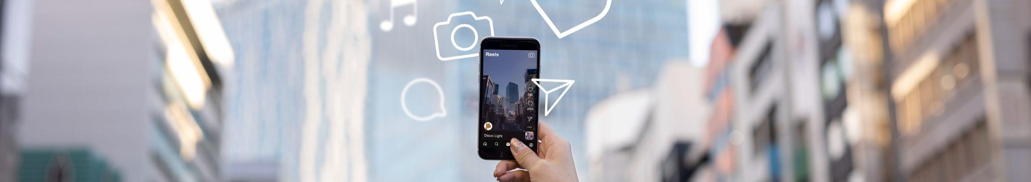
A picture always reinforces the concept
Images reveal large amounts of data, so remember: use an image instead of a long text. Your audience will appreciate it

Slide 24
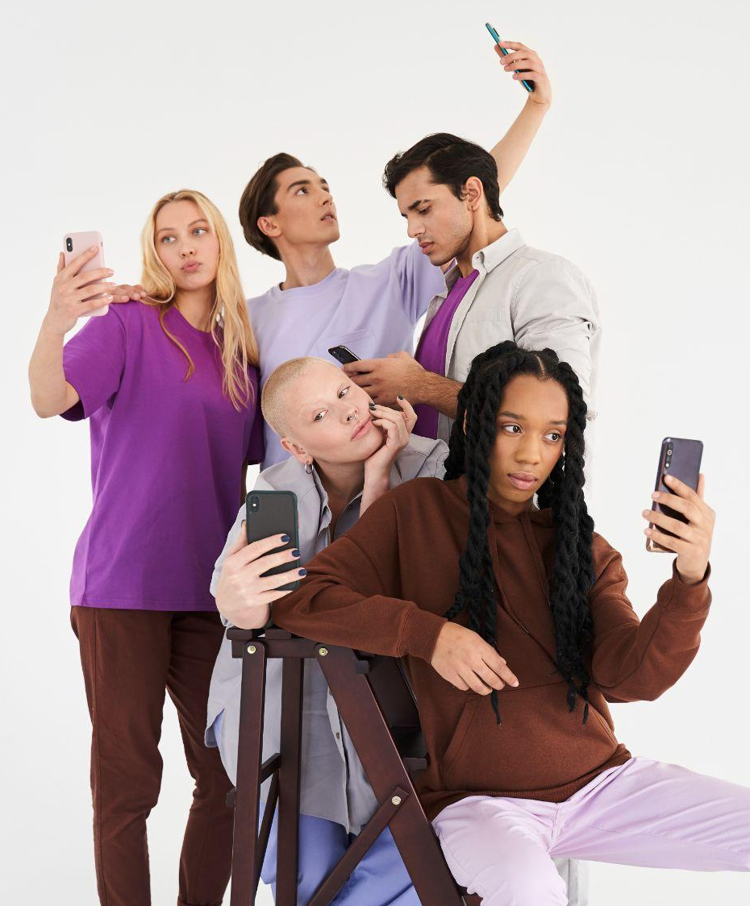
A picture always reinforces
the concept
Images reveal large amounts of data, so remember: use an image instead of a long text. Your audience will appreciate it

Slide 25

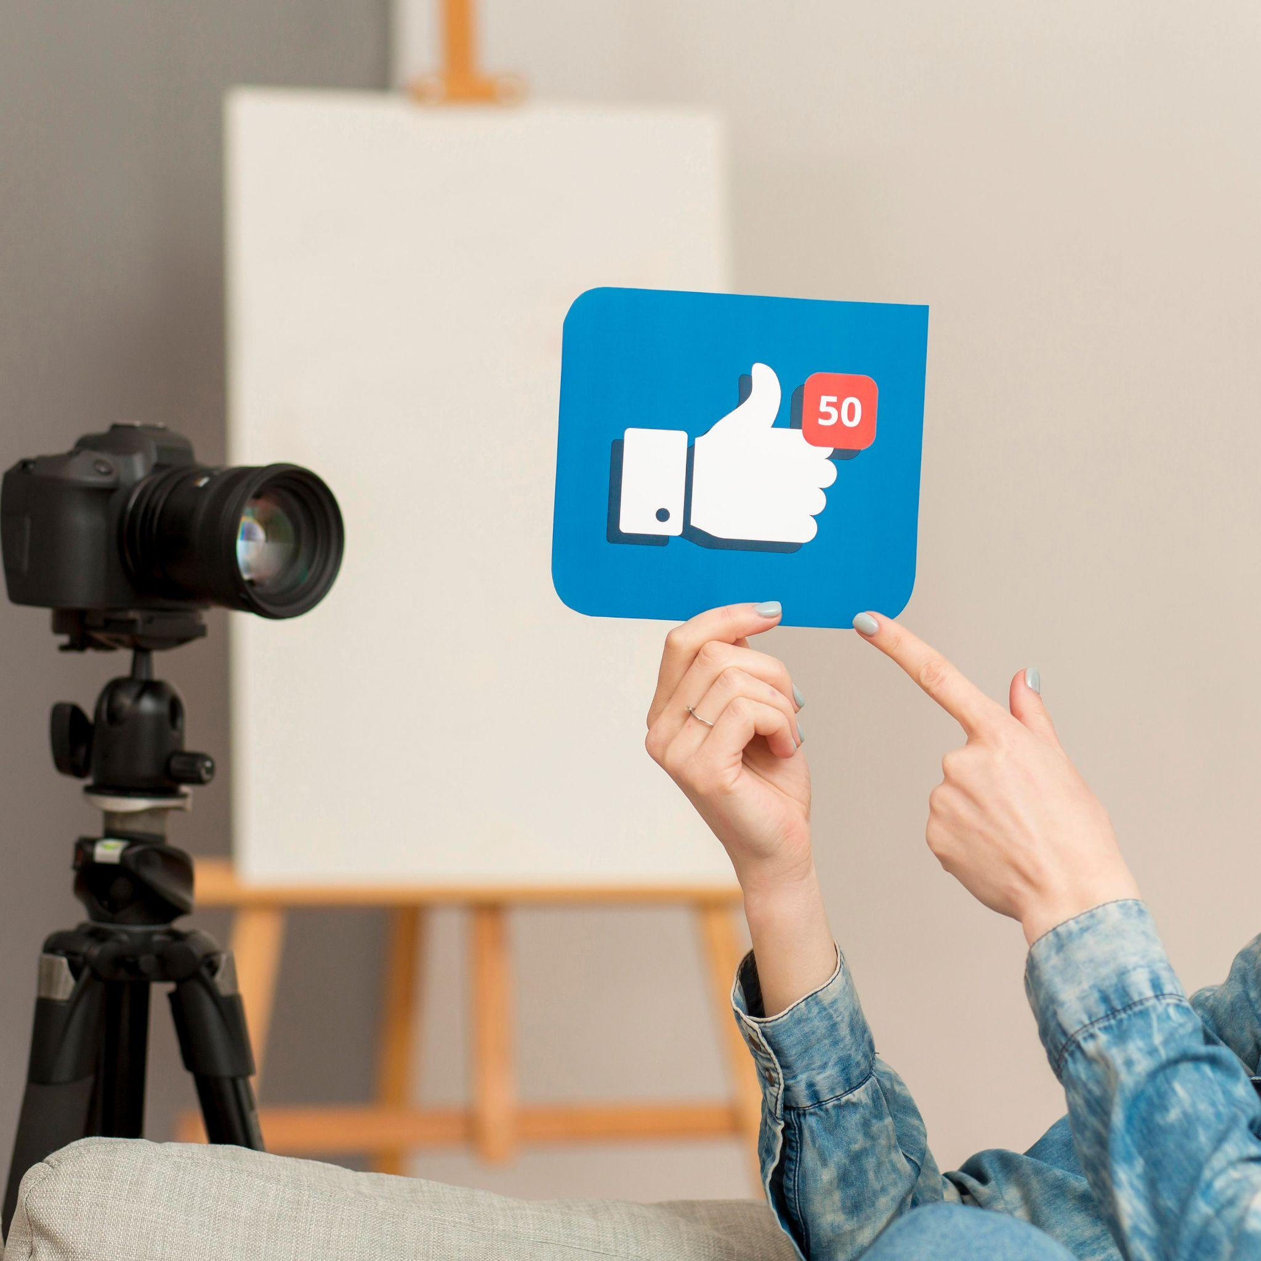
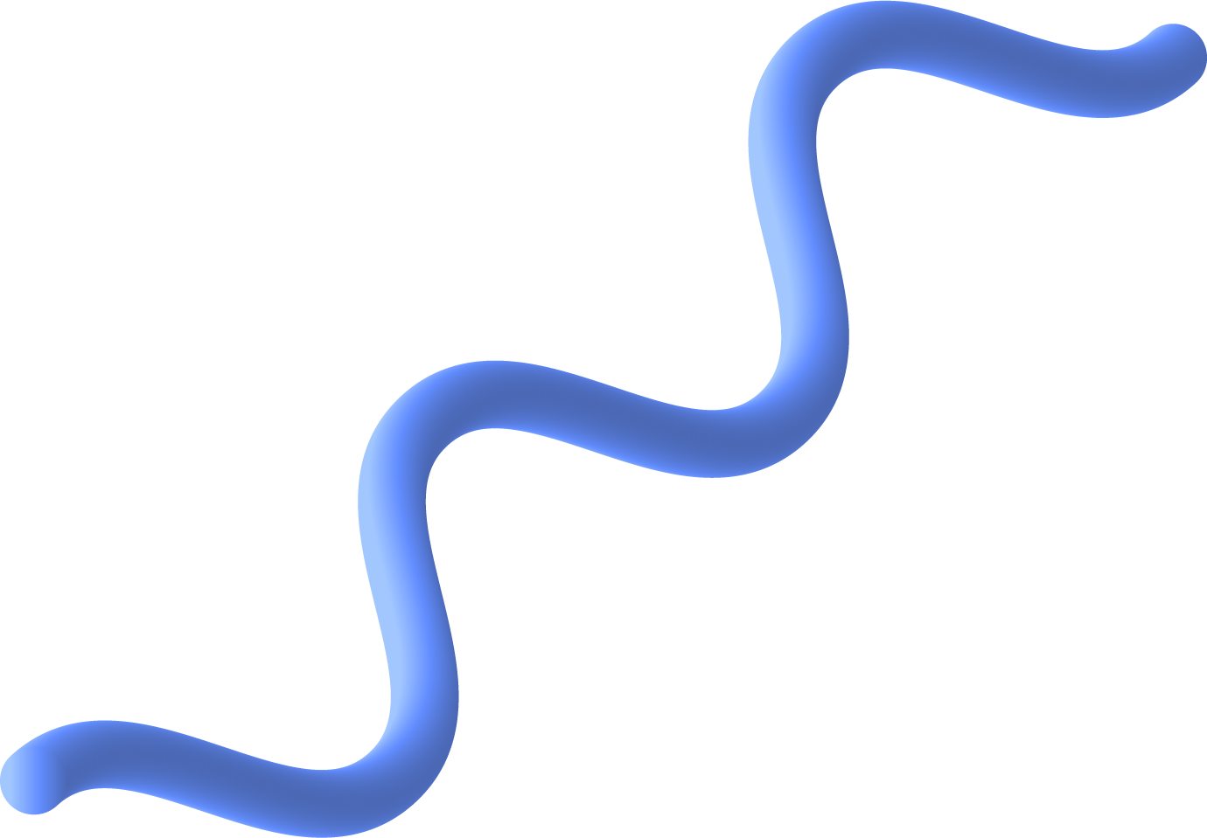
A picture
always reinforces
the concept
Images reveal large amounts of data, so remember: use an image instead of a long text. Your audience will appreciate it

Slide 26
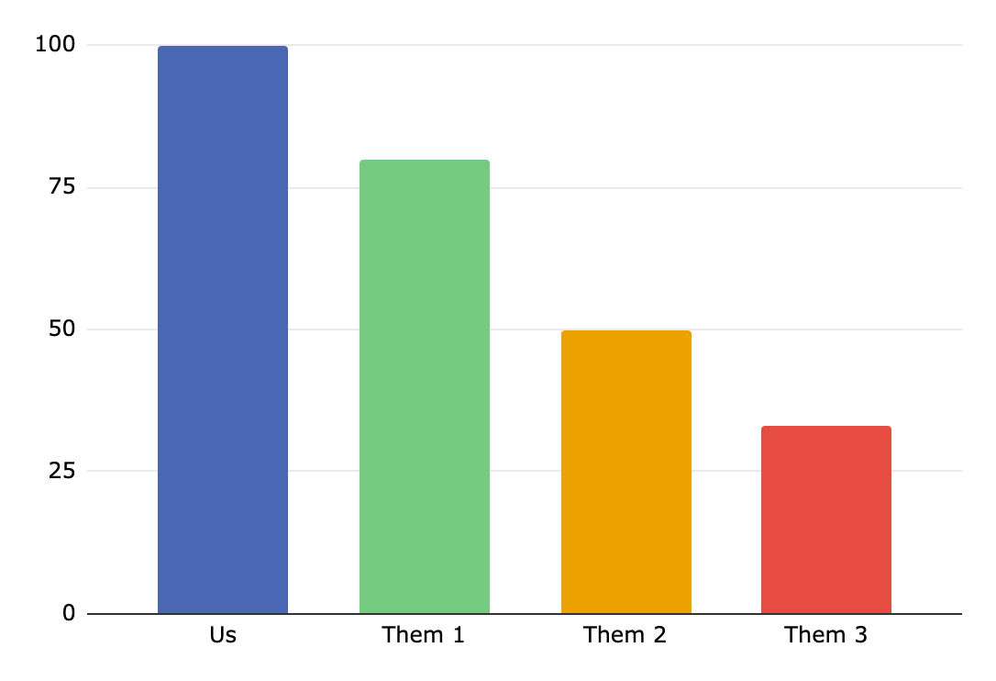
The “competition”
Us
Them 1
Them 2
Them 3
Venus is the second planet from the Sun
Jupiter is the biggest planet of them all
Despite being red, Mars is a cold place
Follow the link in the graph to modify its data and then paste the new one here. For more info, click here
Saturn is a gas giant and has several rings

Slide 27
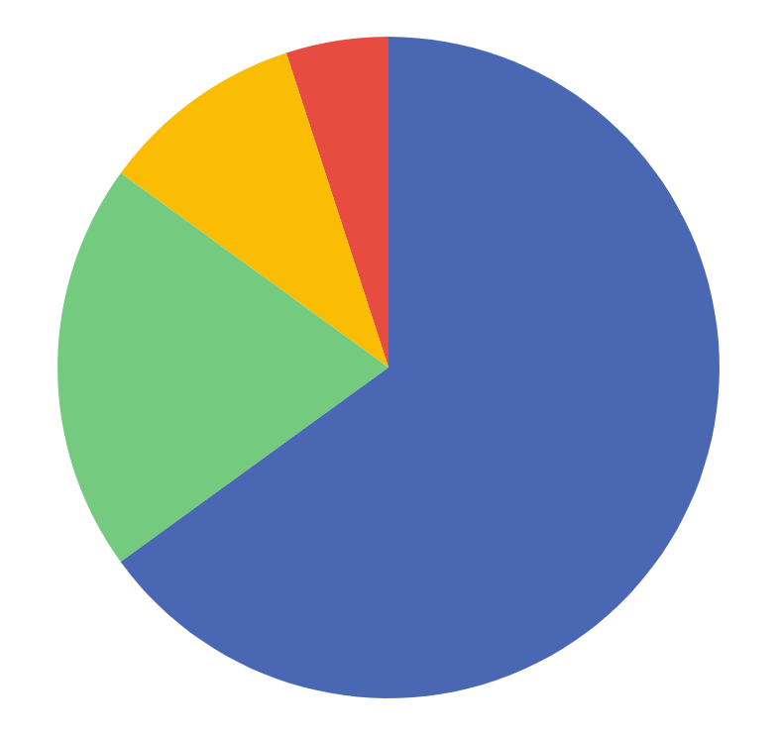

Other apps
5%
App 1
App 2
10%
20%
65%
App 3
App 4
Jupiter is the biggest planet of them all
Mercury is the closest planet to the Sun
Mars is actually a very cold place
Venus is the second planet from the Sun
Follow the link in the graph to modify its data and then paste the new one here. For more info, click here

Slide 28
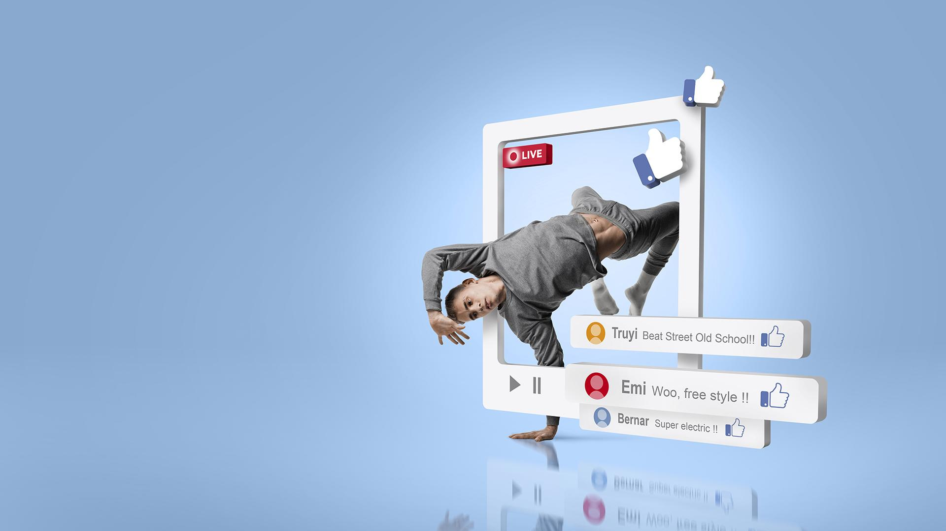
A picture is worth a thousand words

Slide 29
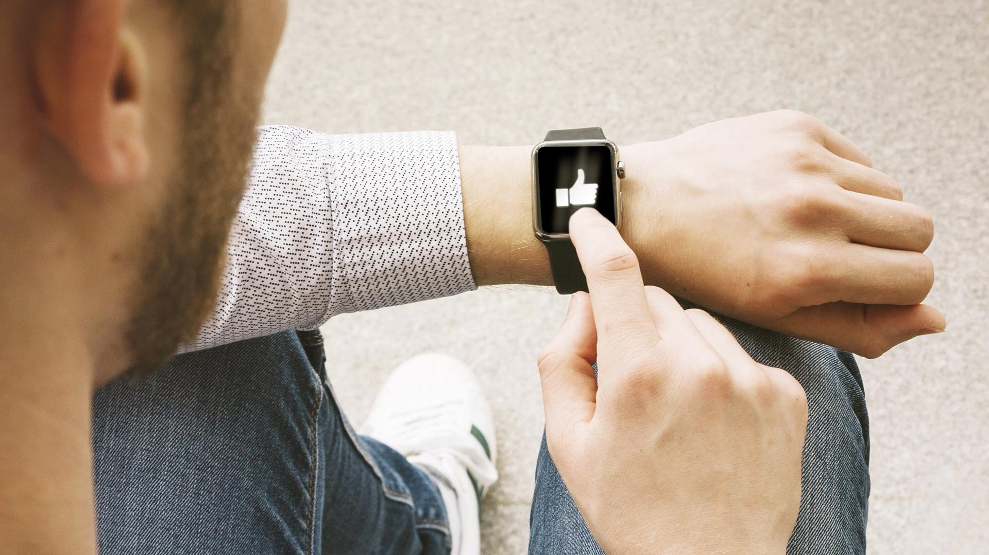
A picture is worth a thousand words

Slide 30
03
Goals & strategy
You can enter a subtitle here if you need it

Slide 31
Goals
Mercury
Venus
Mars
Jupiter
Saturn
Mercury is the closest planet to the Sun
Venus is the second planet from the Sun
Despite being red, Mars is actually a very cold place
Jupiter is the biggest planet of them all
It’s composed mostly of hydrogen and helium

Slide 32
Goals
Mercury
Venus
Mars
Jupiter
Saturn
Neptune
Mercury is the closest planet to the Sun
Venus is the second planet from the Sun
Despite being red, Mars is actually a very cold place
Jupiter is the biggest planet of them all
It’s composed mostly of hydrogen and helium
It’s the farthest planet from the Sun

Slide 33
Strategy
Mercury
Jupiter
Venus
Saturn
Mars
Neptune
Mercury is the closest planet to the Sun
Jupiter is the biggest planet of them all
Venus is the second planet from the Sun
It’s composed mostly of hydrogen and helium
Despite being red, it’s actually a very cold place
It’s the farthest planet from the Sun

Slide 34
Strategy
Earth
Mercury
Venus
Mars
Mercury is the closest planet to the Sun
Venus is the second planet from the Sun
Despite being red, Mars is a very cold place

Slide 35
Goals & strategy
Goals
Strategy
Saturn is a gas giant with several rings
Saturn
Earth
Earth is the third planet from the Sun
Jupiter is the biggest planet of them all
Jupiter
Mars
Despite being red, Mars is a cold place
Pluto is considered a dwarf planet
Pluto
Venus
Venus has a very beautiful name
Mercury is the closest planet to the Sun
Mercury
The Sun
The Sun is the star tat we all orbit

Slide 36
Organize the data
 | Mercury | It’s the closest planet to the Sun and the smallest one in the Solar System
 | Venus | Venus has a beautiful name and is the second planet from the Sun
 | Mars | Despite being red, Mars is actually a cold place. It’s full of iron oxide dust
 | Jupiter | Jupiter is a gas giant and the biggest planet in the entire Solar System

Slide 37
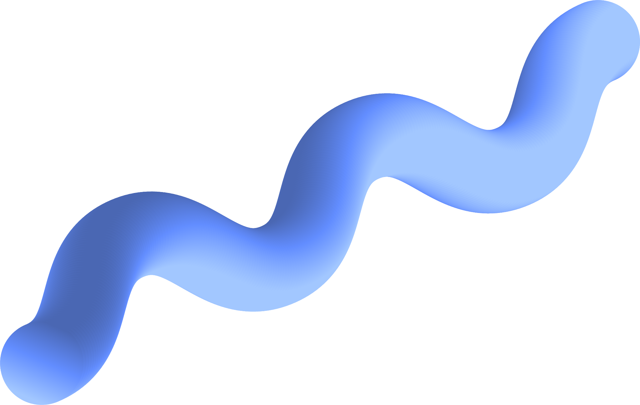
Organize a little more
Venus | Mars | Jupiter
Venus has a beautiful name and is the second planet from the Sun | Despite being red, Mars is actually a cold place. It’s full of iron oxide dust | Jupiter is a gas giant and the fourth-brightest object in the night sky
Venus is very hot It has a beautiful name | Mars is very cold Mars is made of basalt | Jupiter is very big Jupiter is very bright

Slide 38
Feb 4, 2004
Big numbers catch your audience’s attention

Slide 39
Feb 4, 2004
Big numbers catch your audience’s attention

Slide 40
Our history
2004
2005
2019
2021
Birth
Update
Mercury is the closest planet to the Sun
Despite being red, Mars is a very cold place

Slide 41
Our history
2004
2019
2023
Mercury
Venus
Mars
It’s the closest planet to the Sun and the smallest one in the Solar System
Venus has a beautiful name and is the second planet from the Sun
Despite being red, Mars is actually a cold place. It’s full of iron oxide dust

Slide 42

04
Content plan
You can enter a subtitle here if you need it

Slide 43
9h 55m 23s
333,000
Jupiter's rotation period
The Sun’s mass compared to Earth’s

Slide 44
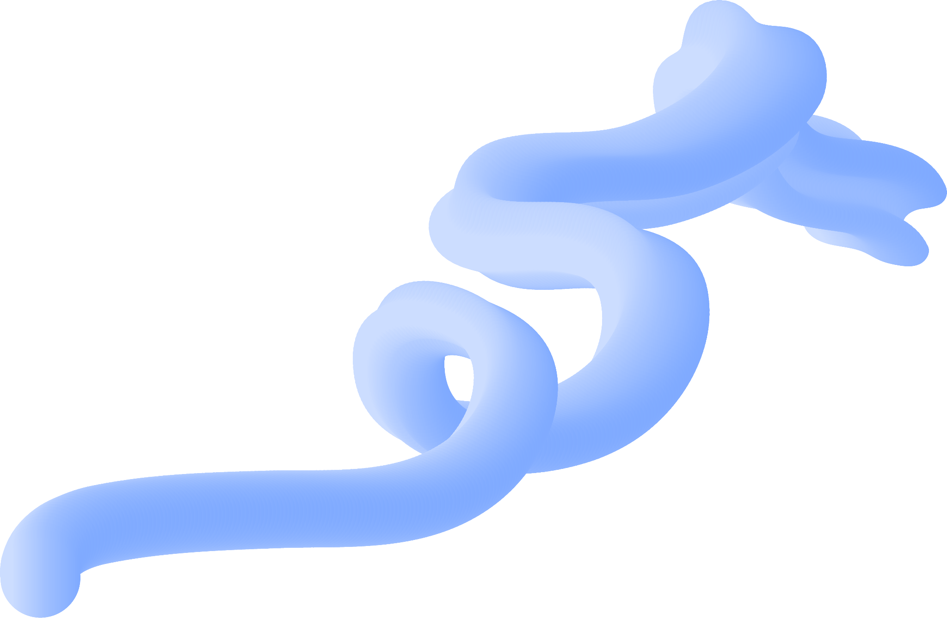


9h 55m 23s
333,000
86,000 km
Jupiter's rotation period
The Sun’s mass compared to Earth’s
Distance between Earth and the Moon

Slide 45
Our areas of expertise
Mercury
Earth
Venus
It’s the closest planet to the Sun and the smallest one in the Solar System
Venus has a beautiful name and is the second planet from the Sun

Slide 46

Our areas of expertise
Mercury is the closest planet to the Sun and the smallest one in the Solar System
1
Venus is the second planet from the Sun
2
Despite being red, Mars is a cold place
3
Jupiter is the biggest planet of them all

Slide 47
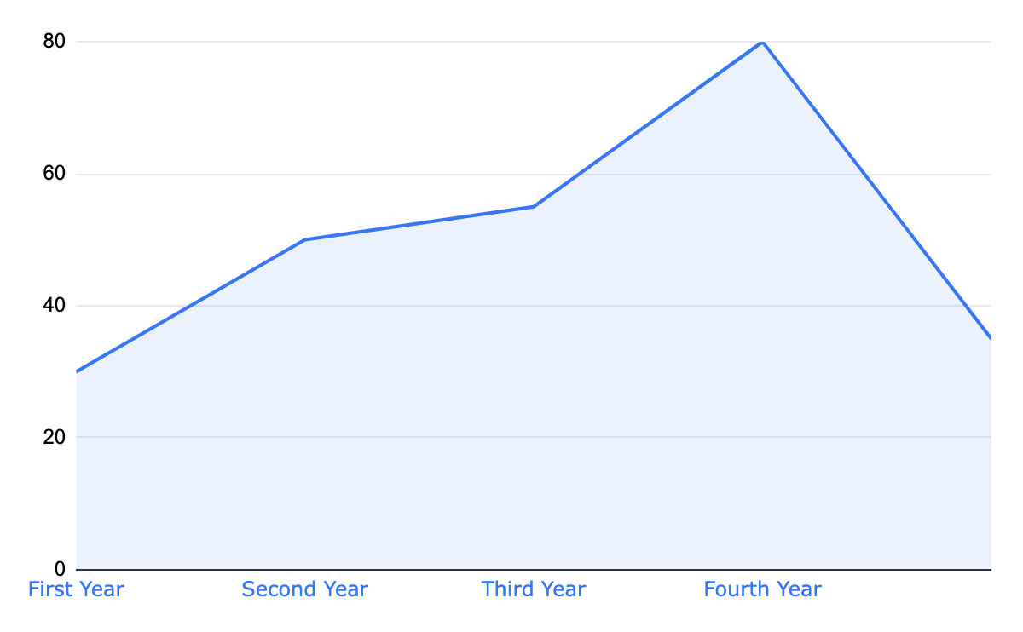
Plan overview
Venus
Venus has a beautiful name and is the second planet from the Sun
Follow the link in the graph to modify its data and then paste the new one here. For more info, click here

Slide 48

Plan overview
20%
80%
90%
10%
60%
40%
50%
50%
Venus
Venus has a beautiful name and is the second planet from the Sun
Mercury
It’s the closest planet to the Sun and the smallest one in the Solar System
Venus
Mars
Jupiter
Saturn

Slide 49
Plan overview
60%
40%
50%
50%
Mercury
Mercury is the smallest planet in the Solar System
Venus is the second planet from the Sun
The Sun
Saturn is composed of hydrogen and helium
Earth is the beautiful planet where we live on

Slide 50

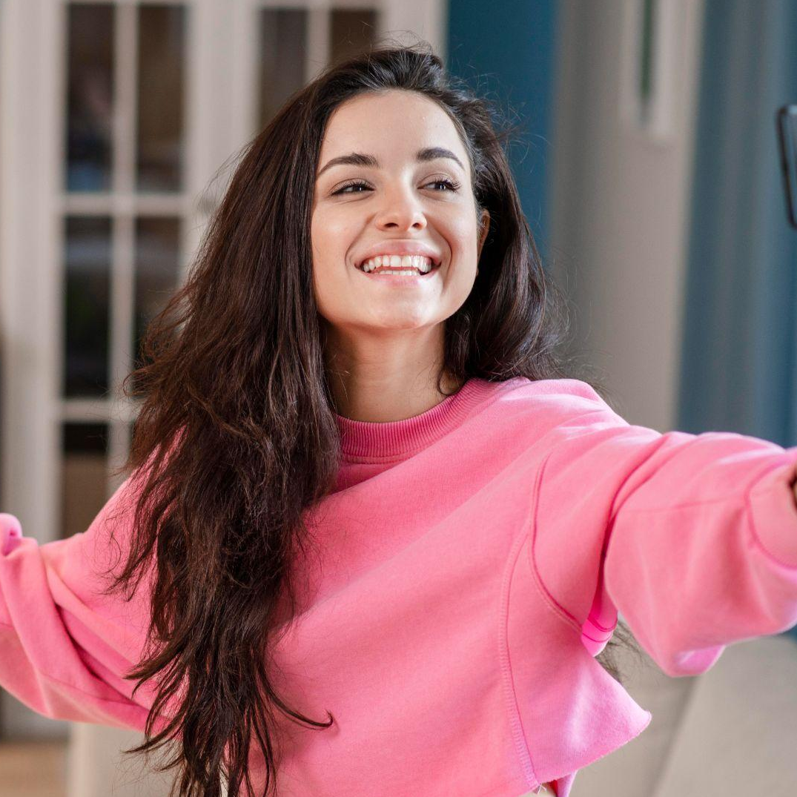
Our team
Megan Smith
Katy Johnson
You can talk about this person here and provide a short bio
You can talk about this person here and provide a short bio

Slide 51
Our content
Venus
Mars
Jupiter
Saturn
It’s even hotter than Mercury and its atmosphere is poisonous
It's full of iron oxide dust, which gives the planet its reddish cast
Jupiter is a gas giant and the biggest planet in the Solar System
It was named after the Roman god of wealth and agriculture

Slide 52
Content sharing
Content sharing plan
Topic | Content | Date | Time
Venus | Venus is very beautiful | Tuesday | 12:30
Mars | Mars is very cold | Saturday | 12:30
Jupiter | Jupiter is very big | Sunday | 22:30
Saturn | Saturn is a giant | Everyday | 15:30
Neptune | Neptune is cold | Friday | 18:00

Slide 53
A look to the past
Feb 4th
February 2004
Su | Mo | Tu | We | Th | Fr | Sa
1 | 2 | 3 | 4 | 5 | 6 | 7
8 | 9 | 10 | 11 | 12 | 13 | 14
15 | 16 | 17 | 18 | 19 | 20 | 21
22 | 23 | 24 | 25 | 26 | 27 | 28
29
We were born on this day!

Slide 54
Budget
$6 m.
$10 m.
Budget for December
Budget for January

Slide 55
Budget
Revenue
Topic 1 | $2,000
Topic 2 | $2,000
Topic 3 | $1,000
Topic 4 | $1,500
Total revenue | $6,500
Expenses
Topic 1 | $1,000
Topic 2 | $1,000
Topic 3 | $1,000
Topic 4 | $1,000
Total revenue | $4,000
Total budget
$1,500

Slide 56
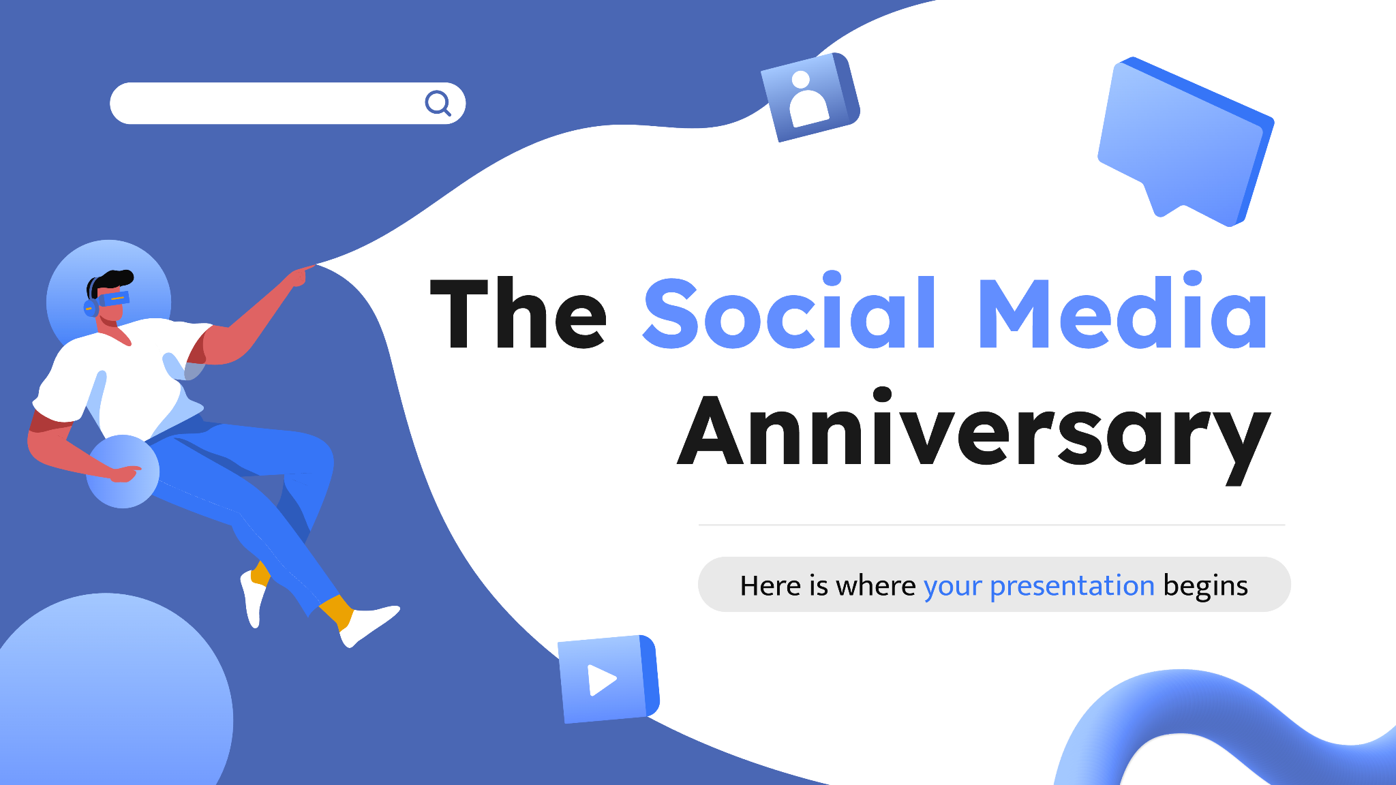
Mockup: computer
You can replace the image on the screen with your own work. Just right-click on it and select “Replace image”

Slide 57
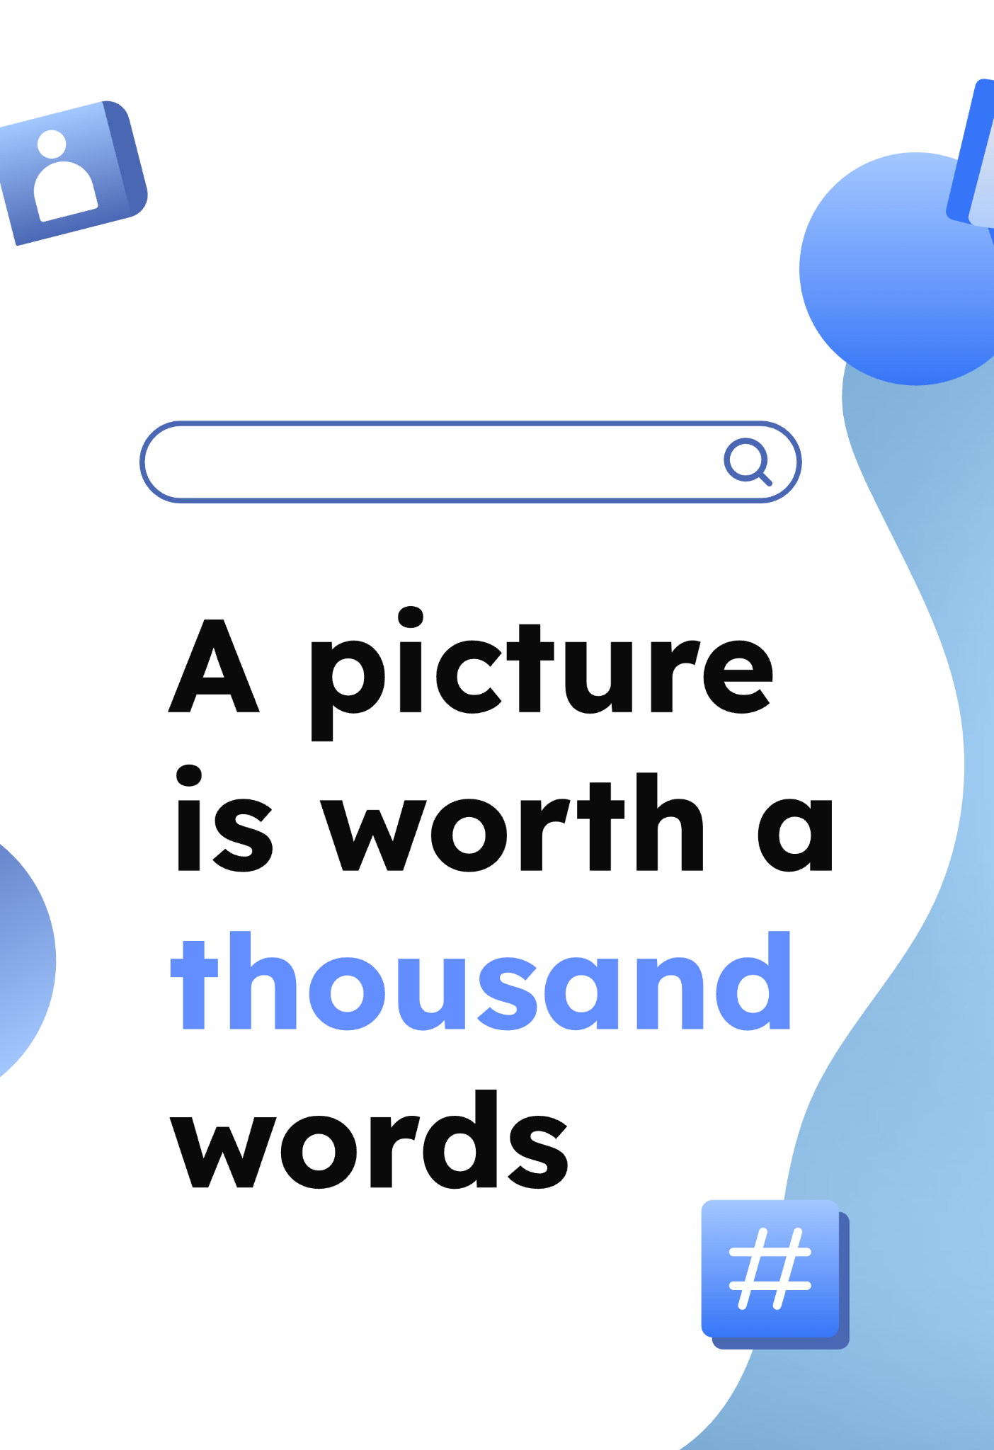
Mockup: tablet
You can replace the image on the screen with your own work. Just right-click on it and select “Replace image”

Slide 58
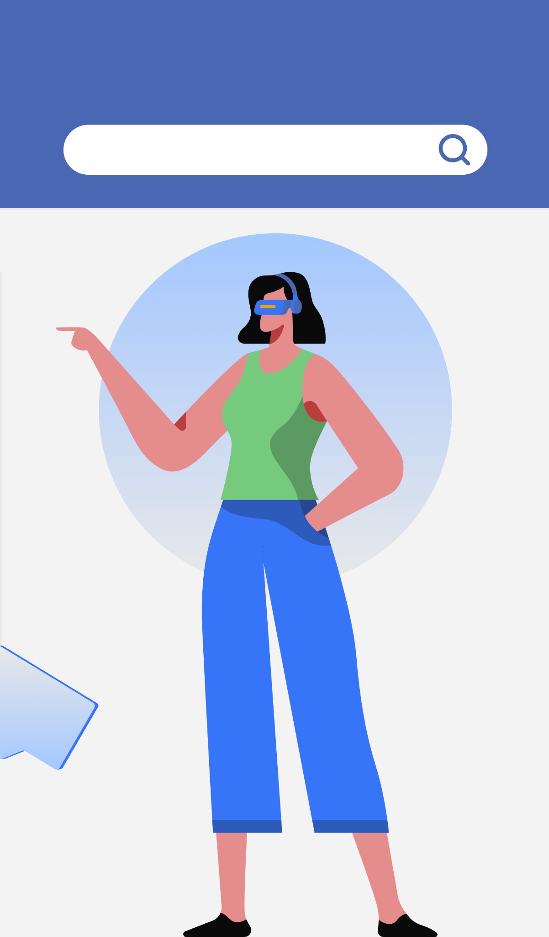
Mockup: smartphone
You can replace the image on the screen with your own work. Just right-click on it and select “Replace image”

Slide 59
Thanks!
Do you have any questions?
addyouremail@freepik.com
+91 620 421 838
yourcompany.com
Please keep this slide for attribution

Slide 60
Icon pack: social media interactions

Slide 61
Icon pack: social media interactions

Slide 62
Premium icon pack

Slide 63
Alternative resources
Here’s an assortment of alternative resources whose style fits the one of this template:
Photos:
Close-up woman holding like button
Young japanese influencer recording vlog
Female influencer at home with dog and smartphone
Scrabble wooden game with like symbol, facebook word and icon
Vectors:
Colorful gradient 3d shapes background
3d geometric shapes background
Virtual reality landing page template I
Virtual reality landing page template II
App development landing page template
Virtual reality landing page template III
Couple using virtual reality glasses
Virtual reality landing page template IV
Virtual reality concept landing page with man
Man playing while wearing virtual reality headset

Slide 64
Premium alternative resources
Here’s an assortment of alternative resources whose style fits the one of this template:
Photos:
Hand drawn metaverse concept instagram stories
Gradient virtual metaverse illustration
Gradient metaverse instagram stories
Hand drawn flat design metaverse background
Hand drawn metaverse template design

Slide 65
Resources
Did you like the resources of this template? Get them for free at our other websites!
Photos:
People connected on social media
Happy young blogger using selfie stick and talking to the phone
Female vlogger at home with smartphone and mug
Influencer dancing and posting on social media
Icons:
Social Media Interactions | Blue
Vectors:
Floating man using virtual reality headset concept
Virtual reality landing page template I
People standing and using virtual reality headset
App development illustration
Virtual reality landing page template II
Virtual reality landing page template III
Virtual reality landing page template IV
Virtual reality landing page template V
Colorful 3d background
Gradient 3d curvy lines abstract covers
Tridimensional shapes landing page

Slide 66
Premium resources
Did you like the resources of this template? Get them for free at our other websites!
Photos:
Male finger taps like icon on smart watch
Collage of people using reels
Close-up woman holding like button
Icons:
Icon Pack: Social Media | Gradient
Vectors:
3d colorful emojis background design
3d colorful emojis background style
Dynamic geometric shapes 3d background
3d geometric background
3d shapes background
Gradient 3d geometric background
Virtual reality concept landing page template
Hand drawn flat design metaverse illustration
Hand drawn metaverse concept instagram stories
Hand drawn flat design metaverse illustration
Hand drawn flat design metaverse illustration

