Slide 1


Slide 2


Unit
8
SHOPPING
LESSON 4: Communication
1

Slide 3
LESSON 4: COMMUNICATION
WARM-UP
Chatting
Task 1: Listen and read the conversation. Paying attention to the highlighted parts.
Task 2: Make complaints about the situation.
EVERYDAY ENGLISH
Task 3: Listen to three people talking about their favourite shopping places and tick the place they mention.
Task 4: Ask and answer what each person in 3 likes about their shopping place.
Task 5: Share your favourite shopping place with your group.
MY FAVOURITE SHOPPING PLACE
CONSOLIDATION
Wrap-up
Homework

Slide 4
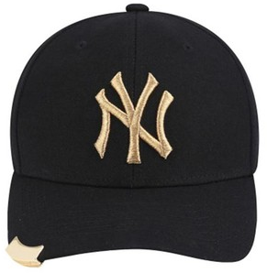

CHATTING
WARM-UP
Supposing you ordered a hat online, but when you got it, it didn’t have the same color as you ordered. What would you do in that case?
The hat you ordered
The hat you received
MAKING COMPLAINTS

Slide 5

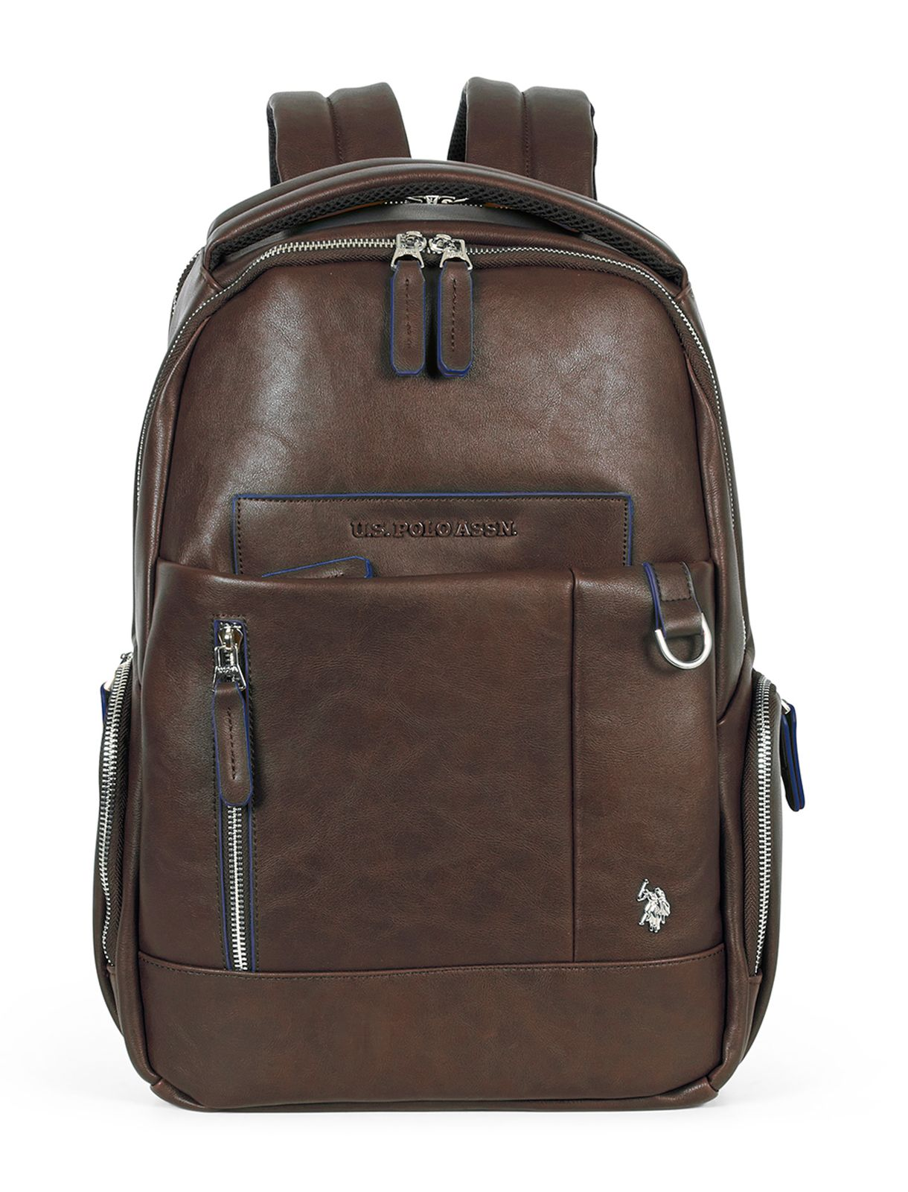
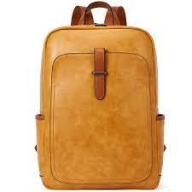
EVERYDAY ENGLISH
1
Listen and read the conversation. Pay attention to the highlighted parts.
Tom: I’m calling to make a complaint about the SMART backpack I ordered from you last week. I got it this morning, and it’s smaller than the one you advertised online.
Trang: Well … Let me check it.
Tom: And I’m not happy with the colour, either. In your picture, it’s dark brown, and this one is yellowish brown.
Trang: I’m sorry about that. I’ll send you another one.

Slide 6
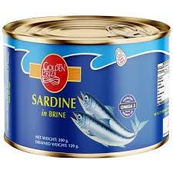
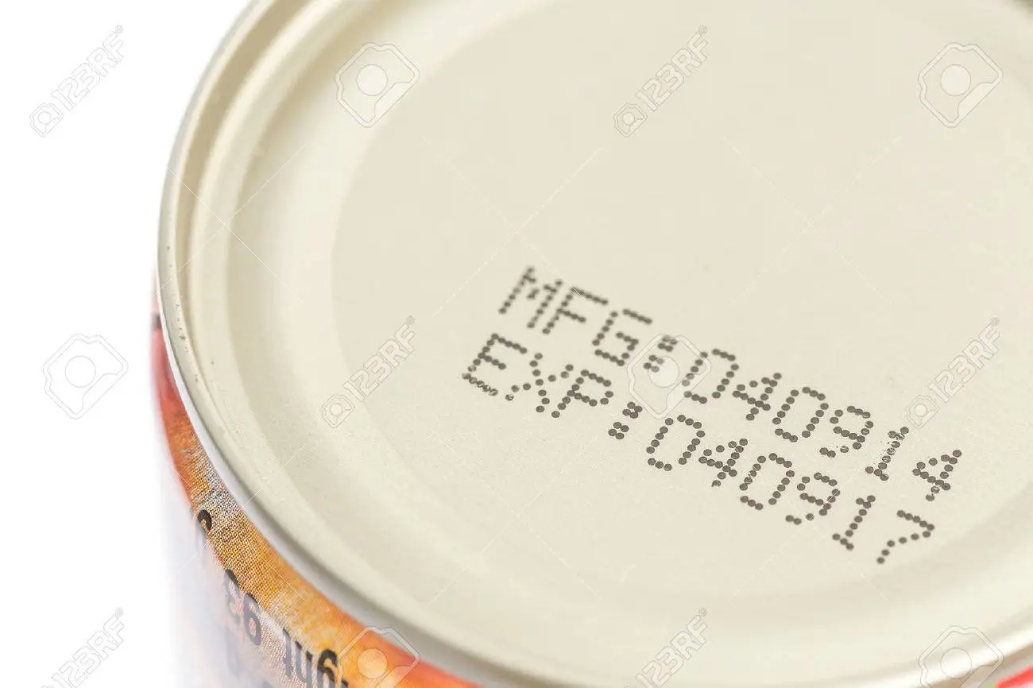
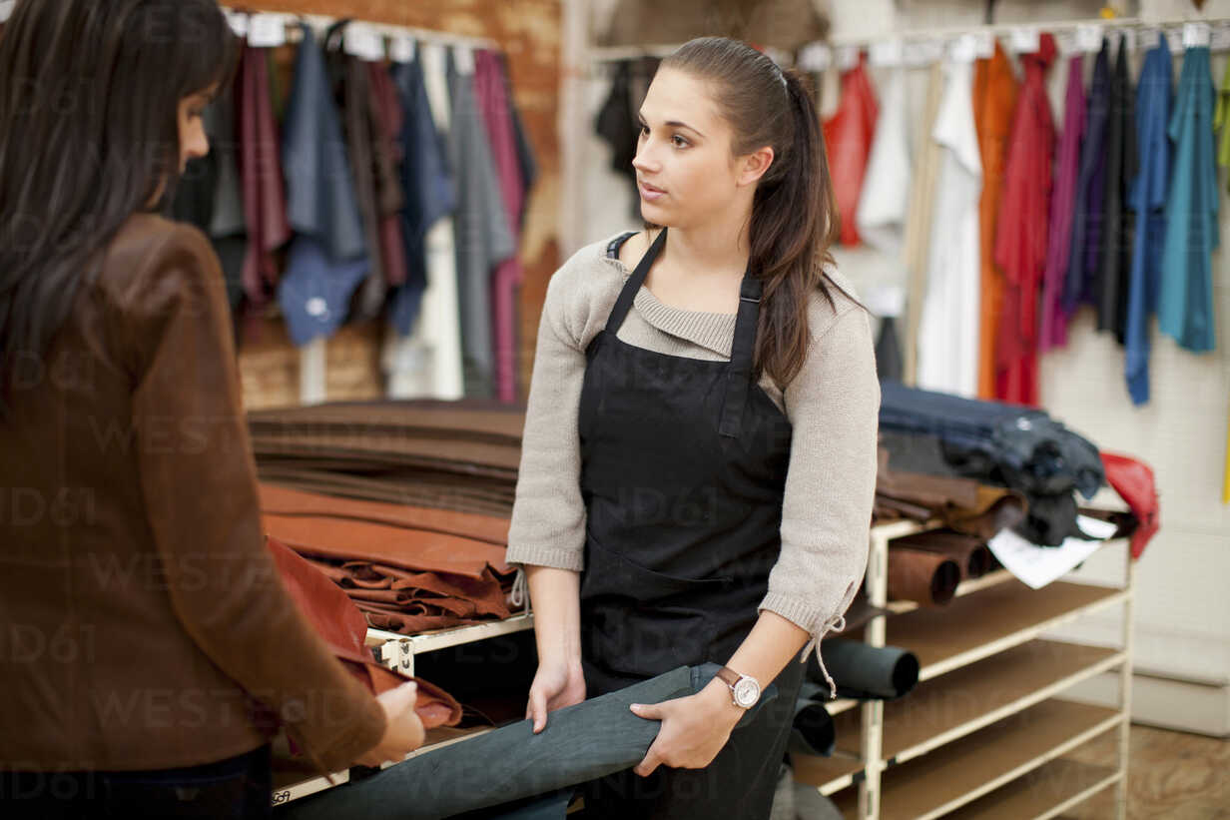
EVERYDAY ENGLISH
2
Work in pairs. In turn, make complaints about the situations below.
The cans of fish you bought at the shop expired five days ago.
An assistant at the shop was not very helpful.

Slide 7
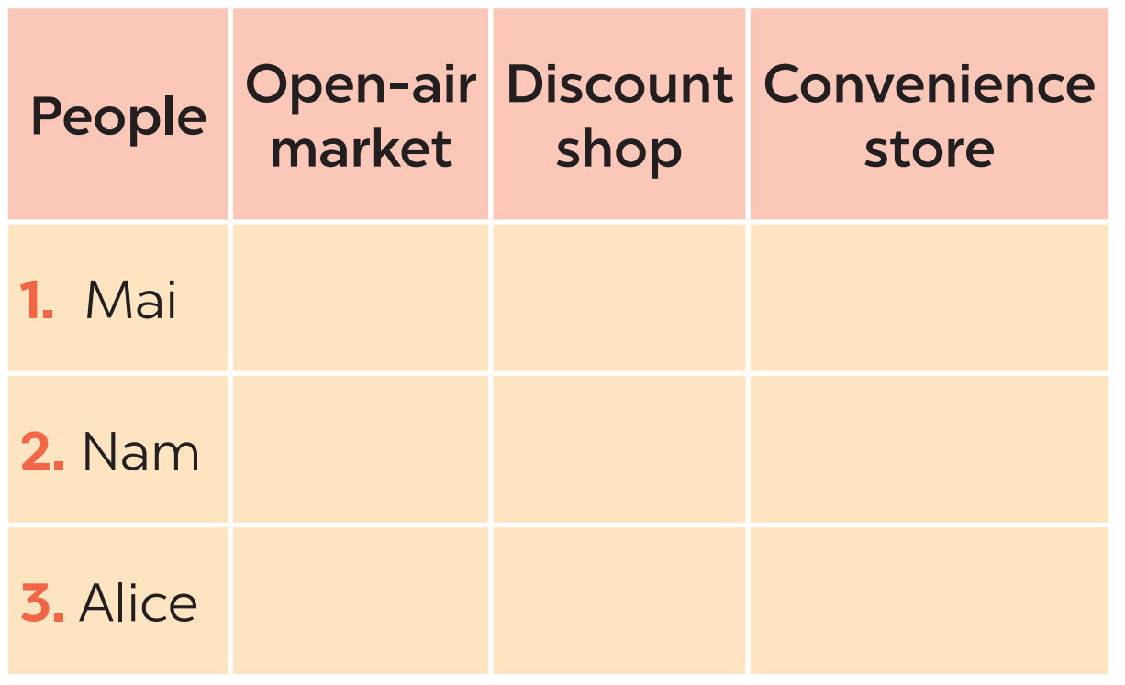

MY FAVOURITE SHOPPING PLACE
3
Listen to three people talking about their favourite shopping places and tick the place they mention.

Slide 8
MY FAVOURITE SHOPPING PLACE
4
Work in pairs. Take turns to ask and answer what each person in 3 likes about their shopping place.
1. Mai
2. Nam
3. Alice
Example:
A: What does Nam like about shopping at a convenience store?
B: It saves him time.

Slide 9

MY FAVOURITE SHOPPING PLACE
5
Work in groups. Share your favourite shopping place with your group.
You can include:
The name of the place
The reason(s) why you like it

Slide 10

CONSOLIDATION
1
Wrap-up
What have we learnt in this lesson?
Making complaints
Some favourite shopping places

Slide 11

CONSOLIDATION
2
Homework
Learn the ways to make complaints by heart.
Write a paragraph of 50-70 words about your favourite shopping place.
Do the exercises in the Workbook

Slide 12

Website: hoclieu.vn
Fanpage: facebook.com/tienganhglobalsuccess.vn/

