Slide 1
KEY ENGLISH TEST 1 SPEAKING TEST 2

Slide 2
KET SPEAKING
Time allowed - 8-10 minutes
Normally you will do the speaking test with another candidate. The two of you will meet two examiners. One of the examiners will talk to you, the other does not particpate in the conversations.
There are two parts to the speaking test:
Speaking part 1: short questions and answers between you and the examiner
Speaking part 2: the examiner gives you some information or a card with some ideas for questions. You have to talk with the other candidate and ask or answer questions. How to prepare for KET Speaking
Speak as much as you can, with your friends
Practise asking and asnwering questions about daily life
Practise giving information about yourself

Slide 3
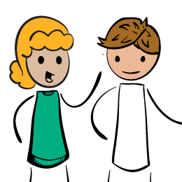
Part 1: Student – examiner interaction
Section 1: The examiner will ask you:
Your name
Where you come from
Your work/study
Provide full-sentence answers

Slide 4
Part 1: Student – examiner interaction
Section 2: You will be asked some questions that require longer answers. For example:
Why you like something
Details about a hobby,…
Popular topic:
Music Sport Cinema and TV reading
Traveling work shopping future plans
Past experience family personal interests education

Slide 5
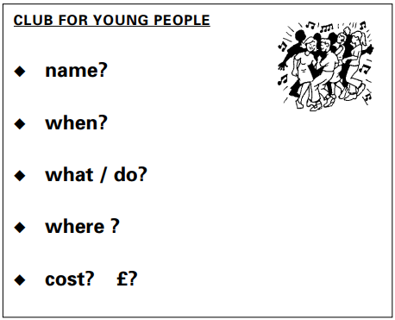
Part 2: Student – student interaction
Ask and answer questions based on the cue cards
For example:
Do not just read from the cards.Answer in full sentences
Pay attention to the grammar

Slide 6
SPEAKING PART 1

Slide 7
Part 1:
Where do you study?
What subjects do you study?
Which subjects do you like best?
What do you do at the weekends?
Who do you like spending time with?
Tell me about your best friend.
Remember to add more details to your answer to make it longer

Slide 8
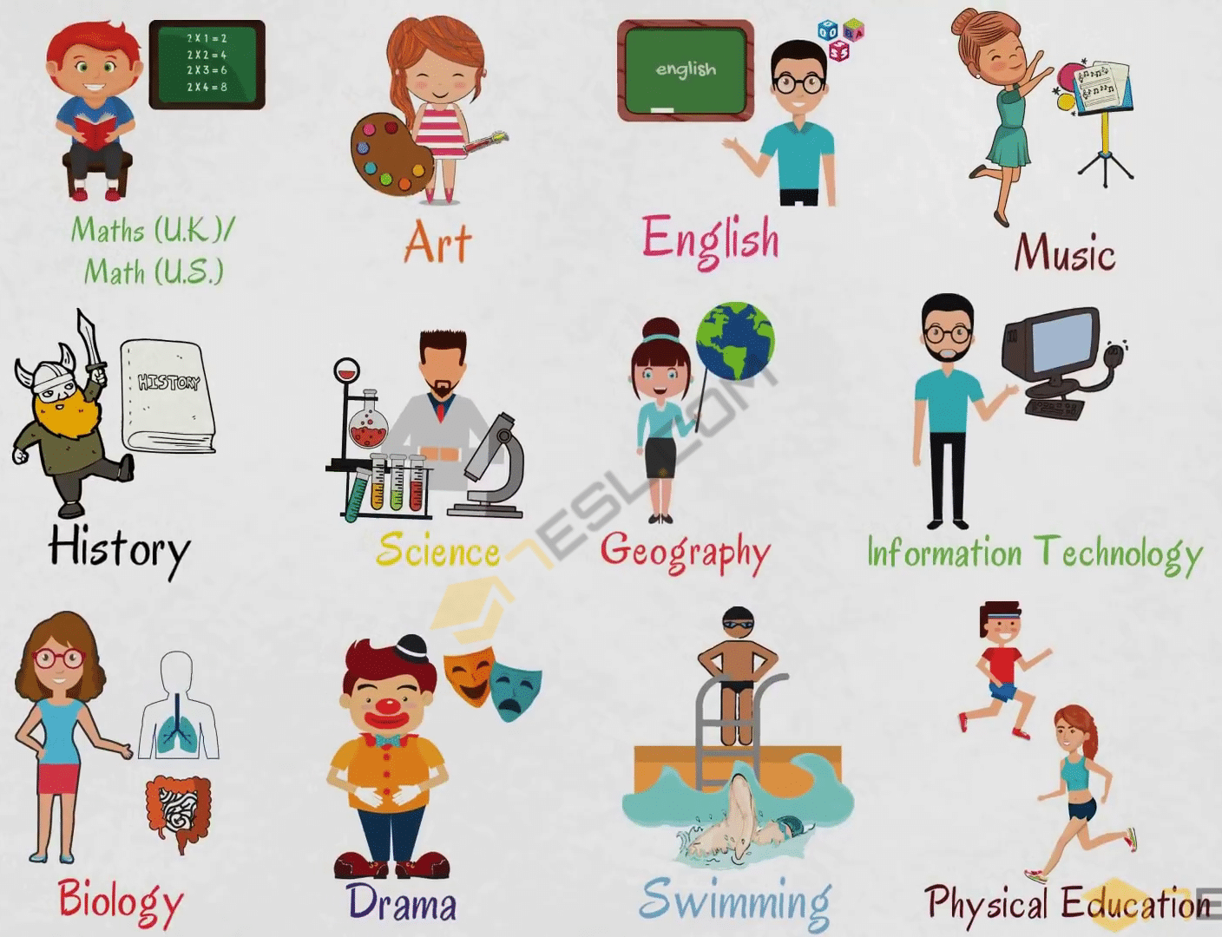
Studies
What subjects do you study?
Which subjects do you like best?
I learn many subjects at school, such as maths, english, music, history,etc.
I like English the best because it helps me communicate with English-speaking people around the world
Many = a lot of/ lots of = a wide range of = a wide variety of

Slide 9
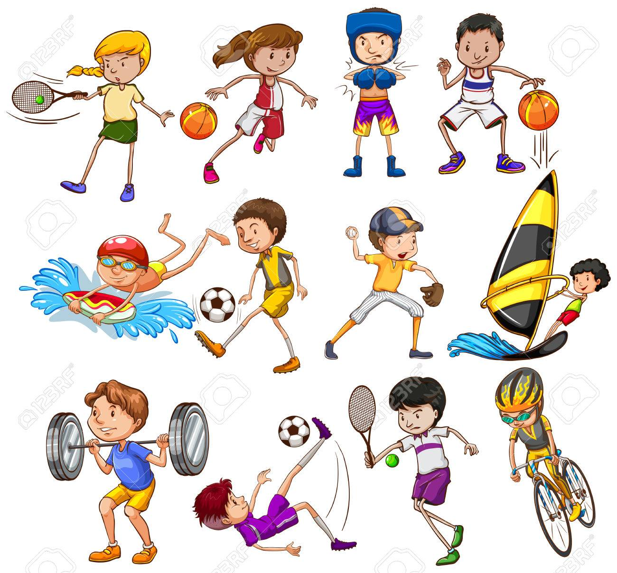
What do you do at the weekends?
For example: I usually playing sports with my friends to keep fit and healthy.
Who do like spending time with?
- I like spending time with my best friend, Layla. We often chit chat about everything and help each other with our homework.

Slide 10
Best friend
The answer should be at least 3 sentences
Helpful outline and vocabulary
Best friend
Name/age
Physical appearance
Personality
Name/ Nickname
Younger/ Older
- The same age/ the same class
Tall / thin/…
Hair: long/ short / curly/…
Kind/ helpful / patient/ supportive / trustful
Reliable,…

Slide 11
Practice some more questions
Do you have much homework at home?
Do your teachers often give you much homework?
How much time do you spend doing your homework every day?
Do you have to take extra classes?
How long is your summer vacation?
Do you like going to school?

Slide 12
SPEAKING PART 2

Slide 13
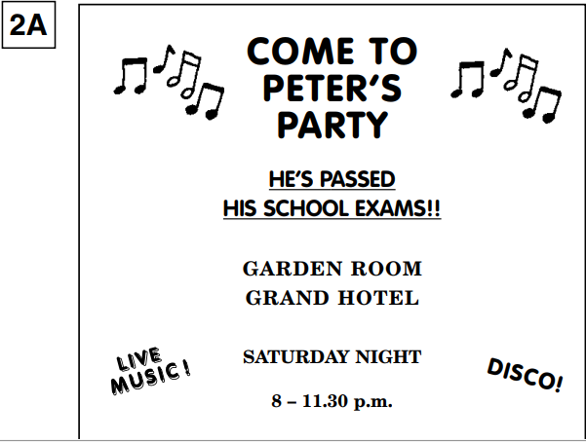
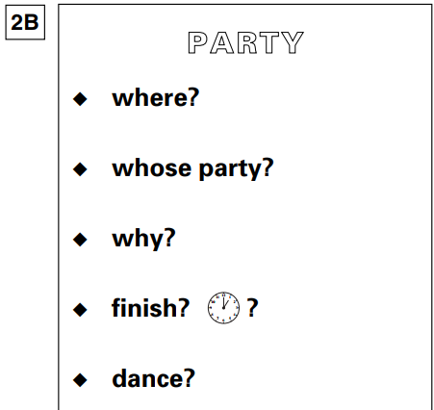
Asking and answering questions using these prompt cards

Slide 14
1. Where is the party held? | It is held in Garden room of Grand Hotel
2. Whose party is it? | It is Peter’s party
3. Why does Peter hold the party? | Because he’s passed his school exams
4. What time does it finish? | It finishes at 11.30 pm
5. Can we dance there? | Yes, we can.
Can you think of other questions or other ways to ask and answer?

Slide 15
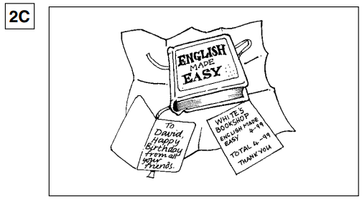
Who is the present for?
Why does she get a present?
What is the name of the book?
How much is it?
What is the name of the shop?
Can you think of other questions or other ways to ask and answer?

