Slide 1
NEW ITEM NEW ITEM NEW ITEM
WE ARE OPEN WE ARE OPEN
WE ARE OPEN WE ARE OPEN
WE ARE OPEN WE ARE OPEN
GRAND
OPENING
GRAND
OPENING
GRAND
OPENING
WE ARE OPEN WE ARE OPEN

Slide 2
NEW ITEM
NEW ITEM
NEW ITEM
EXCLUSIVE EXCLUSIVE EXCLUSIVE
EXCLUSIVE EXCLUSIVE EXCLUSIVE
Eu eos utinam democritum, sed no sale recusabo maluisset, eu cum malorum tacimates

Slide 3
EXCLUSIVE EXCLUSIVE EXCLUSIVE
LIMITED!
20%
OFF
Eu eos utinam democritum, sed no sale recusabo maluisset, eu cum malorum tacimates

Slide 4
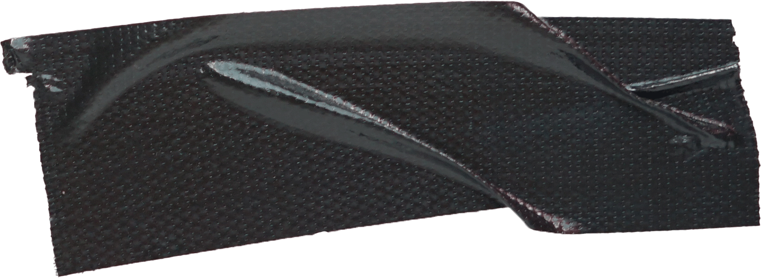
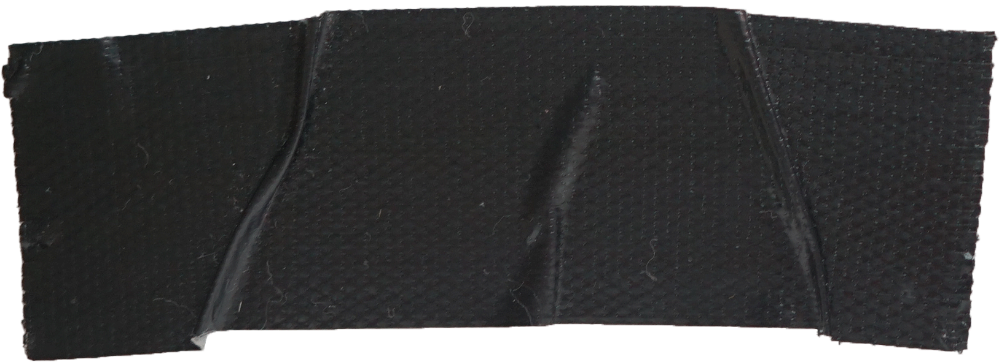
EXCLUSIVE EXCLUSIVE EXCLUSIVE
NEW OLD STUFF
IS SALE NOW!
NEW ITEM NEW ITEM NEW ITEM
WWW.YOURWEBSITE.COM

Slide 5
WWW.YOURWEBSITE.COM
SALE
EXCLUSIVE EXCLUSIVE EXCLUSIVE
35%
OFF

Slide 6
NEW STUFF NEW
NEW STUFF NEW
NEW STUFF NEW
NEW STUFF NEW
NEW STUFF NEW
NEW ITEM NEW ITEM NEW ITEM

Slide 7
NEW ITEM NEW ITEM NEW ITEM
YOUR PRESENT
. . . . . . . . . . . . . . . . .
NEW ARRIVAL
STUFF

