Slide 1

Unit 5: Sports and hobbies
Review & Practice 1
Page 80

Slide 2
Lesson Outline
Warm-up
Listening
Writing
Consolidation
Wrap-up

Slide 3
Objectives
By the end of this lesson, students will be able to review and practice the sports and hobbies Vocabulary and Structure.

Slide 4

WARM UP

Slide 5


Swap positions

Slide 6
How to play
The students stand in a circle (or sit on the circle of chairs), except for one student (or the teacher), who stands in the middle. Each student must have a fixed position.
The person in the middle says a sentence that starts with Change positions if you… and ends with some condition (e.g. …have curly hair).
If that condition is true for a student, they have to stand up and find a new position as quickly as possible.
Students who can't find swap positions will be penalized.

Slide 7
1. Change positions if you can play badminton.
2. Change positions if you use your legs in soccer.
3. Change positions if you use head in volleyball.
4. Change positions if you have curly hair.
5. Change positions if you like to sing.

Slide 8
6. Change positions if the first letter of your name is D.
7. Change positions if the last letter of your name is G.
8. Change positions if you can play tennis.
9. Change positions if you have long hair.
10. Change positions if you love your teacher.

Slide 9

It’s time to Review & Practice

Slide 10

Listening

Slide 11


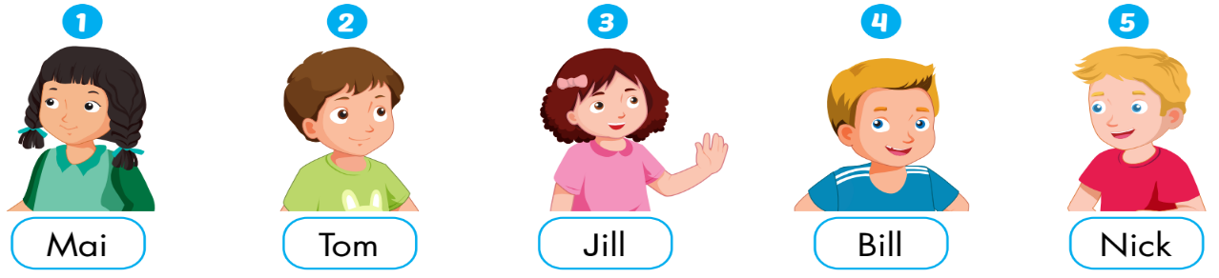

Slide 12
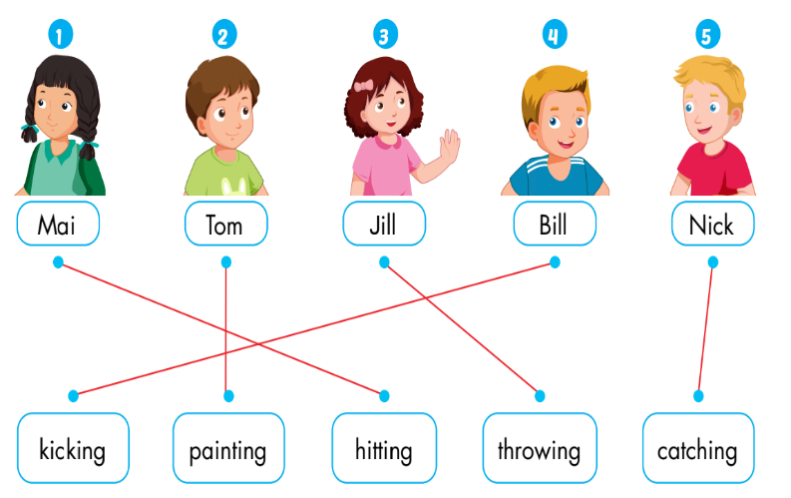
1. James: What are you good at, Mai?
Mai: I'm good at hitting the ball. Watch me!
Listen again
2. James: What about you, Tom? What are you good at?
Tom: I don't really like sports. I'm good at painting.
3. James: Next, what are you good at, Jill?
Jill: I'm good at throwing.
4. James: And...what are you good at, Bill?
Bill: I'm good at kicking.
5. James: What are you good at, Nick?
Nick: I'm good at catching. Let's play

Slide 13

Writing

Slide 14

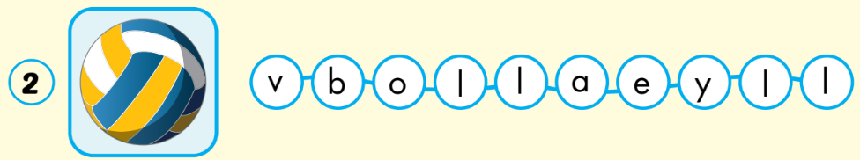
soccer
volleyball

Slide 15
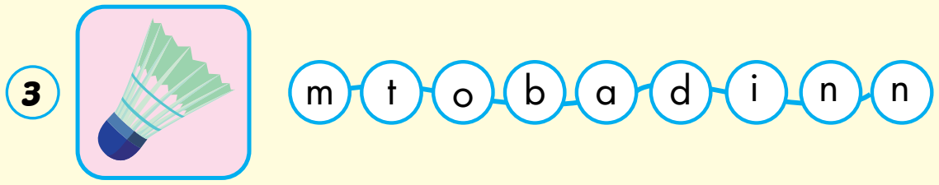
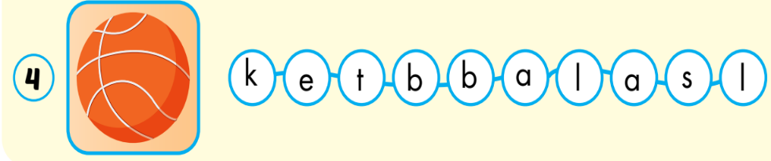
badminton
basketball

Slide 16

Further
Practice

Slide 17



Extra Practice
WB, page 56.
throwing
kicking

Slide 18


Extra Practice
WB, page 56.
watch TV
go out

Slide 19


Extra Practice
WB, page 56.
go skateboarding
catching

Slide 20

CONSOLIDATION

Slide 21
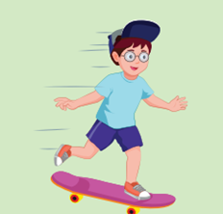
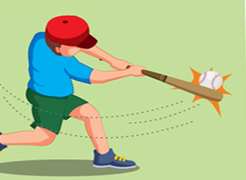




4
1
6
1
SPIN
5
2
2
5
4
3
3
6
Notes:
GV dùng vòng quay để HS chọn số ngẫu nhiên. Khi chọn vào ô số nào thì sẽ làm câu cho số đó

Slide 22

WRAP-UP

Slide 24









Please help me find the correct answers

Slide 25


h_ _ _ _ _ _
hitting

Slide 26
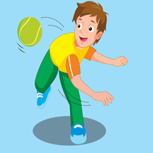
_h_ _ _ _ _ _
throwing

Slide 27

c _ _ _ _ _ _ _
catching

Slide 28

_ _ _ k _ _ _
kicking

Slide 29

llovyelalb
volleyball

Slide 30

csorec
soccer

Slide 31

imnntoadb
badminton

Slide 32
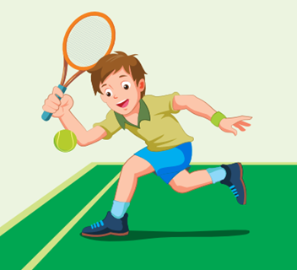
entins
tennis

Slide 33

skbatllabe
basketball

Slide 34
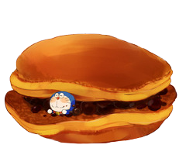
Your reward ☺
end

Slide 35
Homework
Practice vocabularies and structure. Make sentences using them.
Do the exercises in Tiếng Anh 3 i-Learn Smart Start Workbook (page 56)
Do the exercises in Tiếng Anh 3 i-Learn Smart Start Notebook (page 37)
Play the consolidation games in Tiếng Anh 3 i-Learn Smart Start DHA App on www.eduhome.com.vn
Prepare the next lesson (page 81)

Slide 36

Have a nice day!

