Slide 2



Unit
10
HOUSES IN THE FUTURE
LESSON 3: A CLOSER LOOK 2
1

Slide 3
LESSON 3: A CLOSER LOOK 2
LESSON 1: GETTING STARTED
WARM-UP
Game: Game: Sentence puzzling
PRESENTATION
Grammar focus
Task 1: Teacher explicates the forms.
PRACTICE
Task 2: Put the verbs in the brackets in the future simple.
Task 3: Work in pairs. Make sentences from the given words and pictures.
Task 4: Teacher explicates the forms of “might”.
Task 5: Read and tick.
PRODUCTION
Task 6: Game: Find the differences.
CONSOLIDATION
Wrap-up
Homework

Slide 4
WARM-UP
ENGLISH | NEXT YEAR. | SHE | WILL LEARN
WILL | HIS FATHER | OVER NIGHT. | WORK
SENTENCES PUZZLING
WILL | PHONG AND NICK | SOON. | COME
FINISH | SAM | WON’T | HIS WORK.

Slide 5
WARM-UP
SHE | WILL LEARN | ENGLISH | NEXT YEAR.
HIS FATHER | WILL | WORK | OVER NIGHT.
SENTENCES PUZZLING
PHONG AND NICK | COME | ENGLISH | SOON.
SAM | WON’T | FINISH | HIS WORK.

Slide 6
PRESENTATION
*Grammar
FUTURE SIMPLE
+
S + will + V
STRUCTURES:
-
S + will not (won’t) + V
?
Will + S + V ?

Slide 7
SIGNAL
PRESENTATION
1. Adverbs of time
Tomorrow
Next week/ month/ year/ day/ Sunday …
Someday
In + period of time: in 3 months, in 4 minutes
2. Some verbs
Think
Promise
Predict
Think/ believe/ suppose
3. Some adverbs
Perhaps
Probably
Maybe

Slide 8
PRACTICE
1
Ex 1. Fill will (‘ll) or won’t to make the sentences true for you (P.41)
Example:
I think I’ll listen to music in the afternoon.
1.
I think I _______ stay at home tonight.
will / ‘ll
2.
My friends _______ go to the library this afternoon.
will
3.
My mum _______ make a cake today.
will / ‘ll
4.
I _______ have an English test tomorrow.
won’t
5.
Our family _______ move to the new house next week.
will / ’ll

Slide 9
PRACTICE
2
Complete the conversation with will ('ll) or won’t. (P.41)
A: Oh, no. The dog ran away again!
B: Don’t worry – he (1) _______ come back.
A: Are you sure he (2) _______?
B: OK, he might not come back today. But I’m sure he (3) _______
come back tomorrow.
A: I don’t believe you! He (4) _______ comeback. We (5) _______
never see him again. I’m sure.
B: Oh, look ... Here he is!
will / ‘ll
will
will / ‘ll
won’t
will / ’ll

Slide 10
PRACTICE
3
Write sentences, using will ('ll) or won't and the words given. (P.41)
1.
computer / do / housework
A computer will / won’t help me to do my housework.
2.
robot / water / ﬂowers
A robot will help me to water the flowers.
3.
smart TV / cook / meal
A smart TV won’t help me to cook meals.
4.
washing machine / iron / clothes
A washing machine will / won’t help me to iron the clothes.
5.
smartphone / take care / children
A smartphone won’t help me to take care of the children.

Slide 11
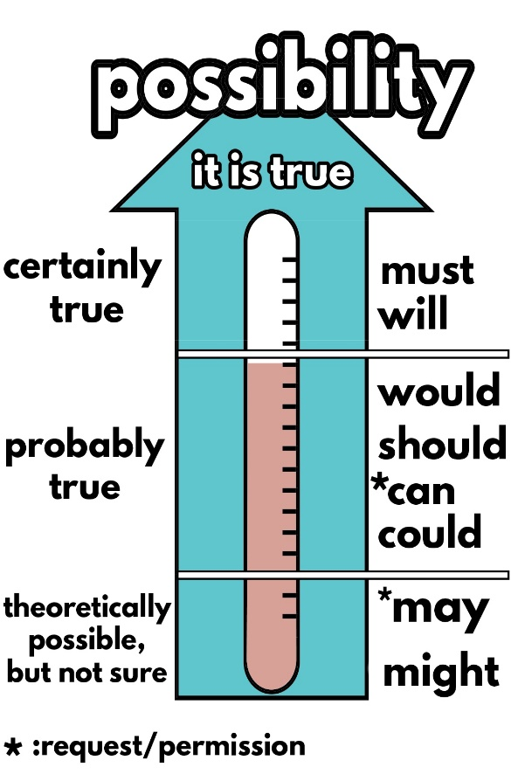
“We might live in a UFO.”
PRACTICE
What structure do I use in this sentence?
might + V
Why do I use “might” instead of “will”?
We use might for future possibility.
Notes:
I’m not sure but I think robots might not do everything we want, because they are not human, they don’t have feelings …
- What verb do I use in this sentence? (might)
- Why do I use ‘might’ instead of ‘will’?
Let’s see it more clearly.

Slide 12


Might for future possibility
PRACTICE
We use might + V to talk about actions that are possible in the future (We are not sure if they will happen or not).
Example:
We might live in a UFO.
They might not travel in cars.

Slide 13


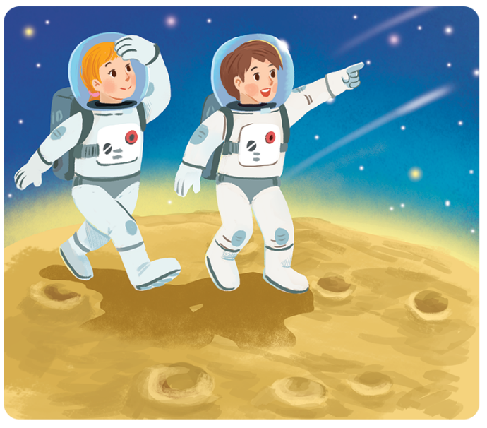
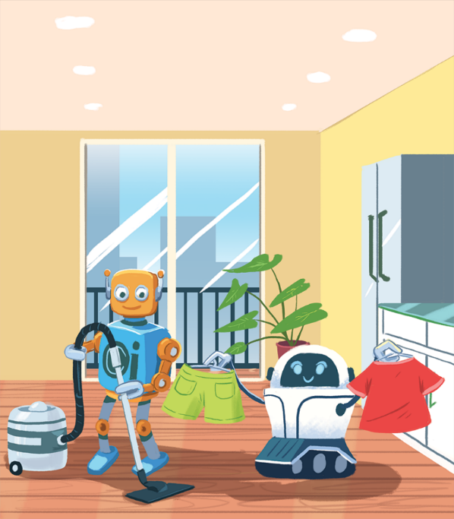
PRACTICE
4
Read the poems:
In the future
We might live with robots.
They might clean our houses.
They might wash our clothes.
They might not talk to us.
In the future
Jenny, aged 12
We might go on holiday to the Moon.
We might stay there for a long time.
We might have a great time.
We might come home soon.
Henry, aged 11

Slide 14

CONSOLIDATION
1
Wrap-up
What have we learnt in this lesson?
Future Simple and Might for future possibility.

Slide 15

CONSOLIDATION
2
Homework
Do Part B in your Workbook
Write the answers on your notebook.

Slide 16






Website: hoclieu.vn
Fanpage: facebook.com/www.tienganhglobalsuccess.vn/

