Slide 1


Slide 2

1
Unit
FAMILY LIFE
REVIEW 2
LESSON 3
SKILLS (2)

Slide 3

Unit
1
1
FAMILY LIFE
Family Life
Unit
OBJECTIVES
1. Knowledge
Review the skills Reading and Writing they have learnt in Unit 4-5.
2. Core competence
- Develop critical thinking skill;
- Be collaborative and supportive in pair work and team work;
- Actively join in class activities.
3. Personal qualities
- Develop self-study skills

Slide 4
LESSON 2
SKILLS
Unit
GETTING STARTED
WARM-UP
WARM UP
READING
Activity 1: Read the text. Match the highlighted words with their meanings.
Activity 2: Read the text again and choose the best answers.
Activity 3: Play with cards.
WRITING
Activity 1: Brainstorming
Activity 2: Completing the application letter for a volunteer job by writing a short paragraph.
CONSOLIDATION
Wrap-up
Home work

Slide 5
LESSON 2
SKILLS
Unit
GETTING STARTED
WARM-UP
WARM UP

Slide 6

WARM-UP
TRY TO GUESS THIS WORD

Slide 7
LESSON 2
SKILLS
Unit
GETTING STARTED
WARM-UP
WARM UP
READING
Activity 1: Read the text. Match the highlighted words with their meanings.
Activity 2: Read the text again and choose the best answers.
Activity 3: Play with cards.

Slide 8
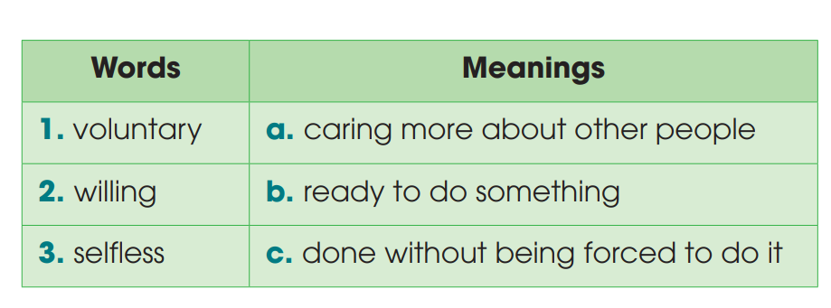
READING
1
Read the text. Match the highlighted words with their meanings
(p.64-65)

Slide 9
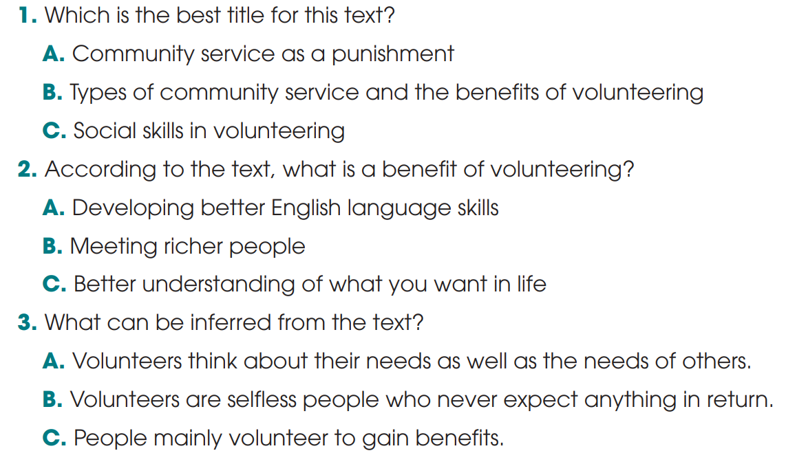
VOCABULARY
2
Read the text again and choose the best answers. (p.65)

Slide 10
READING
3
Play with cards.
- Work in pairs
- Prepare two quiz questions based on the reading text
- Write them on cards or pieces of paper, e.g. How many types of community service are there? Why does the writer think volunteering isn’t always selfless?
- Go to the board, pick a card, and answer the question.

Slide 11
LESSON 2
SKILLS
Unit
GETTING STARTED
WARM-UP
WARM UP
READING
Activity 1: Read the text. Match the highlighted words with their meanings.
Activity 2: Read the text again and choose the best answers.
Activity 3: Play with cards.
WRITING
Activity 1: Brainstorming
Activity 2: Completing the application letter for a volunteer job by writing a short paragraph.

Slide 12
WRITING
BRAINSTORMING
Which skills and qualities are needed to be a volunteer for an organization collecting books for children?
fond of reading love helping others
love meeting new people develop social skills
good interpersonal skills be enthusiastic and helpful

Slide 13
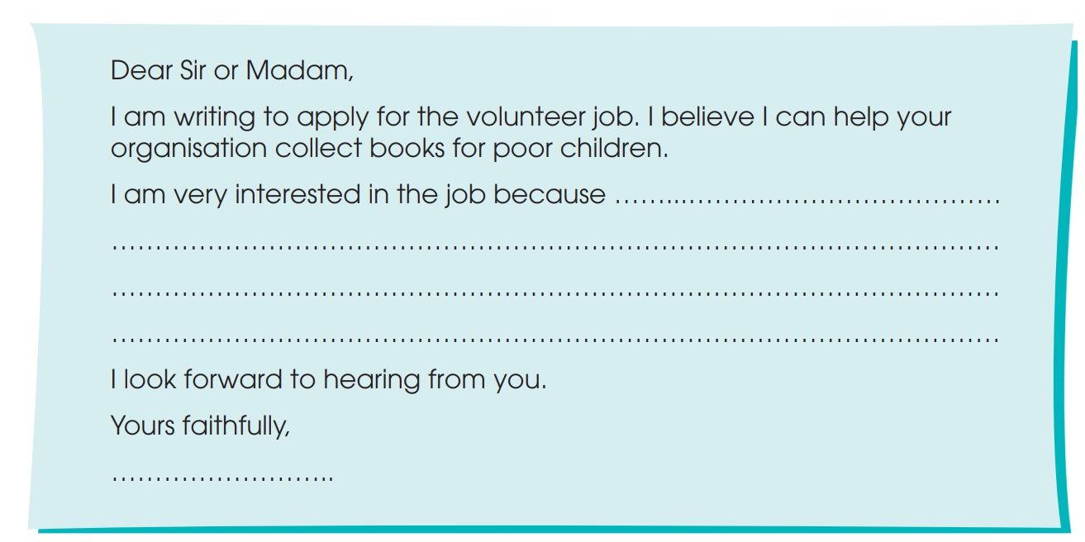
WRITING
Complete this application letter for a volunteer job by writing a short paragraph. You may use the ideas below to help you. (p.65)
fond of reading love helping others
love meeting new people develop social skills

Slide 14
WRITING
Complete this application letter for a volunteer job by writing a short paragraph. You may use the ideas below to help you. (p.65)
Sample answer:
I am very interested in the job because I am very fond of reading and I can sort books very well. I also love helping others and meeting new people, especially children. In fact reading books to children is my favorite hobby. I am also interested in this job because it will help me to develop my social skills, such as communication and teamwork skills.

Slide 15
LESSON 2
SKILLS
Unit
GETTING STARTED
WARM-UP
WARM UP
READING
Activity 1: Read the text. Match the highlighted words with their meanings.
Activity 2: Read the text again and choose the best answers.
Activity 3: Play with cards.
WRITING
Activity 1: Brainstorming
Activity 2: Completing the application letter for a volunteer job by writing a short paragraph.
CONSOLIDATION
Wrap-up
Home work

Slide 16
CONSOLIDATION
1
Wrap-up
1. Knowledge
Review the skills Reading and Writing they have learnt in Unit 4-5.
2. Core competence
- Develop critical thinking skill;
- Be collaborative and supportive in pair work and team work;
- Actively join in class activities.
3. Personal qualities
- Develop self-study skills

Slide 17
CONSOLIDATION
2
Homework
Do exercises in the workbook
Prepare for the next lesson:
Unit 6. Lesson 1: Getting Started

Slide 18


