Slide 1
KEY ENGLISH TEST 1 SPEAKING TEST 3

Slide 2
KET SPEAKING
Time allowed - 8-10 minutes
Normally you will do the speaking test with another candidate. The two of you will meet two examiners. One of the examiners will talk to you, the other does not particpate in the conversations.
There are two parts to the speaking test:
Speaking part 1: short questions and answers between you and the examiner
Speaking part 2: the examiner gives you some information or a card with some ideas for questions. You have to talk with the other candidate and ask or answer questions. How to prepare for KET Speaking
Speak as much as you can, with your friends
Practise asking and asnwering questions about daily life
Practise giving information about yourself

Slide 3
SPEAKING PART 1

Slide 4
Part 1:
Remember to add more details to your answer to make it longer
How long have you learned English?
What time do your lessons start in the morning?
How many students are there in your class?
How do you go to school every day?
What do you like doing after school?
Tell me something about your favorite teacher

Slide 5
How long have you learned English?
Answer: I have learnt English + for …. + since…

Slide 6
- What time do your lessons start everyday?
- How many students are there in your class?
Answers:
The lessons start at (time) in the morning and (time) in the afternoon
There are (number) students/pupils in my class
- What do you like doing after school?
Answers: I like/love/ am fond of + Ving

Slide 7
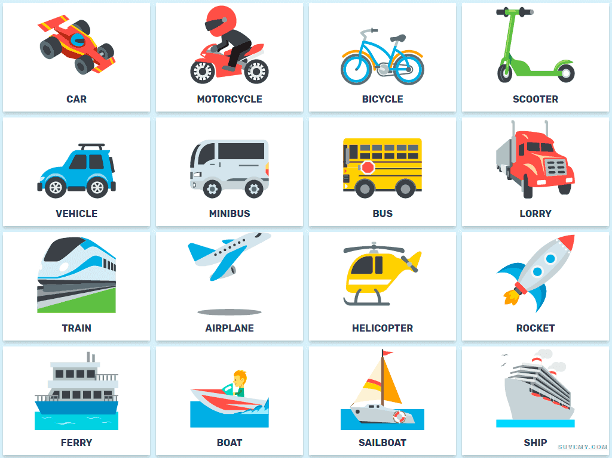
How do you go to school every day?
By + vehicle
On foot

Slide 8
Favorite teacher
The answer should be at least 3 sentences
Helpful outline and vocabulary
Favorite teacher
Name/age/ subject
Physical appearance
Personality
Her name…..
She is….
- She teaches me …..
Tall / thin/…
Hair: long/ short / curly/…
Kind/ helpful / patient/ supportive / trustful
Reliable, devoted, considerate, …

Slide 9
SPEAKING PART 2
Asking and answering questions using these prompt cards

Slide 10
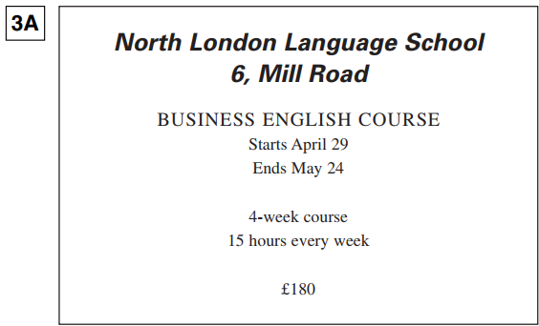
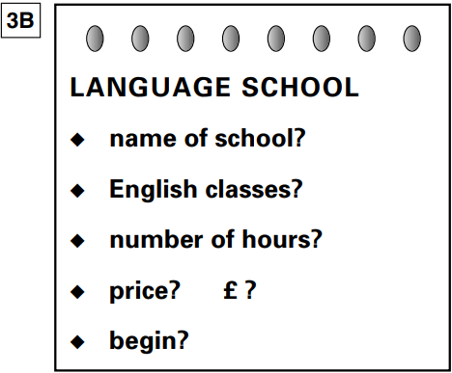
What is the name of the school?
Are there English classes?
How many hours does the course last every week?
How much is the fee?
When does the course begin?
Can you think of other questions or other ways to ask and answer?

Slide 11
What is the name of the bookshop?
Are there English dictionaries in the bookshop?
What time is its closing time?
Does it open on Saturday?
What is the address of the bookshop?

Slide 12
Now, imagine you are the owner of this bookshop. Introduce it based on given information

