Slide 1

Unit 2: Every Day
Lesson 2h: Right on!
Page 49

Slide 2
Lesson Outline
Warm-up
Presentation
Practice
Production
Consolidation
Wrap-up

Slide 3
Objectives
By the end of this lesson, students will be able to…
review the vocabulary and grammar points in the unit.
make a presentation about their ideal neighbourhood.

Slide 4

WARM-UP

Slide 5
PAIRWORK
Ask and answer about your neighbourhood.
Where do you live?
What do you like about your neighbourhood?
What do you want to change?

Slide 6

It’s time to learn …

Slide 7

Presentation

Slide 8
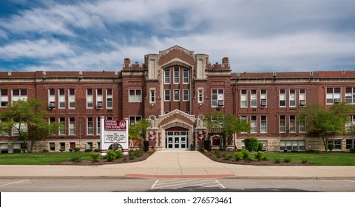

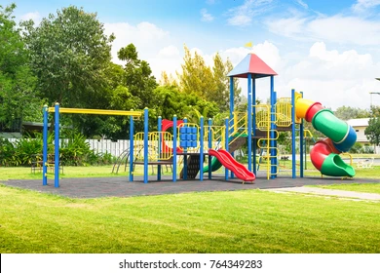

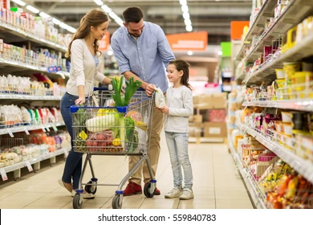
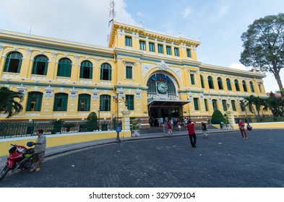
Label these places.
school
library
playground
cinema
supermarket
post office

Slide 9
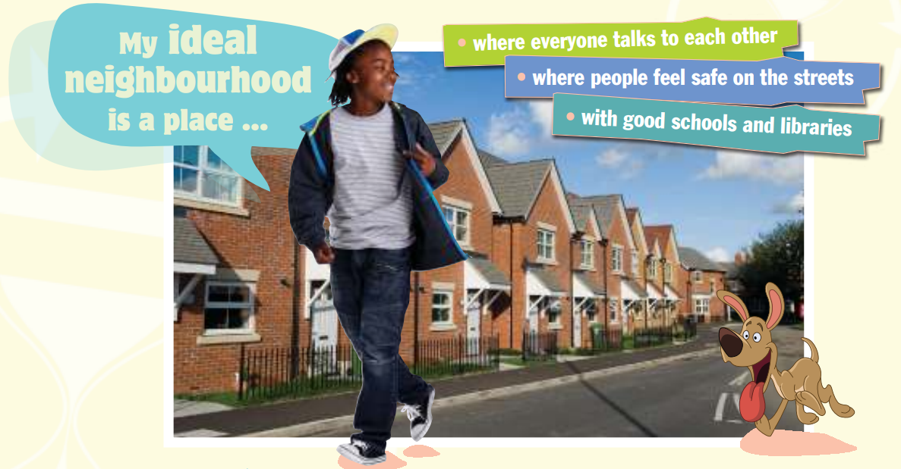
1. What is your ideal neighbourhood like? Think about streets, buildings, parks, transport and facilities. Draw a map of the area and tell the class.

Slide 10
Planning
Streets: wide pavements and bicycle lanes
Buildings: brick houses with grey roofs
Parks: a playground
Transport: good public transport system
Facilities: supermarket, post office, cinema, gym, cafés

Slide 11
Pairwork
Tell your friend about your ideal neighbourhood.
My ideal neighbourhood is a place where the streets have wide pavements and bicycle lanes. There are brick houses with grey roofs. There is a park with a playground for kids, too. People say hello to each other, and they feel safe. It has a good public transport system, too. It’s a place where there are lots of other facilities. There is a supermarket, a post office, a cinema and a gym. There are some nice cafés, too.

Slide 12

Listening

Slide 13

2. Listen to two people presenting their ideal neighbourhoods and make notes in your notebook.
Streets:
Buildings:
Parks:
Transport:
Facilities:

Slide 14
Speaker 1
Streets:
Buildings:
Parks:
Transport:
Facilities:
wide streets and pavements (walk safely)
for both older people and children
lots of car parks, walk or cycle to school
shops, restaurants

Slide 15
Speaker 2
Streets:
Buildings:
Parks:
Transport:
Facilities:
children play happily
small cottages with beautiful gardens
lots of trees and flowers
lots of car parks, walk or cycle to school
playground, nice little shops, a small café and a pizza house

Slide 16
Are the features of their neighbourhoods the same as yours?
The recording mentions wide streets and people talking to each other and feeling safe. These are also some of the features of my ideal neighbourhood.

Slide 17

Production

Slide 18
3. Use your ideas in Exercise 1 to present your ideal neighbourhood to the class.
Good morning, everyone! What does your neighbourhood look like? Is it in a busy city or in a quiet village?
My ideal neighbourhood is a place in the city where people feel comfortable and safe. There are wide streets, beautiful buildings and a good public transport system. There are lots of facilities such as a supermarket, a post office, a cinema and a gym. Children play in the park while older people enjoy walking or reading their favourite books there in the mornings. Police officers patrol my neighbourhood, so everyone feels safe.
Would you like to live in my ideal neighbourhood? I would. Thanks for listening.

Slide 19

Cooperation
4 a) Read the statements. Which do you agree with? Which do you disagree with? Talk with your partner.
Working together ...
1 is fun.
2 brings people together.
3 leads to more mistakes.
4 takes more time.
5 encourages people to talk.
6 means everyone makes decisions.
7 makes the work easier.

Slide 20
Expressions to give opinions
Agree
I agree that …
I (really) think that …
I believe (that) …
I’m sure that …
In my opinion
My opinion is …
Disagree
I don’t think that …
I disagree that …
I'm afraid I disagree that ...
I totally disagree that ...

Slide 21
I agree that working together is fun. It brings
people together and it encourages people to talk. It means everyone makes decisions, and it makes the work easier.
I disagree that it leads to more mistakes or that it takes more time.

Slide 22
b) Why should people work together? Tell the class.
I think people should work together because more people means more ideas and less work because everyone shares it.

Slide 23

CONSOLIDATION

Slide 24
Write a short paragraph (about 60 words) about your ideal neighbourhood. Use the ideas you have presented to the class.

Slide 25

WRAP-UP

Slide 26
Today’s lesson
Vocabularies
Places in the neighbourhood.
Speaking
Making a presentation.
Listening
Listen to a talk about the neighbourhood.

Slide 27
Homework
Practise the vocabularies and make sentences using them.
Prepare the next lesson (p. 50 SB)

Slide 28
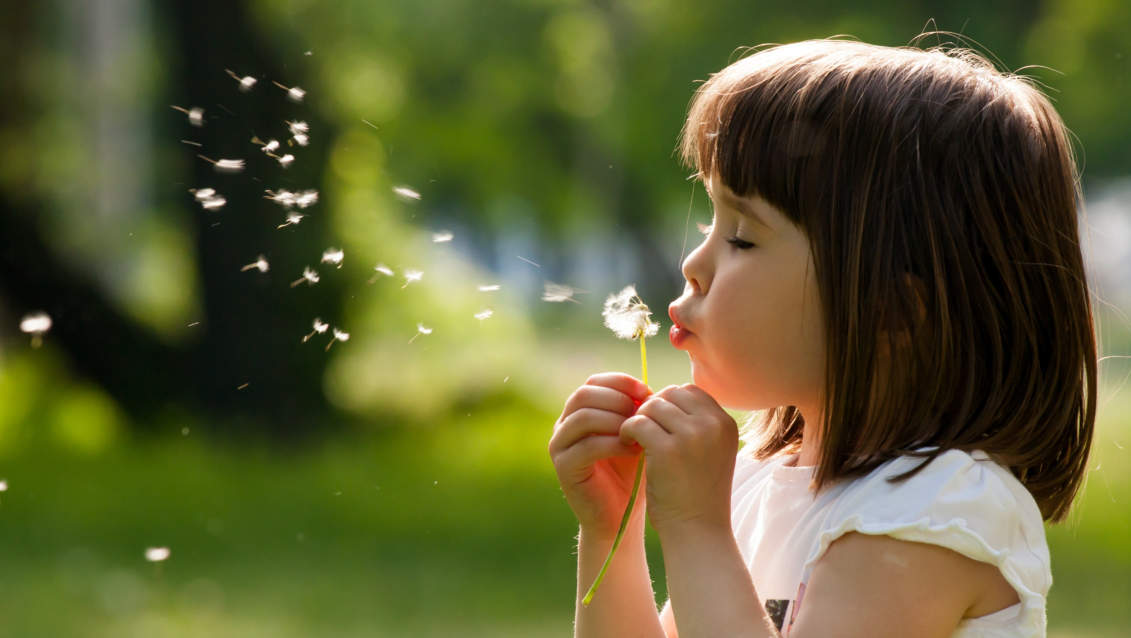
Enjoy your day!

