Slide 1

Unit 4: Holidays!
Lesson 4g: CLIL
Page 82

Slide 2
Lesson Outline
Warm-up
Vocabulary
Reading
Grammar
Speaking
Consolidation
Wrap-up

Slide 3
Objectives
By the end of this lesson, students will be able to…
use words related to camping: container, contaminated, allow, attend, put out, leash, disease.
read the text for important details.
use the structure have to / don’t have to.
talk about what they have to / don’t have to do when camping.

Slide 4

WARM-UP

Slide 5
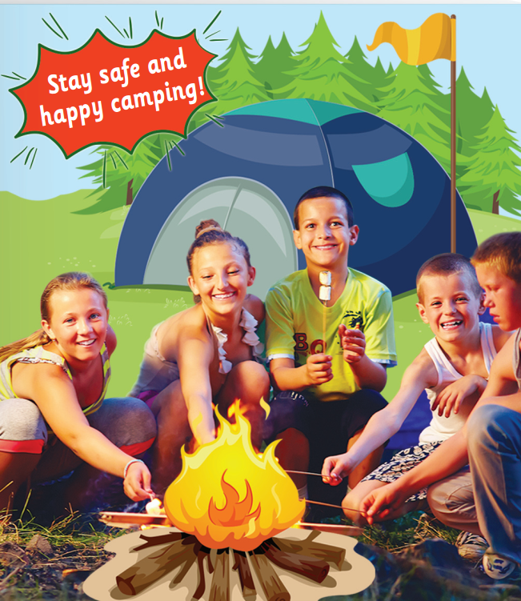

Work in pairs.
Hidden picture: What are they doing?
=> They are camping / going camping.
Notes:
Click vào từng ô màu để hình hiện ra từ từ

Slide 6

Work in pairs
Do you like camping? Why?
Where do people often go camping?
Is camping popular in Vietnam?
Yes, I like camping because I can spend more time with nature.
People often go camping in the countryside.
Yes, camping is very popular in Vietnam.

Slide 7

It’s time to learn …

Slide 8

Reading

Slide 9
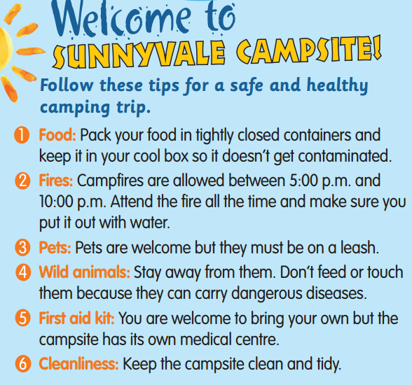
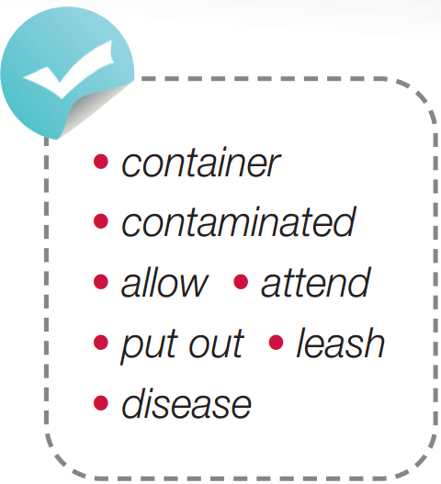
Pre-reading
Find these words in the text, try to guess their meanings.

Slide 10

Vocabulary
Listen and repeat.
allow /əˈlaʊ/ (v): cho phép
attend /əˈtend/ (v): tham gia, tham dự
container /kənˈteɪnə/ (n): vật chứa/đựng
contaminated /kənˈtæmɪneɪtɪd/ (adj): bị hư hỏng, nhiễm bẩn
disease /dɪˈziːz/ (n): bệnh
leash /liːʃ/ (n): dây xích (động vật)
put out /pʊt ˈaʊt/ (v): dập tắt (lửa)

Slide 11
Choose suitable words to complete each sentence. container * contaminated * allowed * attend * put out * leash * disease
Extra Practice
The fire was ___________ very quickly and everyone was safe.
I didn’t ___________ the class yesterday because I was sick.
The teacher is bringing a heavy ___________ of paper into our class.
Please remember to keep your dogs on a ___________ in public places.
We shouldn’t eat ___________ food because it’s bad for our health.
His mother said no at first, but later she ___________ him to go to the movie.
Because of the ___________, he’s feeling tired and doesn’t want to eat.
put out
attend
container
leash
contaminated
allowed
disease

Slide 12
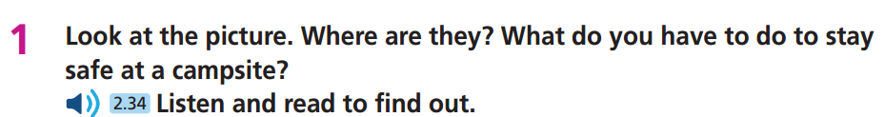
Pre-reading
Underline key words

Slide 13
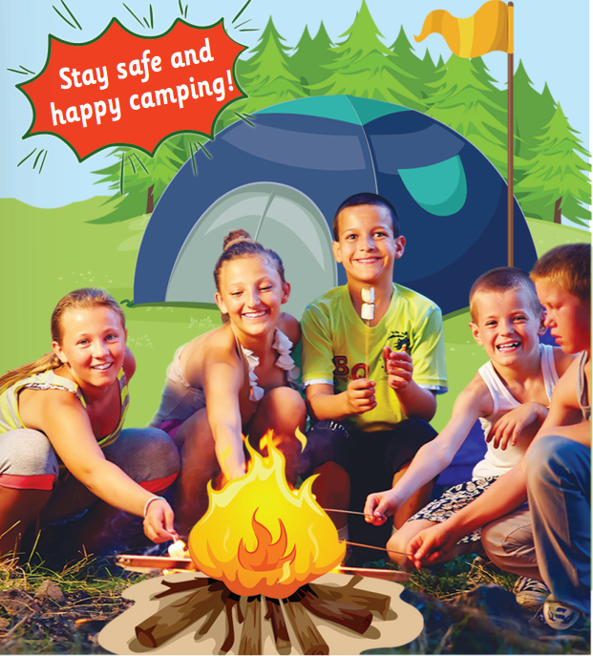
Look at the picture. Where are they? What do you have to do to stay safe at a campsite?
While- reading
They are at a campsite in the countryside.
To stay safe at a campsite, you have to keep your food in a cool box, attend your campfire at all times, put the fire out with water, and stay away from wild animals.

Slide 14
Read the text again and fill in each gap with only ONE word:
Extra practice
Tips for a healthy camping trip:
Keep your food in tightly closed____________.
Make sure to put the fire out with ____________ before 10 p.m.
Always keep your ____________ on a leash.
Stay away from wild animals because they can have _________.
Remember to keep the campsite ____________ and tidy.

Slide 15
Read again to check the answers.
Extra practice
Tips for a healthy camping trip:
Keep your food in tightly closed ____________.
Make sure to put the fire out with ____________ before 10 p.m.
Always keep your __________ on a leash.
Stay away from wild animals because they can have __________.
Remember to keep the campsite ____________ and tidy.
containers
water
pets
diseases
clean

Slide 16
Work in pairs
Post-reading
Look at the text on page 82 again and discuss which tips are useful for you when going camping.
I think the tip about the fire is very useful for me because I can be sure that it is put out with water and it is safe for us.

Slide 17

have to / don’t have to
Presentation

Slide 18
Choose suitable words to fill in the gaps to complete the rules about have to / don’t have to: doesn’t have to * have to * don’t have to * has to e.g. You have to check out at 2:00 p.m.
They don’t have to bring medicine with them.
She has to wake up early.
He doesn’t have to clean the floor.
Affirmative | Negative
I/ We/ You/ They……………………… He/ She/ It ……………………… (It’s the rule.) | I/ We/ You/ They ……………………… He/ She/ It ……………………..… (It isn’t necessary.)
have to
don’t have to
has to
doesn’t have to

Slide 19
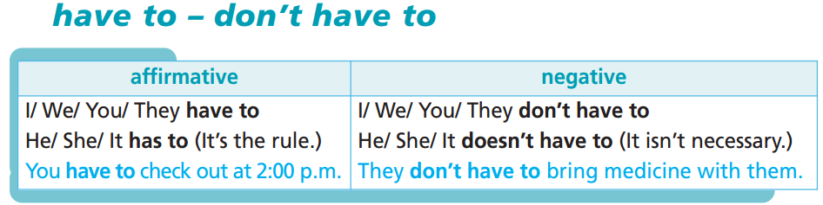
Remember:

Slide 20

Practice

Slide 21
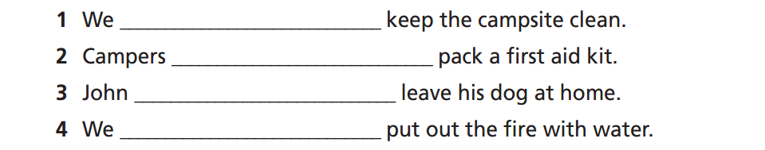
have to
don’t have to
doesn’t have to
have to

Slide 22

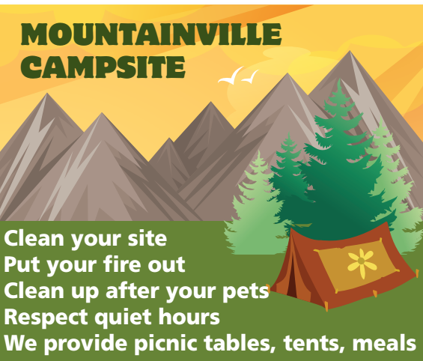
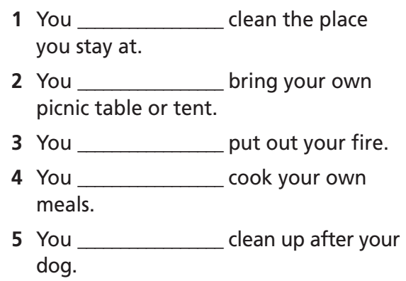
Extra Practice
WB page 42
have to
don’t have to
have to
don’t have to
have to

Slide 23

Production

Slide 24
Ask and answer the following questions:
Work in pairs
What do you have to do today?
What are the things you don’t have to do today?
Today I have to wake up early.
Today I don’t have to wash the dishes.

Slide 25

Speaking

Slide 26
Work in pairs
You have to pack your food in tightly closed containers and keep it in your cool box.
You have to attend the campfire at all times, and you have to put it out with water.
You don’t have to leave your pet at home, but you have to keep it on a leash.
You have to stay away from wild animals.
You don’t have to bring a first-aid kit.
You have to keep the campsite clean and tidy.

Slide 27

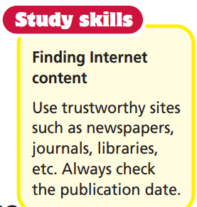
E.g. You have to put on sun cream.
You have to stay out of the midday sun.
You have to stay under an umbrella. You don’t have to bring your own – most beaches have some to hire.
You have to wear a hat.

Slide 28

CONSOLIDATION

Slide 29
Imagine you are going camping with your class this weekend. Write a paragraph (about 50-60 words) to describe what you have to / don’t have to prepare for it and how to stay safe when camping. You can use the following information:
Do you have to prepare food/drinking water/clothes / a first-aid kit / …? Why?
What do you have to / don’t have to do with fires/pets /wild animals / … to stay safe when camping? Why?
e.g.
This weekend I am going camping with my class. I have to………………

Slide 30
Imagine you are going camping with your class this weekend. Write a paragraph (about 50-60 words) to describe what you have to / don’t have to prepare for it and how to stay safe when camping.
This weekend I am going camping with my class. I have to prepare clothes. I don’t have to prepare food, drinking water, and a first-aid kit because the teacher will bring them. I have to put out the fire with water to stay safe. I have to stay away from wild animals because they can have dangerous diseases.

Slide 31

WRAP-UP

Slide 32
Today’s lesson
Reading:
Read the text for important details.
Grammar:
Use the structure have to / don’t have to.
Speaking:
Talk about what they have to / don’t have to do when camping.
Vocabulary
container
contaminated
allow
attend
put out
leash
disease

Slide 33
Homework
Practise the vocabulary and make sentences using them.
Prepare for the next lesson (p. 83 SB).

Slide 34
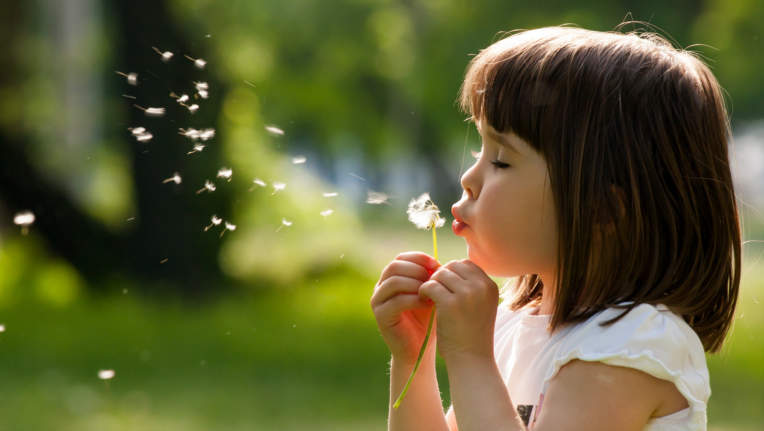
Enjoy your day!

