Slide 1
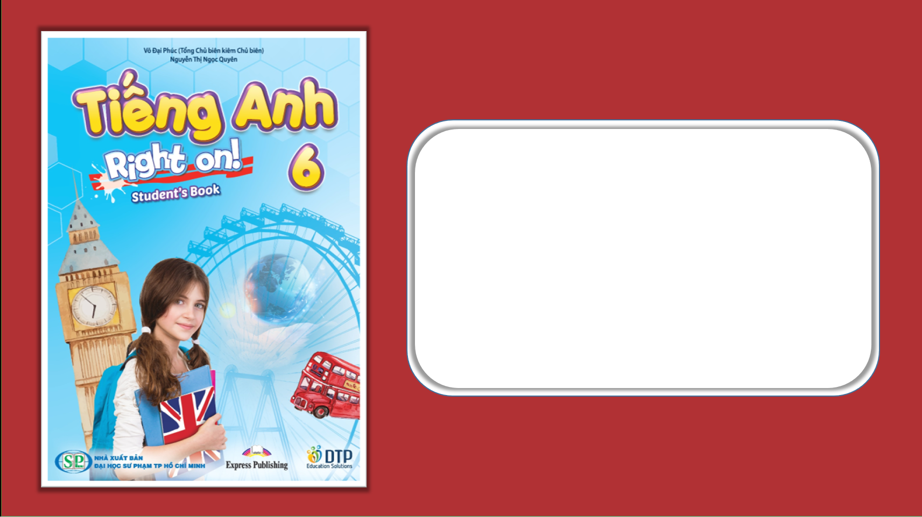
Unit 1: Home and Places
Lesson 1f: Skills
Page 30

Slide 2
Lesson Outline
Warm-up
Vocabulary
Reading
Consolidation
Wrap-up

Slide 3
Objectives
By the end of this lesson, students will be able to…
Learn vocabulary: Nouns (countryside, suburb, driveway, floor, row).
Learn about different types of British houses.
Describe a picture and their room, read for specific information.
Talk about British homes.

Slide 4

WARM-UP

Slide 5
Look at the picture and choose the appropriate prepositions to fill in the missing words.
under
in front of/near
next to/near
There is a big white sofa 1) ______________ the window. There is an armchair 2) ______________ the coffee table. There is a carpet 3) ______________ the coffee table. There aren’t any beds in the room.

Slide 6

It’s time to learn …

Slide 7

Reading

Slide 8

Vocabulary:
• driveway /ˈdraɪvweɪ/ (n): đường lái xe vào nhà
• suburb /ˈsʌbɜːb/ (n): ngoại ô
• floor /flɔː/ (n): tầng, sàn (nhà)
• row /rəʊ/ (n): dãy nhà phố
• countryside /ˈkʌntrisaɪd/ (n): nông thôn

Slide 9
Vocabulary:
• driveway /ˈdraɪvweɪ/ (n): đường lái xe vào nhà
• suburb /ˈsʌbɜːb/ (n): ngoại ô
• floor /flɔː/ (n): tầng, sàn (nhà)
• row /rəʊ/ (n): dãy nhà phố
• countryside /ˈkʌntrisaɪd/ (n): nông thôn

Slide 10
1. Look at the pictures. Which of these houses are in big cities in the UK?

Slide 11
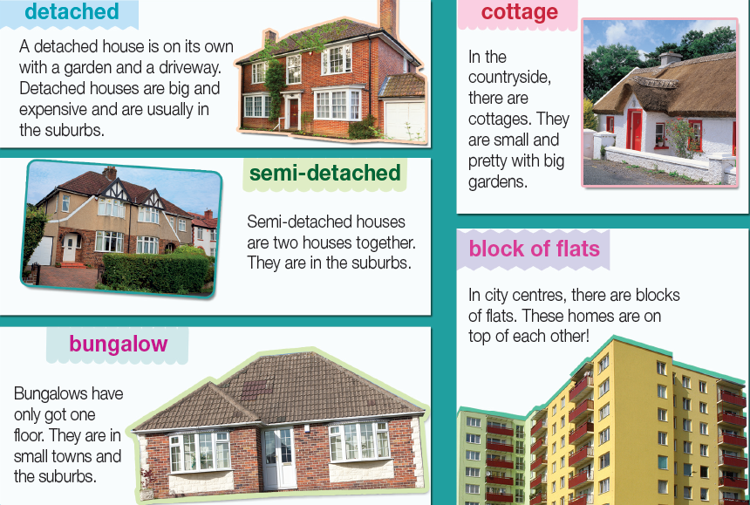
While-reading:
Read and listen to find out.

Slide 12
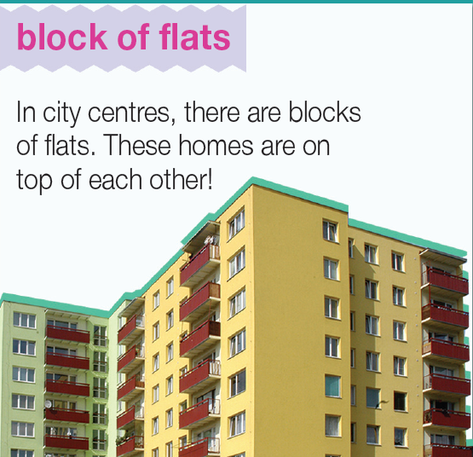
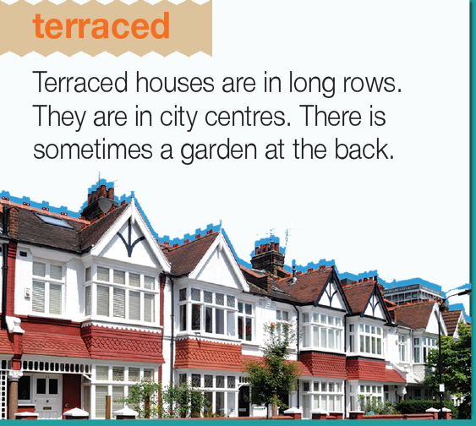
There are terraced houses and blocks of flats in big cities in the UK.

Slide 13
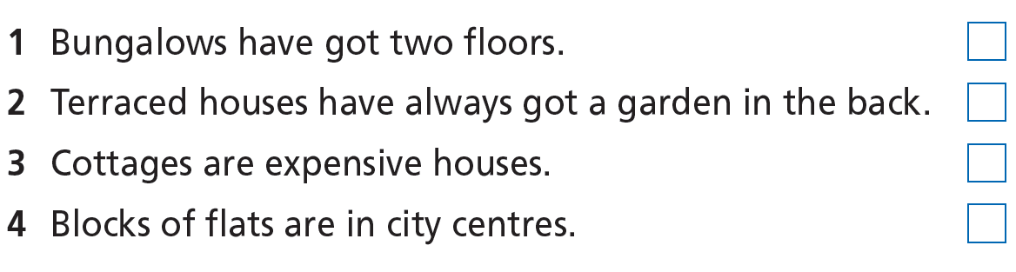
2. Read the text again and decide if the sentences are R (right), W (wrong) or DS (doesn’t say).

Slide 14
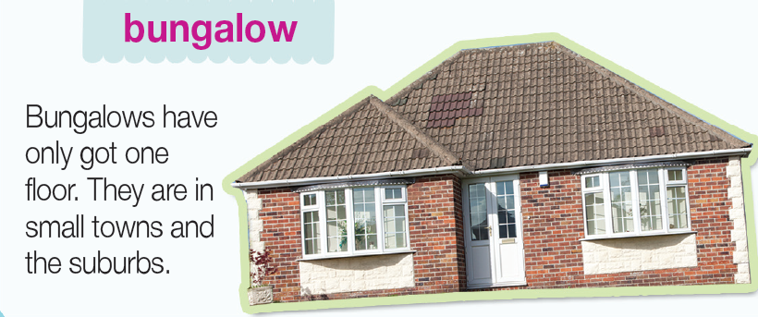
1 Bungalows have got two floors.
W

Slide 15
2 Terraced houses have always got a garden in the back.
W

Slide 16
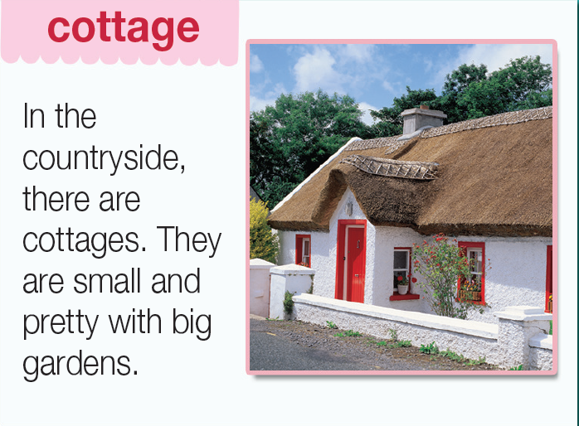
3 Cottages are expensive houses.
DS

Slide 17
4 Blocks of flats are in city centres.
R

Slide 18
3 Answer the questions. What types of houses …
1 are in city centres? ___________________________________
2 have got a garden? __________________________________
3 are expensive? _____________________________________
4 are in the countryside? _______________________________
terraced houses and blocks of flats
Detached houses, cottages, and some terraced houses
Detached houses
Cottages

Slide 19
More Practice:
Read the text again and choose the correct answer:
1. What are detached houses like?
A. small and expensive B. beautiful and small
C. big and comfortable D. big and expensive
2. How many houses does a semi-detached house have?
four B. three C. two D. five
3. Where are bungalows?
in the countryside B. in small towns
C. in cities D. in the mountains
4. What do cottages often have?
A. big gardens B. small gardens C. big garages D. small garages

Slide 20
Post-reading:
4. Present one of the different types of British homes to the class.
Eg: Detached houses are big. They’re usually in the suburbs. They’ve got gardens and driveways. They are expensive.

Slide 21

CONSOLIDATION

Slide 22
Write a paragraph (about 40-60 words) to describe one popular type of houses in your country.

Slide 23

WRAP-UP

Slide 24
Today’s lesson
Vocabularies
- Types of houses
Skills
- Reading
- Speaking

Slide 25
Homework
Practise the vocabularies and make sentences using them.
Do the exercises in TA 6 Right on WB (p. 17)
Prepare the next lesson (p. 31 SB)

Slide 26

Enjoy your day!

