Slide 1

Unit 5: Food and Drinks
Lesson 1.1: Vocabulary & Listening
Page 36

Slide 2



: FOOD AND DRINKS
LESSON OUTLINE
Consolidation

Slide 3
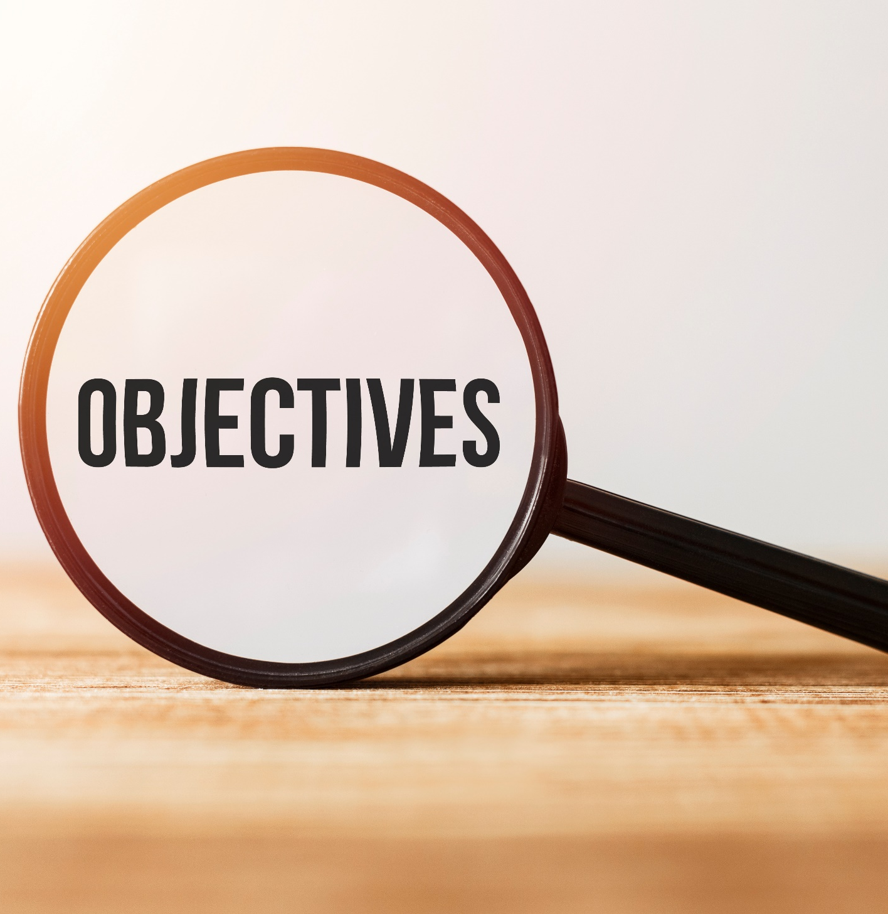
: FOOD AND DRINKS
By the end of this lesson, students will be able to…
know more vocabulary about ingredients and measurements.
talk about what food they need to buy.
listen to and understand a talk between a boy and his mom.
ask for repetition to check an amount or quantity.

Slide 4

: FOOD AND DRINKS
New words
spaghetti
lemon
tomato
onion
tablespoon
teaspoon
grams
milliliters

Slide 5

: FOOD AND DRINKS
WARM-UP

Slide 6

: FOOD AND DRINKS
Work in groups
- Make a shopping list of things to buy to prepare dinner.
- Add the quantity of the things you intend to buy.

Slide 7
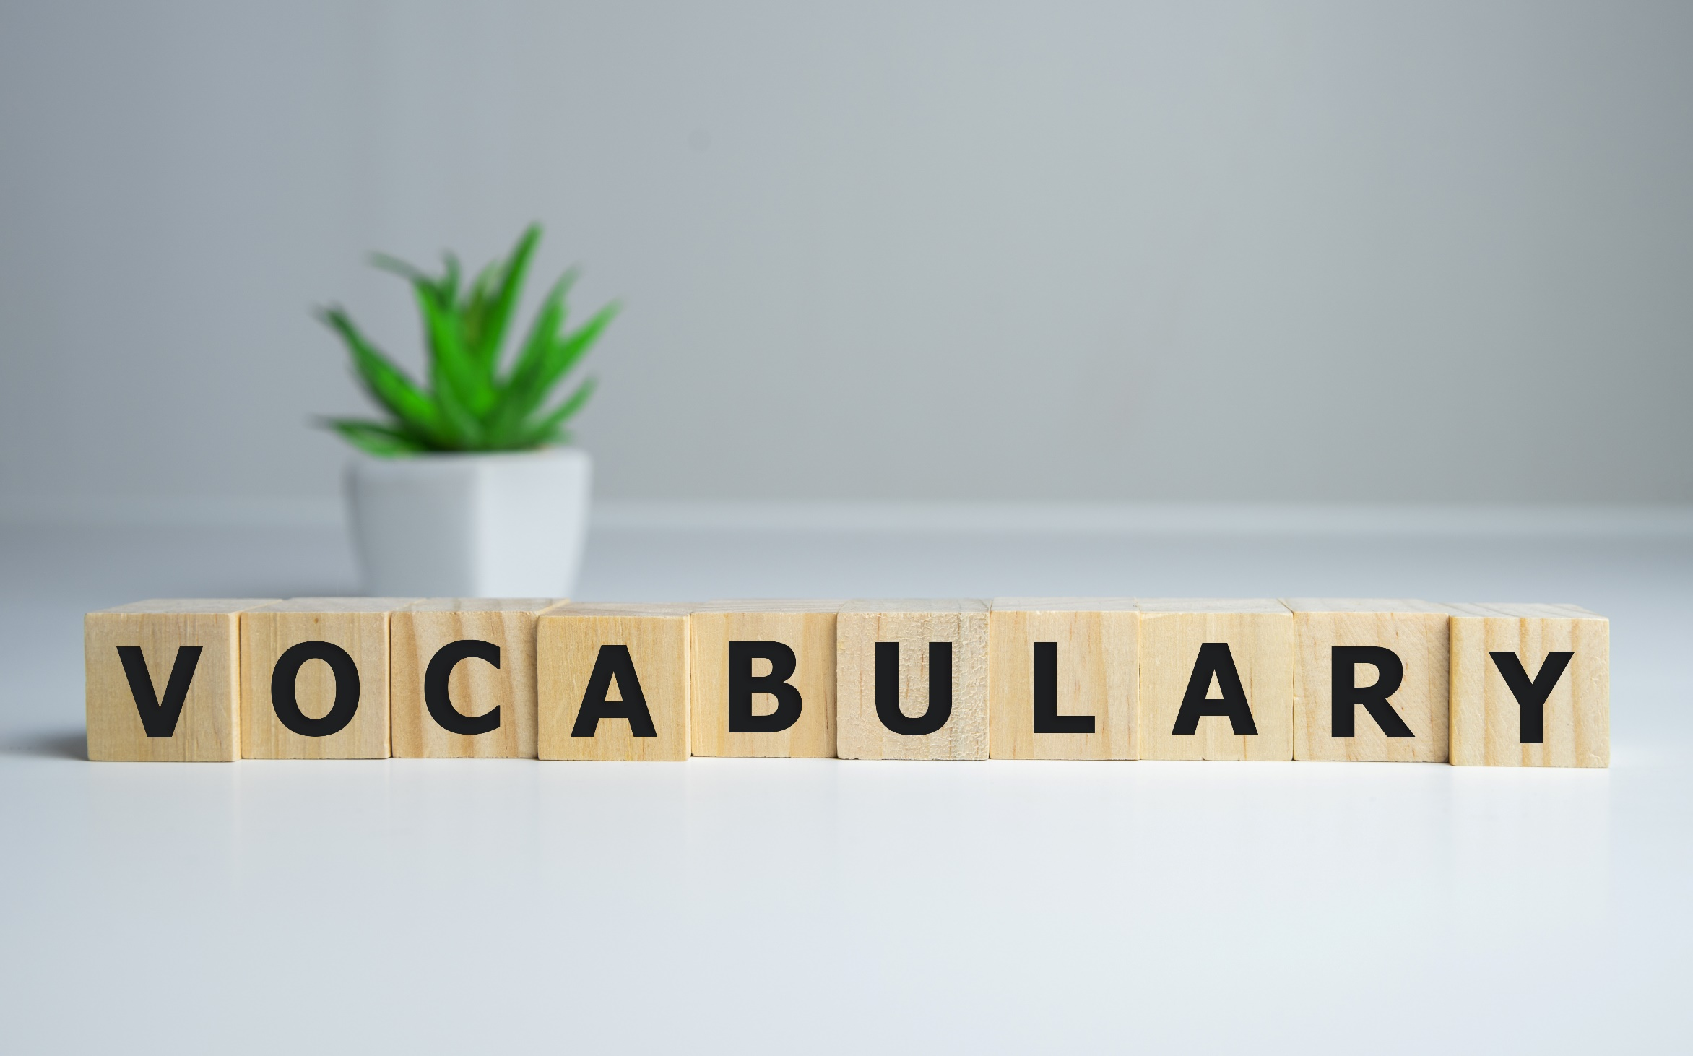

: FOOD AND DRINKS

Slide 8

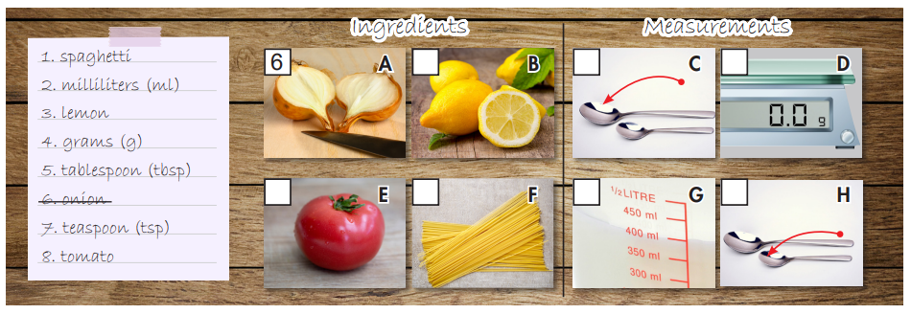
: FOOD AND DRINKS
Work in pairs. Number the pictures.
3
5
4
8
1
2
7

Slide 9

: FOOD AND DRINKS
Listen and repeat. Click each phrase to hear the sound.
1. spaghetti (n) /spəˈɡeti/ mì Ý
2. milliliter (n) /ˈmɪlɪˌliːtər/ mi-li-lít
3. lemon (n) /ˈlemən/ quả chanh
4. gram (n) /ɡræm/ gam / gram
5. tablespoon (n) /ˈteɪblspuːn/ thìa canh
6. onion (n) /ˈʌnjən/ hành tây
7. teaspoon (n) /ˈtiːspuːn/ thìa cà phê
8. tomato (n) /təˈmeɪtoʊ/ quả cà chua
Notes:
GV click vào từng cụm nghe âm thanh

Slide 10
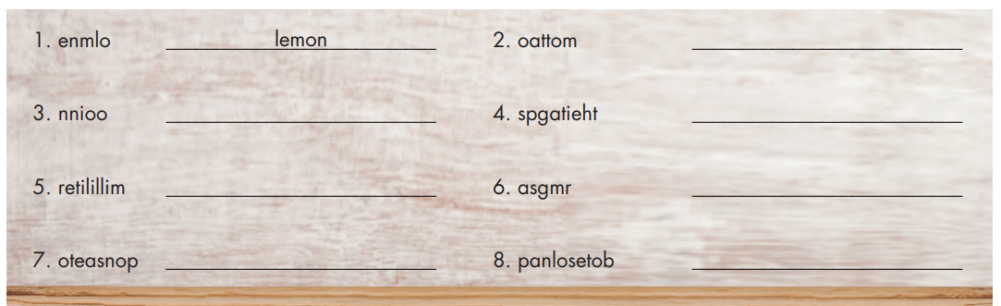
: FOOD AND DRINKS
Extra Practice
WB, page 26
Unscramble the words.
tomato
onion
spaghetti
milliliter
grams
teaspoon
tablespoon

Slide 11
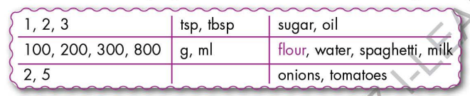
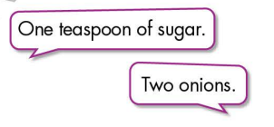
: FOOD AND DRINKS
Work in pairs.
Practice saying units of measurement with the ingredients using the numbers below.

Slide 12


: FOOD AND DRINKS
It’s listening time….

Slide 13
: FOOD AND DRINKS
Pre - listening
Read the instruction quickly. Underline the key words. What are we going to do?
Listen and choose the correct answer.
a. Listen to Logan talking to his mom. Where are they?

Slide 14
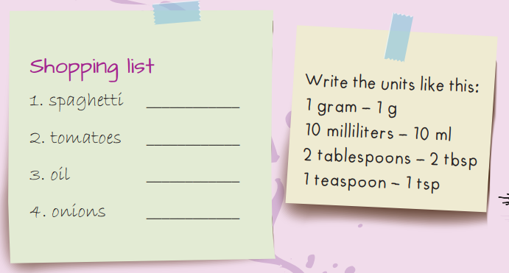
: FOOD AND DRINKS
Pre - listening
b. Now listen and write the amounts or quantities they need.
Guess the answer!

Slide 15
: FOOD AND DRINKS
While - listening
a. Listen to Logan talking to his mom. Where are they?
☞ YOUR ANSWER?
☞ WHY?
Now, finish your homework and then we can go shopping!

Slide 16
: FOOD AND DRINKS
While - listening
b. Now listen and write the amounts or quantities they need.
450g
five
1 bottle
four

Slide 17

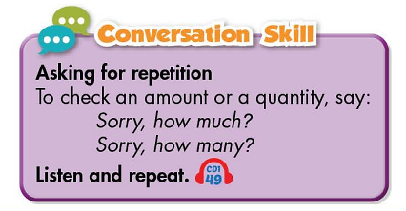
: FOOD AND DRINKS
Work in pairs
Post - listening
What do you usually buy at the supermarket?

Slide 18

: FOOD AND DRINKS
CONSOLIDATION

Slide 19
: FOOD AND DRINKS
Make a shopping list for things to prepare for lunch / dinner.

Slide 20
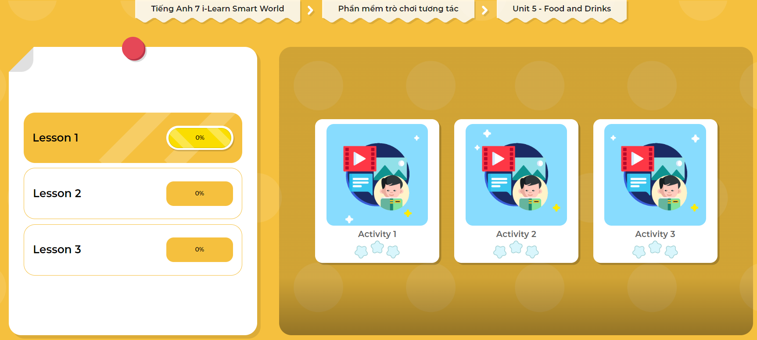
: FOOD AND DRINKS
LET’S PLAY!
Click here to play the games!

Slide 21

: FOOD AND DRINKS
WRAP-UP

Slide 22
: FOOD AND DRINKS
Today’s lesson
Vocabularies
spaghetti
lemon
tomato
onion
tablespoon
teaspoon
grams
milliliters

Slide 23
: FOOD AND DRINKS
Today’s lesson
Listening:
Listening for main ideas and specific information.
Speaking:
Talking about shopping list, amounts and quantities.
Asking for repetition.

Slide 24
: FOOD AND DRINKS
Homework
Learn by heart the new vocabulary and practice talking about what to buy at the supermarket.
Do the exercises in WB (pages 26 & 27 – WB).
Prepare the next lesson (page 37 – SB).
Play the consolidation games in Tiếng Anh 7 i-Learn Smart World DHA App on www.eduhome.com.vn
Do the exercise in Tiếng Anh 7 i-Learn Smart World Notebook (page 28).

Slide 25

Lesson 3
Stay positive and have a nice day!

