Slide 1
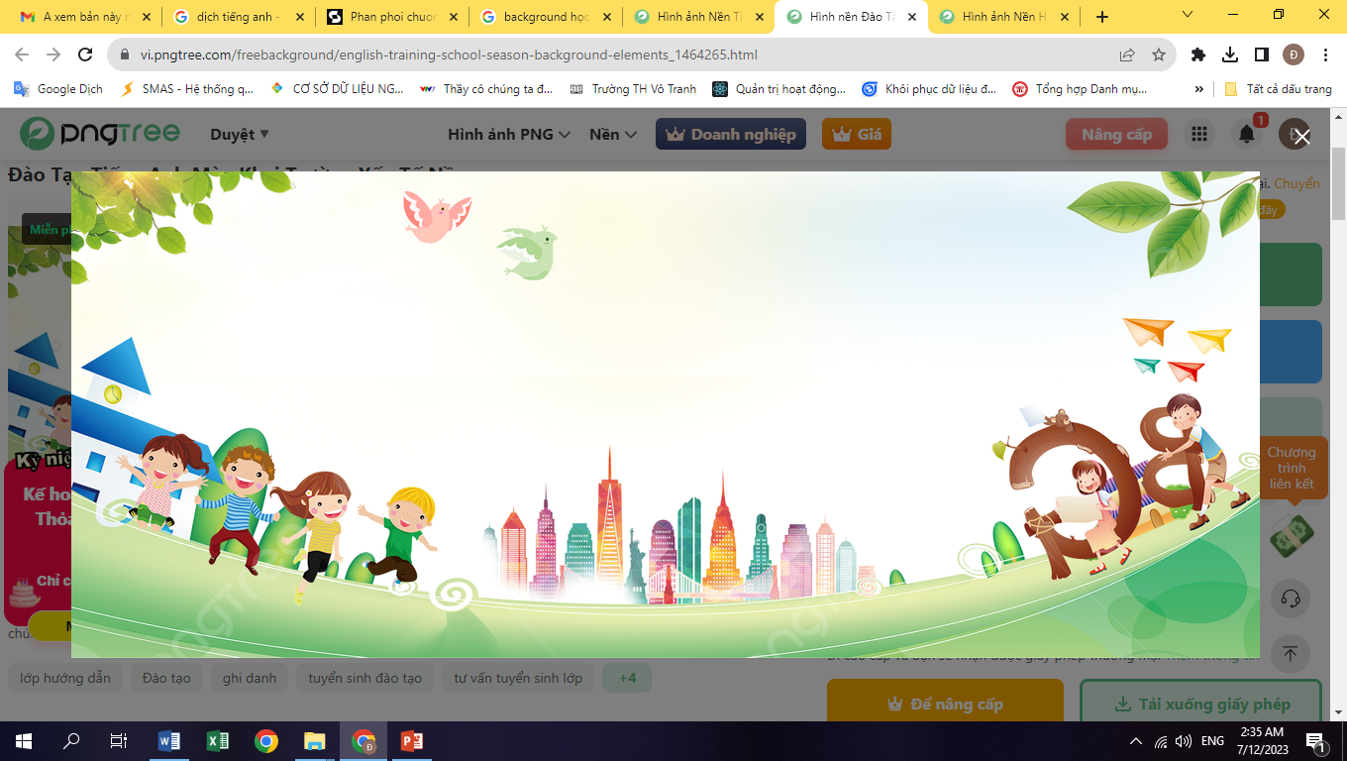



Genious Junior

Slide 2
KHỞI ĐỘNG
Genious Junior

Slide 3




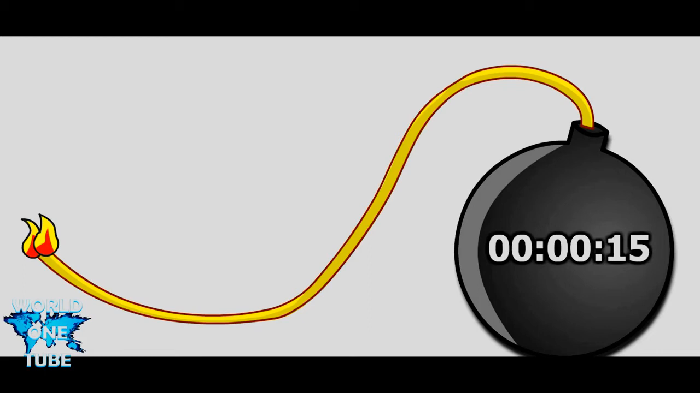

Question 1. Choose the word which has the underlined part pronounced differently from that of the rest.
A. both
B. tooth
C. clothing
D. thank
Time’s up
Answer: C
30
Time’s up
Start
15

Slide 4
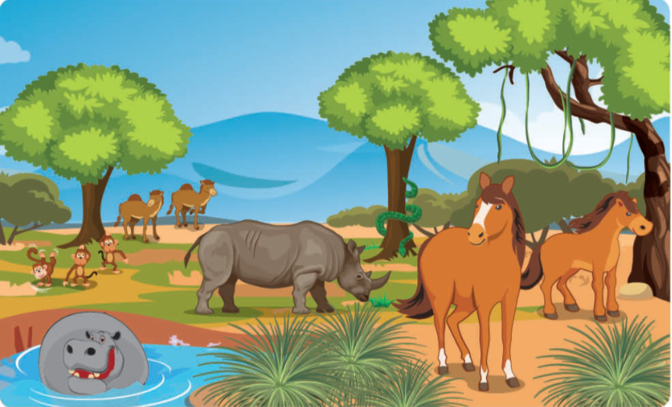
Question 2. Choose the word which has the underlined part pronounced differently from that of the rest.
A. couch
B. house
C. soup
D. ground
Time’s up
Answer: C
30
Time’s up
Start
15

Slide 5
Question 3. Choose the best option.
Would you like .......................... that for you?
A. me doing
B. me
C. that I do
D. me to do
Time’s up
Answer: D
30
Time’s up
Start
15

Slide 6
Question 4: Choose the best option.
Eiffel Tower is the most attractive ____________ in France.
A. building
C. square
B. resort
D. landmark
Time’s up
Answer: A
30
Time’s up
Start
15

Slide 7
Question 5. Choose the best option.
We should use _________to save natural resources.
A. oil
B. solar energy
C. coal
D. gas
Time’s up
30
Answer: B
Time’s up
Start
15

Slide 8
Question 6. Choose the best option.
………………… long or short?
A. Does Mai have hair
B. Is Mai’s hair
C. Does Mai’s hair have
D. Is hair of Mai
Time’s up
30
Answer: B
Time’s up
Start
15

Slide 9
Question 7. Choose the best option.
It is twenty – five past …………………….
A. fifty
B. a quarter
C. four o’clock
D. eleven
Time’s up
30
Answer: D
Time’s up
Start
15

Slide 10
Question 8. Choose the best option.
What do you call a baby horse?
A. infant
B. foal
C. kids
D. bunny
Time’s up
30
Answer: B
Time’s up
Start
15

Slide 11
Question 9. Choose the best option.
How many horns does a kangaroo have? ...........................
A. one
B. two
C. no horn
D. three
Time’s up
30
Answer: C
Time’s up
Start
15

Slide 12
Question 10. Choose the best option.
Karate is a form of martial _____.
A. fighting
B. skill
C. sports
D. arts
Time’s up
Answer: D
30
Time’s up
Start
15

Slide 13
TĂNG TỐC
Genious Junior

Slide 14
Question 11. Choose the best option
According to the pattern below, find the 7th number in the sequence?
5, 6, 8, 11,…..
A. 26
B. 20
C. 25
D. 15
30
29
28
27
26
25
24
23
22
21
20
19
18
17
16
15
14
13
12
11
10
9
8
7
6
5
4
3
2
1
0
Answer: A
Time’s up
Start

Slide 15
Question 12. Choose the best option.
What is the capital city of Russa?
A. Moscow
B. Rome
C. Los Angeles
D. Berlin
Answer: A
30
29
28
27
26
25
24
23
22
21
20
19
18
17
16
15
14
13
12
11
10
9
8
7
6
5
4
3
2
1
0
Time’s up
Start

Slide 16

Question 13. Listen and choose the best option.
The word pub .......................................
A. means 'public house'.
B. comes from London.
C. means 'old house'.
D. mean”ancient house”
30
29
28
27
26
25
24
23
22
21
20
19
18
17
16
15
14
13
12
11
10
9
8
7
6
5
4
3
2
1
0
Answer: A
Time’s up
Start

Slide 17
Question 14: Choose the best option.
How many countries are there in Asia?
A. 46
C. 48
B. 47
D. 49
Answer: C
30
29
28
27
26
25
24
23
22
21
20
19
18
17
16
15
14
13
12
11
10
9
8
7
6
5
4
3
2
1
0
Time’s up
Start

Slide 18
Question 15: Choose the best option.
How many province does Phu Tho share border with?
A. 4
B. 5
C. 6
D. 7
Answer: C
30
29
28
27
26
25
24
23
22
21
20
19
18
17
16
15
14
13
12
11
10
9
8
7
6
5
4
3
2
1
0
Time’s up
Start

Slide 19
Question 16: Choose the best option.
Which country isn’t located in South East Asia?
A. Laos
B. Vietnam
C. China
D. Thailand
Answer: C
30
29
28
27
26
25
24
23
22
21
20
19
18
17
16
15
14
13
12
11
10
9
8
7
6
5
4
3
2
1
0
Time’s up
Start

Slide 20
Question 17: Listen and write your answer.
What does Mr Philip do?
Answer: a teacher
30
29
28
27
26
25
24
23
22
21
20
19
18
17
16
15
14
13
12
11
10
9
8
7
6
5
4
3
2
1
0
Time’s up
Start

Slide 21
Question 18: Choose the best option.
What is the hottest country in the world?
A. Lybia
B. India
C. Brazil
D. Iran
Answer: A
30
29
28
27
26
25
24
23
22
21
20
19
18
17
16
15
14
13
12
11
10
9
8
7
6
5
4
3
2
1
0
Time’s up
Start

Slide 22
Question 19: Choose the best option.
Which country has the most volcanic activity in the world?
A. Australia
B. Singapore
C. Indonesia
D.Malaysia
30
29
28
27
26
25
24
23
22
21
20
19
18
17
16
15
14
13
12
11
10
9
8
7
6
5
4
3
2
1
0
Answer: C
Time’s up
Start

Slide 23
Question 20: Write your answer
Nam has twenty pencils. Hoa has one fifth as pencils as Nam. How many pencils does Hoa have?
Answer: 4/four
30
29
28
27
26
25
24
23
22
21
20
19
18
17
16
15
14
13
12
11
10
9
8
7
6
5
4
3
2
1
0
Time’s up
Start

Slide 24
Question 21: Choose the best option.
Choose the word which has different stress from the other three.
A. heavy
B. rewrite
C. bookshop
D. garden
30
29
28
27
26
25
24
23
22
21
20
19
18
17
16
15
14
13
12
11
10
9
8
7
6
5
4
3
2
1
Answer: B
0
Time’s up
Start

Slide 25
Question 22: Choose the best option.
Which song belongs to the folk music of the Southern area, Viet Nam?
A. Trong com
B. Inh La oi
C. Cay Truc Xinh
D. Ly Dia Banh Bo
30
29
28
27
26
25
24
23
22
21
20
19
18
17
16
15
14
13
12
11
10
9
8
7
6
5
4
3
2
1
0
Answer: D
Time’s up
Start

Slide 26
Question 23: Write your answer.
What is the most popular activity in Viet Nam before Tet Holiday?
A. Making postcards
B. Cleaning the house
C. Visiting pagodas
D. Giving lucky money
30
29
28
27
26
25
24
23
22
21
20
19
18
17
16
15
14
13
12
11
10
9
8
7
6
5
4
3
2
1
0
Answer: B
Time’s up
Start

Slide 27
Question 24. Choose the best option
Who invented Tik Tok?
A. Zhang Yiming
B. Mark Zuckerberg
C. Thomas Edison
D. Martin Cooper
30
29
28
27
26
25
24
23
22
21
20
19
18
17
16
15
14
13
12
11
10
9
8
7
6
5
4
3
2
1
0
Answer: A
Time’s up
Start

Slide 28
Question 25. Write your answer on the board.
Which word need correcting?
We should put the coffee table among the armchair and the couch.
A. should put
B. The coffee
C. Among
D. Couch
30
29
28
27
26
25
24
23
22
21
20
19
18
17
16
15
14
13
12
11
10
9
8
7
6
5
4
3
2
1
0
Answer: C
Time’s up
Start

Slide 29
VỀ ĐÍCH
Genious Junior

Slide 30
Question 26. Write your answer on the board.
Engineers build this to take things in boats from one place to another.
Answer: canal
30
29
28
27
26
25
24
23
22
21
20
19
18
17
16
15
14
13
12
11
10
9
8
7
6
5
4
3
2
1
0
Time’s up
Start

Slide 31
Question 27: Write your answer.
Who is the coach of Vietnamese woman fooball?
Answer: MAI DUC CHUNG
30
29
28
27
26
25
24
23
22
21
20
19
18
17
16
15
14
13
12
11
10
9
8
7
6
5
4
3
2
1
0
Time’s up
Start

Slide 32
Question 28. Write your answer.
Complete the saying:
New one in, old one …………..
Answer: out
30
29
28
27
26
25
24
23
22
21
20
19
18
17
16
15
14
13
12
11
10
9
8
7
6
5
4
3
2
1
0
Time’s up
Start

Slide 33
Question 30. Write your answer.
When will Uncle Ho’s 135th birthday be?
Answer: in 2025
30
29
28
27
26
25
24
23
22
21
20
19
18
17
16
15
14
13
12
11
10
9
8
7
6
5
4
3
2
1
0
Time’s up
Start

