Slide 1

Unit 5: London Was Great!
Lesson 5f: Skills
Page 96

Slide 2
Lesson Outline
Warm-up
Vocabulary
Reading
Consolidation
Wrap-up

Slide 3
Objectives
By the end of this lesson, students will be able to…
- learn new words related to the topic: snore, set up, camp, torch, scientist, informative.
- listen and read for key information.

Slide 4

WARM-UP

Slide 5
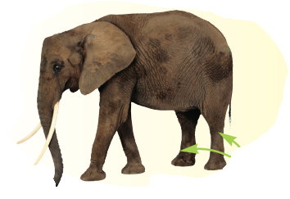
It’s an animal with big ears, a big head, and a long trunk.
elephant

Slide 6
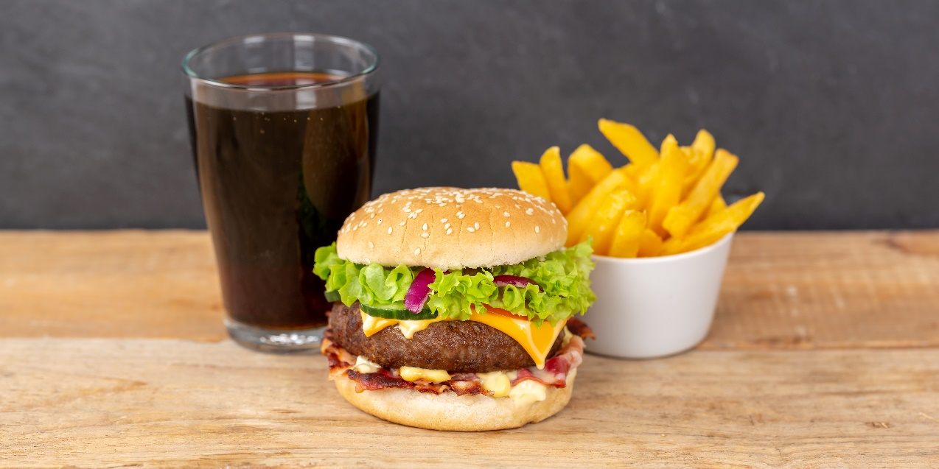
https://www.shutterstock.com/image-photo/hamburger-cheeseburger-meal-fastfood-fast-food-2139716943
Fast food is not good for your health. It is __________.
unhealthy

Slide 7
It’s an animal with a long tail, that climbs trees and eat banana.
monkey

Slide 8
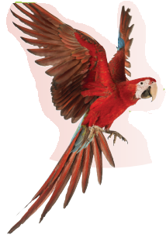
A parrot’s got a _____ beak.
sharp

Slide 9
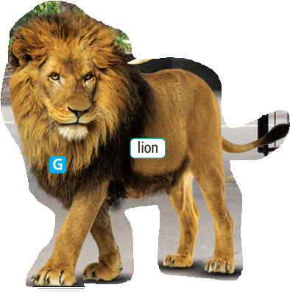
What do we call this part of a lion?
mane

Slide 10
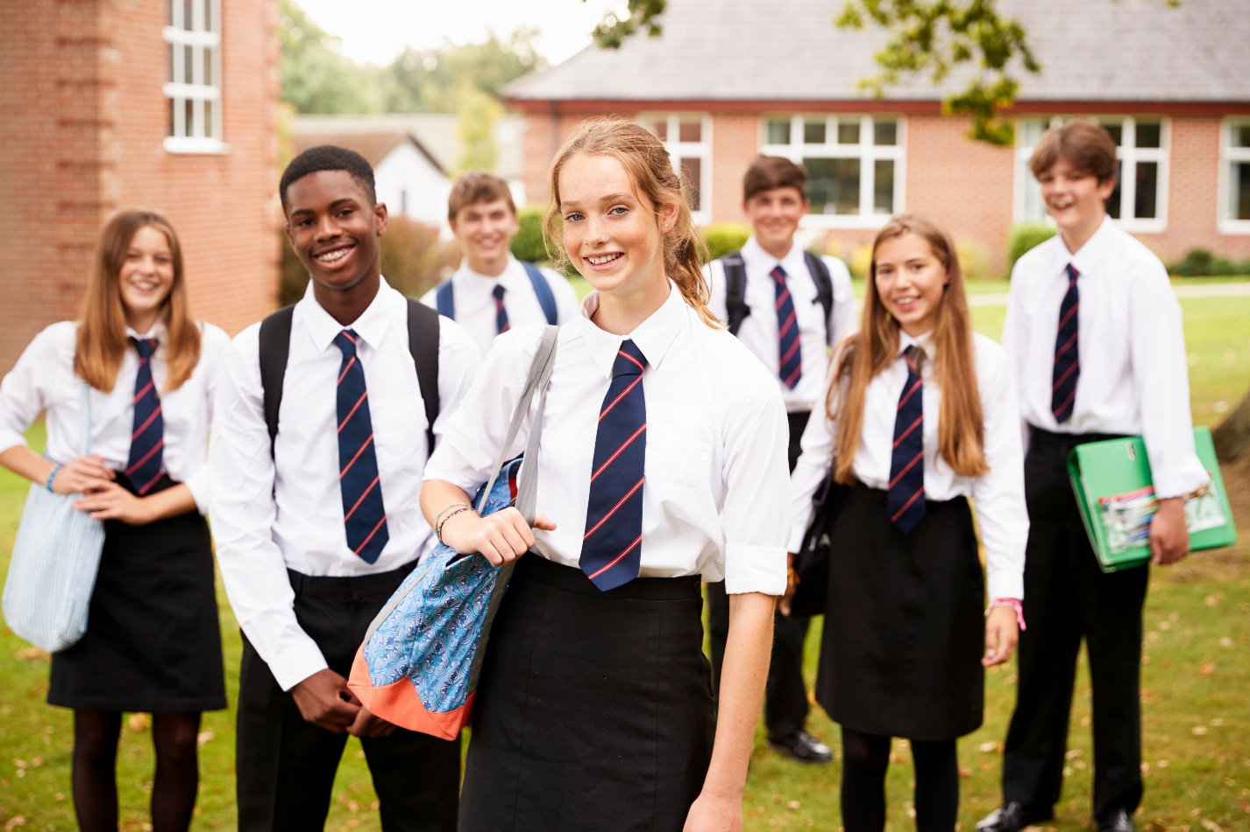
Special set of clothes that you must wear when you go to school.
uniform

Slide 11
U
E
S
U
M
M
Make a meaningful word with those letter.
MUSEUM

Slide 12

Work in pairs
Do you like going to the museum?
List down some museums you know.
What do we need to bring when we visit the museum?

Slide 13

It’s time to learn …

Slide 14

New words
snore, set up camp,
torch, scientist, informative

Slide 15

Listen and repeat. Click each phrase to hear the sound.
snore (v) /snɔː/ ngáy
set up camp (v phr) /set ʌp kæmp/ dựng trại
torch (n) /tɔːtʃ/ đèn pin
scientist (n) /ˈsaɪəntɪst/ nhà khoa học
informative (adj) /ɪnˈfɔːmətɪv/ cung cấp nhiều thông tin

Slide 16
Put the letters in the correct order to write the correct word.
onrse
snore
netifmiratov
informative
tesictins
scientist
hroct
torch

Slide 17
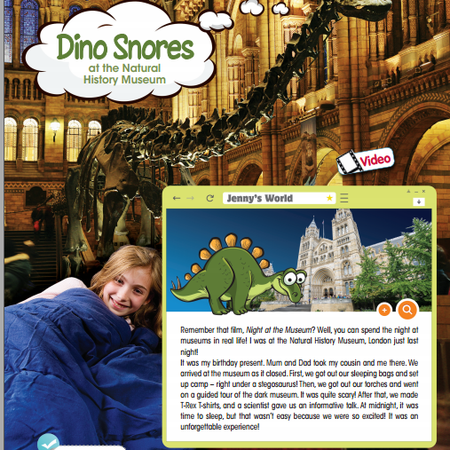
Pre-reading
Can you guess where she is?
How does she feel?

Slide 18
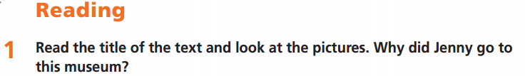
Pre-reading
Underline key words. What are you going to do?

Slide 19
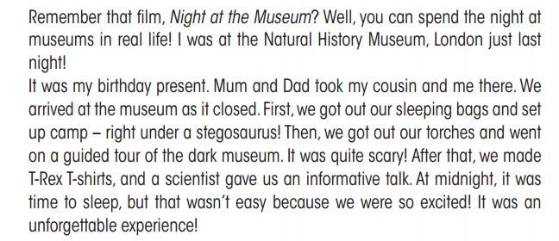
While-reading
☞ YOUR ANSWER?
Jenny went to this museum to spend the night there. It was her birthday present.

Slide 20
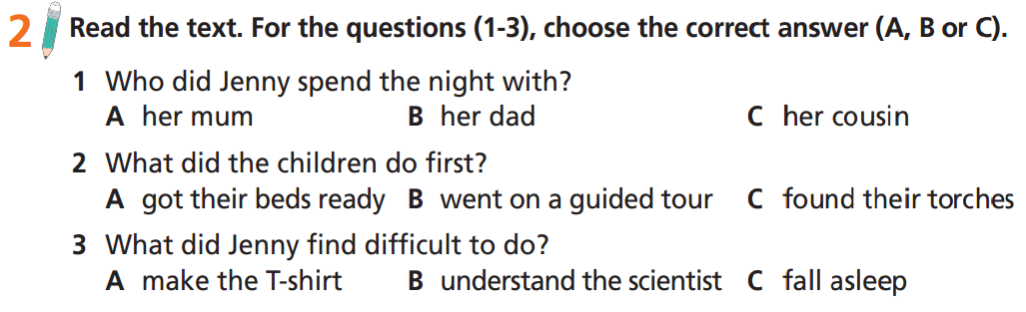
While-reading
Underline key words. What are you going to do?

Slide 24
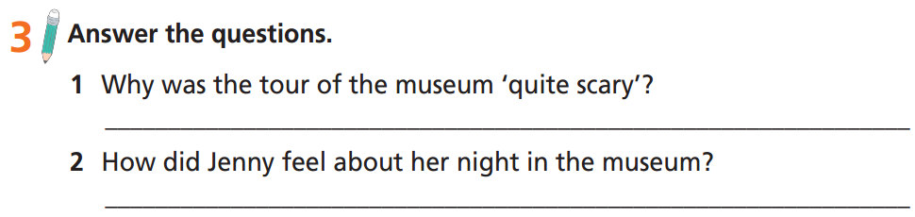
While-reading
Underline key words. What are you going to do?

Slide 25
The tour was ‘quite scary’ because there were no lights except torches.

Slide 26
Jenny really enjoyed her night in the museum.

Slide 27
Extra-practice
Read the text again and decide if these statements are TRUE, FALSE or DOESN’T SAY?
Jenny was at the Museum last month.
When they came to the museum, there were many people there.
They set up camp under a big tree.
They listened to a talk from a scientist.

Slide 28
Extra-practice
Read the text again and decide if these statements are TRUE, FALSE or DOESN’T SAY?
FALSE
Jenny was at the Museum last month.
When they come to the museum, there are many people there.
They set up camp under a big tree.
They listened to a talk from a scientist.
DOESN’T SAY
FALSE
TRUE

Slide 29
post-speaking
In my opinion, we should spend a night in this museum because of the following reasons.
Firstly, ……………………………..
Secondly, …………………………………
In my opinion, we should spend a night in this museum because of the following reasons.
Firstly, it is a great experience.
Secondly, it is educational. You can listen to talks by scientists and learn a lot of information.

Slide 30
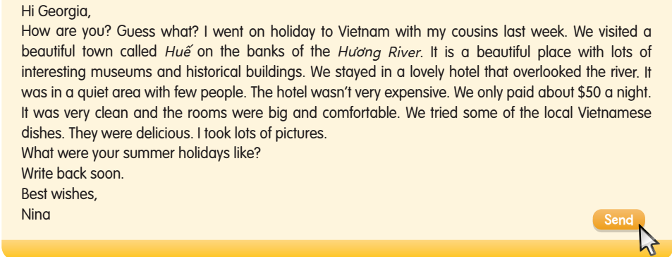
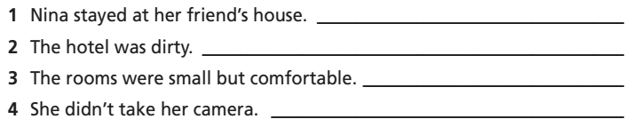
Read the email and correct the sentences.
Extra-practice
WB-p. 49
Nina stayed in a hotel.
It was very clean.
The rooms were big and comfortable.
She took lots of pictures.

Slide 31
Read the email and correct the sentences.
Nina stayed in a lovely hotel.

Slide 32
Read the email and correct the sentences.
It was very clean.

Slide 33
Read the email and correct the sentences.
The rooms were big and comfortable.

Slide 34
Read the email and correct the sentences.
She took lots of pictures.

Slide 35

CONSOLIDATION

Slide 36
Imagine that you spent a night in a place. Talk about that place. Here are some suggested questions:
Where was that place?
When did you go there?
What did you bring?
Why did you choose that place?

Slide 37

WRAP-UP

Slide 38
Today’s lesson
Vocabularies
snore, set up, camp, torch, scientist, informative
Listening & Reading
Listen and read for key information.

Slide 39
Homework
Practise the vocabularies and make sentences using them.
Do the exercises in TA 6 Right on WB (p. 49).
Prepare the next lesson (p. 97 SB).
Do Unit 5 Test 1 in Bài Tập Bổ Trợ TA 6 Right on (pp. 42-43).

Slide 40
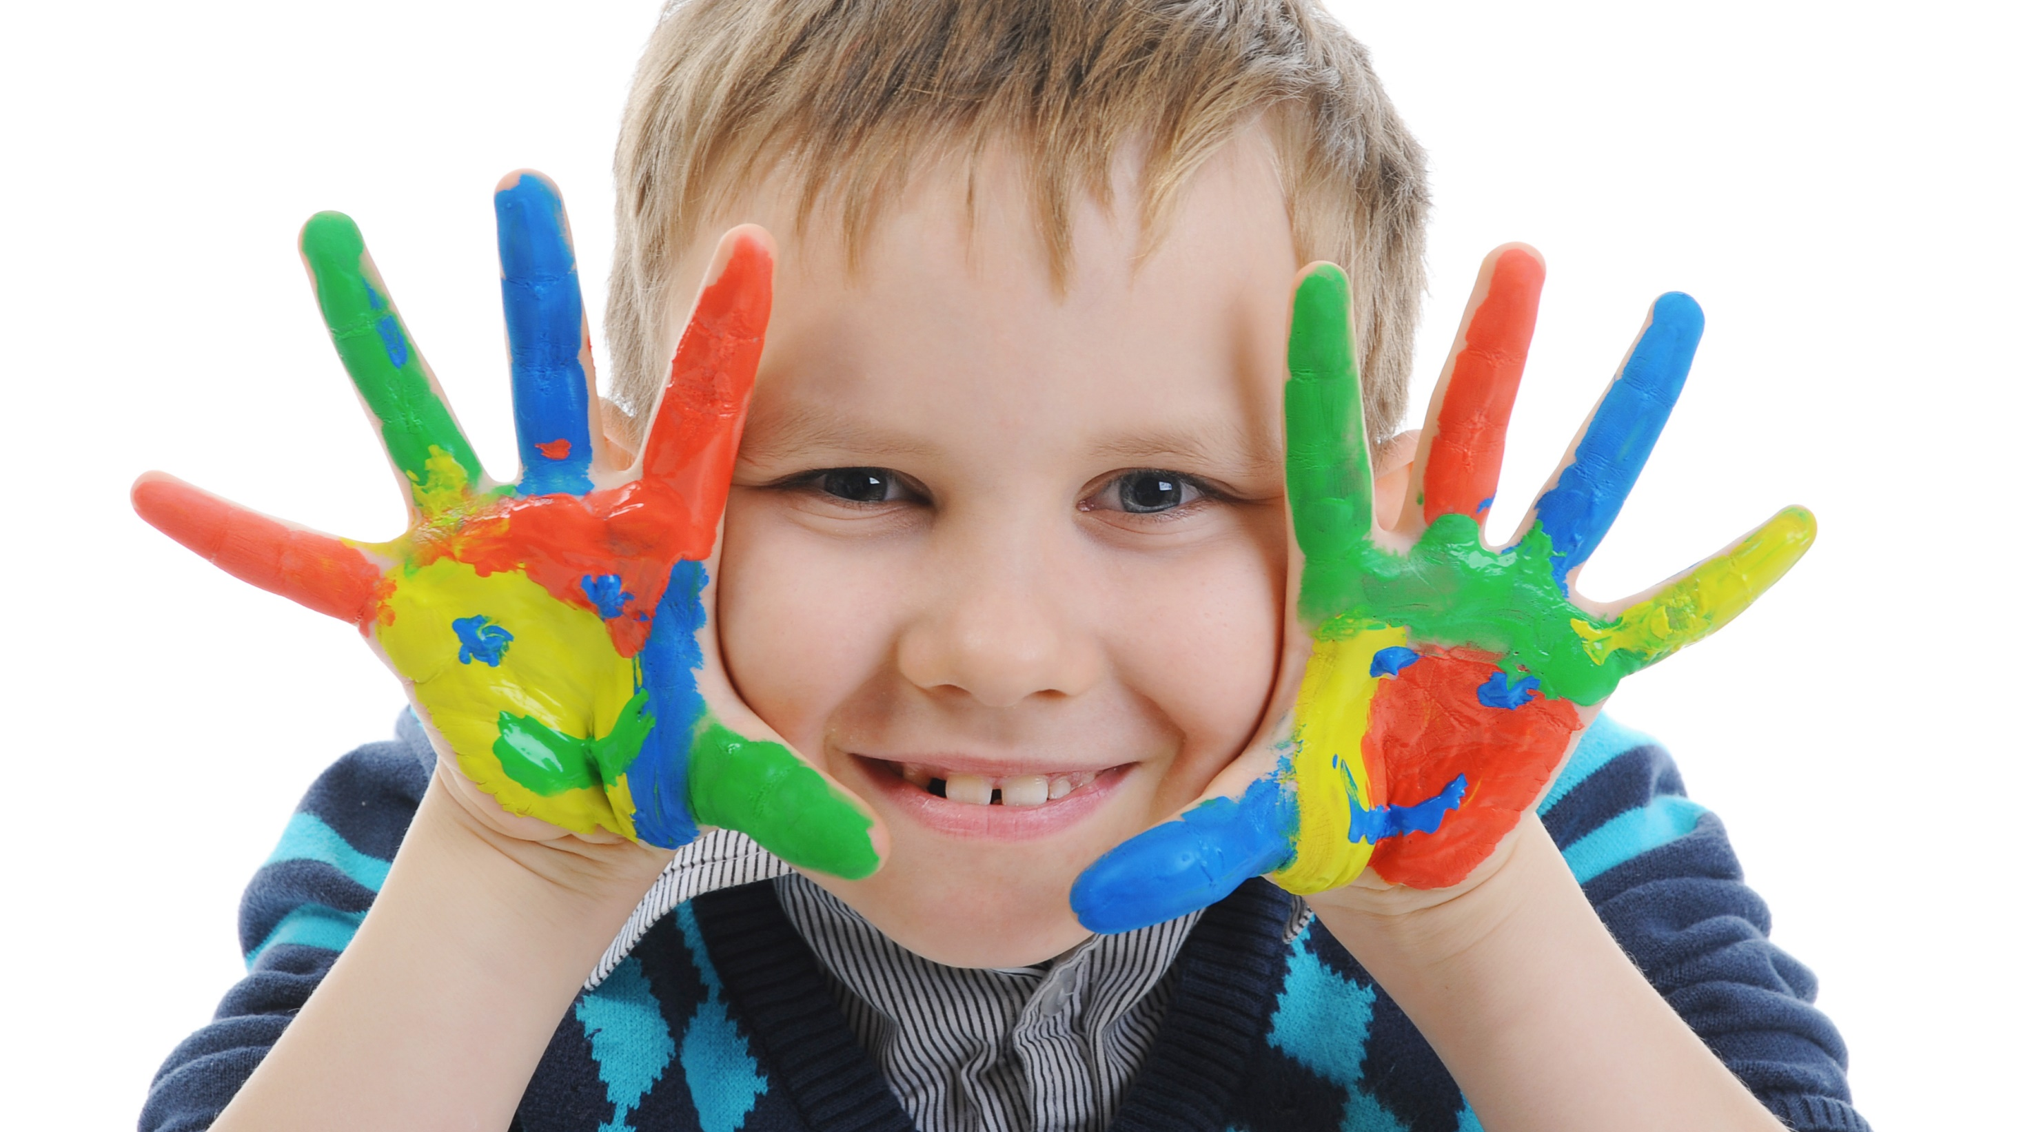
Enjoy your day!

