Slide 1
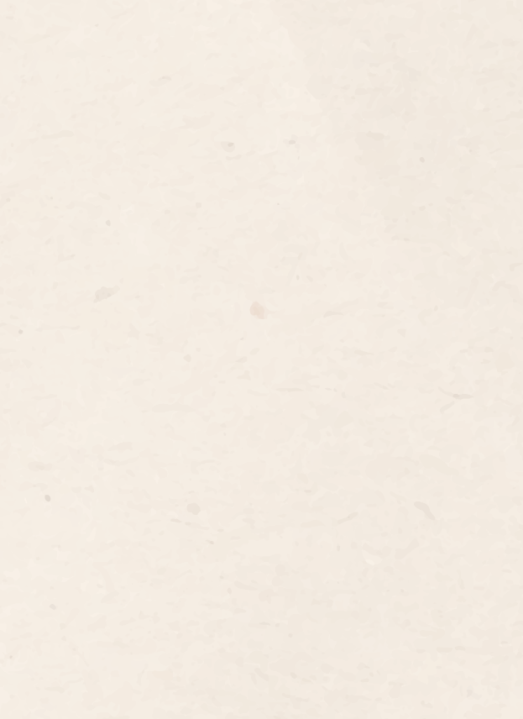
Heart Failure Clinical Case Infographics
Here is where this template begins

Slide 2
About Heart Failure Infographics
This template contains an assortment of complementary infographic resources for the Heart Failure Clinical Case presentation.
These infographics are adapted to the style of the aforementioned presentation, so you can insert them easily and have them completely integrated at once. You just need to do the following:
  Select the element that you want to copy
  Right-click and choose “Copy”
  Go to the slide where you want the element to appear
  Right-click and choose “Paste”

Slide 3
Heart Failure Infographics
Venus
Mars
Saturn
Jupiter
Venus is the second planet from the Sun
Despite being red, Mars is a cold place
Saturn is a gas giant and has rings
It’s a gas giant and has eight moons

Slide 4
Heart Failure Infographics
25%
50%
75%
MARS
Venus
JUPITER
Despite being red, Mars is a cold place
Venus is the second planet from the Sun
It’s a gas giant and has eight moons

Slide 5
Heart Failure Infographics
Venus
Venus is the second planet from the Sun
Mars
Earth
Jupiter
Despite being red, Mars is a cold place
Earth is the planet with life
It’s a gas giant and has eight moons
Saturn
Saturn is a gas giant and has rings

Slide 6
Heart Failure Infographics
Earth is the planet with life
Saturn has beautiful rings
2XXX
EARTH
2XXX
Saturn
Mars
2XXX
Jupiter
2XXX
Mars is full of iron oxide dust
Jupiter is a huge gas giant

Slide 7
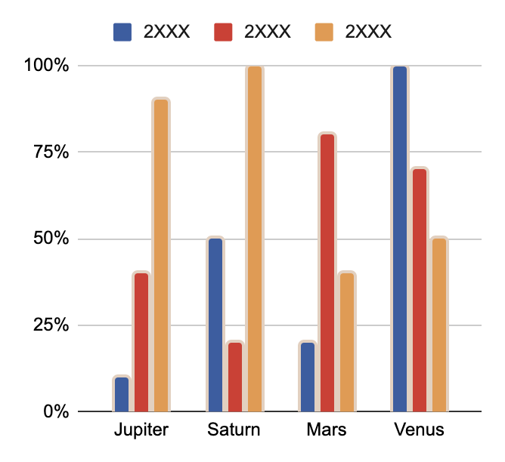
Heart Failure Infographics
47%
57%
Jupiter
Saturn
It’s a gas giant and has eight moons
Saturn is a gas giant and has rings
47%
73%
Mars
Venus
Despite being red, Mars is a cold place
Venus is the second planet from the Sun
Follow the link in the graph to modify its data and then paste the new one here. For more info, click here

Slide 8
Heart Failure Infographics
1,000,000 cases
60%
Elderly
Jupiter is a gas giant and has eight moons
40%
Adults & young adults
Saturn is a gas giant and has rings

Slide 9
Heart Failure Infographics
venus
Mars
Venus is the second planet from the Sun
Despite being red, Mars is a cold place
mercury
Saturn
It’s the closest planet to the Sun
Saturn was named after a Roman god
Jupiter
Neptune
Jupiter doesn’t have a solid surface
Neptune is far away from Earth

Slide 10
Heart Failure Infographics
01
02
Jupiter
Saturn
It’s a gas giant and has eight moons
Saturn is a gas giant and has rings
04
03
Mars
Venus
Despite being red, Mars is a cold place
Venus is the second planet from the Sun

Slide 11
Heart Failure Infographics
Venus
Venus is the second planet from the Sun
Jupiter
It’s the biggest planet in the Solar System
Mars
Despite being red, Mars is a cold place
Saturn
Saturn is a gas giant and has several rings

Slide 12
Heart Failure Infographics
50%
JUPITER
It’s a gas giant and has eight moons
25%
MARS
Despite being red, Mars is a cold place
75%
Venus
Venus is the second planet from the Sun

Slide 13
Heart Failure Infographics
Case 1
Case 2
Case 3
Venus is the second planet from the Sun
Despite being red, Mars is actually a cold place
Saturn is a gas giant and has several rings

Slide 14
Heart Failure Infographics
Earth
Venus
Mars
Jupiter
Saturn
Venus is very hot
It’s a cold planet
Jupiter is big
It’s a gas giant
It’s a red planet
It’s a gas giant
Saturn has rings
Named after a god

Slide 15
Heart Failure Infographics
Despite being red, Mars is a cold place
Venus is the second planet from the Sun
Saturn is a gas giant and has rings
It’s a gas giant and has eight moons
Mars
Venus
saturn
Jupiter

Slide 16
Heart Failure Infographics
Venus is the second planet from the Sun
Venus
It’s a gas giant and has eight moons
Jupiter
Despite being red, Mars is a cold place
Mars
Saturn is a gas giant and has rings
Venus

Slide 17
Heart Failure Infographics
Venus
Jupiter
Venus is the second planet from the Sun
It’s a gas giant and has eight moons
Mars
Saturn
Despite being red, Mars is a cold place
Saturn is a gas giant and has rings

Slide 18
Heart Failure Infographics
50%
60%
Venus
Jupiter
Venus is the second planet from the Sun
It’s a gas giant and has eight moons
75%
70%
Mars
Saturn
Despite being red, Mars is a cold place
Saturn is a gas giant and has rings

Slide 19
Heart Failure Infographics
Case description | Exam a | Exam B | Exam c | Exam d | Exam e
Venus has a toxic atmosphere | Positive | Negative | Positive | Negative | Positive
Mars is made of basalt | Negative | Negative | Positive | Positive | Negative
Jupiter is a huge gas giant | Negative | Positive | Negative | Negative | Negative
Saturn has several rings | Positive | Positive | Negative | Positive | Negative
Neptune is far away from us | Negative | Negative | Positive | Negative | Positive

Slide 20
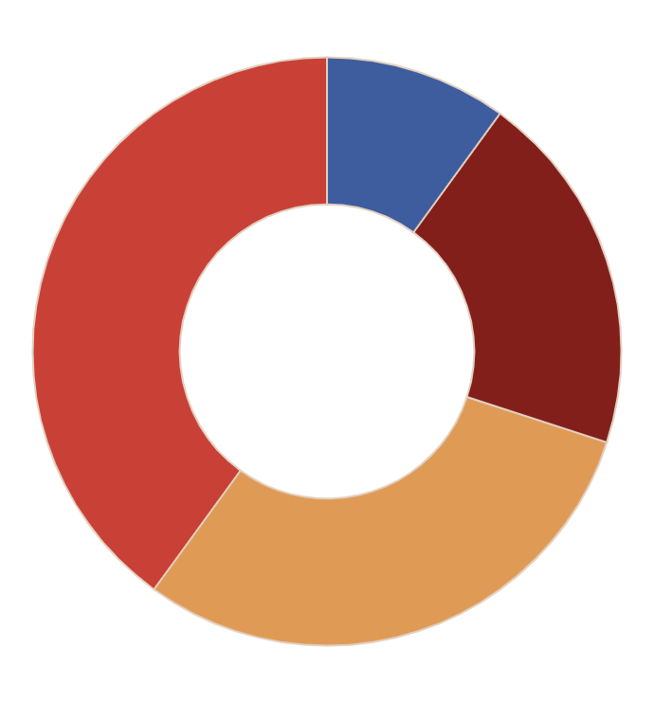
Heart Failure Infographics
40%
10%
Venus
JUPITER
Venus is the second planet from the Sun
It’s a gas giant and has eight moons
30%
20%
MARS
SATURN
Despite being red, Mars is a cold place
Saturn is a gas giant and has rings
Follow the link in the graph to modify its data and then paste the new one here. For more info, click here

Slide 21
Heart Failure Infographics
Jupiter is a gas giant and has eight moons
Jupiter
Saturn
Saturn is a gas giant and has several rings
Despite being red, Mars is a cold place
Mars
Venus
It’s the second planet from the Sun

Slide 22
Heart Failure Infographics
 | JAN | FEB | MAR | APR | MAY | JUN | JUL | AUG | SEP
CASE 1
PHASE A
PHASE B
CASE 2
PHASE A
PHASE B

Slide 23
Heart Failure Infographics
Jupiter
Venus
It’s a gas giant and has eight moons
Venus is the second planet from the Sun
Mars
Despite being red, Mars is a cold place

Slide 24
Heart Failure Infographics
Jupiter
CERES
04
01
Jupiter is a gas giant and has eight moons
Ceres is located in an asteroid belt
Saturn
Saturn is a gas giant and has rings
Mars
Venus
03
02
Despite being red, Mars is a cold place
Venus is the second planet from the Sun

Slide 25
Heart Failure Infographics
Saturn
Saturn is a gas giant and has several rings
Venus
It’s the second planet from the Sun
Jupiter
Jupiter is a gas giant and has eight moons
Mars
Despite being red, Mars is a cold place

Slide 26
Heart Failure Infographics
No. | Case | Description | Check
01 | Mercury | Mercury is the closest planet to the Sun | Done
02 | Venus | Venus is the second planet from the Sun | In progress
03 | Mars | Despite being red, Mars is actually a very cold place | Undone
04 | Jupiter | Jupiter is the biggest planet of them all | Done
05 | Saturn | Saturn is composed of hydrogen and helium | Undone

Slide 27
Heart Failure Infographics
40%
60%
Venus
Saturn
It’s the second planet from the Sun
Saturn is a gas giant and has several rings

Slide 28
Heart Failure Infographics
Jupiter is a gas giant and has eight moons
Saturn is a gas giant and has several rings
Despite being red, Mars is a cold place
Venus is the second planet from the Sun
A
b
Neptune is very far away from the Sun
Earth is the planet on which we all live
Mercury is the closest planet to the Sun
Pluto is considered a dwarf planet

Slide 29
Heart Failure Infographics
Jupiter
Mars
venus
25%
50%
75%
It’s a gas giant and has eight moons
Despite being red, Mars is a cold place
Venus is the second planet from the Sun

Slide 30
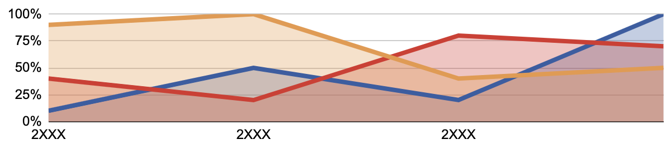
Heart Failure Infographics
45%
Jupiter
53%
Saturn
70%
Mars
Jupiter is a gas giant and has eight moons
Saturn is a gas giant and has several rings
Despite being red, Mars is a cold place
Follow the link in the graph to modify its data and then paste the new one here. For more info, click here

Slide 31
Heart Failure Infographics
Jupiter is a gas giant and has eight moons
Saturn is a gas giant and has several rings
Mercury
Despite being red, Mars is a cold place
Venus is the second planet from the Sun
Mercury is the closest planet to the Sun
Neptune is very far away from the Sun
Earth is the planet on which we all live

Slide 32
Heart Failure Infographics
Jupiter
Saturn
01
04
Jupiter is a gas giant and has eight moons
Saturn is a gas giant and has several rings
Mars
Venus
02
03
Despite being red, Mars is a cold place
Venus is the second planet from the Sun

Slide 33
Instructions for use (premium users)
As a Premium user, you can use this template without attributing Slidesgo.
You are allowed to:
Modify this template.
Use it for both personal and commercial purposes.
Share this template in an editable format with people who are not part of your team.
You are not allowed to:
Sublicense, sell or rent this Slidesgo Template (or a modified version of this Slidesgo Template).
Distribute this Slidesgo Template (or a modified version of this Slidesgo Template) or include it in a database or in any other product or service that offers downloadable images, icons or presentations that may be subject to distribution or resale.
Use any of the elements that are part of this Slidesgo Template in an isolated and separated way from this Template.
Register any of the elements that are part of this template as a trademark or logo, or register it as a work in an intellectual property registry or similar.
For more information about editing slides, please read our FAQs or visit our blog:
https://slidesgo.com/faqs and https://slidesgo.com/slidesgo-school

Slide 34
Infographics
You can add and edit some infographics to your presentation to present your data in a visual way.
Choose your favourite infographic and insert it in your presentation using Ctrl C + Ctrl V or Cmd C + Cmd V in Mac.
Select one of the parts and ungroup it by right-clicking and choosing “Ungroup”.
Change the color by clicking on the paint bucket.
Then resize the element by clicking and dragging one of the square-shaped points of its bounding box (the cursor should look like a double-headed arrow). Remember to hold Shift while dragging to keep the proportions.
Group the elements again by selecting them, right-clicking and choosing “Group”.
Repeat the steps above with the other parts and when you’re done editing, copy the end result and paste it into your presentation.
Remember to choose the “Keep source formatting” option so that it keeps the design. For more info, please visit our blog.

