Slide 1
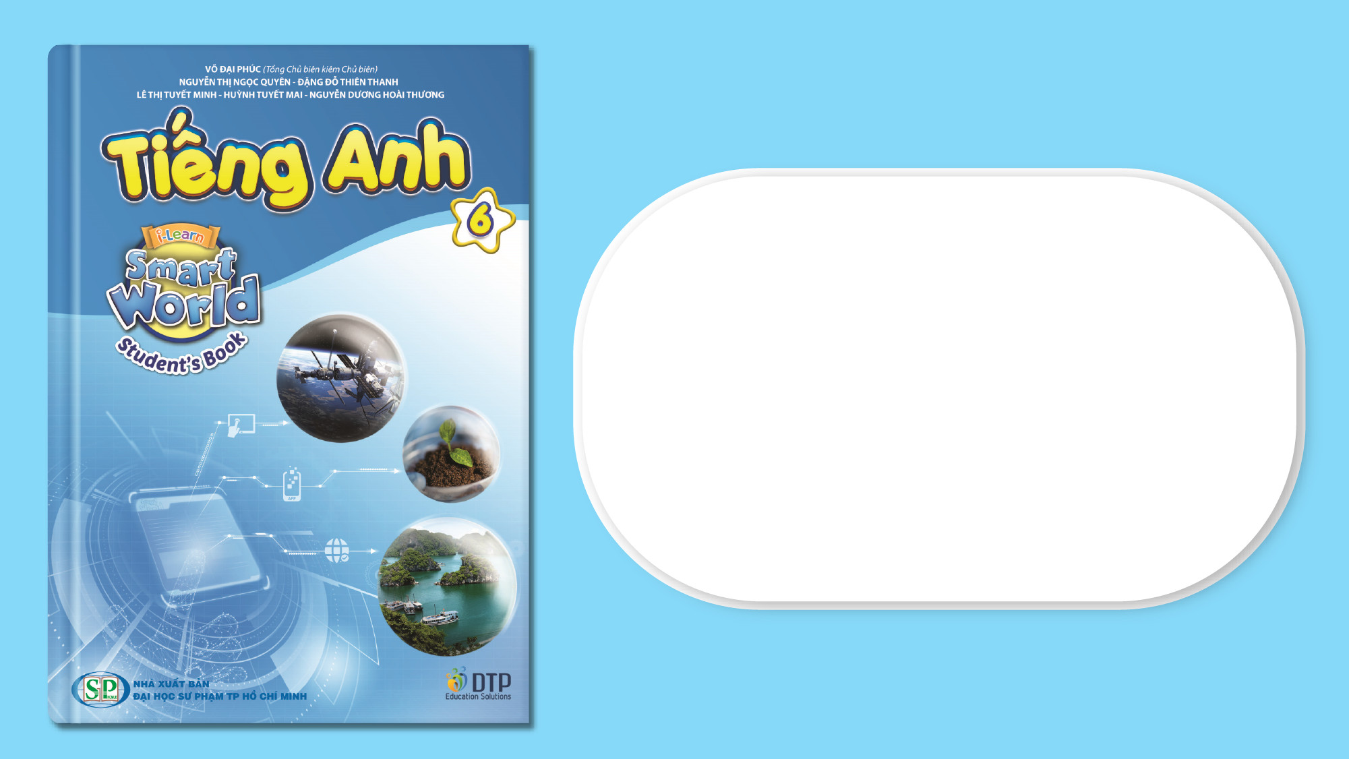
Unit 10: Cities around the World
Lesson 2.1: Vocabulary & Reading
Page 81

Slide 2
Lesson Outline
Warm-up
Vocabulary
Reading
Consolidation
Wrap-up

Slide 3
Objectives
By the end of this lesson, students will be able to…
- compare features of cities around the world
- describe cities around the world or their cities
- get someone’s attention into reading passages and decide whether the information is true or false

Slide 4

WARM-UP

Slide 5
Work in groups of 10
Find out at least three places to entertain/ relax in your city
Describe these places – by adjectives (using a mind map to show your answers)
Stick answers to the board
Look at the example on the next slide

Slide 6
green
Example:
beautiful
Đầm Sen Cultural Park
Ho Chi Minh City
Notre-Dame Cathedral
large
ancient
Landmark 81
modern
high

Slide 7

New words
amusement park
shopping mall
building
modern
crowded
peaceful
noisy

Slide 8


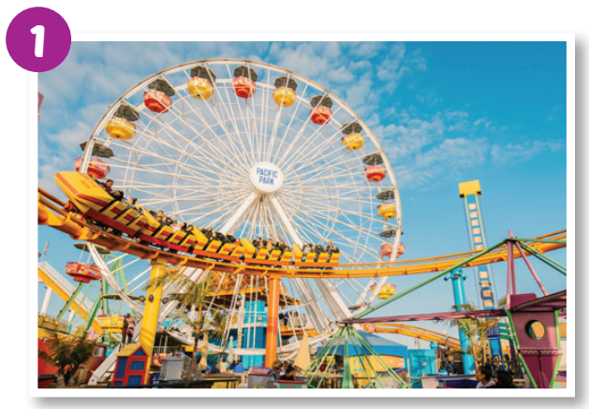
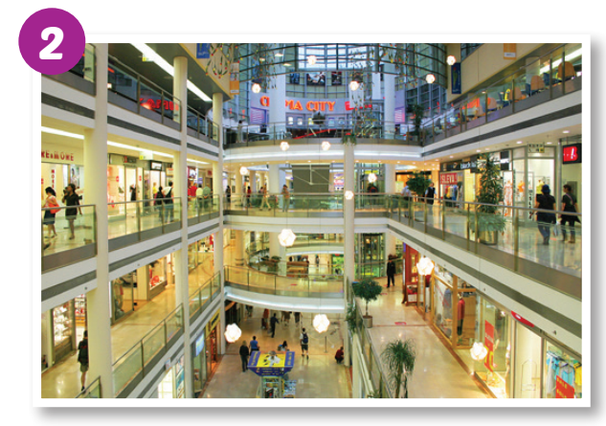
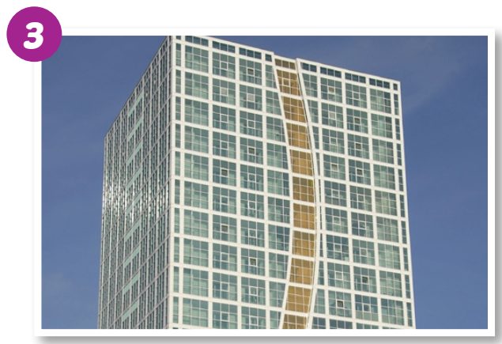
a. Fill in the blanks with "shopping mall", "building", or "amusement park".
Listen and repeat.
amusement park
shopping mall
building

Slide 9
b. Circle the correct definitions for the underlined words. Listen and repeat.
1. Landmark 81 is a really modern building. They finished it last year.
a. new b. old
2. The shopping mall is always crowded on Sundays. Many people like to go shopping then.
a. having a lot of people b. having very few people
3. I like walking early in the morning. There are no cars or people. It is very peaceful.
a. loud and exciting b. quiet and calm
4. The amusement park is always noisy. You can hear music and people shouting.
a. quiet b. loud

Slide 10
amusement park (n) /əˈmjuːzmənt ˌpɑːrk/ công viên giải trí
shopping mall (n) /ˈʃɑːpɪŋ mɑːl/ trung tâm thương mại
building (n) /ˈbɪldɪŋ/ tòa nhà
modern (adj) /ˈmɑːdərn/ hiện đại
crowded (adj) /kraʊdɪd/ đông đúc
peaceful (adj) /ˈpiːsfl/ yên bình
noisy (adj) /ˈnɔɪzi/ ồn ào

Slide 11
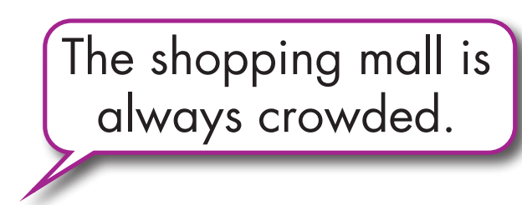
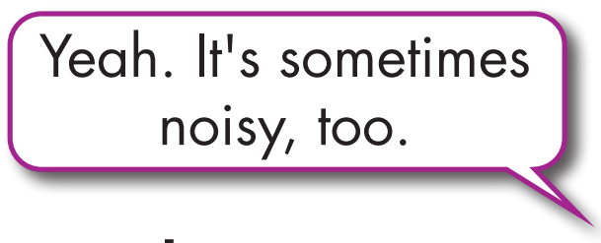
c. Use the adjectives in Task b. to talk about where you live.

Slide 12
Extra Practice
WB page 58
Unscramble the words
1. n o d e r m
__________________
2. p o s n g p i h l a l m
__________________
3. i u d b i n g l
__________________
4. n e e m u s m a t r a k p
_____________________
5. d e o c d w r
_____________________
6. e a f u p l e c
_____________________
modern
amusement park
shopping mall
crowded
building
peaceful

Slide 13
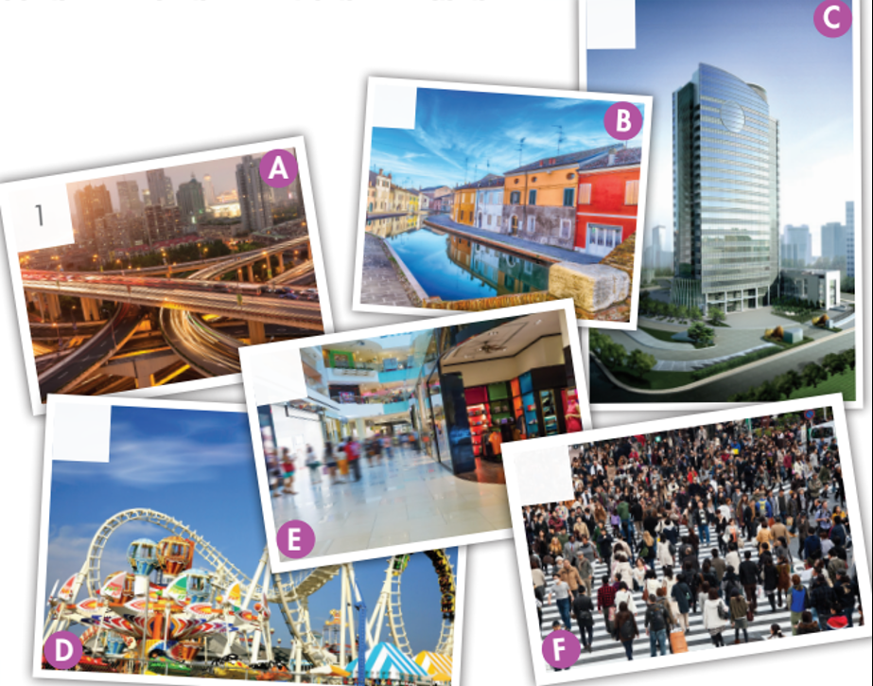
Extra Practice
WB page 58
Match the words with the correct pictures.
3
6
modern
shopping mall
building
amusement park
crowded
peaceful
2
4
5

Slide 14
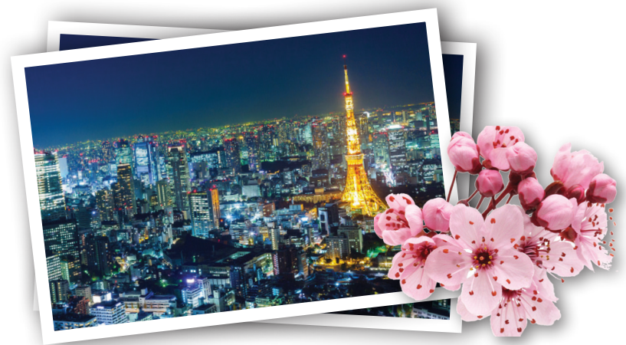
Extra Practice
WB page 58
Read and write the opposites of the underlined adjectives.
Tokyo is a (1) large and (2) noisy city. There are many
(3) modern buildings, (4) expensive shops, and crowded
streets. It is a very (5) exciting place to visit.
1. s _ _ _ _
m a l l
2. p _ _ _ _ _ _ _
e a c e f u l
3. o _ _
l d
h e a p
4. c _ _ _ _
5. b _ _ _ _ _
o r i n g

Slide 15

Reading

Slide 16
Pre-Reading
Read the article comparing Singapore and Kuala Lumpur and write "True" or "False."
What are you going to read?
Article comparing Singapore and Kuala Lumpur
What are some key words in the question?
Write "True" or "False

Slide 17
Pre-Reading
Read the article comparing Singapore and Kuala Lumpur and write "True" or "False."
1. Singapore is very different from Kuala Lumpur. ___________
2. Kuala Lumpur has more shopping malls and amusement parks than Singapore. ___________
3. Public transportation in Singapore is more modern. ___________
4. Eating in Kuala Lumpur is cheaper. ___________

Slide 18
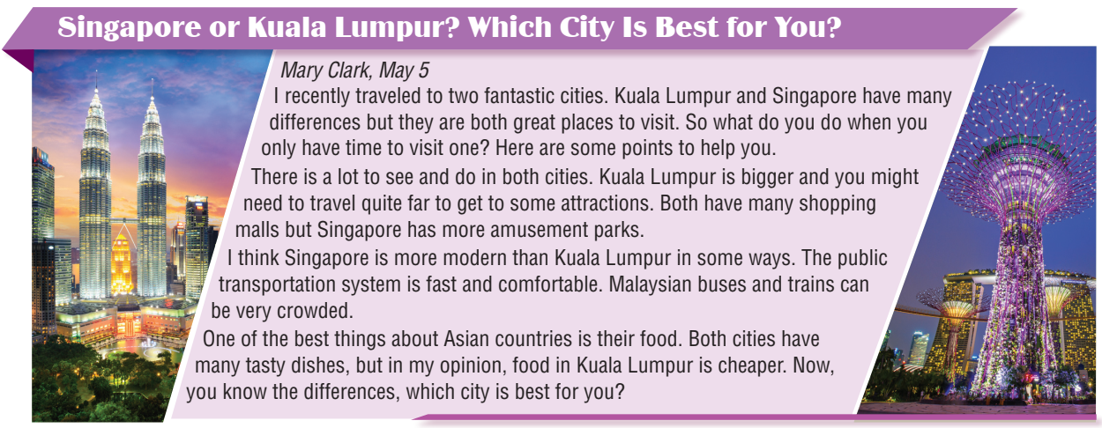
While-Reading

Slide 19
While-Reading
Read the article comparing Singapore and Kuala Lumpur and write "True" or "False."
1. Singapore is very different from Kuala Lumpur. ___________
2. Kuala Lumpur has more shopping malls and amusement parks than Singapore. ___________
3. Public transportation in Singapore is more modern. ___________
4. Eating in Kuala Lumpur is cheaper. ___________
False
False
True
True

Slide 20
While-Reading

Slide 21
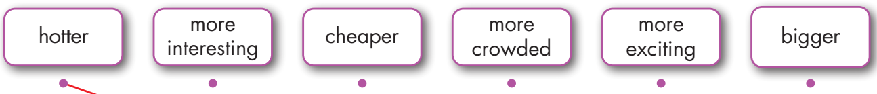
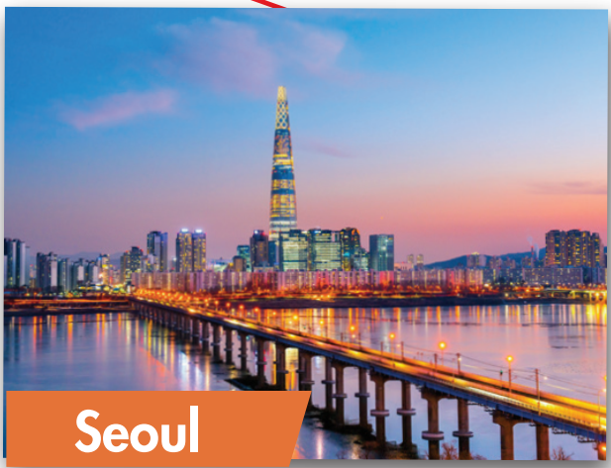
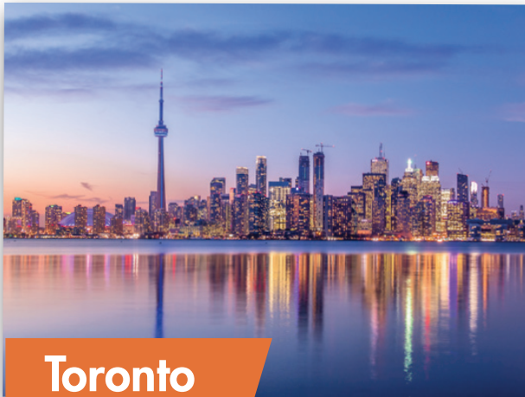
Extra Practice
WB page 58
Listen and draw lines

Slide 22
Owen: Where should we go on holiday?
Mabel: I think either Seoul or Toronto.
Owen: OK. Which city is hotter?
Mabel: Seoul is hotter.
Owen: Hmm. OK. Which city is more expensive?
Mabel: Well, Seoul has cheaper food, so Toronto is more expensive.
Owen: Right. And which is more crowded?
Mabel: Seoul is more crowded.
Owen: So is Toronto bigger?
Mabel: Yes, it is.
Owen: Which place is more interesting?
Mabel: I think Toronto is more interesting. It has some amazing museums.
Owen: OK. And which place is more exciting?
Mabel: I think Seoul is more exciting. There are some amazing festivals and amusement parks.
Owen: OK. I think we should go to Seoul.
Mabel: Yay! Me too!
Audio scripts

Slide 23
Post-Reading
In pair: Talk about the city you like the most (maybe Singapore or Kuala Lumpur or Toronto or Seoul or your city)? Why?

Slide 24

CONSOLIDATION

Slide 25
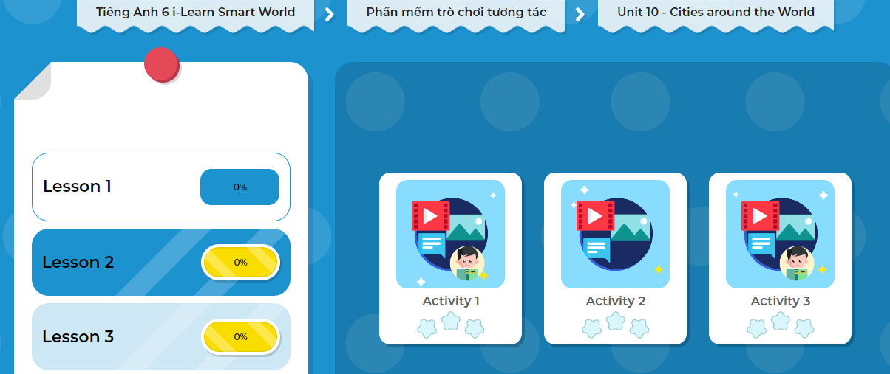
LET’S PLAY!
Click here to play the game!
Notes:
Mở Ứng dụng DHA trên Eduhome. Sách lớp 6, Unit 10, Lesson 2, Activity 1

Slide 26

WRAP-UP

Slide 27
Today’s lesson
Vocabularies
amusement park
shopping mall
building
modern
crowded
peaceful
noisy
Reading
- Get someone’s attention into reading passages and decide whether the information is true or false
- Describe cities around the world or their cities

Slide 28
Homework
Learn by hearts vocabularies and make sentences using them.
Do the exercises in Tiếng Anh 6 i-Learn Smart World Notebook on page 60
Do the exercise on page 58 WB
Prepare the next lesson’s Grammar (page 82 SB)
Play the consolidation games in Tiếng Anh 6 i-Learn Smart World DHA App on www.eduhome.com.vn

Slide 29
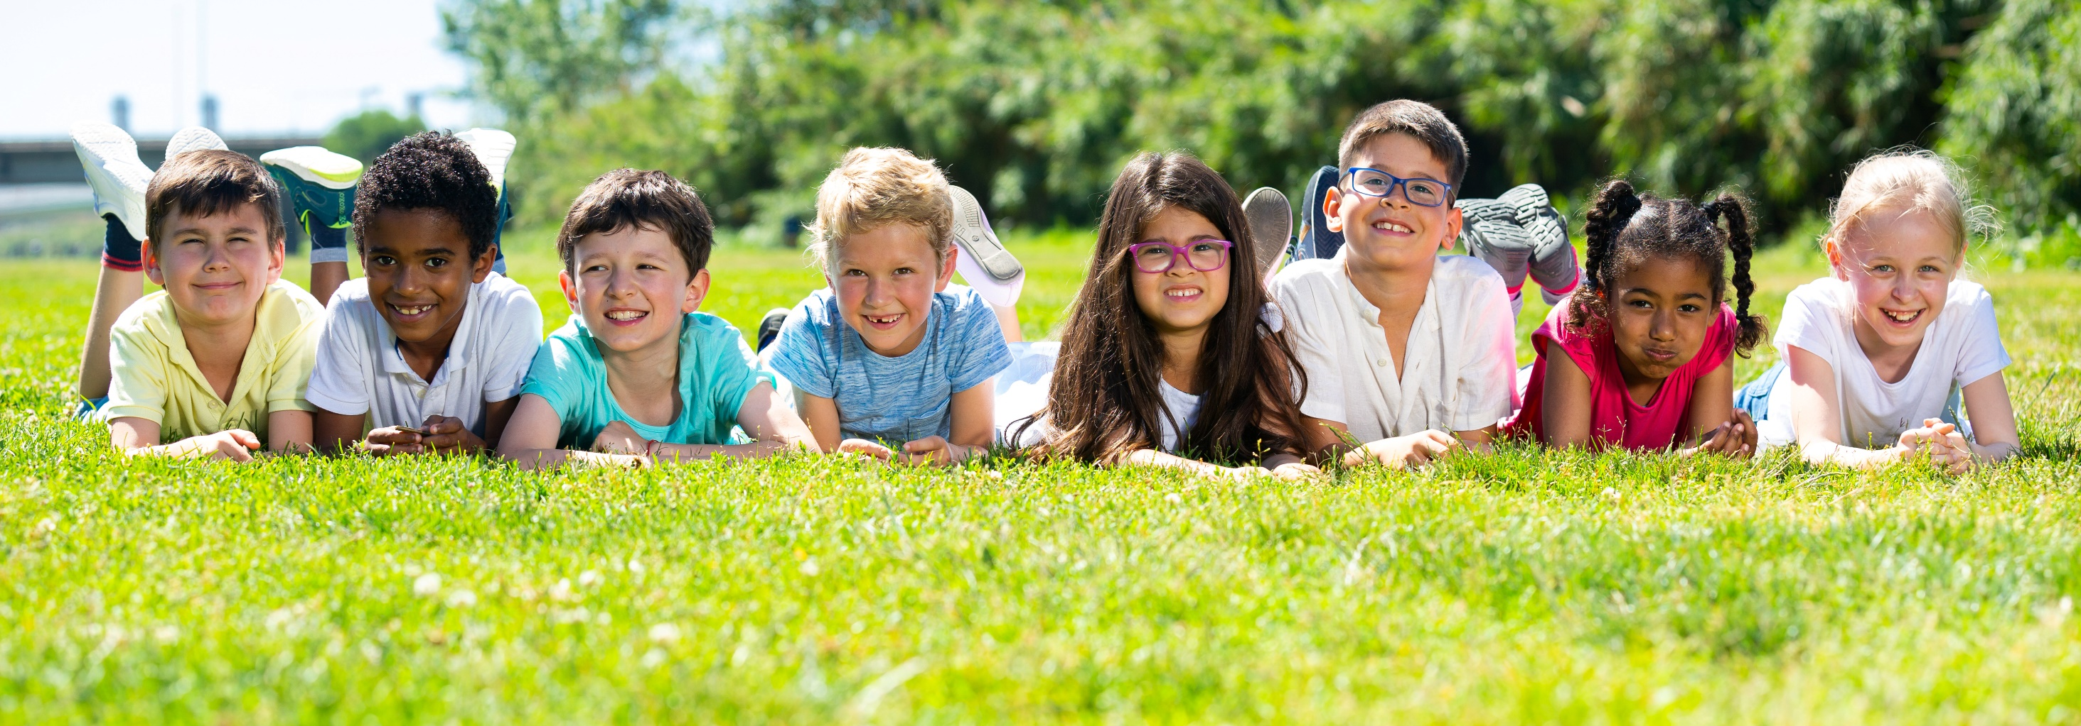
Have a nice day!

