Slide 1
KET SPEAKING
Time allowed - 8-10 minutes
Normally you will do the speaking test with another candidate. The two of you will meet two examiners. One of the examiners will talk to you, the other does not participate in the conversations.
There are two parts to the speaking test:
Speaking part 1: short questions and answers between you and the examiner.
Speaking part 2: the examiner gives you some information or a card with some ideas for questions. You have to talk with the other candidate and ask or answer questions.
Scoring The Speaking section is worth 25% of the total score for the exam.
How to prepare for KET Speaking:
Speak as much as you can, with your friends
Practise asking and answering questions about daily life
Practise giving information about yourself

Slide 2
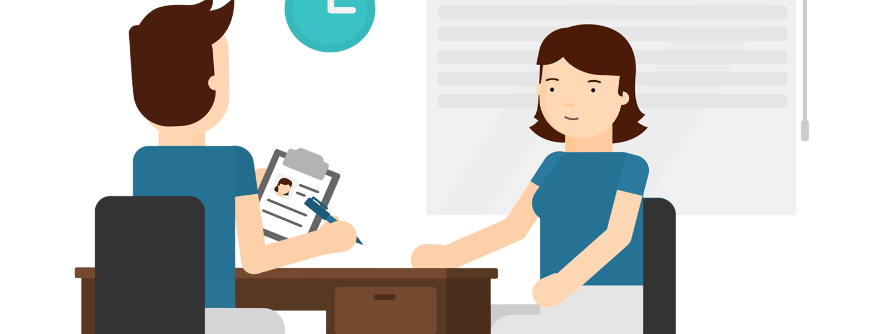
KEY ENGLISH TEST 6
Test 2 - Speaking

Slide 3
Part 1: Student – examiner interaction
Section 1:
The examiner will ask you:
Your name
Where you come from?
Provide full-sentence answers

Slide 4
Part 1: Student – examiner interaction
Section 2: You will be asked some questions that require longer answers. For example:
Why you like something
Details about a hobby…

Slide 5
Popular topic
family
best friend
hometown
your house
sport
computer
collecting
music

Slide 6
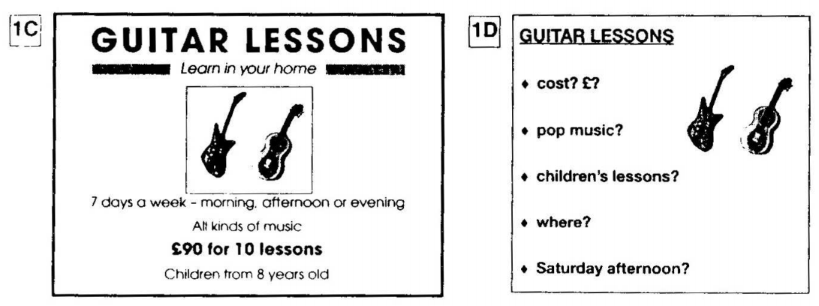
PART 2: Student – student interaction
Ask and answer questions based on the cue cards
For example:
Do not just read from the cards. Answer in full sentences.
Pay attention to the grammar.

Slide 7
SPEAKING PART 1

Slide 8
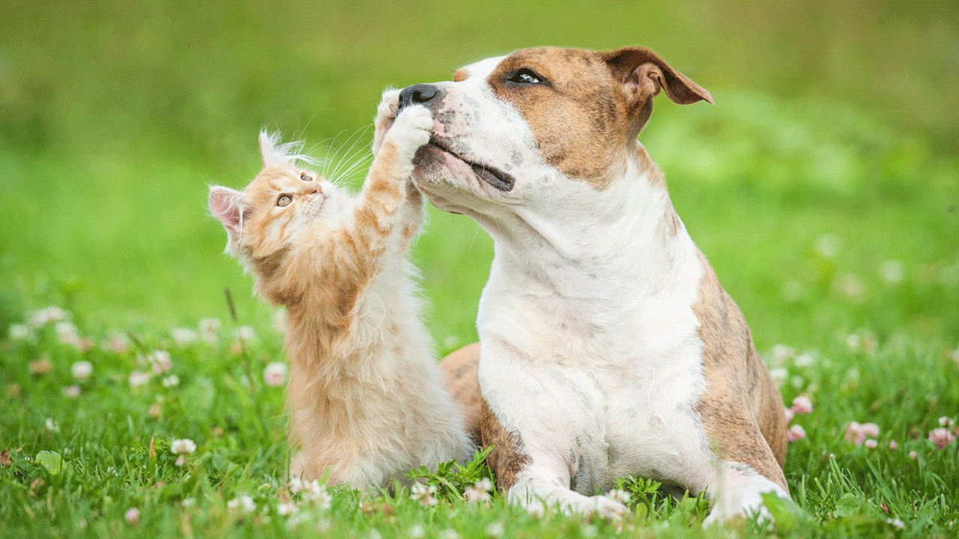
Part 1
Do you have a pet?
Do you like animals? Why/Why not?
What's your favourite animal?
What is a popular pet to have in your country?
Did you have a pet as a child?

Slide 9
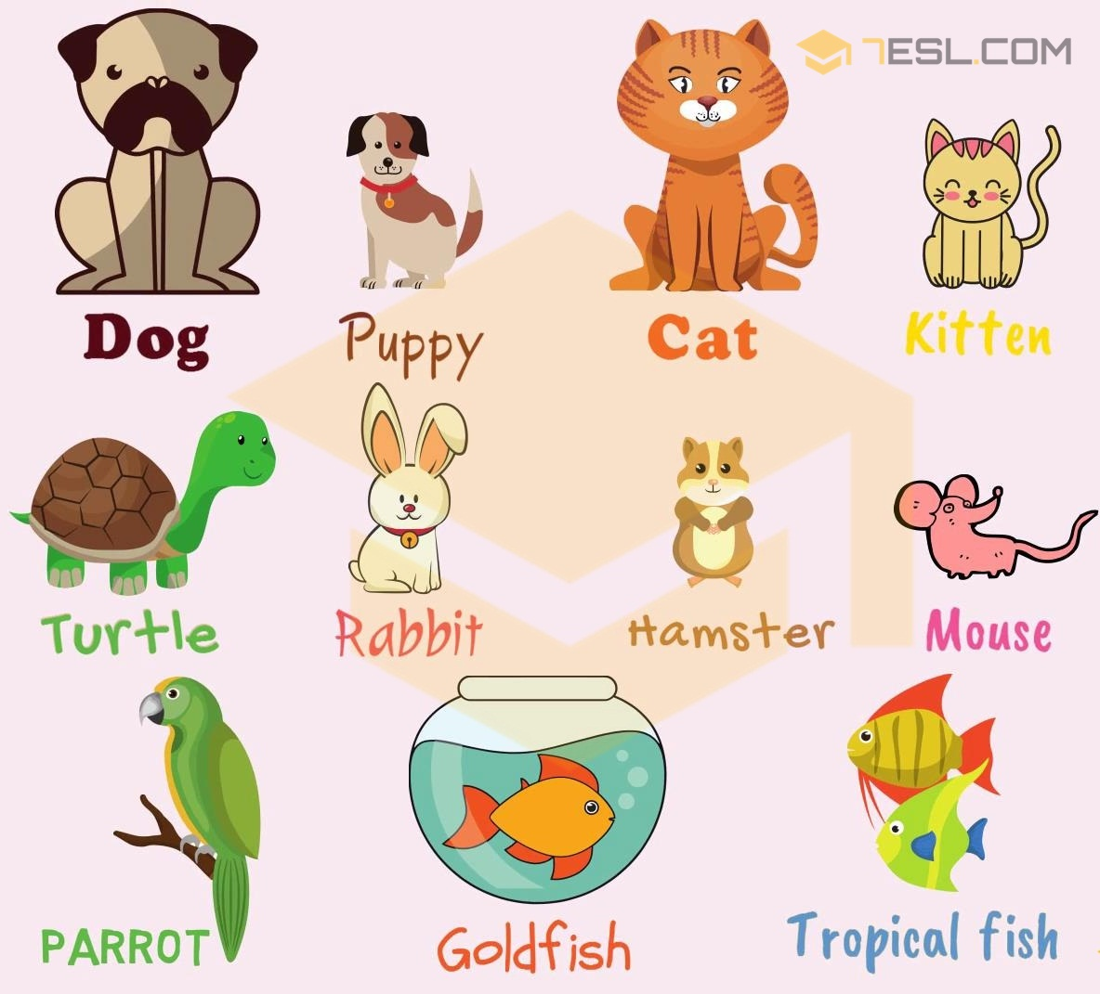

Slide 10
USEFUL VOCABULARY
pooch - slang for ‘dog’ (informal)
canine - formal word for ‘dog’
super adorable - very cute (informal)
puppy-dog eyes - sweet facial expression a person or dog uses when they want something from you
fetch - game dog plays where owner throws something and he/she gets it and brings it back
man’s best friend - idiom used to describe dogs, as they are loyal companions (informal)
hamsters / ferrets - certain species of pets that are kept in cages (formal / informal)
curl up next to - cuddle with (informal)

Slide 11
Why do people have pets?

Slide 12
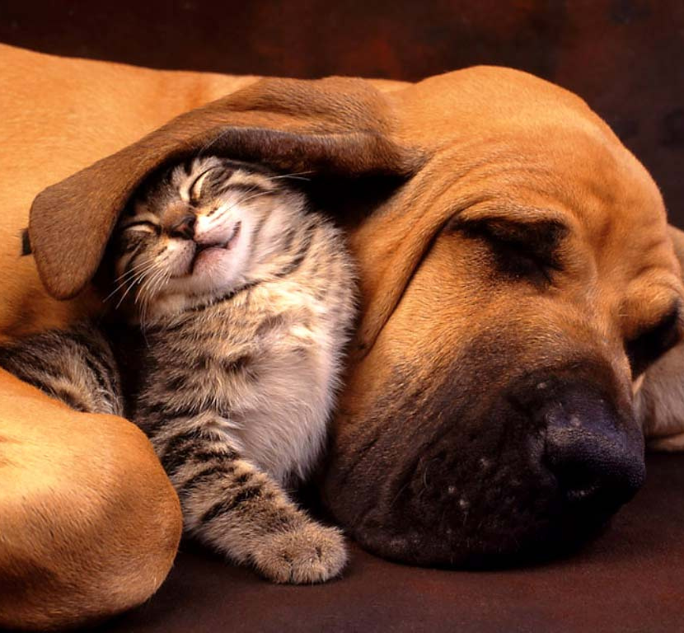
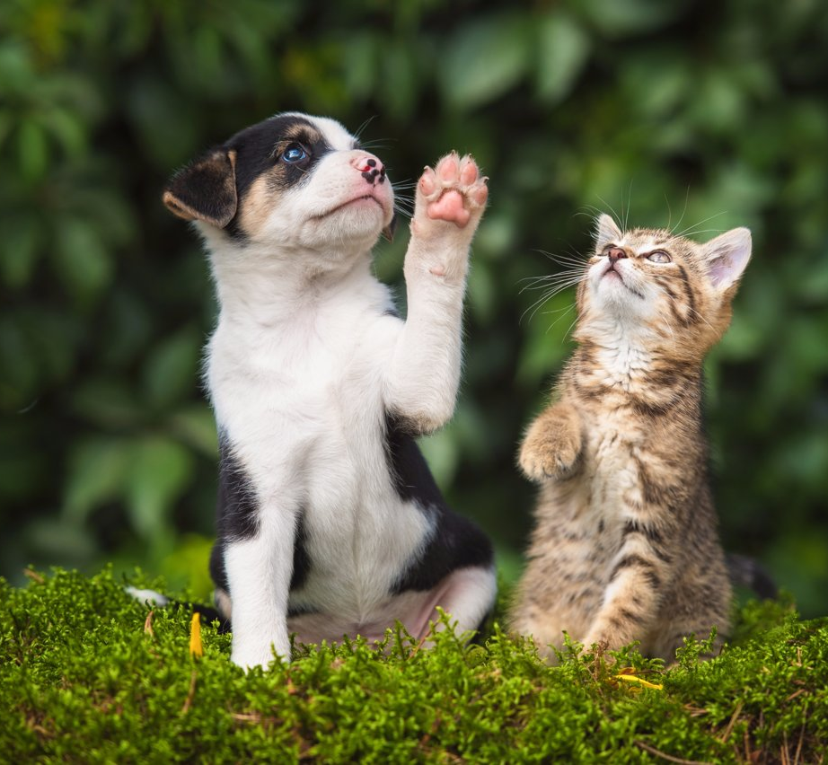
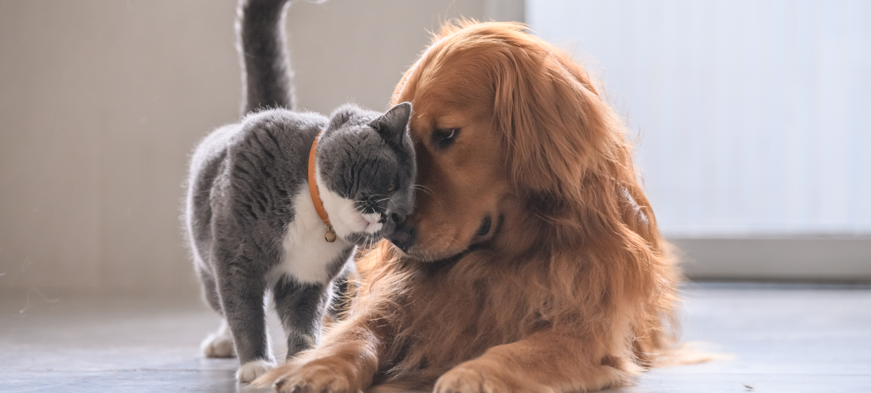
Do you prefer dogs or cats? Tell the reasons.

Slide 13
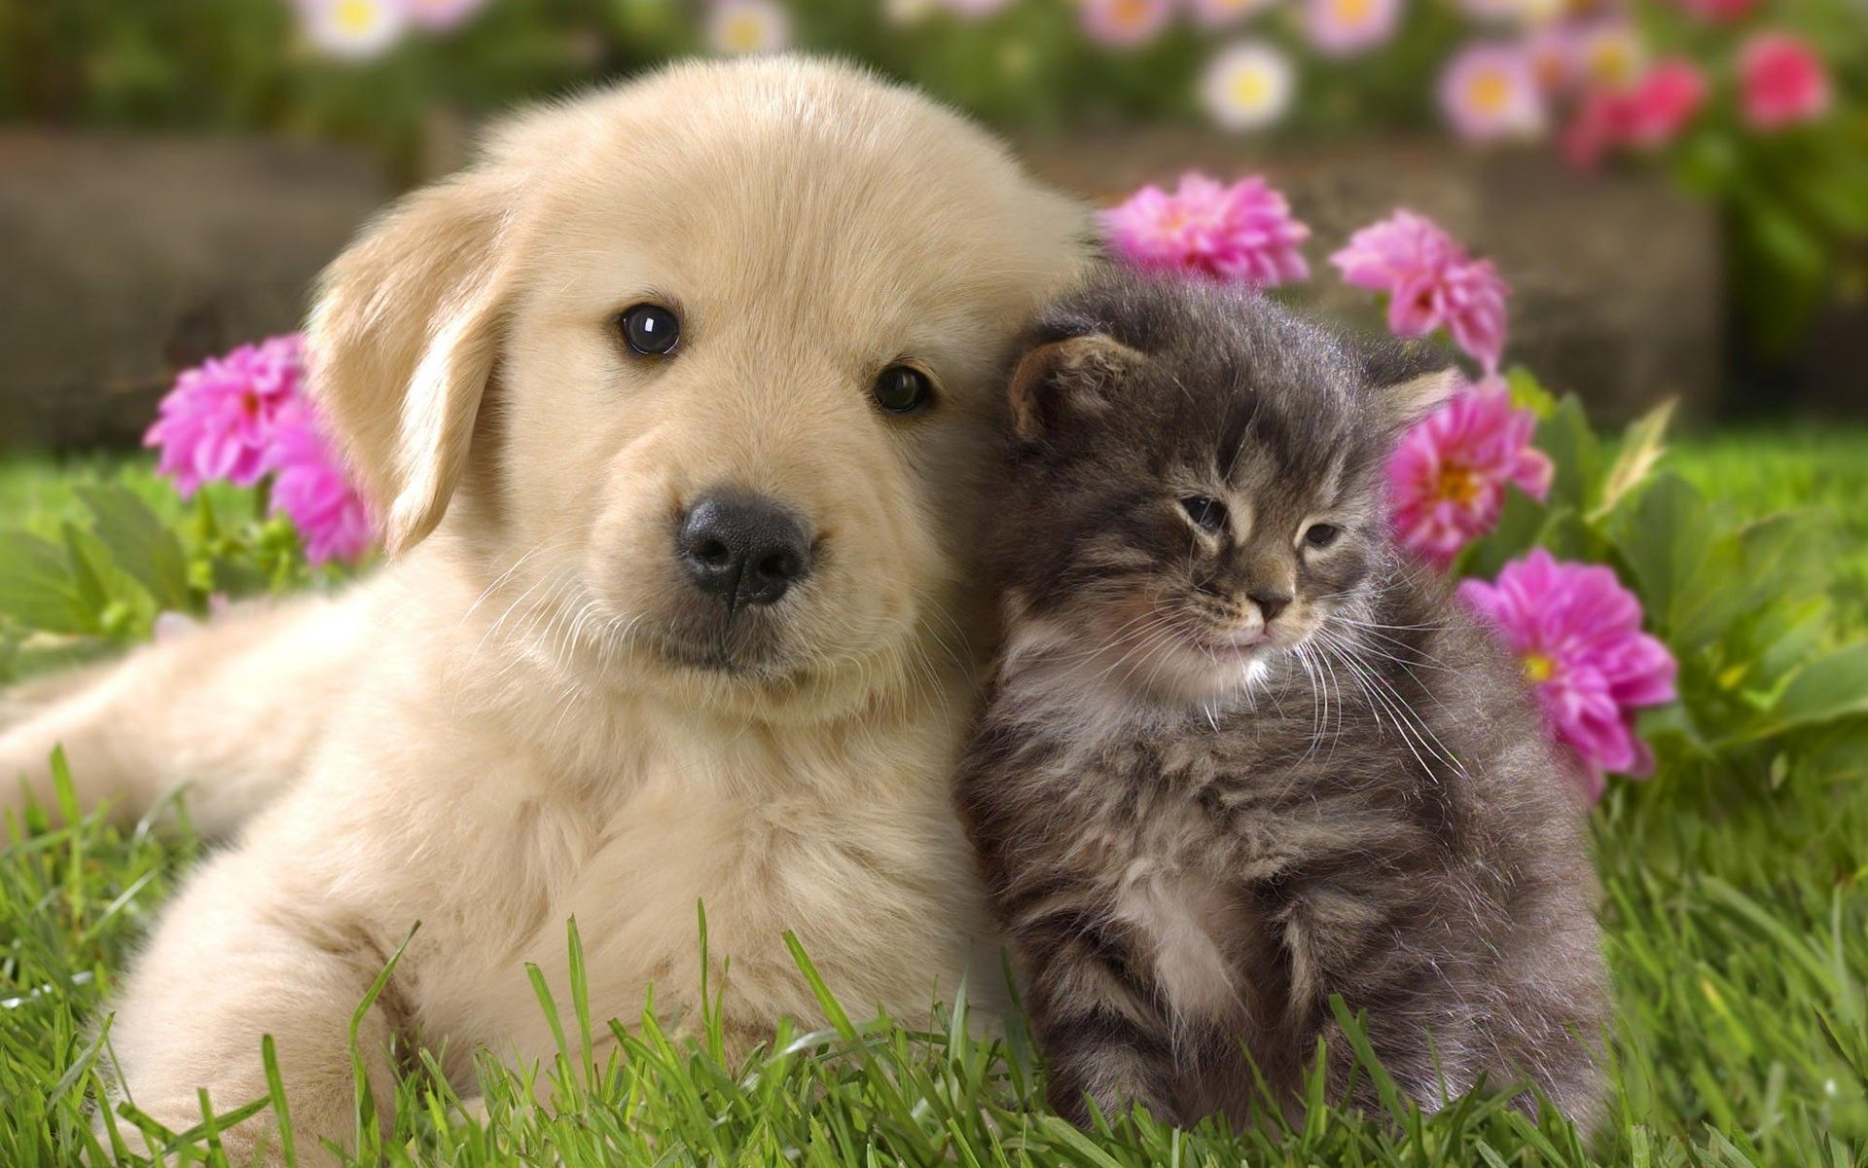
Are there any animal welfare organizations in your hometown?

Slide 14
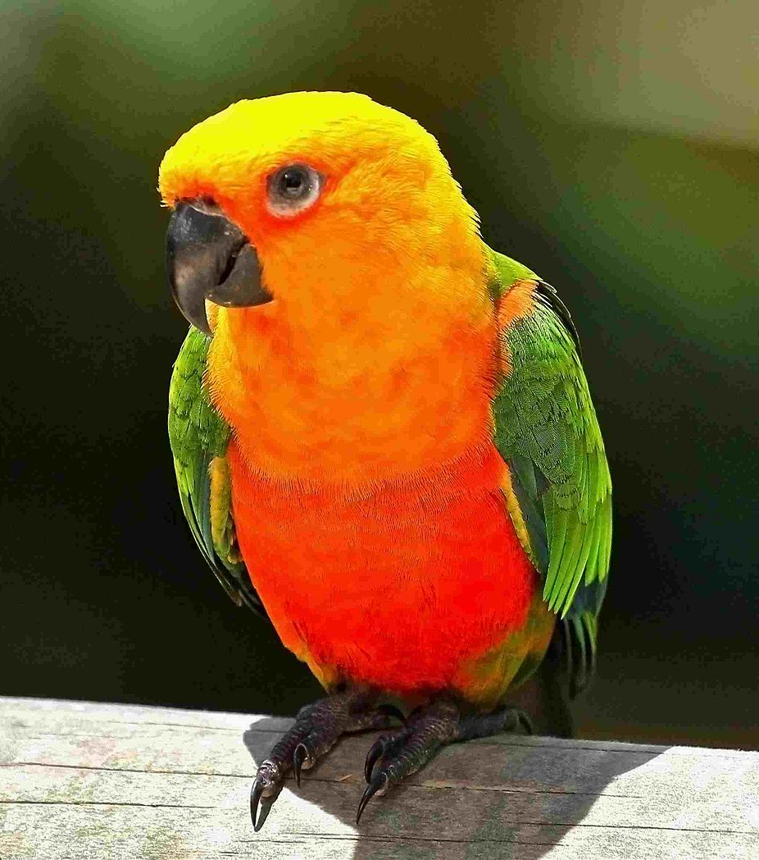
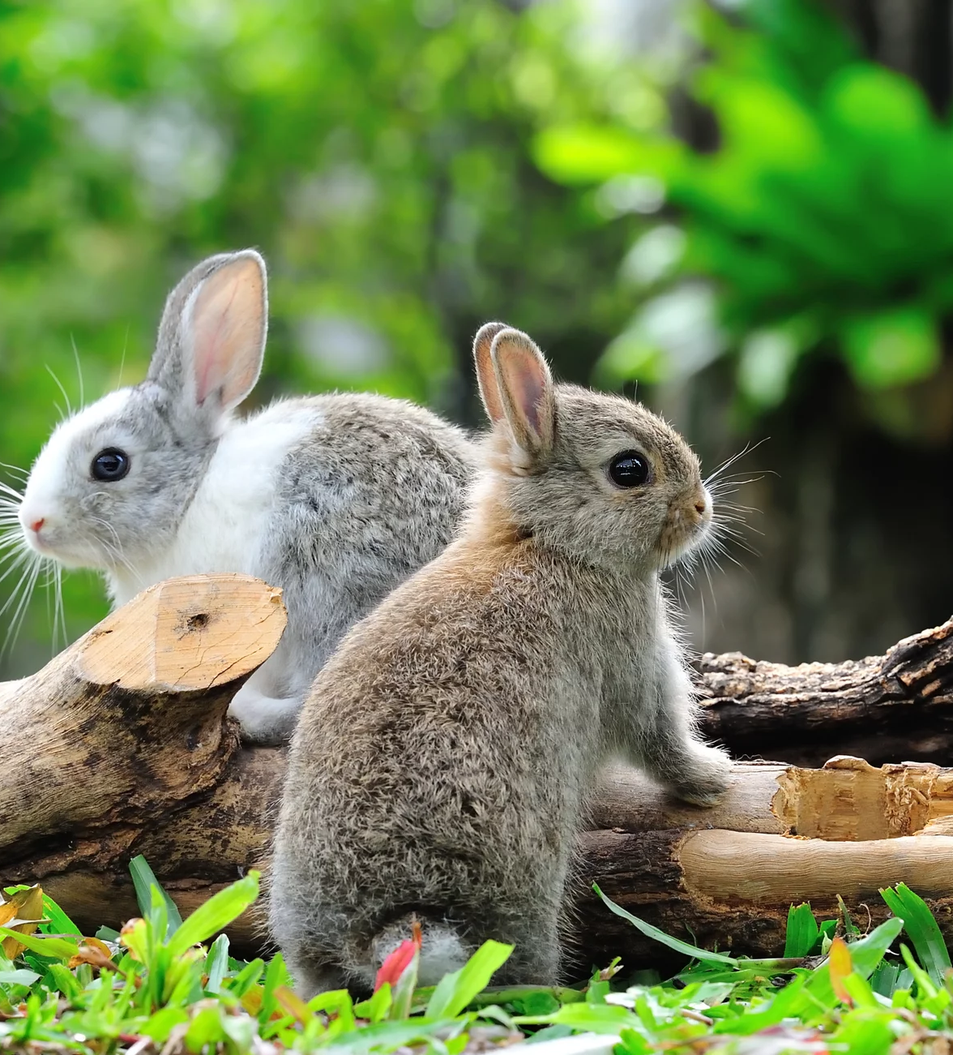
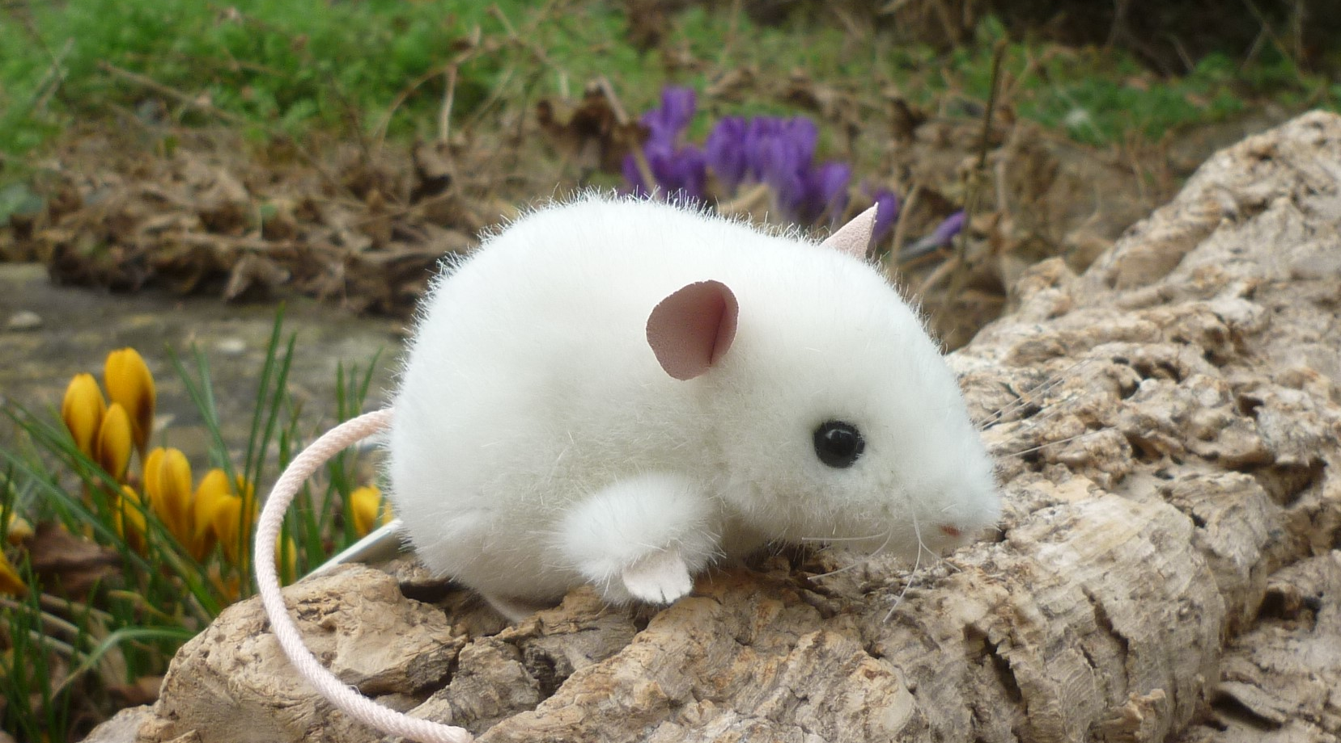
Talk about your favourite pet.
What kind of animal it is?
What is its name
Describe it briefly
And explain why you like it

Slide 15
SPEAKING PART 2
Asking and answering questions using these prompt cards

Slide 16
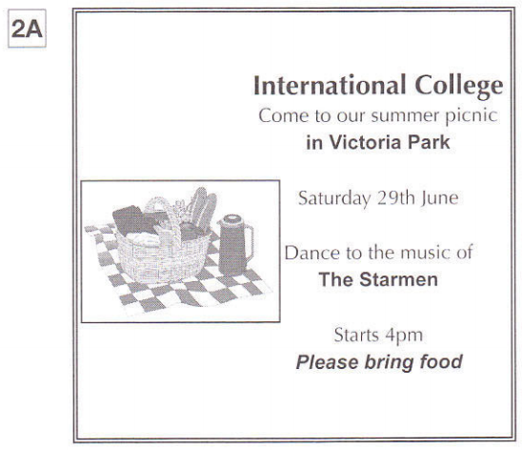
Ask and answer
Ask and answer questions using the words given.

Slide 17
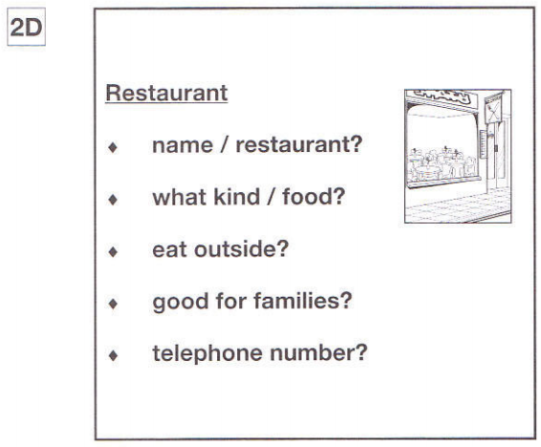
Ask and answer
Ask and answer questions using the words given.
What are other questions and answers you can think of?

Slide 18
Based on the given information, talk about Summer Palace Restaurant.

