Slide 1
KET SPEAKING
Time allowed - 8-10 minutes
Normally you will do the speaking test with another candidate. The two of you will meet two examiners. One of the examiners will talk to you, the other does not participate in the conversations.
There are two parts to the speaking test:
Speaking part 1: short questions and answers between you and the examiner.
Speaking part 2: the examiner gives you some information or a card with some ideas for questions. You have to talk with the other candidate and ask or answer questions.
Scoring
The Speaking section is worth 25% of the total score for the exam.
How to prepare for KET Speaking:
Speak as much as you can, with your friends
Practise asking and answering questions about daily life
Practise giving information about yourself

Slide 2

KEY ENGLISH TEST 6
Test 4 - Speaking

Slide 3

Part 1:
Student – examiner interaction
Section 1:
The examiner will ask you:
Your name
Where you come from?
Provide full-sentence answers

Slide 4

Part 1:
Student – examiner interaction
Section 2: You will be asked some questions that require longer answers. For example:
Why you like something
Details about a hobby…

Slide 5
POPULAR TOPIC
Popular topic
family
best friend
hometown
your house
sport
computer
collecting
music

Slide 6
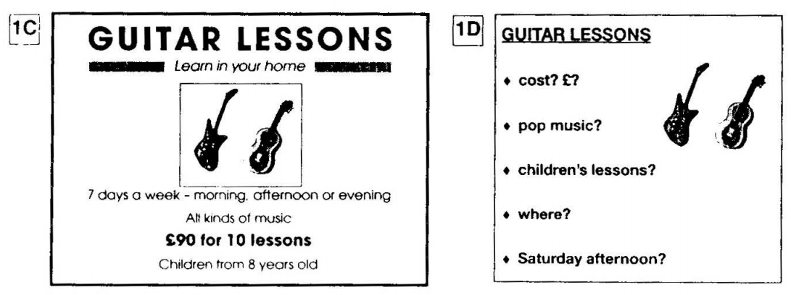
PART 2:
Student – student interaction
Ask and answer questions based on the cue cards
For example:
Do not just read from the cards. Answer in full sentences.
Pay attention to the grammar.

Slide 7

SPEAKING
PART 1

Slide 8

Part 1
Do you like flowers?
What's your favourite flower?
When was the last time you gave someone flowers?
Do any flowers have a special meaning in your country? What are they?

Slide 9
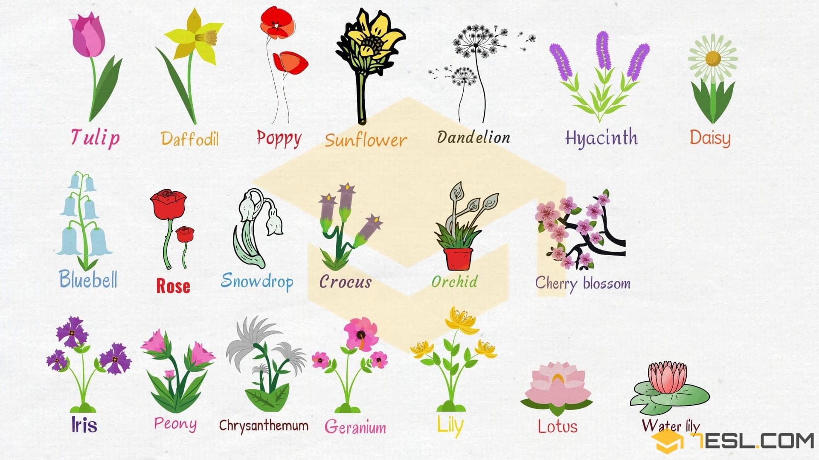

Slide 10


Where would you go to buy flowers?

Slide 11

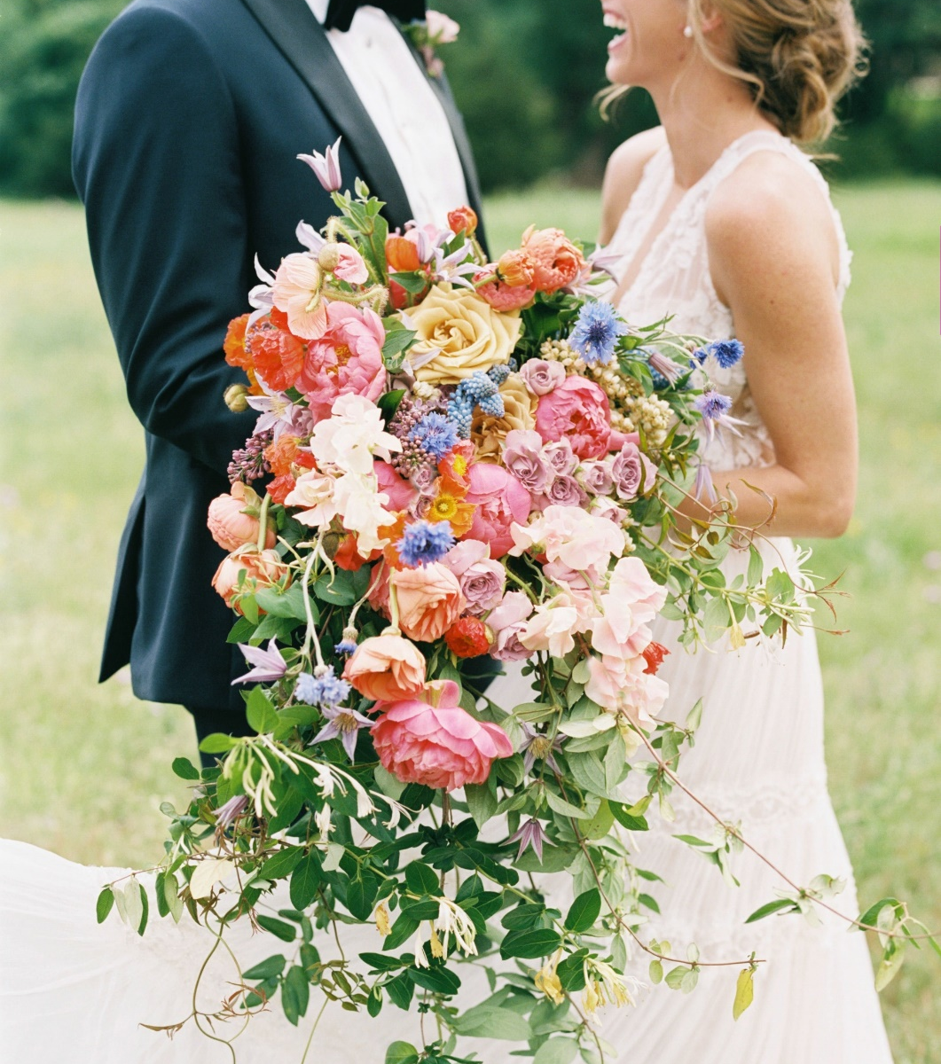


What are the occasions when people give or receive flowers?

Slide 12




Are flowers important in your culture?
(Give examples)

Slide 13




Talk about the last time you gave flowers to someone.
Who you gave flowers for?
What kind of flower
For what occasion
And explain why you chose it

Slide 14
SPEAKING PART 2
Asking and answering questions using these prompt cards

Slide 15

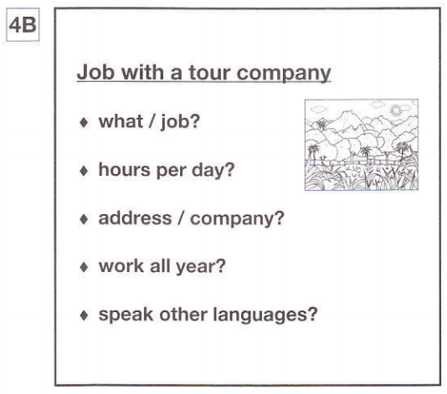
Ask and answer
Ask and answer questions using the words given.

Slide 16

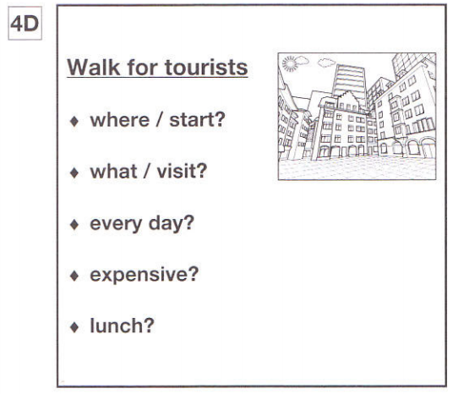
Ask and answer
Ask and answer questions using the words given.
What are other questions and answers you can think of?

Slide 17


Based on the given information, talk about Adventure Tours.

