Slide 1


Slide 2
Unit
8
BECOMING INDEPENDENT
Unit
FAMILY LIFE
COMMUNICATION AND CULTURE / CLIL
LESSON 7

Slide 3
LESSON 7
COMMUNICATION AND CULTURE / CLIL
WARM-UP
Pictures
Task 1: Listen and complete the conversation
Task 2: Make similar conversation for these situations
COMMUNICATION
CLIL
Task 1: Read the text and complete the diagram.
Task 2: Work in groups. Discuss the following questions.
EXTRA ACTIVITY
discuss what you want to change to be more independent.
Wrap-up
Homework
CONSOLIDATION

Slide 4
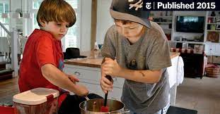

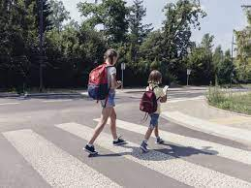
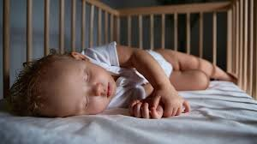
WARM-UP
PICTURES

Slide 5
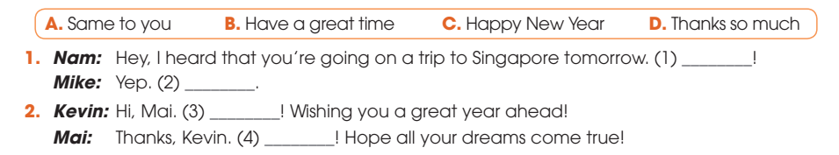
EVERYDAY ENGLISH
1
Listen and complete the conversation with the expressions in the box. Then practice it in pairs.
B
D
C
A

Slide 6
EVERYDAY ENGLISH
Useful expressions
Expressing wishes | Responding to wishes
+ Have a good/great … + Best wishes!/Good luck! + I wish you a happy and healthy new year./ Happy New Year!/Happy holidays! + I wish you best of luck/every success in your new … + Get well soon!/Hope you feel better soon/make a speedy recovery. | + Thanks so much. + Thank you (all) for your wishes. + Thanks. Happy New Year to you too! + (The) same to you! Thanks.

Slide 7
EVERYDAY ENGLISH
2
Work in pairs. Use the models in 1 to make similar conversations for these situations.
Student A is going to take an exam.
Student B is expressing his/her wishes for Student A’s success.
Student B is not feeling well.
Student A is expressing his/her wishes for Student’s recovery.

Slide 8
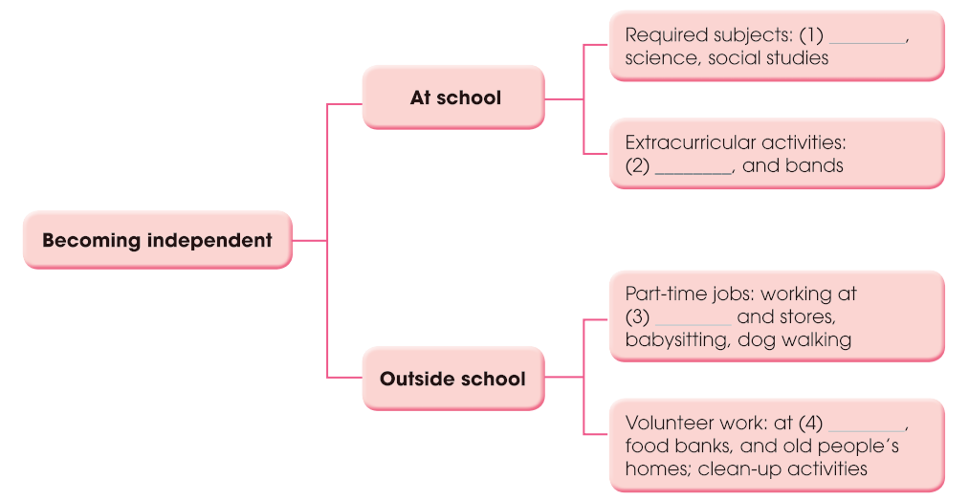
CLIL
1
Read the text and complete the diagram.
English, maths
sports, clubs
fast-food restaurants
at local hospital

Slide 9
CLIL
2
Work in groups. Discuss the following questions.
- Do American teenagers learn to become independent in the same way as Vietnamese teenagers?
- What are the similarities and differences?

Slide 10
EXTRA ACTIVITY
Work in pairs and discuss what you want to change to be more independent.

Slide 11
CONSOLIDATION
1
Wrap-up
What have you learnt today?
Teen independence in the US
Review expressions for wishes and responding

Slide 12
CONSOLIDATION
2
Homework
Do exercises in the workbook.
Prepare for Lesson 8 - Unit 8.

Slide 13

Website: hoclieu.vn
Fanpage: facebook.com/sachmem.vn/

