Slide 1

Unit 1: Home and places
Lesson 1a: Vocab Expansion
Page 23

Slide 2
Lesson Outline
Warm-up
Vocabulary
Speaking
Writing
Consolidation
Wrap-up

Slide 3
Objectives
By the end of this lesson, students will be able to…
- Learn vocabulary about house features and ordinary numbers.
- Practise speaking and writing about houses.

Slide 4

WARM-UP

Slide 5
Choose the word whose underlined part is pronounced differently from that of the others.
1 A. sports B. dog C. clock D. frog
/dɒɡ/
/klɒk/
/frɒɡ/
/spɔːts/
2 A. places B. parents C. table D. fireplace
/pleɪsiz/
/ˈpeərənts/
/ˈteɪbl/
/ˈfaɪəpleɪs/
3 A. bridge B. sink C. fridge D. wife
/brɪdʒ/
/sɪŋk/
/frɪdʒ/
/waɪf/

Slide 6
List some furniture and appliances in your living room, bedroom and kitchen.
Living room: sofa, armchair, TV, carpet, painting, fan,…
Bedroom: bed, pillow, bedside cabinet, lamp, wardrobe,…
Kitchen: fridge, cooker, table, chair, fireplace,…

Slide 7

It’s time to learn …

Slide 8
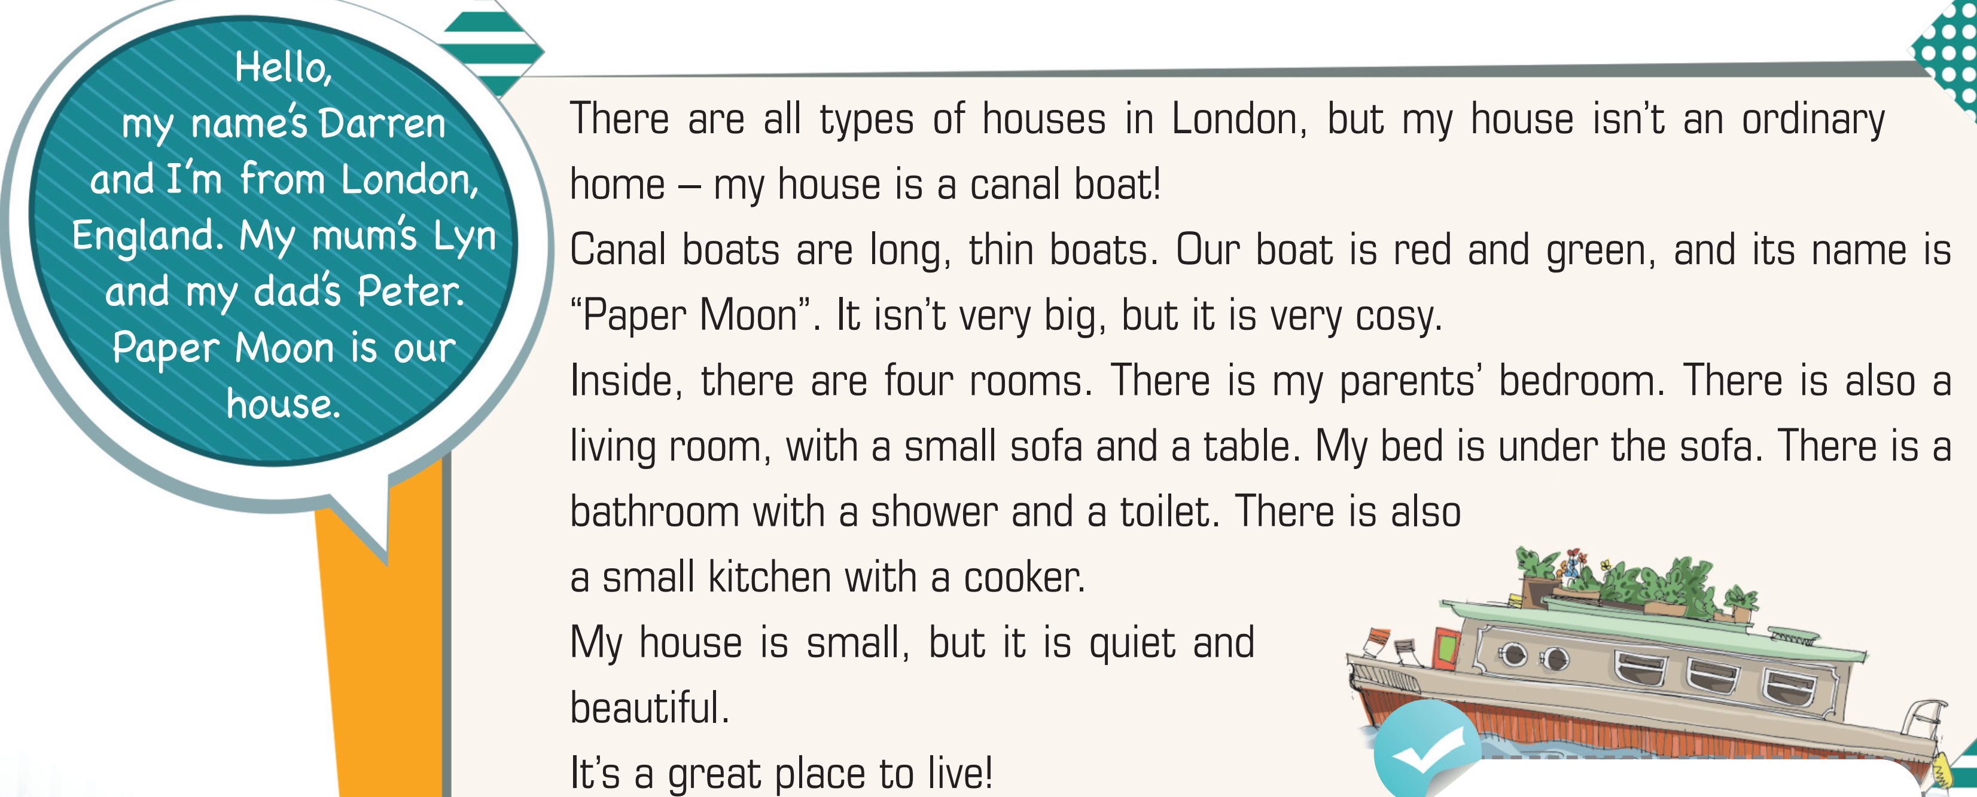
3 Read the text again. Find two pieces of furniture and one appliance.
Two pieces of furniture: sofa, table
One appliance: cooker

Slide 9
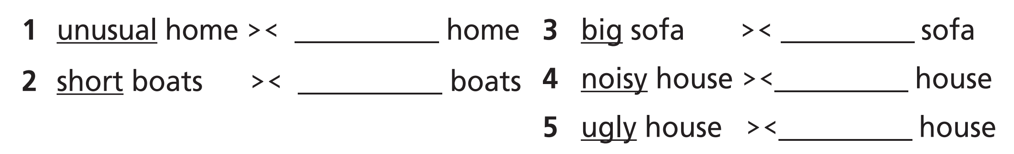
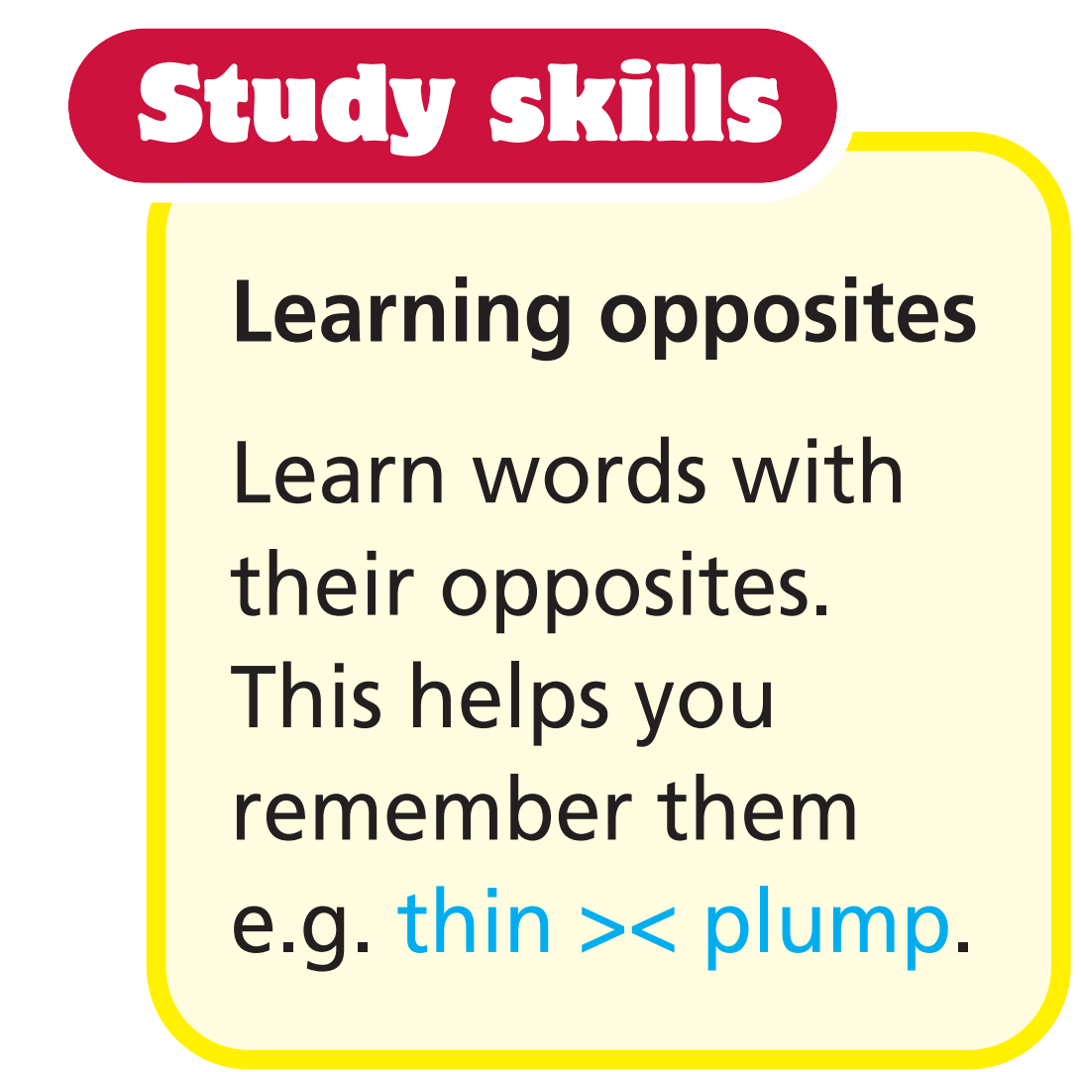
4 Find the adjectives in the text that are opposites to the adjectives below.

Slide 10
ordinary
small
long
quiet
beautiful

Slide 11

Vocabulary
- balcony /ˈbælkəni/ (n) ban công
- chimney /ˈtʃɪmni/ (n) ống khói
- door /dɔː/ (n) cánh cửa
- garden /ˈɡɑːdən/ (n) khu vườn
- roof /ruːf/ (n) mái nhà
- wall /wɔːl/ (n) bức tường
- window /ˈwɪndəʊ/ (n) cửa sổ

Slide 12
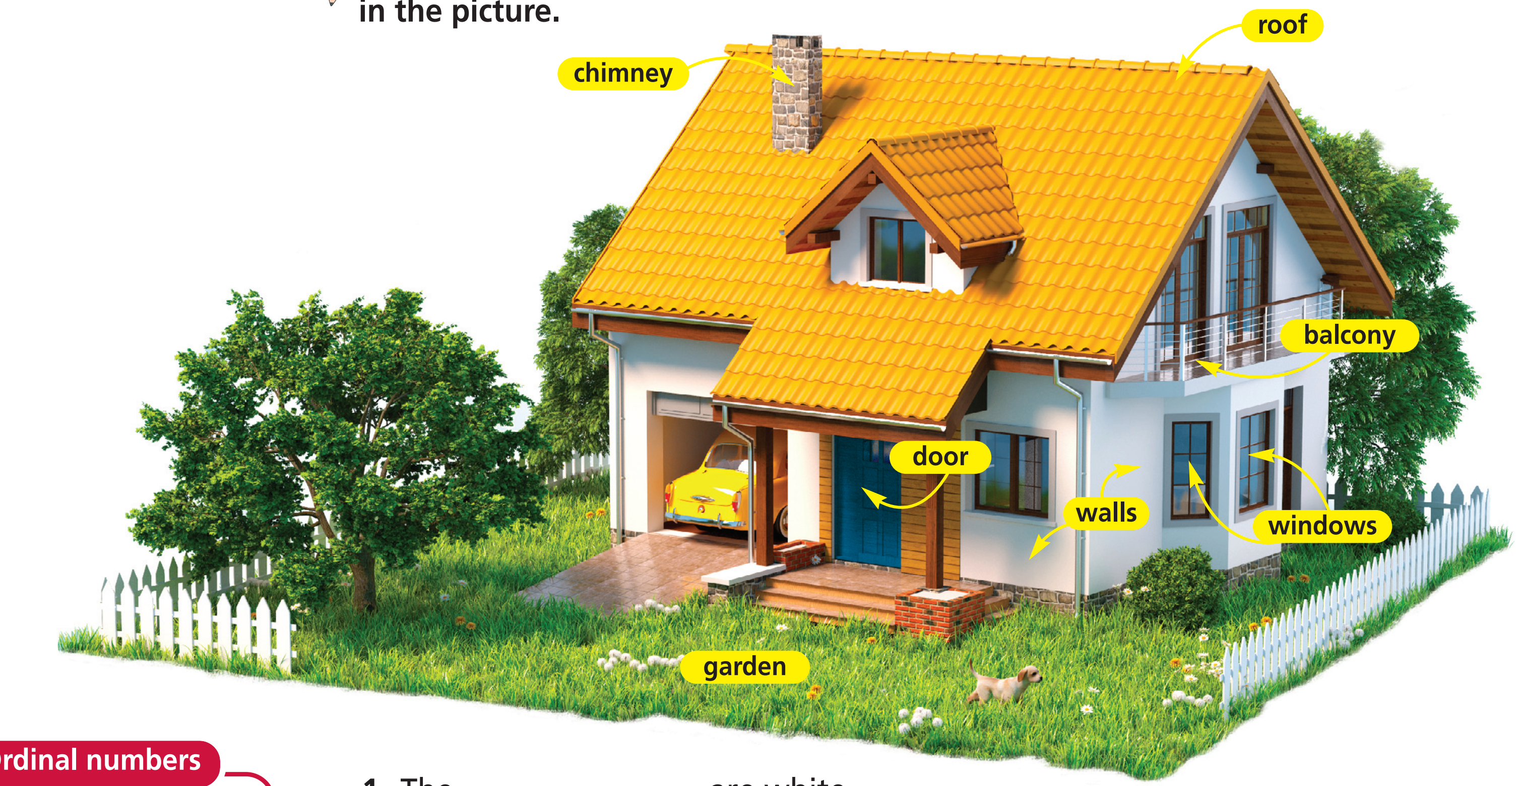
5 Listen and repeat. Then complete the gaps with the words in the picture.
walls
1 The ____________ are white.
2 The ____________ is blue.
3 The ____________ is yellow with a ______________ on it.
4 There are beautiful flowers in the ____________ .
5 There are four ___________ with a great view of the garden.
6 There’s a big _____________ upstairs outside the bedroom
door
roof
chimmey
garden
windows
balcony

Slide 13

1st = first
2nd = second
3rd = third
4th = fourth
5th = fifth
6th = sixth
7th = seventh
8th = eighth
9th = ninth
10th = tenth
11th = eleventh
12th = twelfth
13th = thirteenth
14th = fourteenth
15th = fifteenth
16th = sixteenth
17th = seventeenth
18th = eighteenth
19th = nineteenth
20th = twentieth
21st = twenty-first
Write the ordinal numbers for:
27th _____________________
30th _____________________
42nd _____________________
56th _____________________
64th _____________________
twenty-seventh
thirtieth
forty-second
fifty-sixth
sixty-fourth

Slide 14
Further practice
Working teams
One Student from Team A says a cardinal number from 1 to 100. One Student from Team B says and writes the ordinal number.
Example
Team A S1: 12
Team B S1: 12th twelfth

Slide 15

Speaking

Slide 16
6 Read the text in Exercise 1 again and make notes under the headings: type of house – description – name – rooms & furniture.
Pre-speaking
Suggested notes
Type of house: canal boat
Description: long, thin boat, red and green
Name: “Paper Moon”
Rooms & furniture: four rooms, living room – sofa and table, bathroom – shower and toilet, kitchen – cooker

Slide 17
While-speaking
Use your notes to present Darren’s house to the class.
Type of house: canal boat
Description: long, thin boat, red and green
Name: “Paper Moon”
Rooms & furniture: four rooms, living room – sofa and table, bathroom – shower and toilet, kitchen – cooker

Slide 18

Post-speaking
7 Write two reasons why Darren’s house is special. Which house is bigger, Darren’s or yours? Why?
Example
Darren’s house is special because it is a canal boat
and it is very beautiful. My house is bigger. It is
very big and has got a garden.

Slide 19

CONSOLIDATION

Slide 20
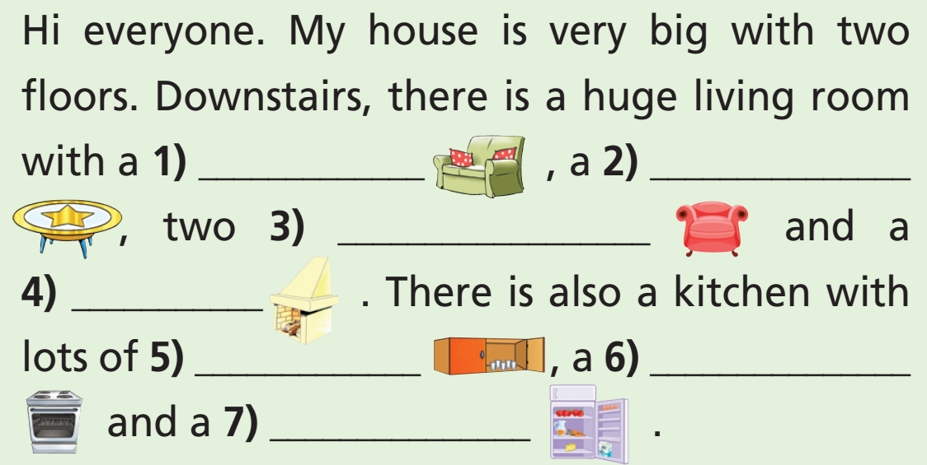
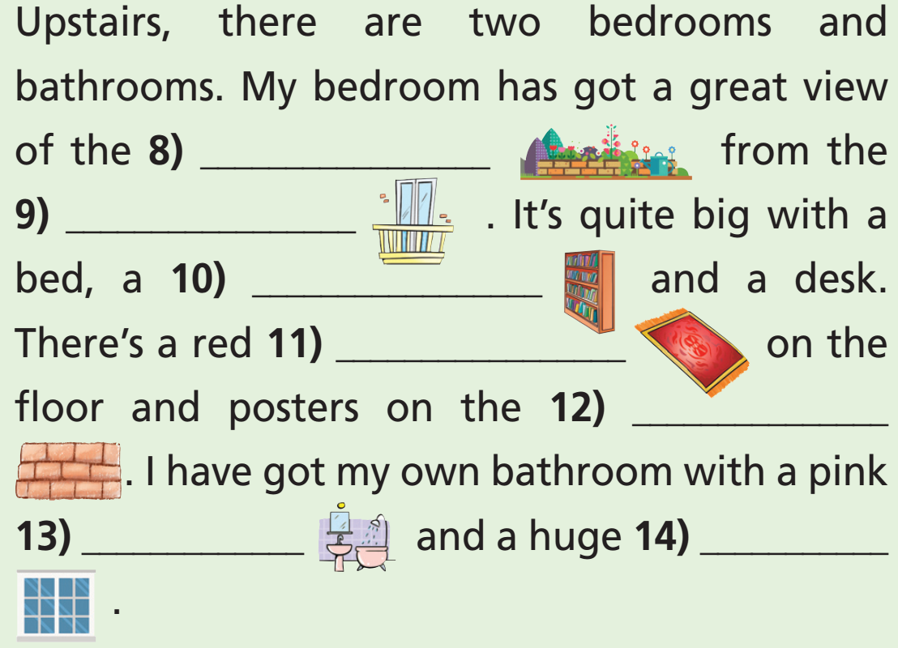
Complete the description.
sofa
coffee table
garden
armchairs
balcony
fireplace
bookcase
carpet
cupboards
cooker
wall
fridge
bath
window

Slide 21

WRAP-UP

Slide 22
Today’s lesson
Vocabularies
- Parts of a house
- Furniture and appliance
- Ordinal numbers

Slide 23
Homework
Practise the vocabularies and make sentences using them.
Do the exercises in TA 6 Right on Notebook (pp. 12 & 13)
Prepare the next lesson (p. 24 SB)

Slide 24
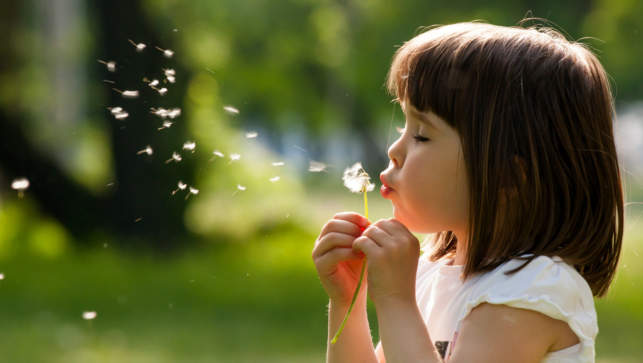
Enjoy your day!

